Slide 1
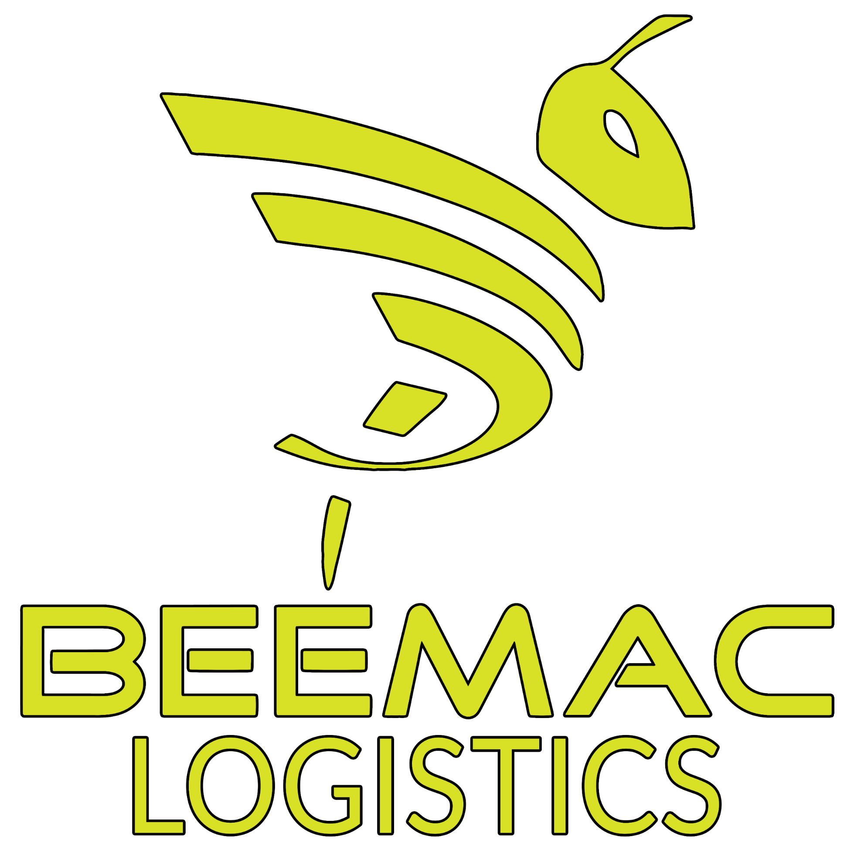
Beemac Logistics
The Future of Logistics is Here
Smart. Connected. Efficient.
2026 OVERVIEW

Slide 2

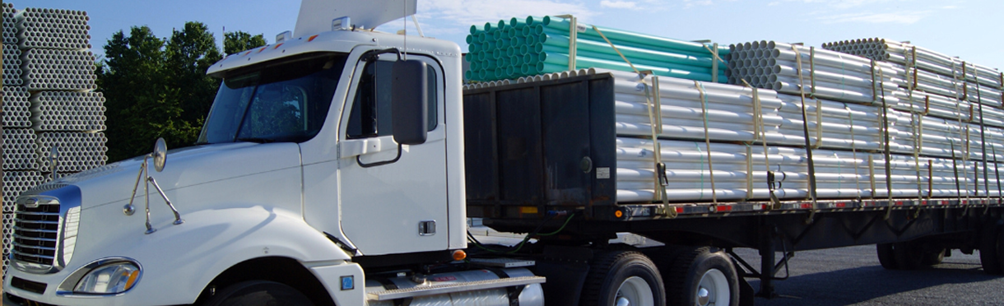

WHO WE ARE
WHO WE ARE
The Beemac Brand was founded in a 1984 and began as a small privately held flatbed trucking provider based in Ambridge, PA.
Beem Logistics is your largest, industrial‑focused logistics network in North America, delivering reliable transportation solutions with clarity and efficiency every step of the way.
We offer logistics services, LTL solutions, intermodal shipping, transloading services, material management and specialized hauling services to customers throughout North America.

Slide 3


Servicing of over 1100 unique customers per month.

Slide 4



40+ YEARS INDUSTRIAL LOGISTICS EXPERIENCE BORN OF AN ASSET-BASED STEEL HAULER
  THE MOST COMPREHENSIVE INDUSTRIAL FOCUSED LOGISTICS NETWORK IN NORTH AMERICA SERVING ALL MODES OF TRANSPORTATION
MULTIPLE BLUE CHIP 3PL AND MANAGED SOLUTIONS CLIENTS UNDER CONTRACT
  FULL-SERVICE LOGISTICS OFFERING
  ON DEMAND CAPACITY ACROSS ALL MODES
  COST EFFECTIVE BROKERAGE SOLUTIONS
  CUSTOMIZED INBOUND MANAGEMENT / MRO PROGRAMS
  44K REGULAR CONTRACT CARRIERS
  LOGISTICS ENGINEERING AND SUPPLY CHAIN CONSULTING SERVICES
MOVING THOUSANDS OF INDUSTRIAL LOADS PER WEEK ACROSS NORTH AMERICA
  48th LARGEST FREIGHT BROKERAGE IN US RANKED BY TRANSPORT TOPICS 2025
  DEDICATED CUSTOMER PORTALS, REAL-TIME TRACKING, AND CUSTOM KPI DASHBOARDS
  BEST IN CLASS TECHNOLOGY AND VISIBILITY TOOLS
  INDUSTRY TRAINED EXPERTS WITH DEEP ROOTS IN OIL AND GAS LOGISTICS

Slide 5


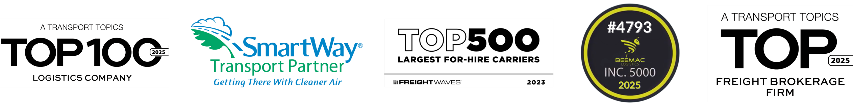
ACHIEVEMENTS AND AWARDS
ACHIEVEMENTS AND AWARDS
-Ranked 48th largest freight brokerage firm in the U.S. by Transport Topics 2025
-Ranked 94th in Top 100 Logistics Companies by Transport Topics 2025
-Named a winner of the Pittsburgh Post-Gazette’s “Top Workplaces 2025” Award
-Ranked No. 4793 on the Inc. 5000 list 2025
-Employee Benefits Excellence Award from employer 2026
-Pittsburgh Top Workplaces Winner from The Pittsburgh Post Gazette 2026

Slide 6

BEEMAC LOGISTICS
OFFICE LOCATIONS
OFFICE LOCATIONS
BEAVER, PENNSYLVANIA
  999 3RD STREET, BEAVER, PA 15009
  ESTABLISHED: 2023
  BEEMAC LOGISTICS HEADQUARTERS
PITTSBURGH, PENNSYLVANIA
  503 MARTINDALE STREET, PITTSBURGH PA15212
  Established: 2018
HOUSTON, TEXAS
  10350 RICHMOND AVE, HOUSTON, TX 77042
  Established: 2019
ST. PETERSBURG, FLORIDA
  200 CENTRAL AVENUE, ST. PETERSBURG FL 33701
  Established: 2022
NASHVILLE, TENNESSEE
  901 Woodland St Nashville, TN
  Established: 2025

Slide 7

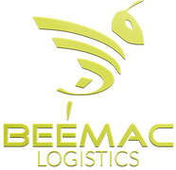
FREIGHT BROKERAGE
LOGISTICS
MATERIAL HANDLING & WAREHOUSING
PORT SERVICES
SERVICES PORTFOLIO
SERVICES PORTFOLIO
CHARTERING & MERCURY TRANSPORTATION

Slide 8
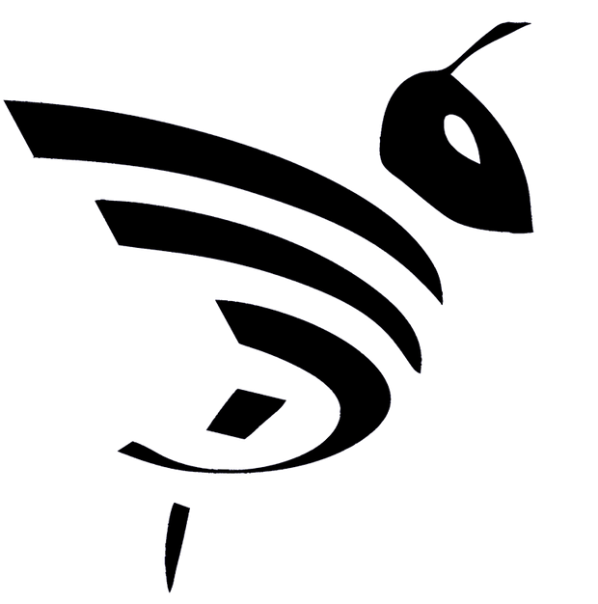





BEEMAC SERVICES PORTFOLIO
BEEMAC LOGISTICS
BEEMAC LOGISTICS
BEEMAC MATERIAL HANDLING & WAREHOUSING
BEEMAC CHARTERING & MERCURY TRANSPORTATION
BEEMAC PORT SERVICES
• Full-service freight brokerage
• 44,000+ contract carriers
• On-demand capacity, all modes
• Managed services & 3PL solutions
• Inbound management / MRO programs
• AI-powered quoting & carrier matching
• Supply chain consulting
• Full-service logistics offering
• On demand capacity across all modes, Managed
Services and 3PL Solutions
• Cost effective brokerage solution
• Inbound management / MRO programs
• 44,000 contract carriers
• Carrier management
• Logistics engineering and Supply Chain
consulting
• Leetsdale, PA, Midland, TX and Houston, TX
• 5 fully managed Pipe yards
• 75 acres combined
•Inspection Services
•Inventory management
•Mobile Forklift services
• Worldwide service of bulk
and break-bulk commodities
• Working with over 2,000
shipowners worldwide
• Operations team to manage
all aspects of the loading
shipment, and unloading
• Turn-key multi-modal
solutions bundling
• Port of Leetsdale, PA / Houston, TX
• 45-Ton overhead river crane in Leetsdale, PA
• Barge and rail car transloading
• Direct Discharge Port of Houston
• Indoor/Outdoor storage space

Slide 9

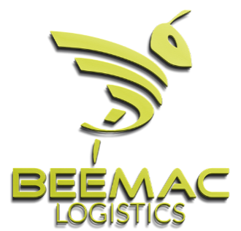
BEEMAC’S TECH ECOSYSTEM
BEEMAC’S TECH ECOSYSTEM
Comprehensive logistics technology stack:
  TMS: McLeod, TAI LTL
  Tracking: Trucker Tools – Integrations with P44, FourKites, MacroPoint
  Carrier Matching: Parade, AI-driven load optimization
  Business Intelligence: KPI dashboards, cost analysis, real-time tracking

Slide 10
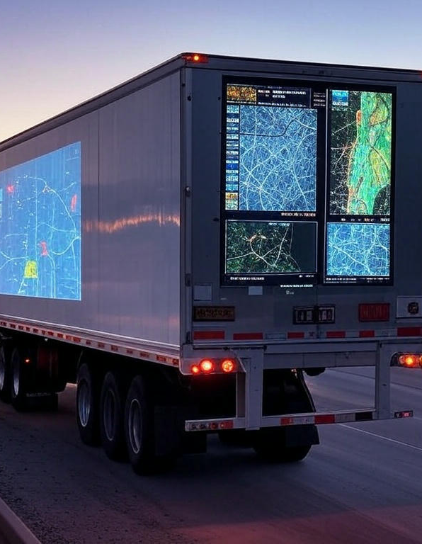
REAL-TIME VISIBILITY & TRACKING
REAL-TIME VISIBILITY & TRACKING
-Integrated tracking solutions ensure seamless updates for customers.
-Real-time data sync across any platform (FourKites, P44, MacroPoint, etc.).
-Carrier compliance monitoring for enhanced shipment accuracy.

Slide 11
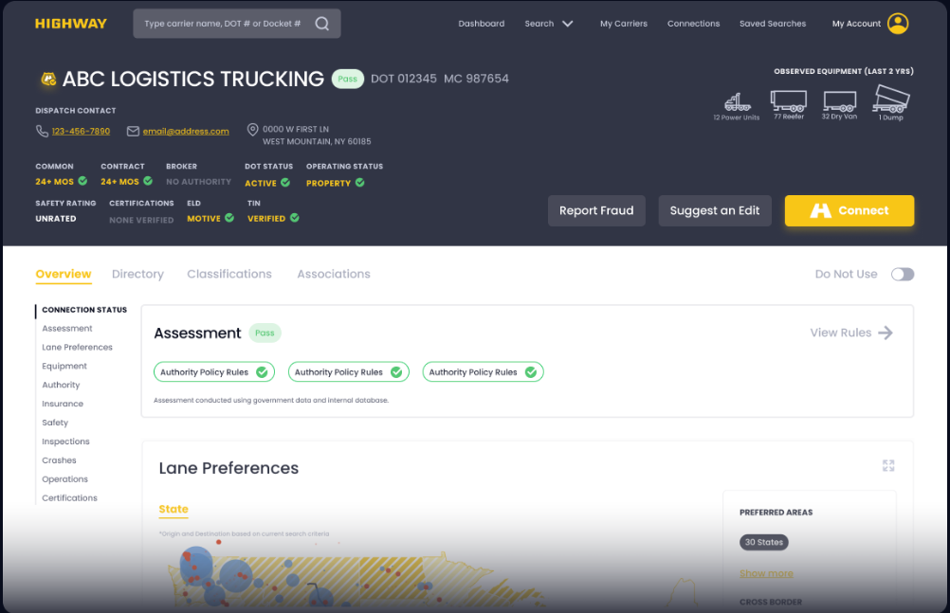
HIGHWAY - CARRIER VETTING AND SAFETY COMPLIANCE
HIGHWAY - CARRIER VETTING AND SAFETY COMPLIANCE
-Enhanced Fraud Prevention: Highway’s Carrier Identity™ technology verifies carrier credentials in real-time, reducing risks like double brokering and freight fraud by ensuring only legitimate, compliant carriers are onboarded.
-Streamlined Compliance Automation: The platform automates vetting processes, continuously monitoring carrier authority, insurance, and safety ratings, saving time and ensuring adherence to rigorous safety and compliance standards.
-Data-Driven Carrier Selection: With access to fleet analytics for over 280,000 carriers and the Lane Certainty™ algorithm, Highway optimizes carrier matching for reliability and efficiency, boosting operational trust and safety.

Slide 12
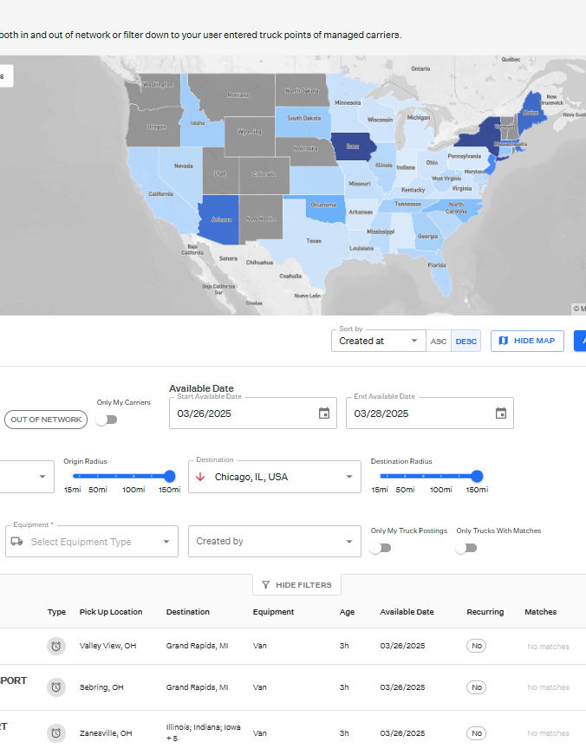
AI-DRIVEN CARRIER MATCHING & LOAD OPTIMIZATION
AI-DRIVEN CARRIER MATCHING & LOAD OPTIMIZATION
-Parade & AI algorithms optimize carrier selection based on historical data and capacity trends.
-Load board integrations for real-time carrier availability.
-Smart rule preferences for customized load matching.

Slide 13

AUTOMATED REPORTING & VISIBILITY
AUTOMATED REPORTING & VISIBILITY
Daily shipment summaries provide direct visibility into real-time operations.
Custom dashboards & analytics for cost tracking and performance measurement.
Predictive analytics help anticipate market shifts and optimize pricing.

Slide 14
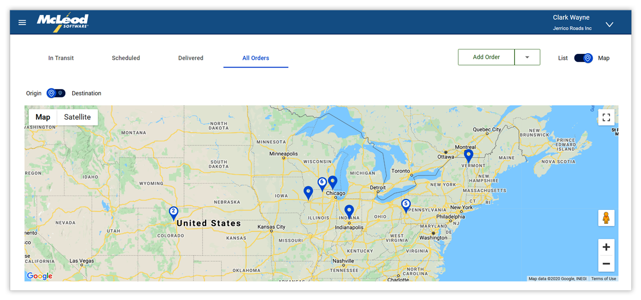
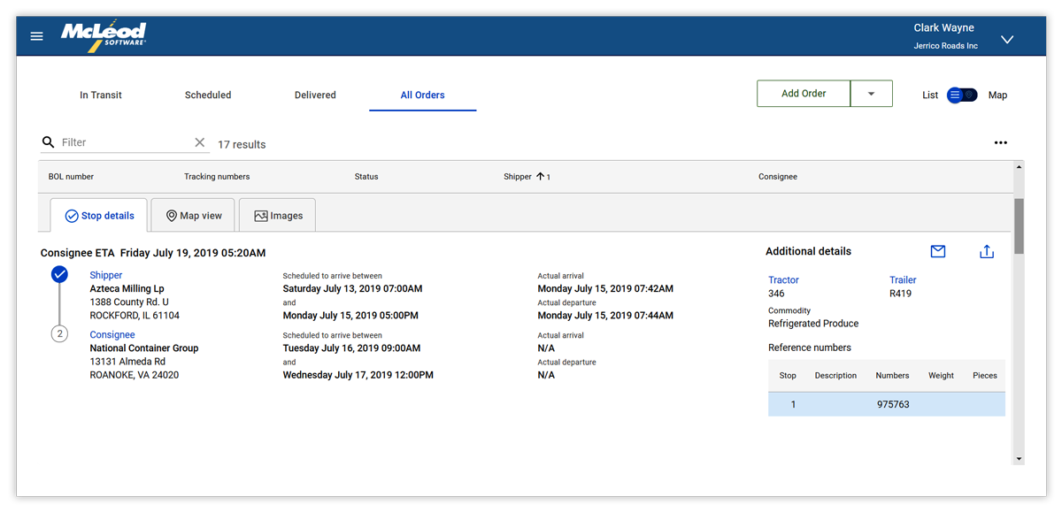
CUSTOMER PORTAL
CUSTOMER PORTAL
What customers get
24/7 self-service access to orders, delivered & in-transit shipments.
Assigned, secure logins per customer; configurable visibility.
Request quotes & submit load tenders (broker/3PL deployments). Download shipment documents (PODs, BOLs, invoices) via built-in retrieval.
Visibility & tracking
Order lists with status filters and quick search; map views of orders with plotted positions.
Filter by date range and export to Excel for analysis.
Fewer “Where’s my truck?” calls thanks to real-time status.
Documents & billing support
Self-serve doc download reduces email back-and-forth for billing.
(Related portal) Carriers/Drivers can upload trip docs to speed invoicing.

Slide 15

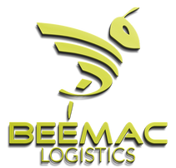
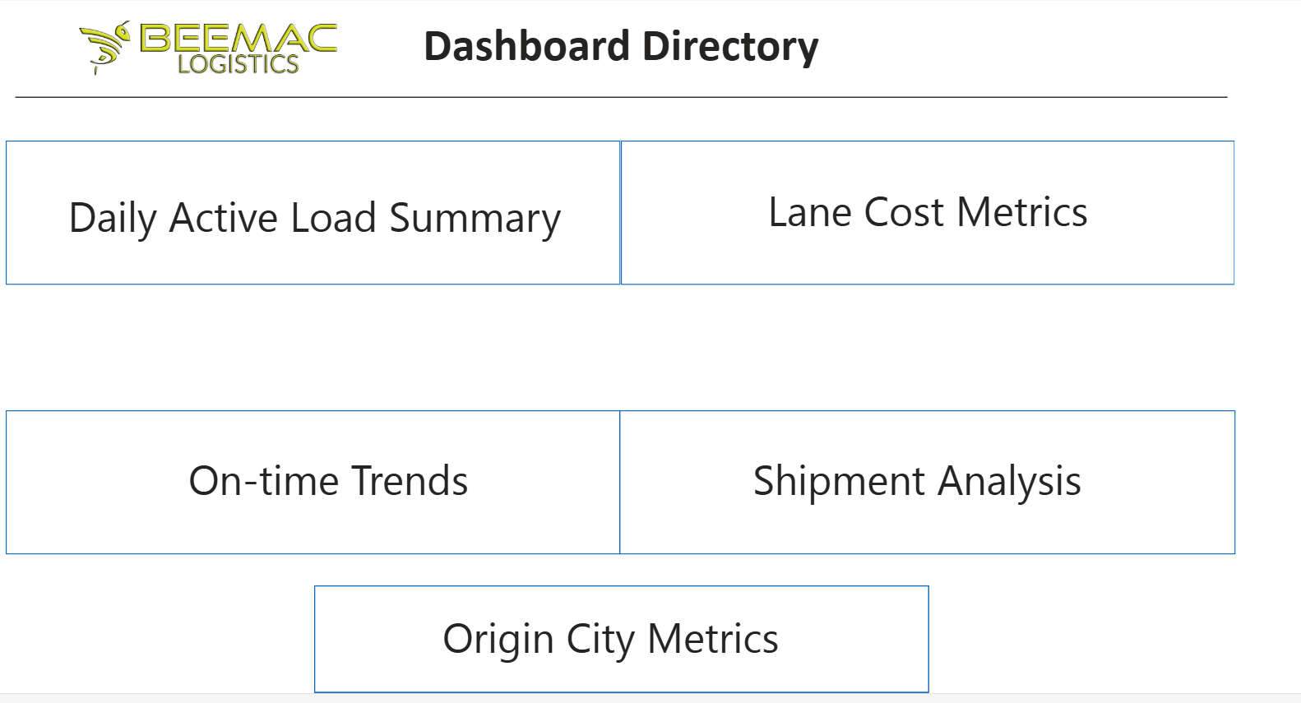
CUSTOM KPI’S/DASHBOARDS
CUSTOM KPI’S / DASHBOARD

Slide 16

THANK YOU
2026

