Slide 1


Business Partner
Development Plan
Beemac Logistics

Slide 2
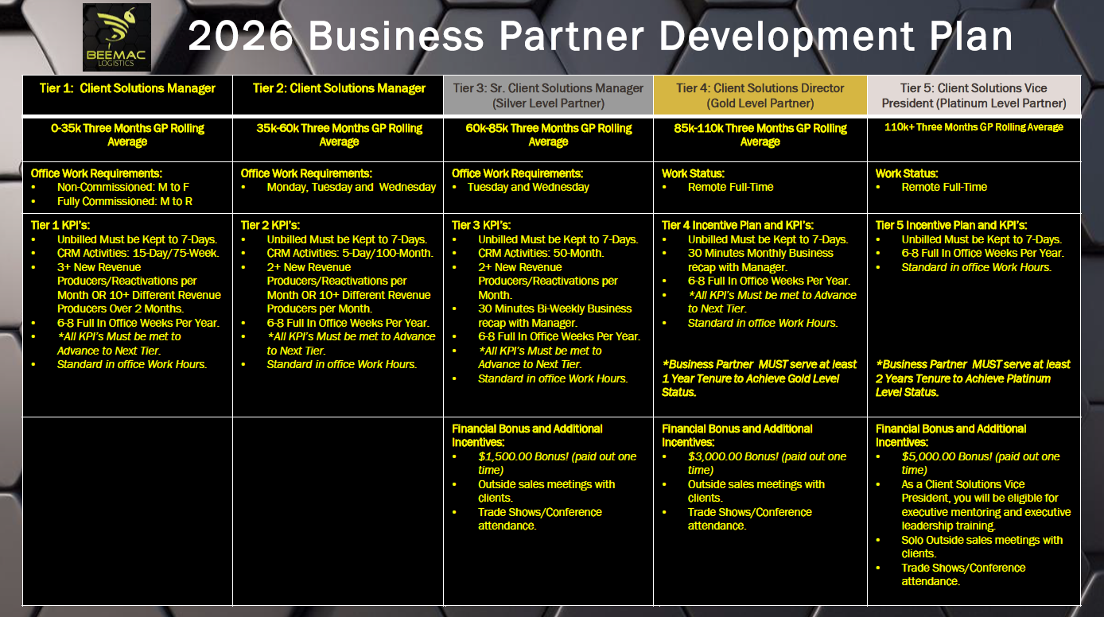

Slide 3
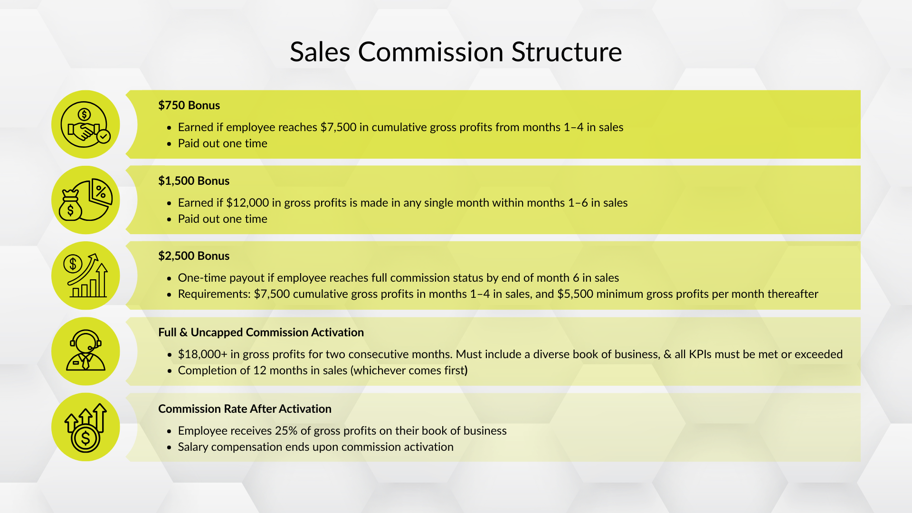
Notes:
0.5% contribution implemented for ops support, but you will be consulted on this before implementation evert time/per account

