Slide 1


Triumph Intelligence
Rates
Formerly Greenscreens.ai
Predictive Freight Pricing for Smarter Decisions

Slide 2

What Changed:
Greenscreens → Triumph
Greenscreens.ai is now part of Triumph Intelligence
Same predictive pricing power, enhanced with deeper data intelligence
Used to price freight faster, smarter, and more profitably at Beemac

Slide 3
What Triumph Rates Does
Predicts accurate buy and sell rates using
real-time market data
Provides confidence scores for pricing decisions
Supports faster negotiations with customers and carriers

Slide 4
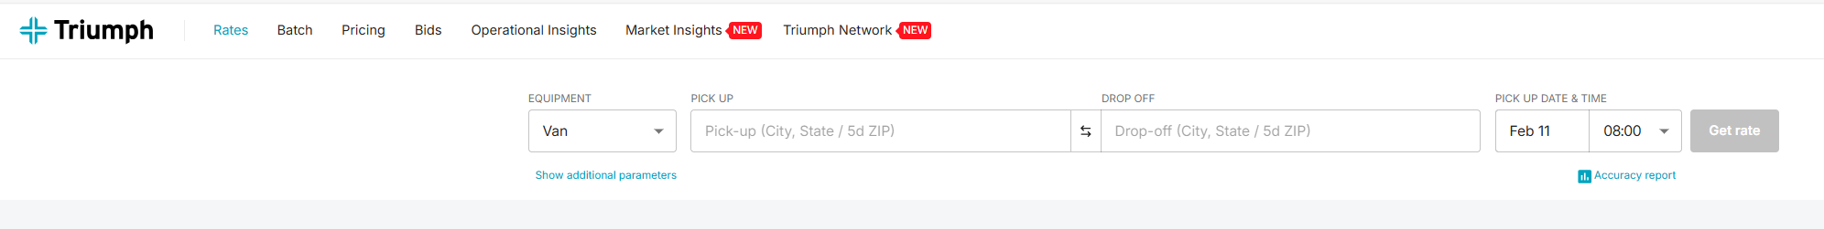
Lane Pricing Basics
1. Enter equipment type, origin, destination, and mode
2. Use ZIP codes when possible for greater accuracy
3. Toggle between flat rate or per-mile pricing

Slide 5
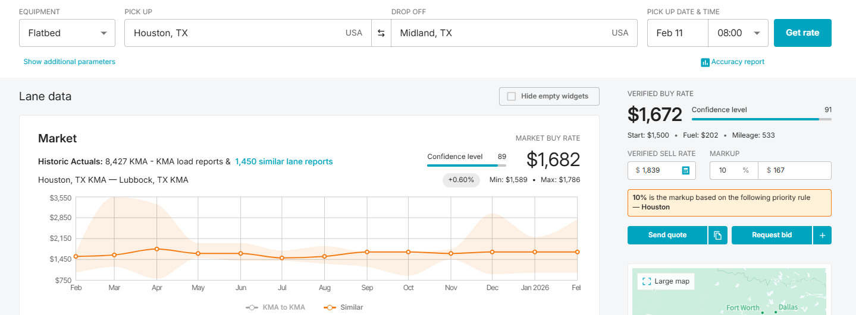
Understanding the Rate Output
All-in carrier rate based on Beemac data
Fuel is already included
Mileage is calculated using Google miles
Default margin target is 15% unless historical data exists

Slide 6
Confidence & Market Signals
Confidence score shows reliability of the rate
Colored dots indicate market conditions
Hover over data points for lane details

Slide 7
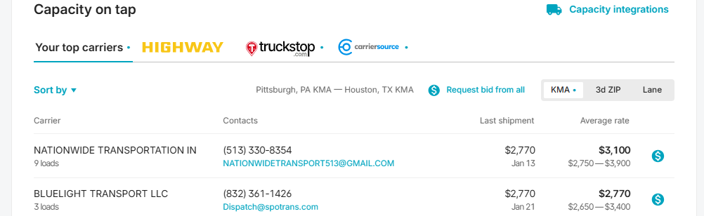
Capacity on Tap: Expanding Carrier Options
Capacity on Tap provides visibility into both trusted carriers and new capacity opportunities, helping brokers cover freight faster and more confidently.
Core Beemac Carriers that frequently move similar lanes for us.
Expanded carrier options - Additional carriers outside our network sourced from: Highway, Truckstop & Carrier Source.

Slide 8
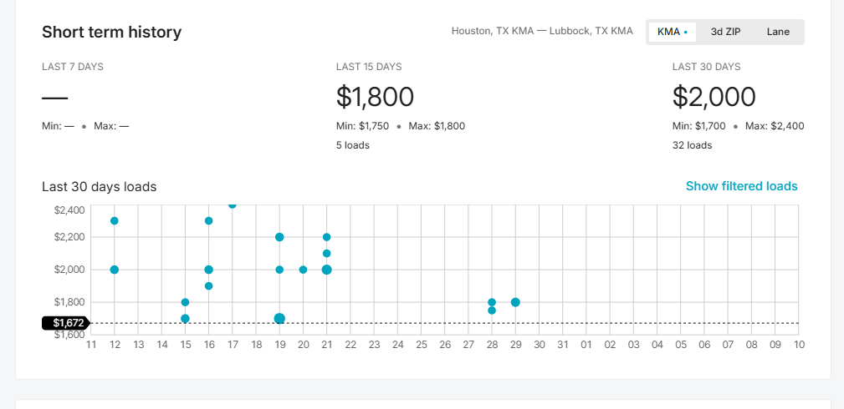
Short-Term History & Analytics
View lanes moved in the last 30 days
See average buy/sell rates and margins
Lane Analytics shows average days-to-cover
Click on the dot to expand the information on a specific load.

Slide 9
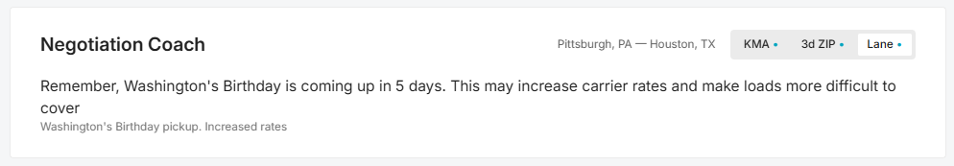
Negotiation Coach
Summarizes recent lane performance
Helps guide pricing conversations
Supports margin protection

Slide 10
Best Practices at Beemac
Always select correct mode (FTL vs Partial)
Use Triumph Rates as your negotiation starting point
Protect margin while staying market-competitive

Slide 11
Triumph: Common Broker Mistakes vs Smart Use
⛔ COMMON MISTAKES
  🎯 Treating Triumph as the final rate
  📉 Ignoring confidence scores
  🏙️ Using city-to-city instead of ZIPs
  ⛽ Forgetting rates are all-in
  📊 Assuming 15% margin always works
✅ SMART BROKER BEHAVIOR
  🧠 Use Triumph as a negotiation guide
  ⚠️ Adjust pricing based on confidence
  📍 Use ZIP codes for accuracy
  🧾 Add accessorials intentionally
  🔍 Review lane history before quoting
Triumph provides intelligence. Winning brokers apply discernment.

