Slide 1


SALES
PROCESS
Email
Prospects

Slide 2

Agenda
  Key elements
  Tips for writing prospecting emails
  What to avoid
  Example emails

Slide 3

Key Elements
Clear Subject Line
-Short, direct, and relevant. BEE creative
-Beemac + Company,
Personalized Introduction
-Address the prospect by name. Reference something specific about their business or needs.
Value Proposition
-State how your service/product solves a specific problem for them.
Next Steps
-Be clear about what action you want them to take (schedule a call, reply, visit Beemac’s website)

Slide 4

Tips for Writing Prospecting Emails
Keep It Short & Sweet
-Be clear and to the point. It shouldn’t be 5 paragraphs long- no one will read that. Do not come off as needy. You are the expert.
Focus on Benefits
-Show how our service/capabilities helps the prospect.
Try to make a connection
-“My office is in Pittsburgh, PA- just a stones throw away from you guys up in Butler, PA. ”
-“I have a customer in Greenwood, IN we deliver to about 4 times a week, and my guys are always looking for a back haul around Indianapolis.”
Follow Up Strategy
-Mention when and how you’ll follow up (ex: “I’ll reach out again next Wednesday 3/19/25 in the morning and give you a call to check in.”)

Slide 5

What to Avoid
Generic Messaging:
-Avoid using blanket messaging that doesn’t speak to the prospect specifically
Overloading with Information:
-Don’t overwhelm with too many details/info.
Being Too Pushy:
-Avoid making prospect feel pressured to act immediately. Respect their time and interest but showing
Grey Areas for Next Steps:
-Never leave your email open-ended without a clear next step

Slide 6
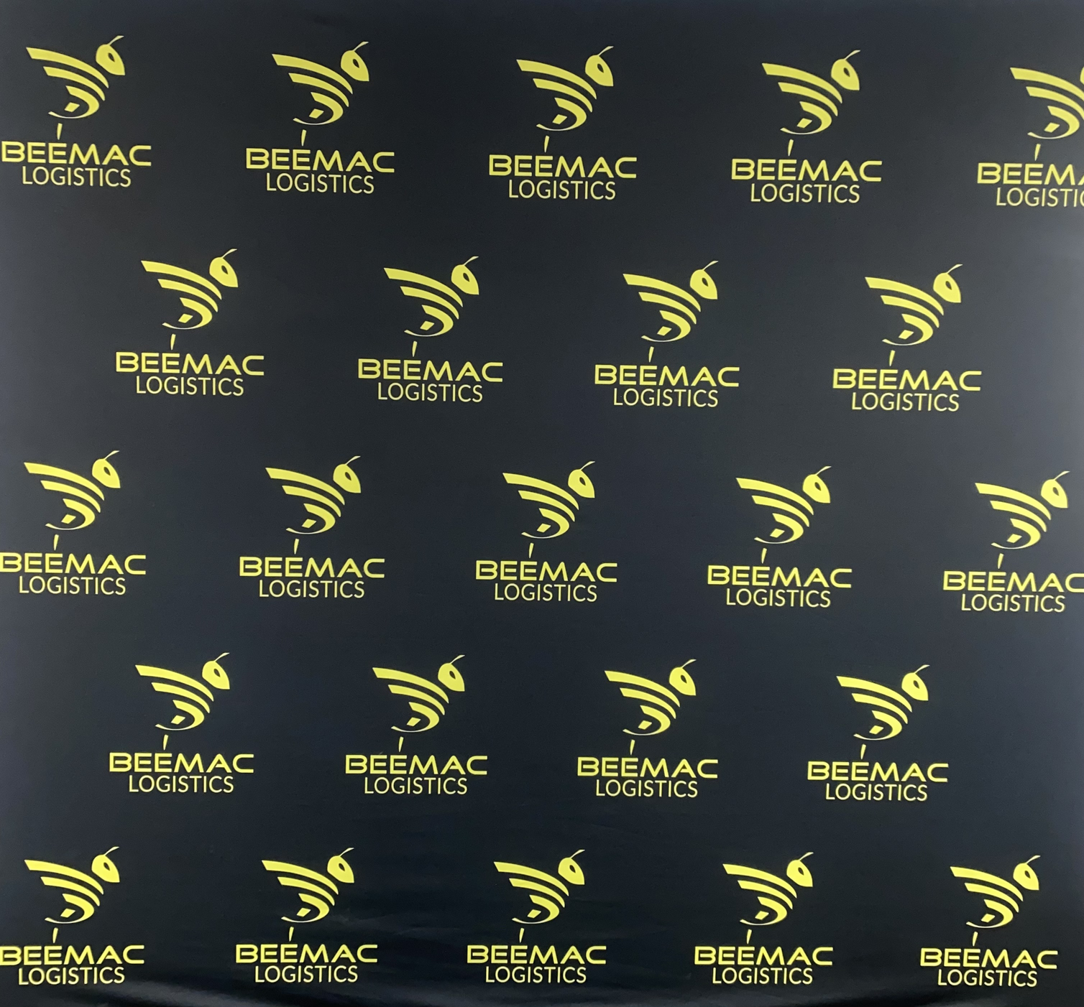
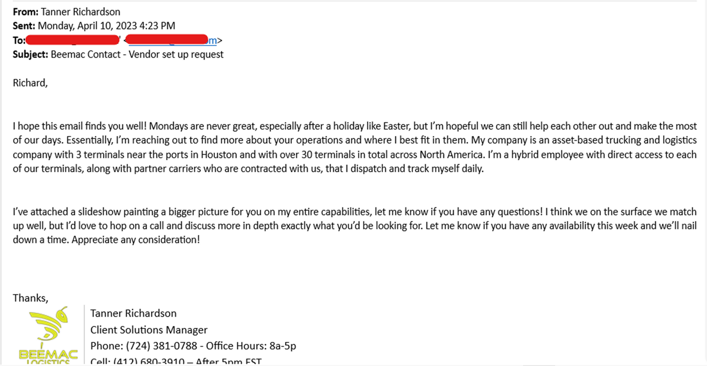
Example Emails

Slide 7
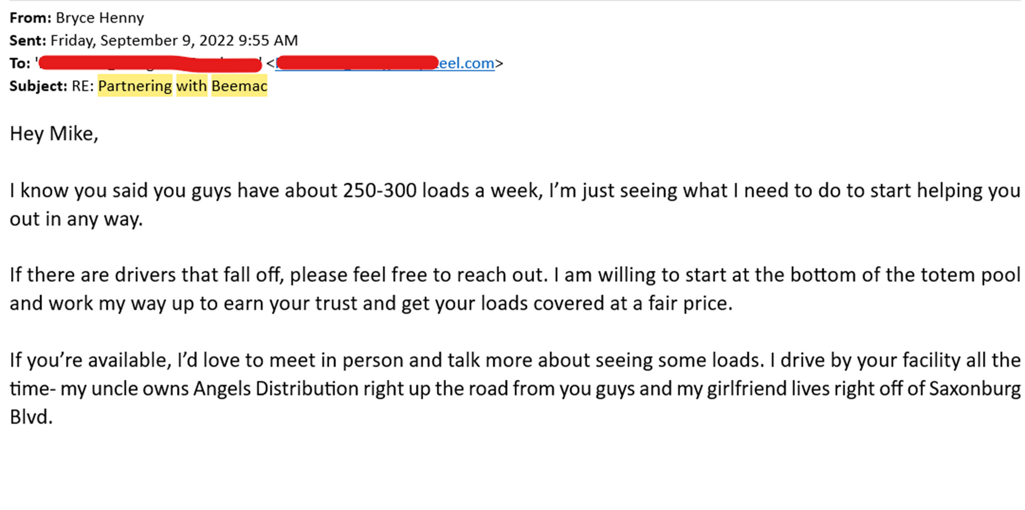
Example Emails

Slide 8
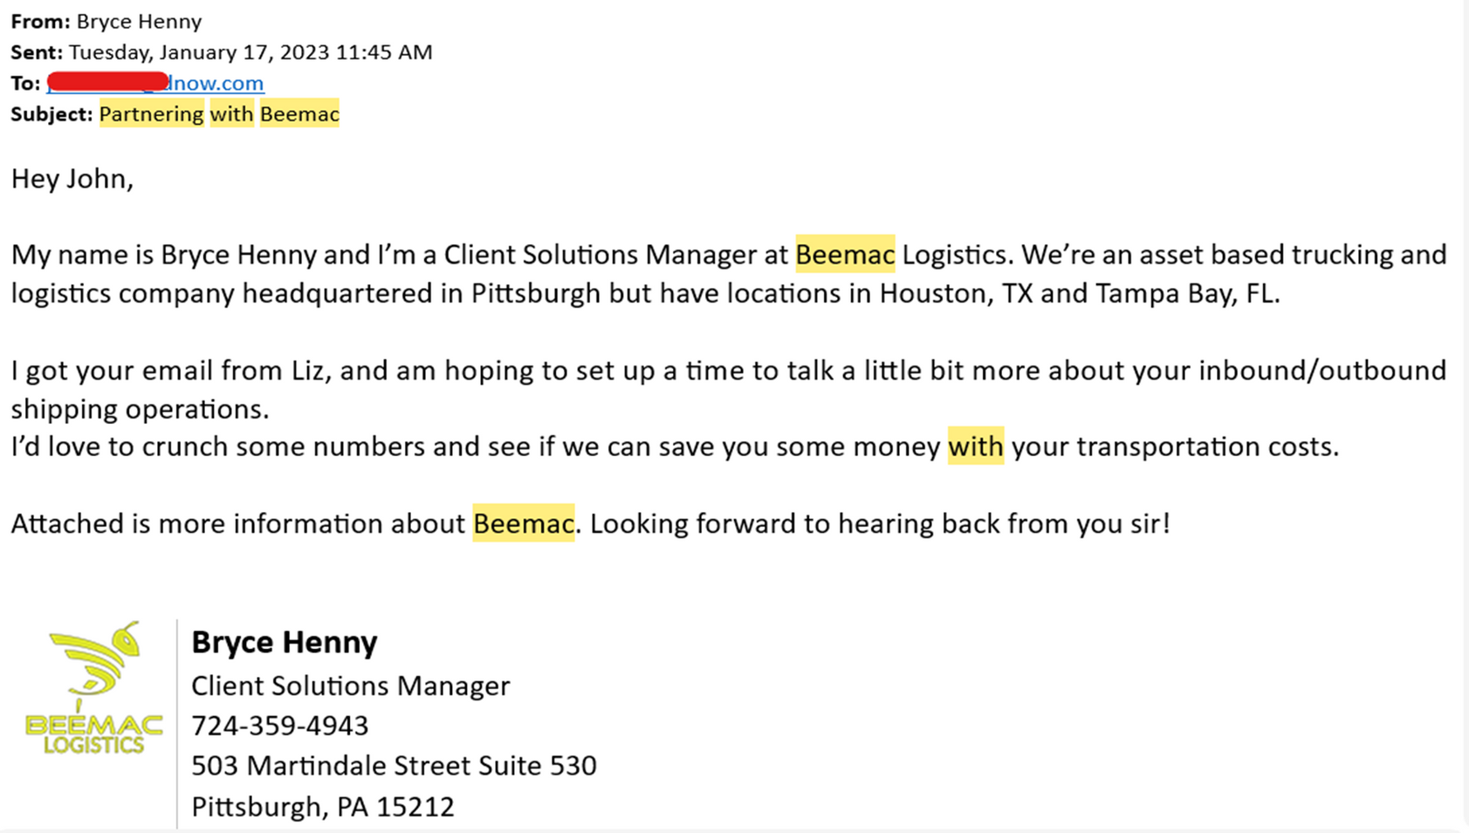
Example Emails

