Slide 1


SALES
PROCESS
5 Steps of Cold Calling

Slide 2

Agenda
  Preparation
  Introduction w/ Gatekeeper
  Discovery w/ Decision Maker
  Value Proposition
  Next Steps

Slide 3

Preparation
  Research your prospect
  Understand their business, needs, and potential pain points
  If needed, prepare/be thinking of an outline to guide the conversation

Slide 4

Introduction with Gatekeeper
  Warm connection w/Gatekeeper: Mention sports, weather, travel, weekend plans, etc.
  Engage briefly: Build that rapport with light conversation
  Ask for decision-maker: “Can you put me over to the person who is in charge of handling your inbound/outbound shipping operations?”
  Other Job titles: Shipping Manager, Logistics Manager, Supply Chain Director

Slide 5
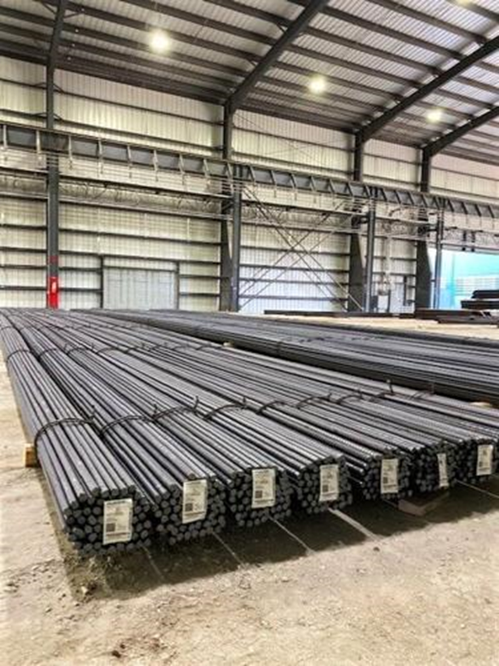
Discovery with Decision Maker
  Reintroduce yourself: Briefly reintroduce yourself/Beemac and make a connection with them.
  Time: "Do you have a moment to discuss your shipping operations?”
  Onboarding priorities: "What are your top priorities when onboarding carriers?”
  Challenges with current carriers: "Any challenges you’re facing with your current carriers?”
  Load Volume: "How many loads a day/week/month do you handle, both inbound and outbound?”

Slide 6

Value Proposition
•Show how you/Beemac can add value to those pain points just mentioned
•Communication issues?: Offer frequent updates during transit to keep them informed. Provide real-time tracking links for better visibility
•Bad transparency?: Ensure clear, consistent communication throughout the shipping process. No good news or bad news-just news

Slide 7
NEXT STEPS
  Depending on the conversation- the close could be getting their information allowing us to send more details, setting up an in-person meeting, being asked for a quote, scheduling a follow-up call, etc.
  Agree with mutually agreed upon next steps
  End with a friendly goodbye

