Slide 1
Order entry

Slide 2
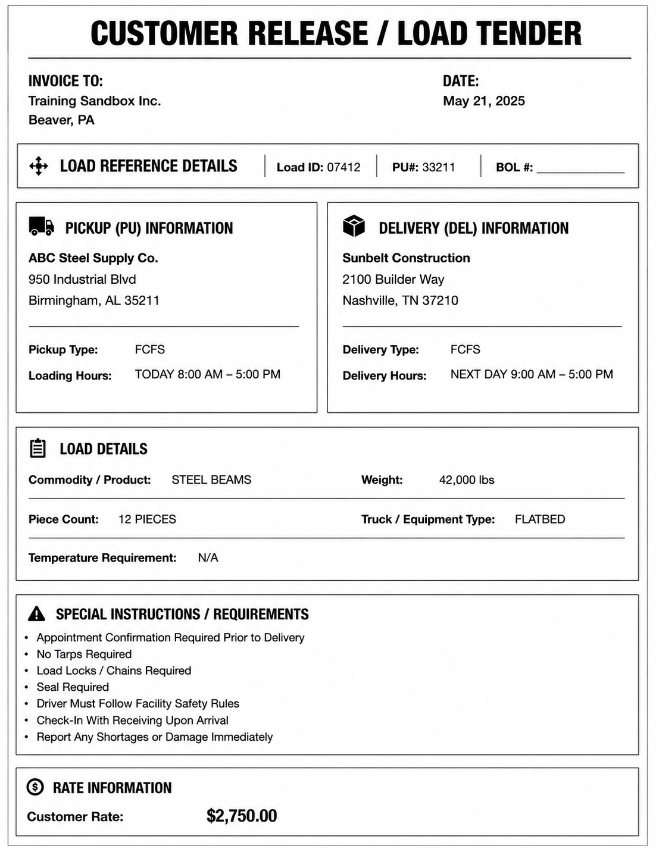
CUSTOMER RELEASE / LOAD TENDER

Slide 3
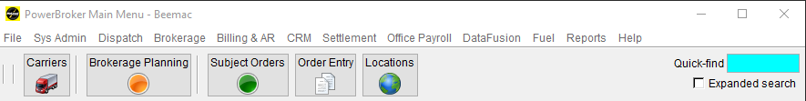
ENTER A NEW ORDER
Click Order Entry to open it.

Slide 4
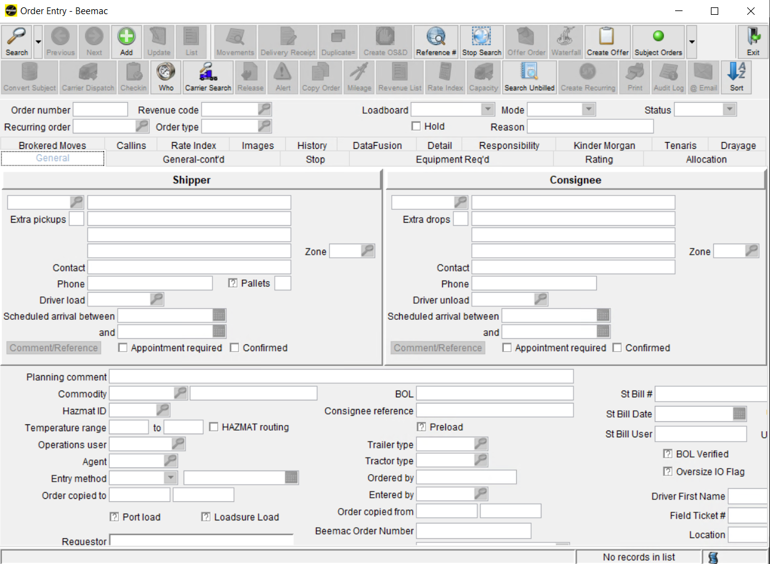
Click ADD to start.

Slide 5
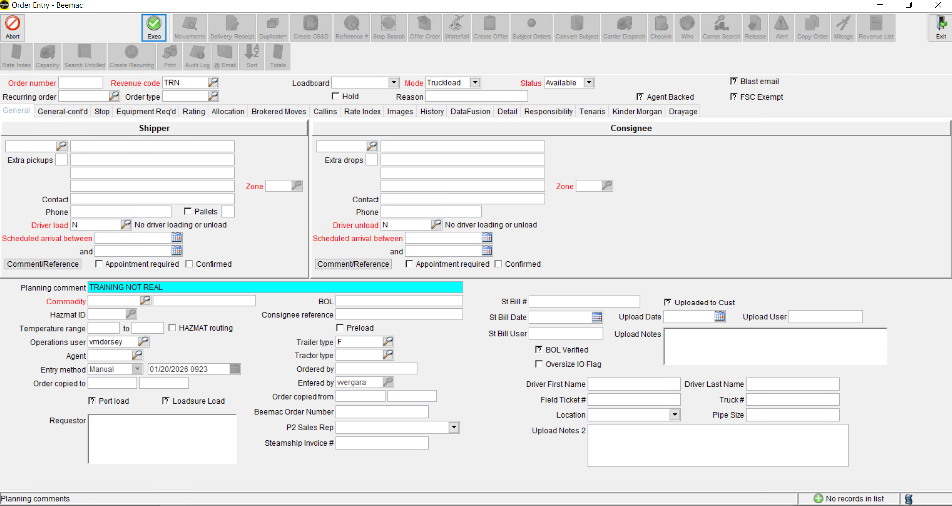
The 2 tabs that we are going to use are General and Rating

Slide 6
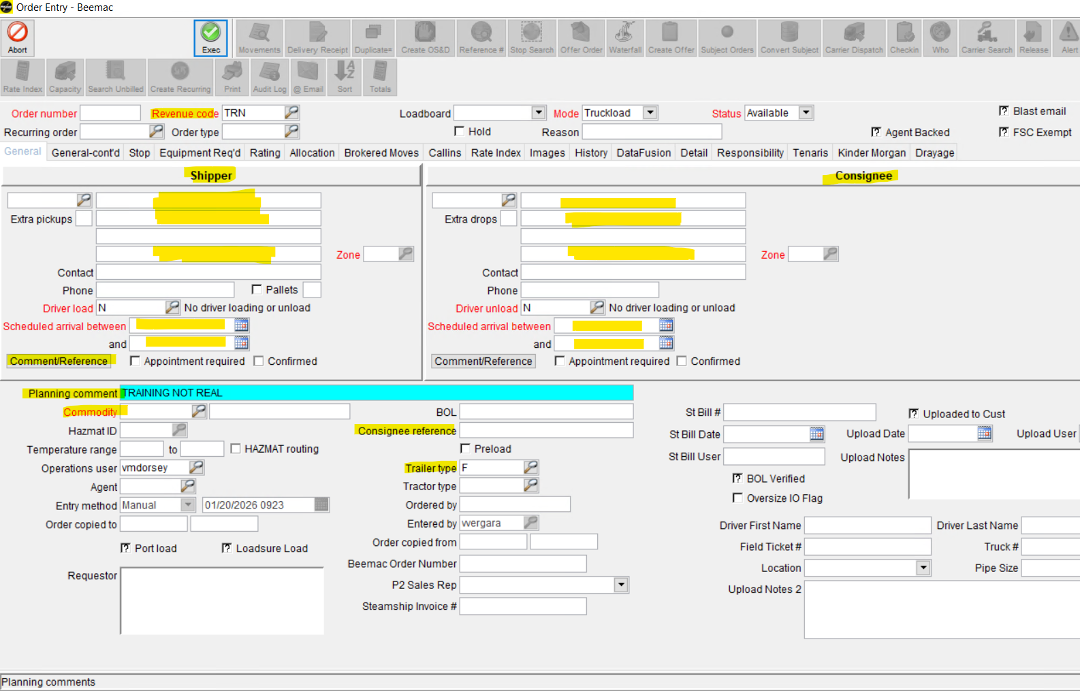

Slide 7
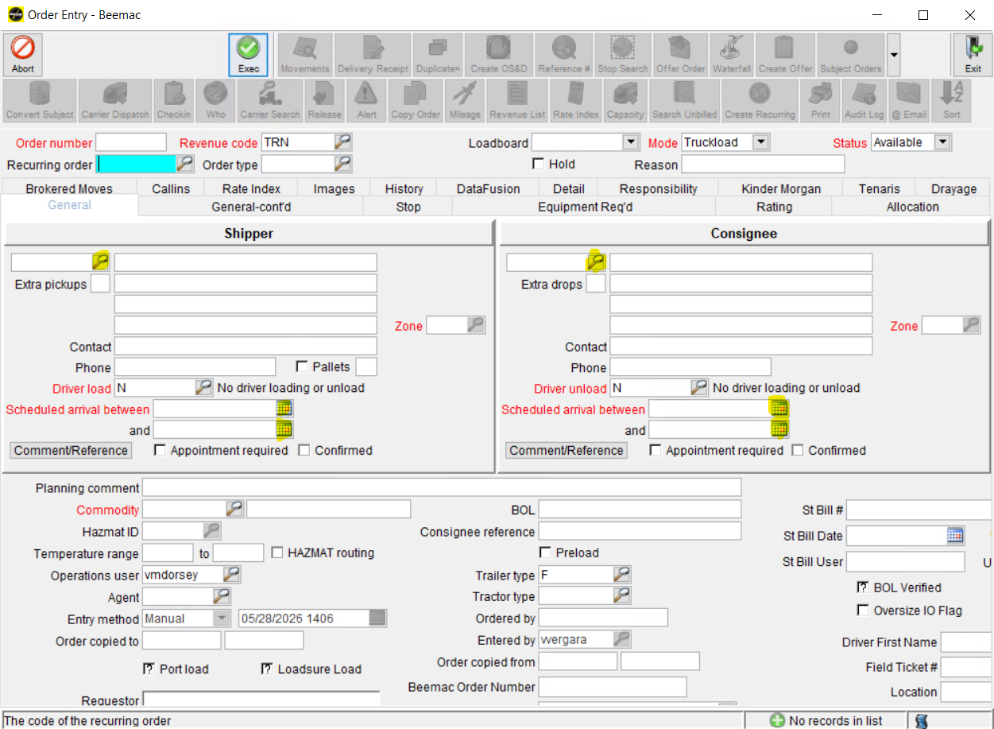
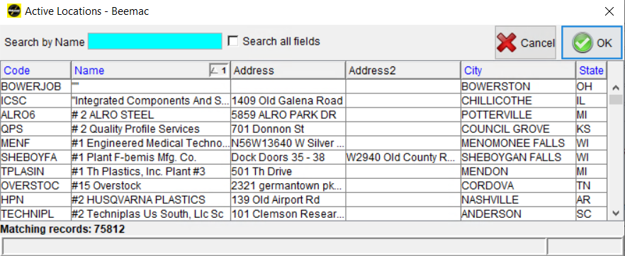
Enter the Pickup / Delivery Location and Dates / Times
Click the magnifying glass to search for the pickup and delivery information. There is one magnifying glass for pickup and another one for delivery.
You can search by
Name
Address
City

Slide 8
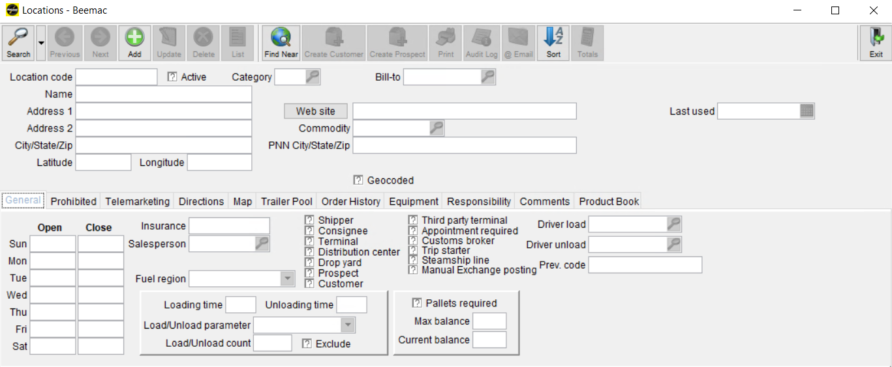
ENTER A NEW LOCATION IN MCLEOD
Once you open the ‘Location’ window you will select the green ‘Add’ button.

Slide 9
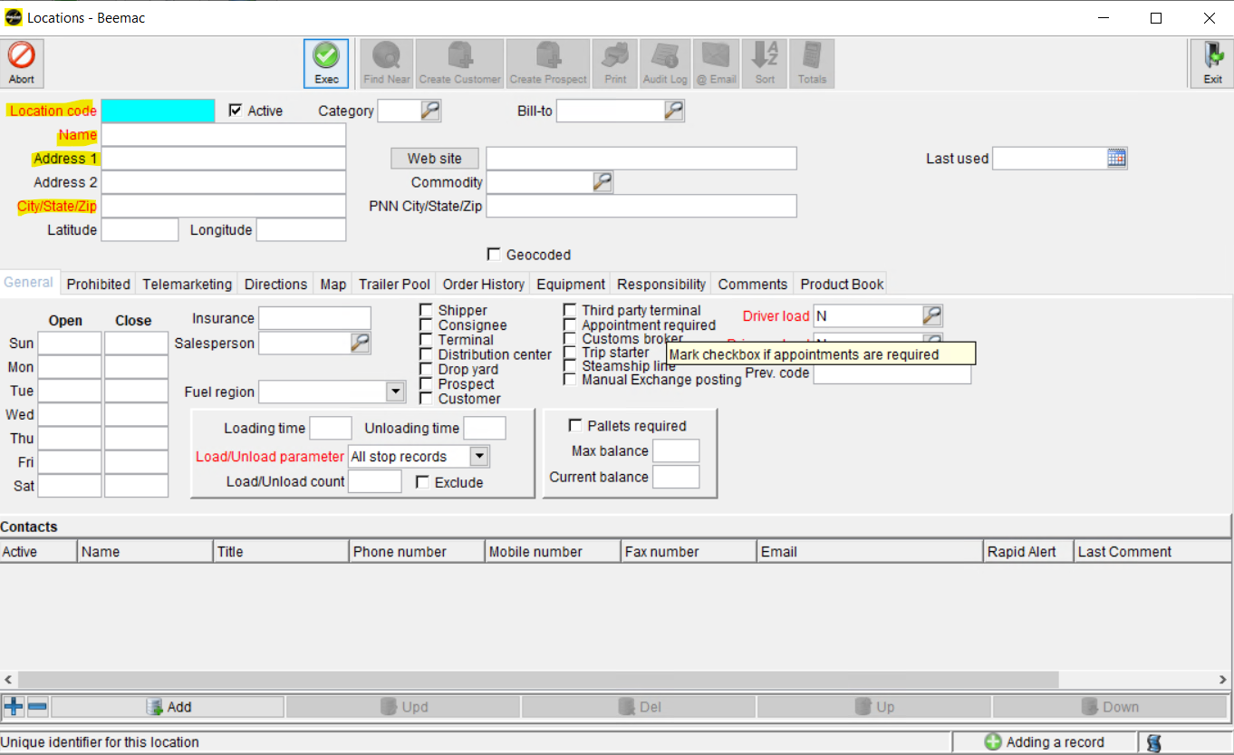
Next you will create a location code.
(use the first three letters of the facility name and the state abbreviation)

Slide 10
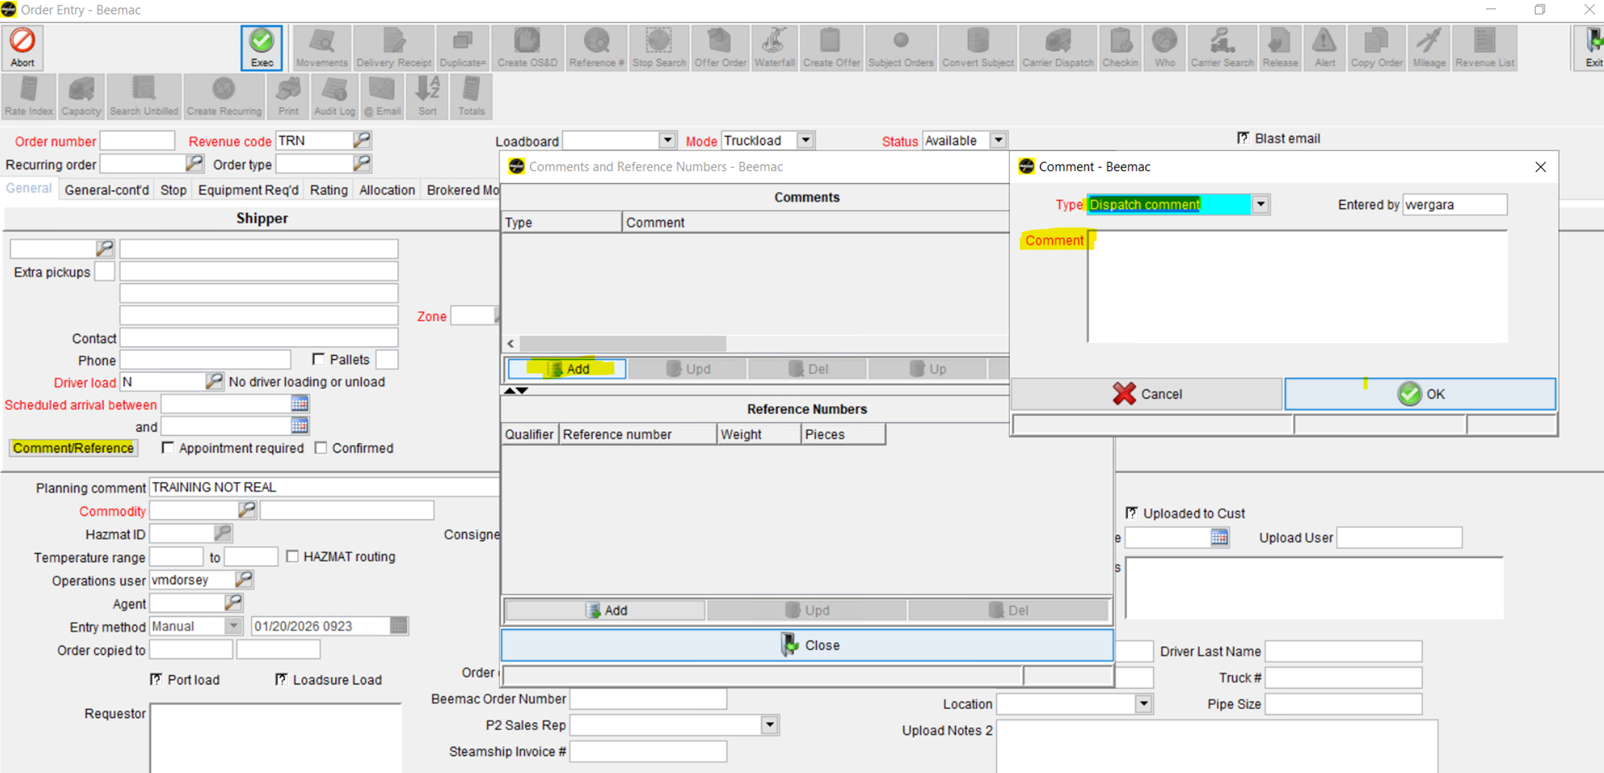
2. Enter the dispatch comments. This information will be included when you send out the rate confirmation.

Slide 11
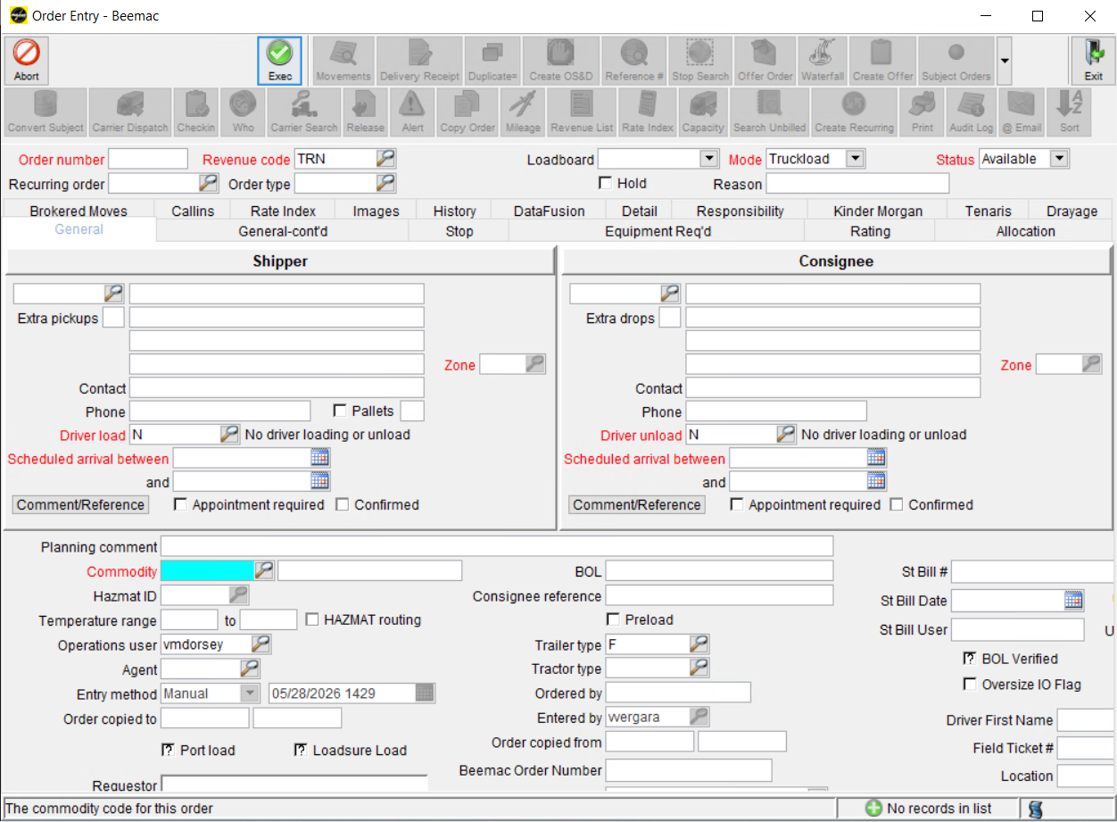
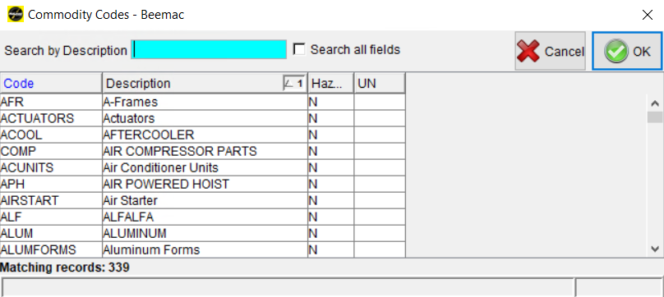
3. Click the magnifying glass to search for the commodity code for the freight the driver will pick up and deliver.

Slide 12
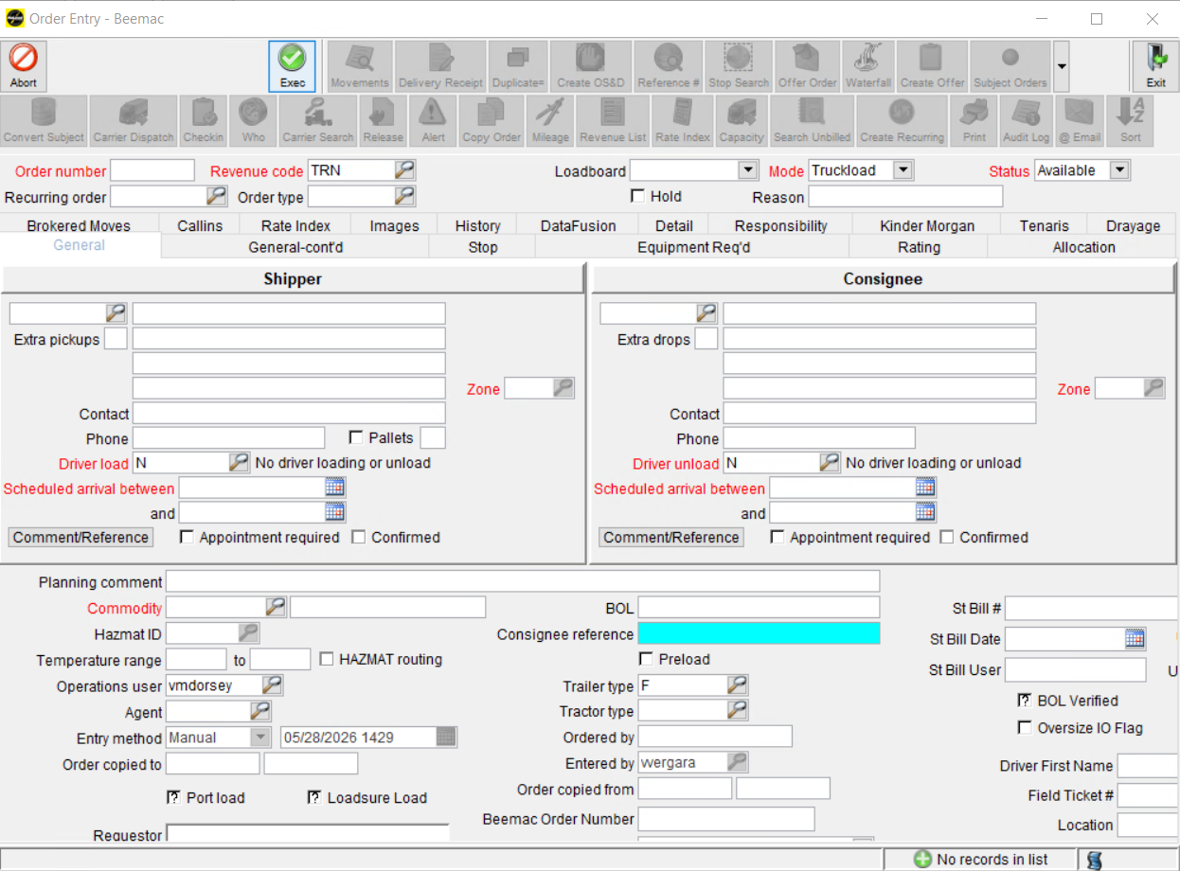
4. Enter the Consignee Reference.
Here goes the Load ID number from the Customer Release or the PO number from the Customer Release

Slide 13
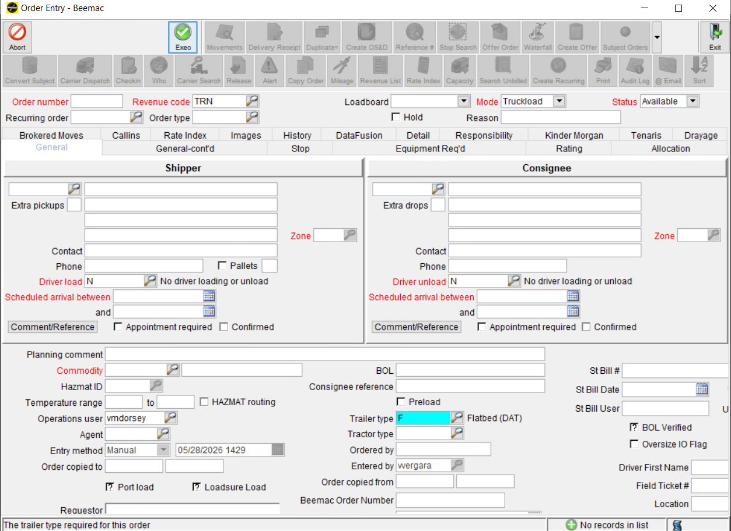
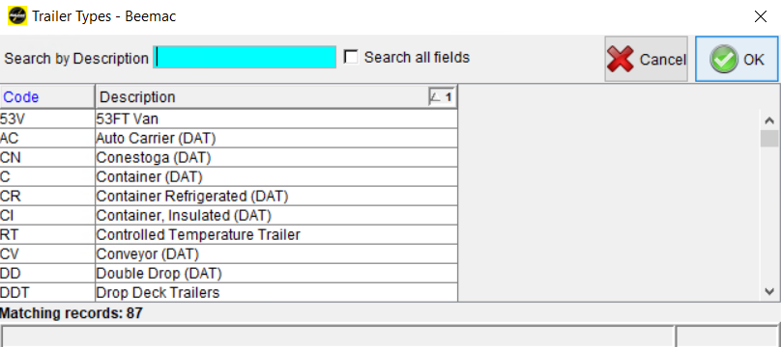
5. Select the Trailer type required for this order.

Slide 14
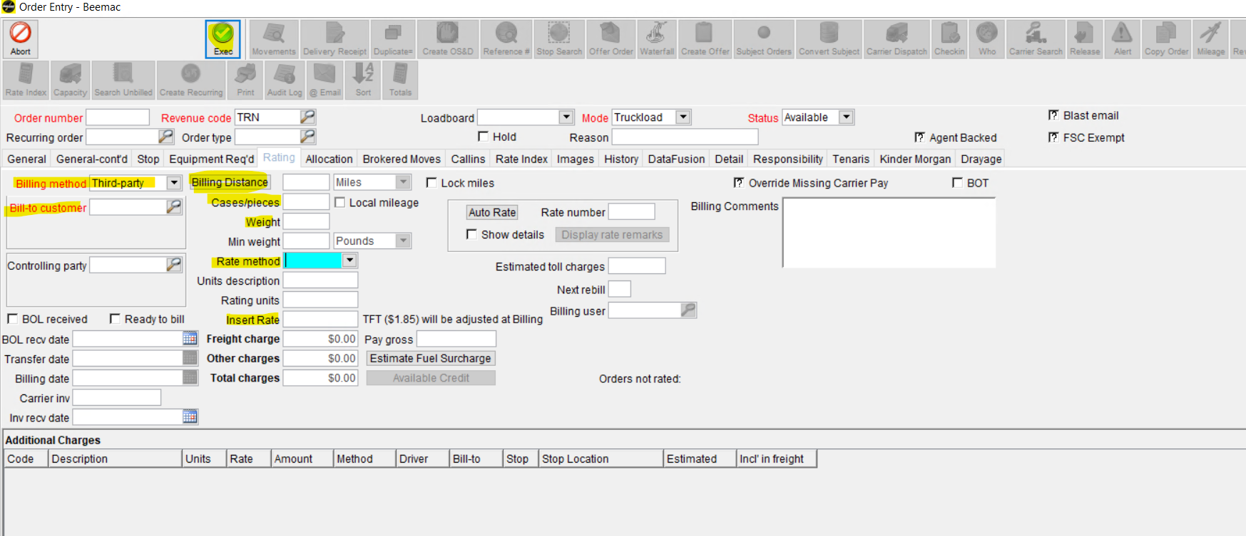

Slide 15
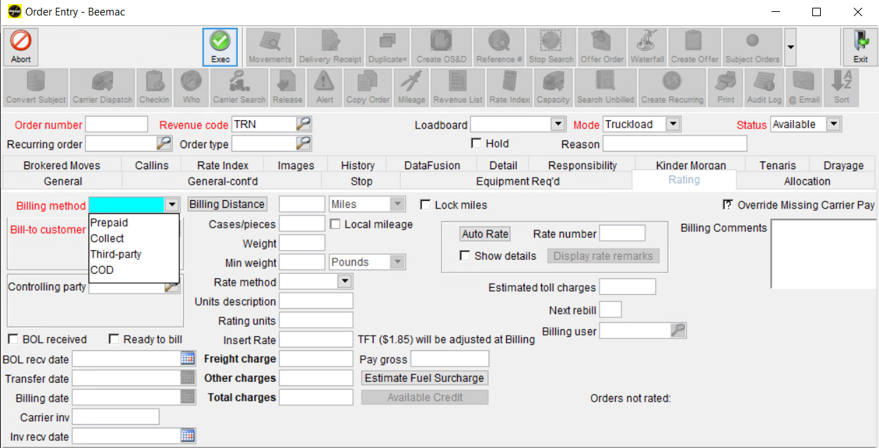
6. Billing method.
Will always be Third party

Slide 16
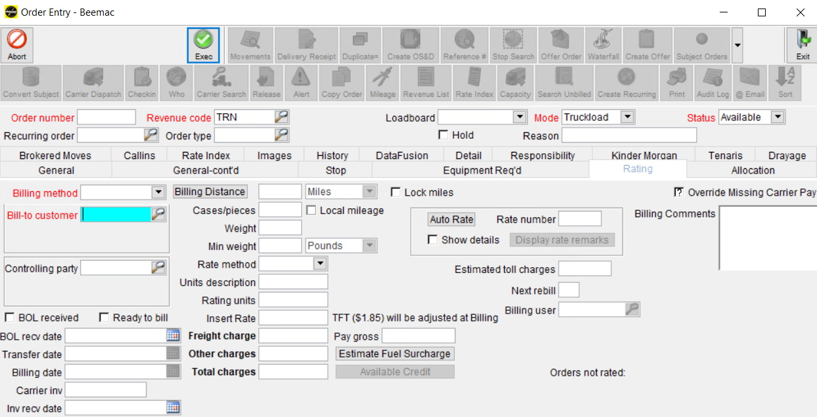
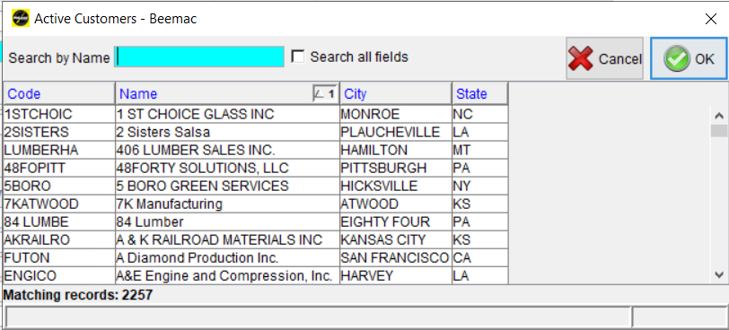
7. Click the magnifying glass to search for the Customer this order will be billed.

Slide 17
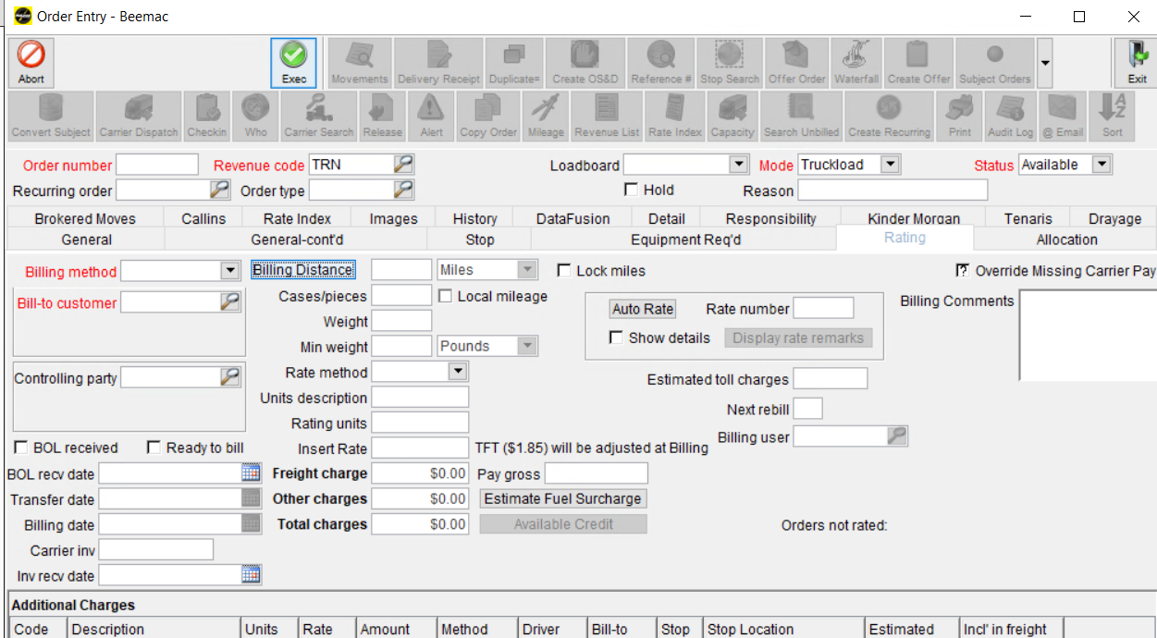
8. Click Billing Distance. Mcleod will calculate the miles from the pickup to the delivery location

Slide 18
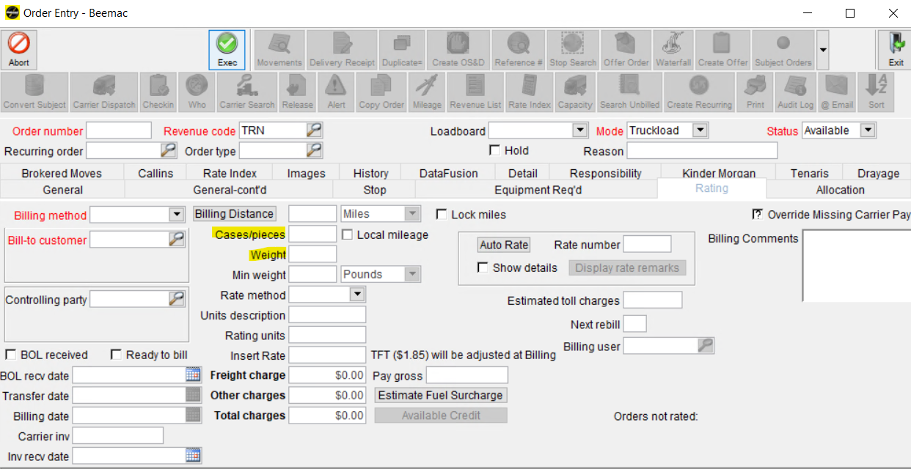
9. Enter cases of pieces for this order.
10. Enter the actual Weight for this order.

Slide 19
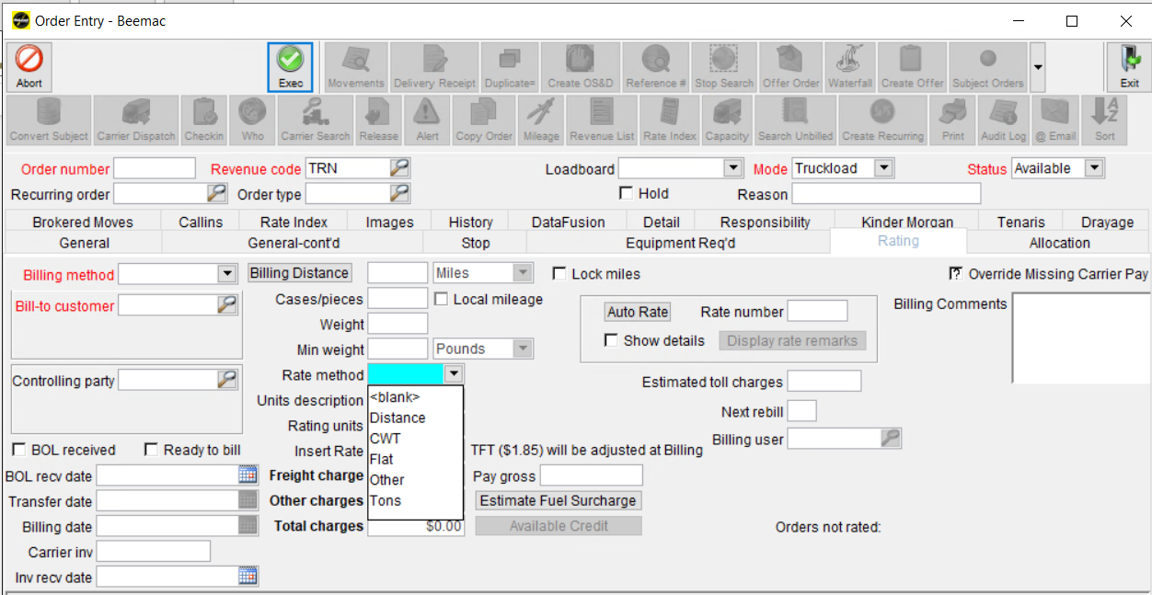
11. Select the Type of Rating calculation applied to this order.
Most of the times will be by FLAT

Slide 20
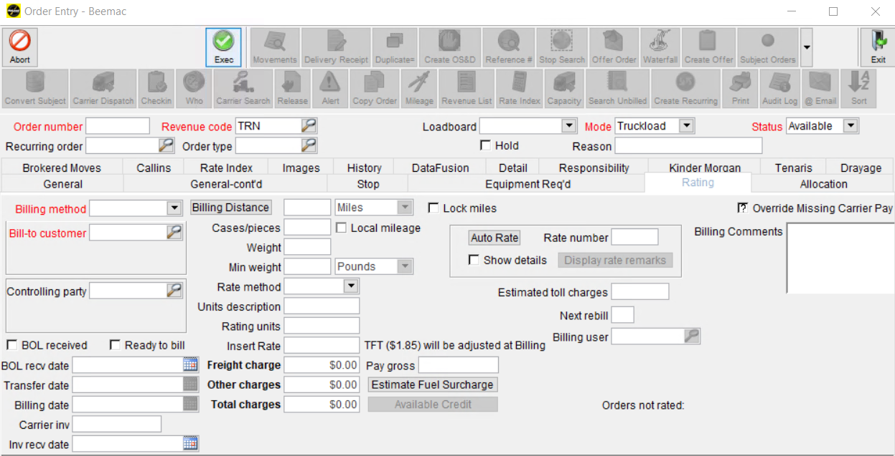
12. Insert the rate the customer rate.

Slide 21
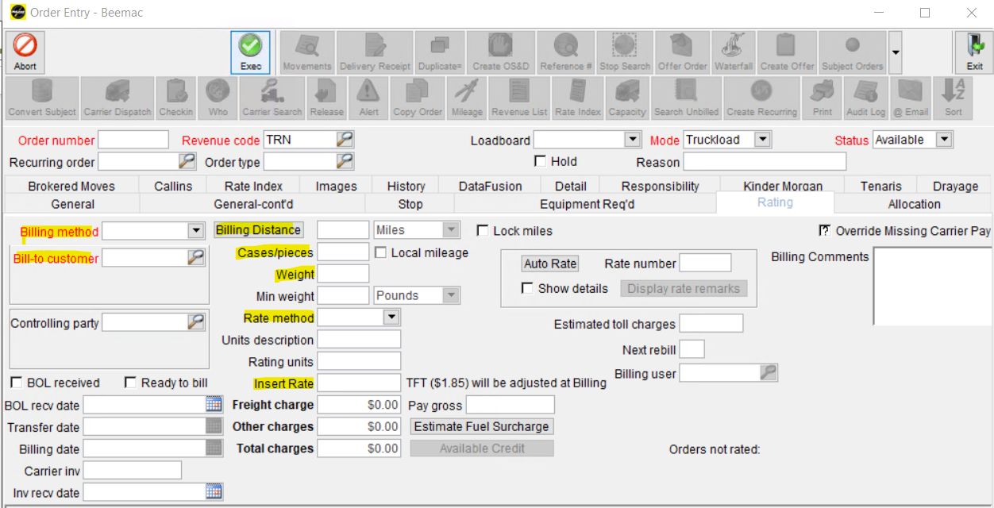
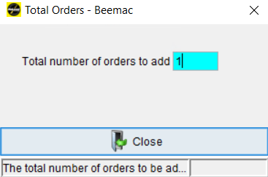
Once you enter all the required details Click Exec.
Total Orders box with pop up, enter the number of order entry you need and Click Close.

Slide 22
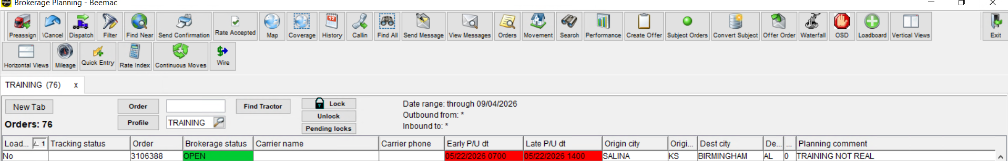
After a load has been built and put into brokerage planning you will then work on the load out of this screen. Brokerage planning is the most useful, versatile screen in McLeod.
I recommend always having this screen open as we do everything off this screen.

