Slide 1
SYSTEM TRAINING

Slide 2
AGENDA
Customer Release/ Load Tender
Order entry
Load Posting
Carrier information/ Carrier Setup
Cover load / Role Play
Carrier rate confirmation
Tracking Link
Confirm Pickup & Delivery
Repeat...

Slide 3
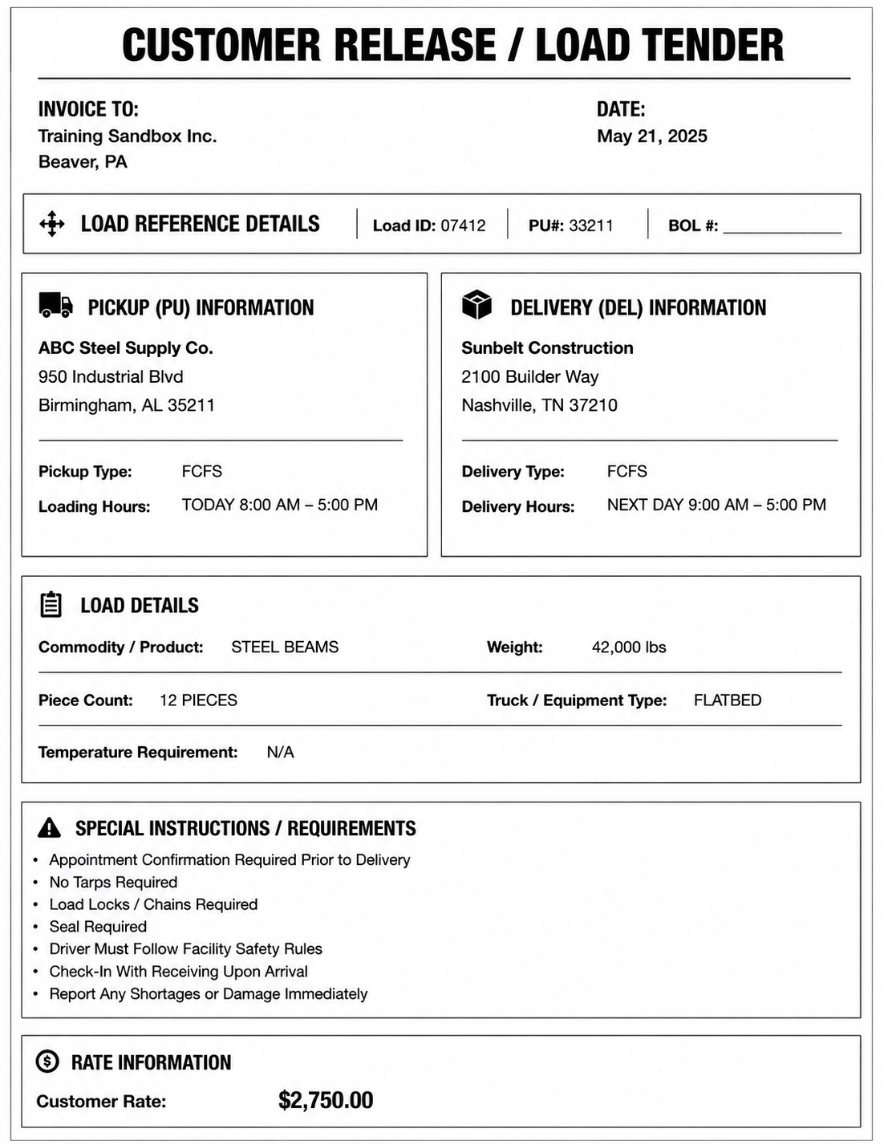
CUSTOMER RELEASE / LOAD TENDER

Slide 4
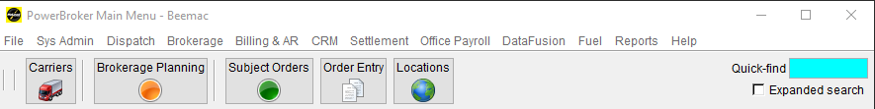
POWERBROKER MAIN MENU
This will be the first thing that pops up when you open McLeod. Here, you can find icons, add or remove them when you no longer use them, and customize them whenever you want.

Slide 5
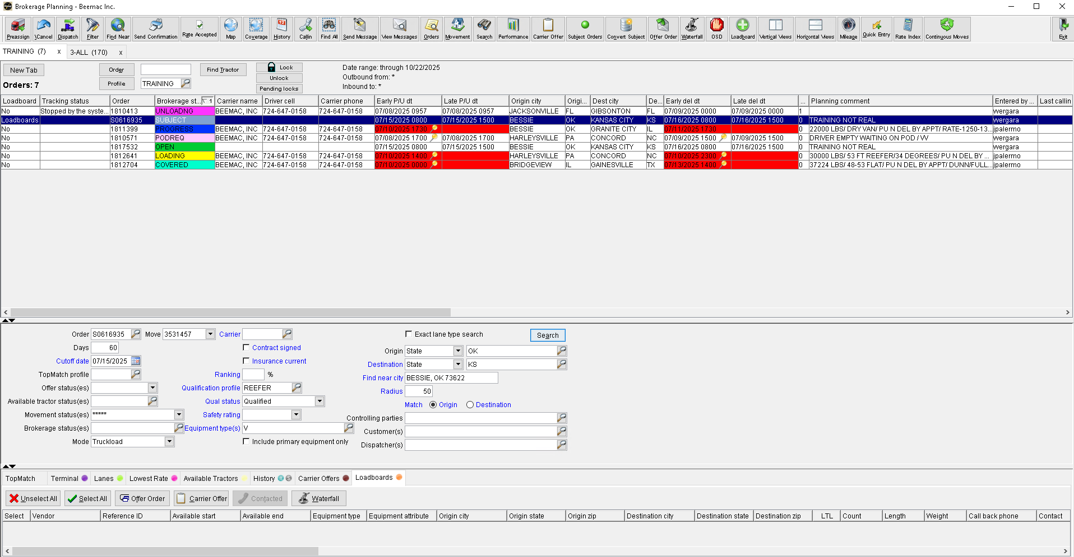
BROKERAGE PLANING
In brokerage planning you can
Sell loads,
Cover loads,
Call out on trucks,
Search open freight,
Confirm pick-up and delivery,
Dispatch,
Send rate confirmations.
Everywhere you click on this screen opens a new pop-up that does something different.

Slide 6
When the Loadboard tab says “Loadboard,” it means the load has been posted.
DAT
TRUCKSTOP
PARADE

Slide 7
ENTER A NEW ORDER
Click Order Entry to open it.

Slide 8
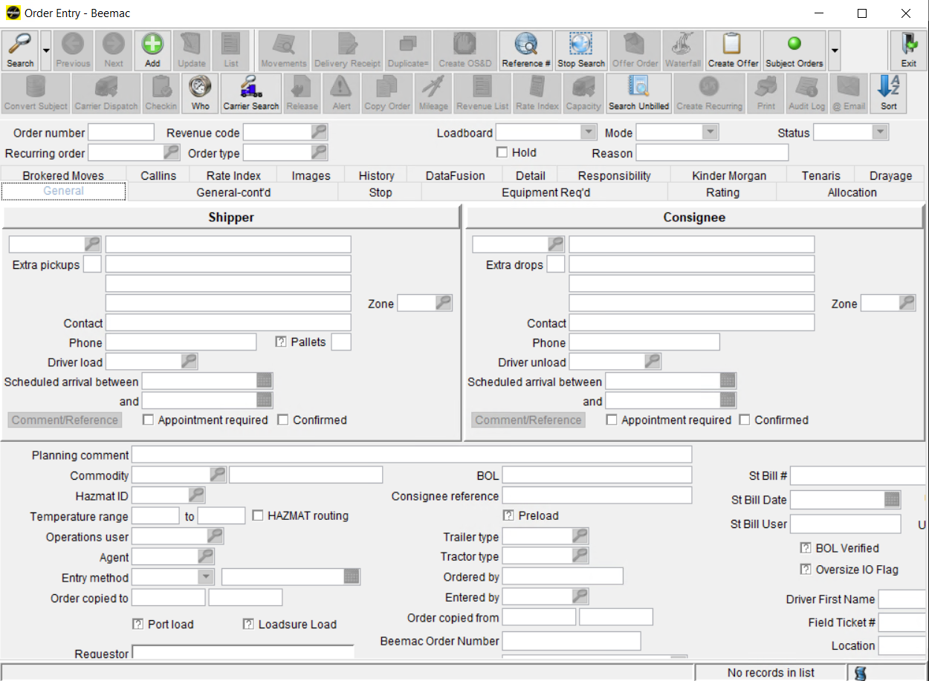
Click ADD to start.

Slide 9
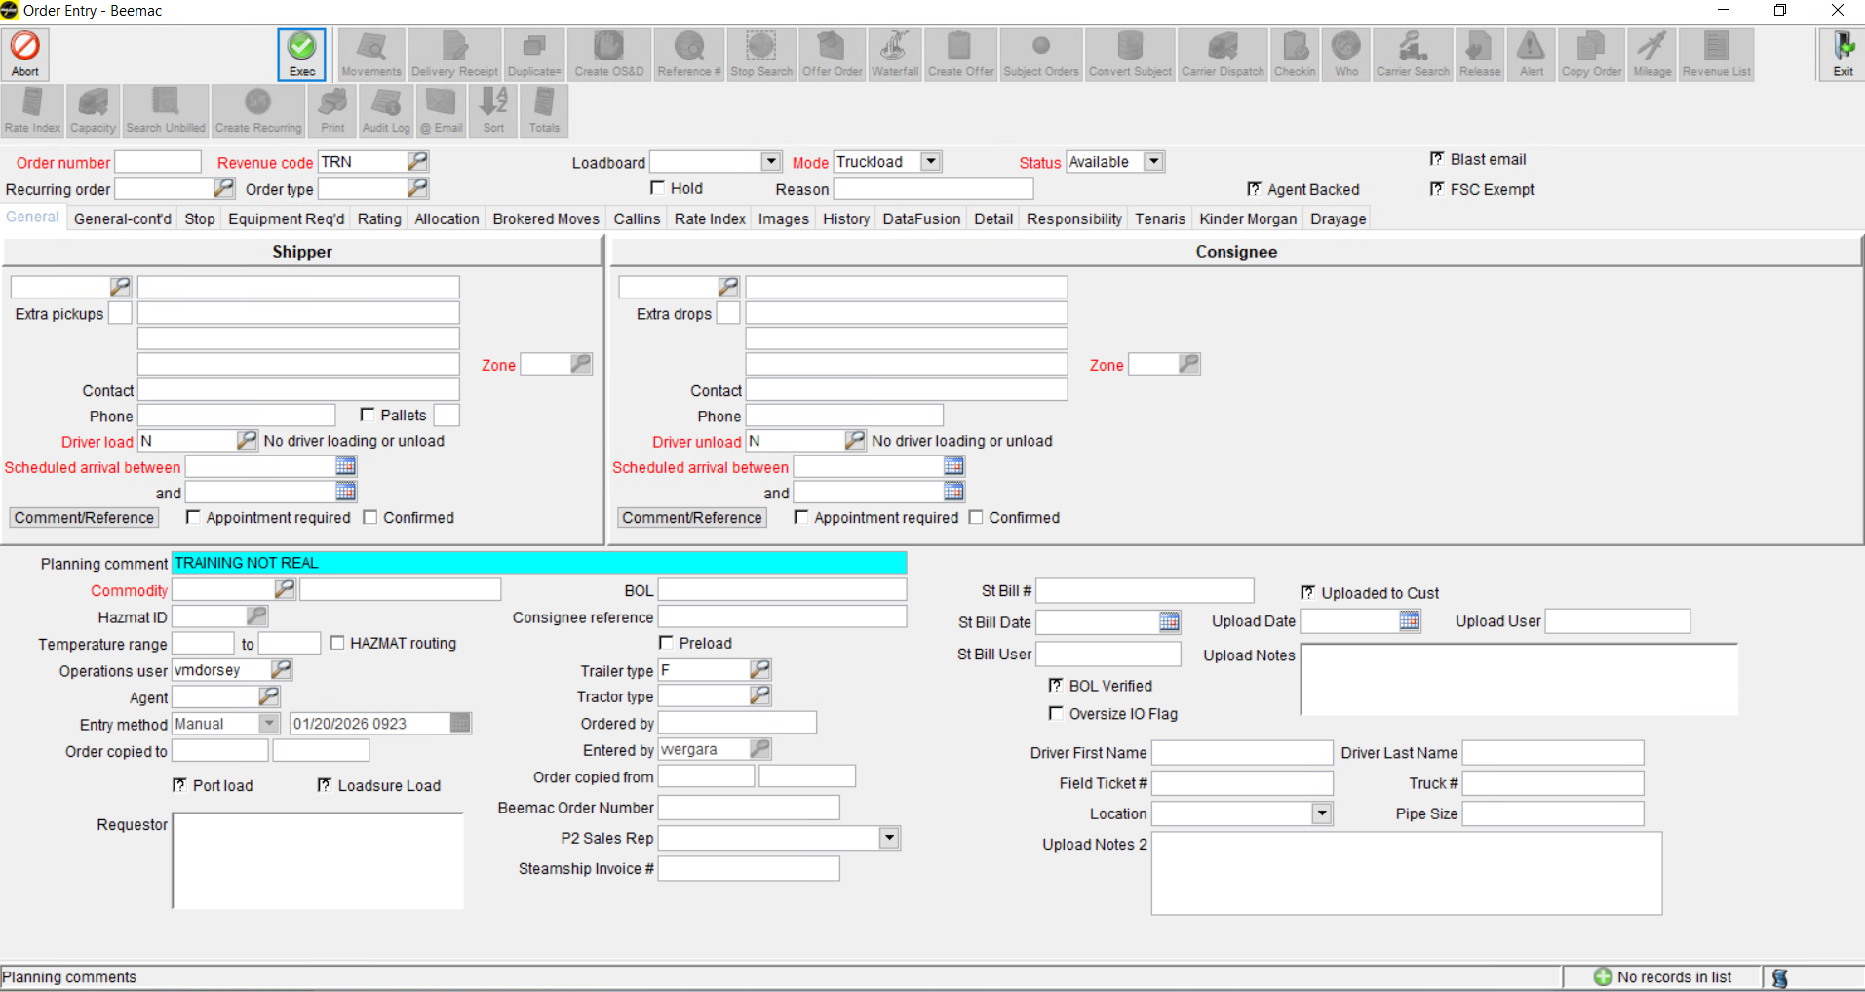
The 2 tabs that we are going to use are General and Rating

Slide 10
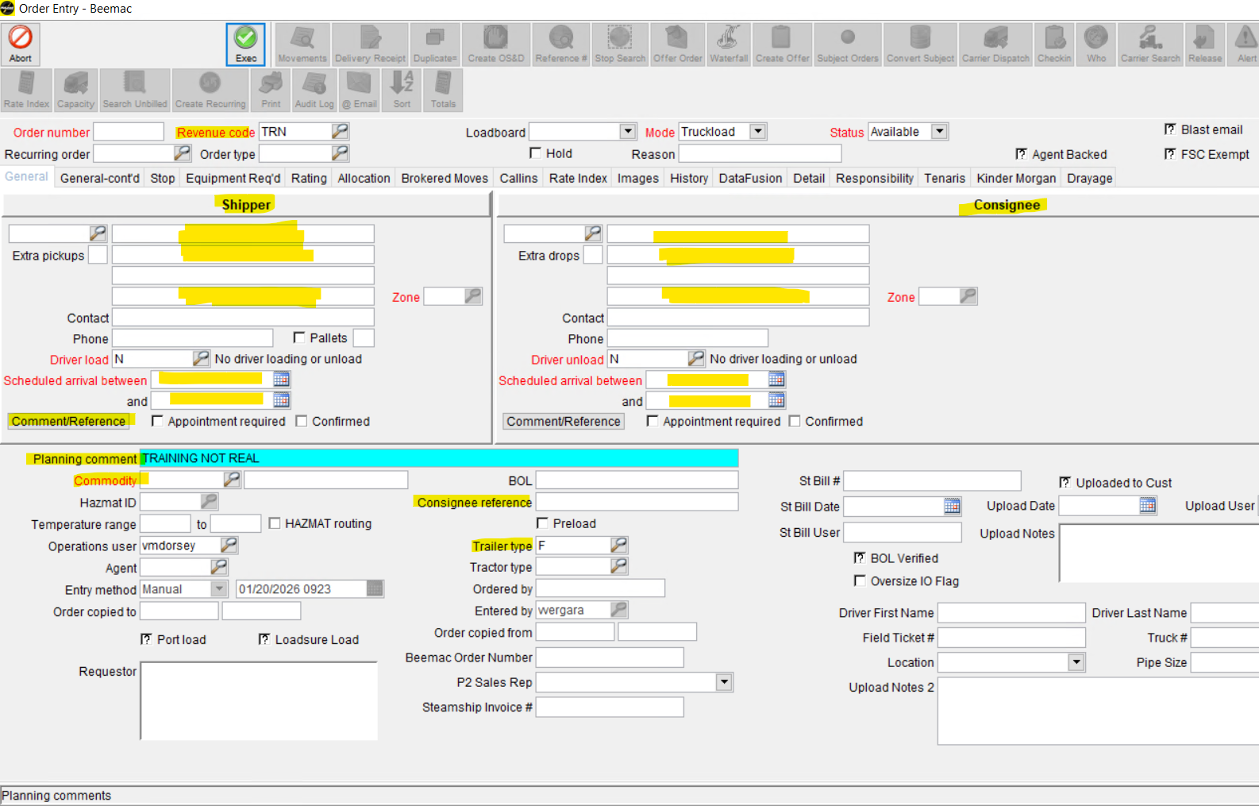

Slide 11
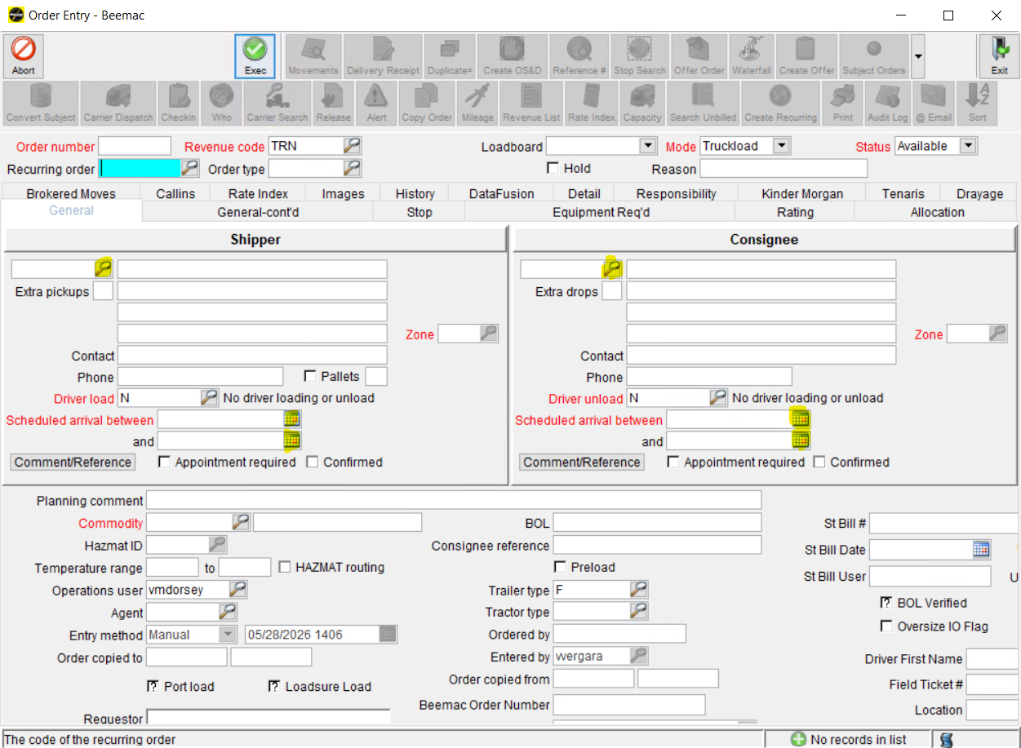
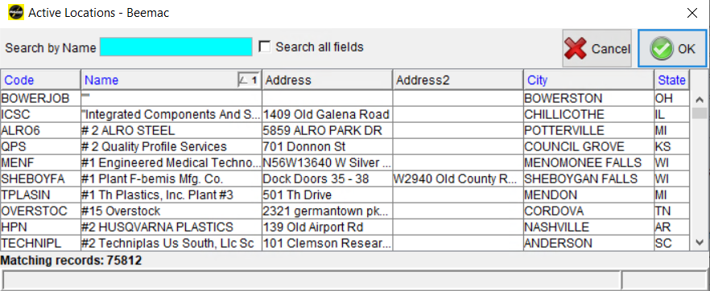
Enter the Pickup / Delivery Location and Dates / Times
Click the magnifying glass to search for the pickup and delivery information. There is one magnifying glass for pickup and another one for delivery.
You can search by
Name
Address
City

Slide 12
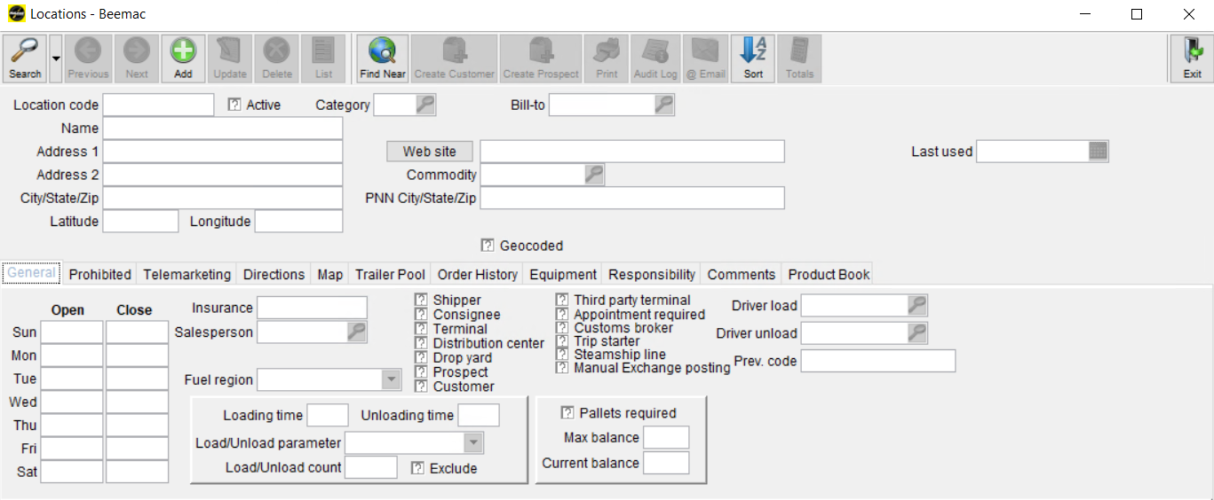
ENTER A NEW LOCATION IN MCLEOD
Once you open the ‘Location’ window you will select the green ‘Add’ button.

Slide 13
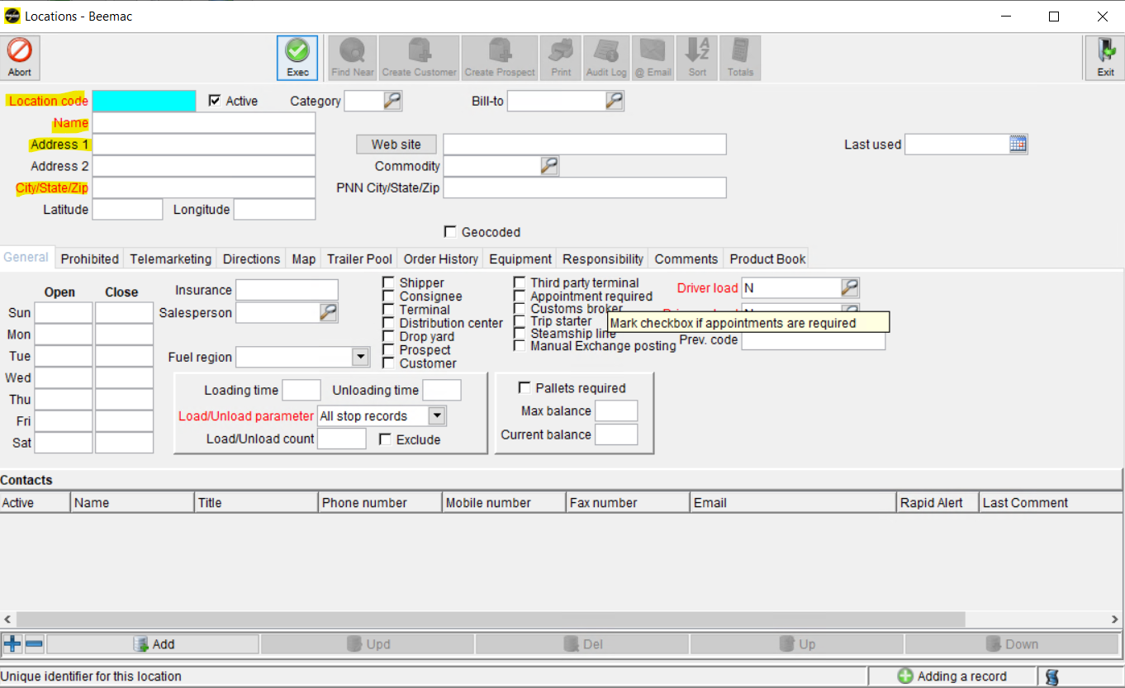
Next you will create a location code.
(use the first three letters of the facility name and the state abbreviation)

Slide 14
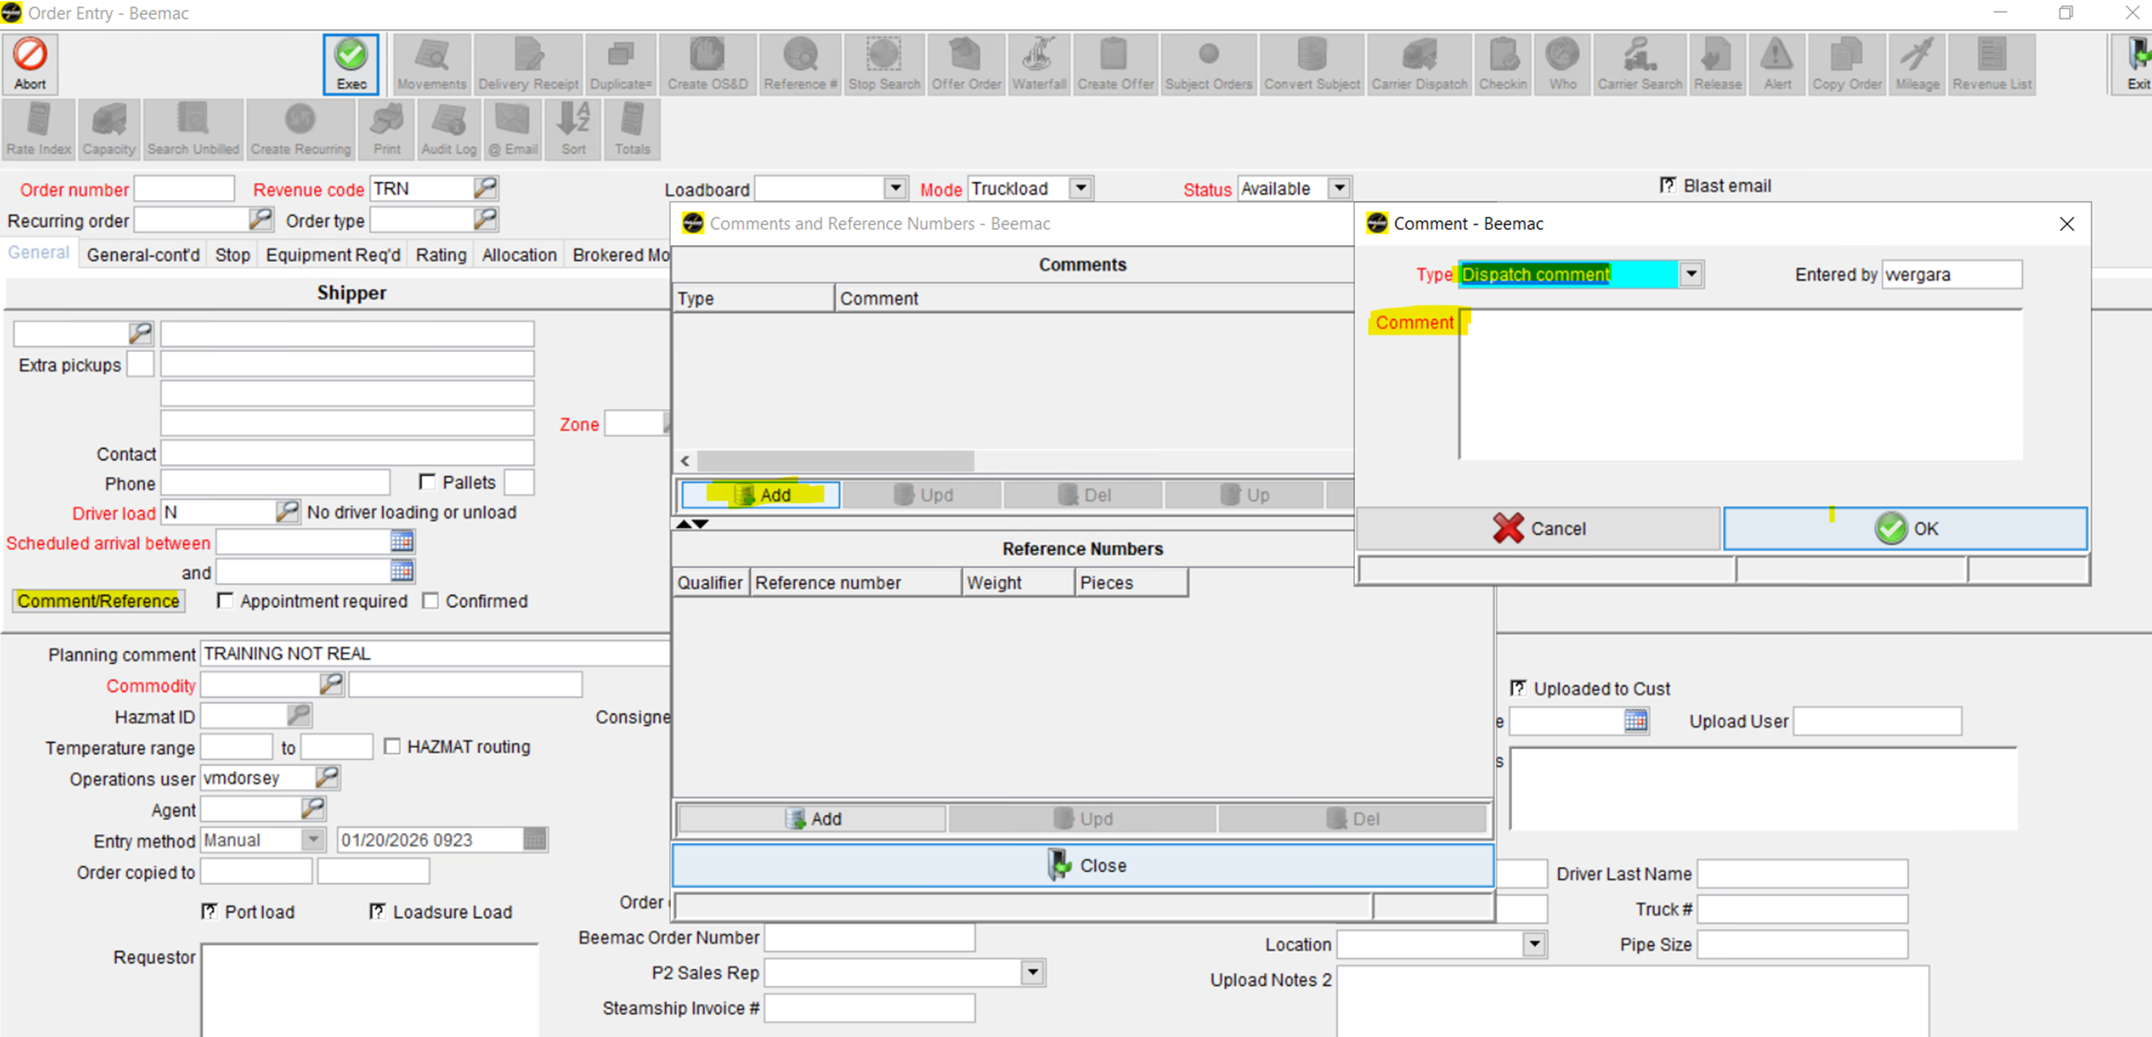
2. Enter the dispatch comments. This information will be included when you send out the rate confirmation.

Slide 15
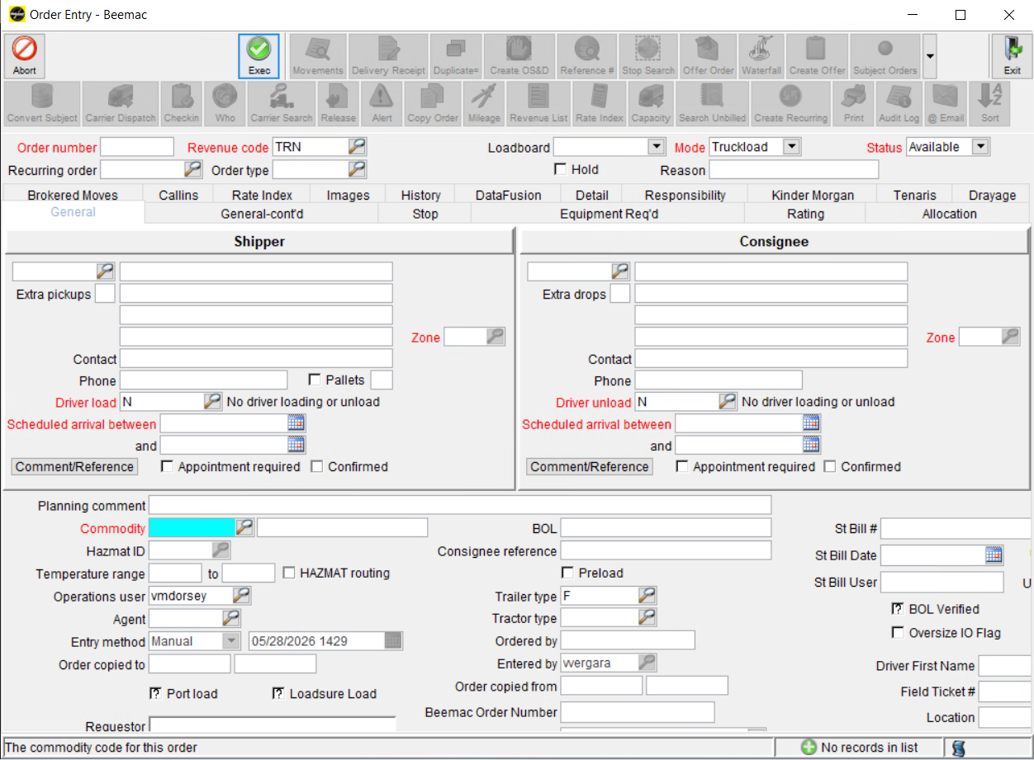
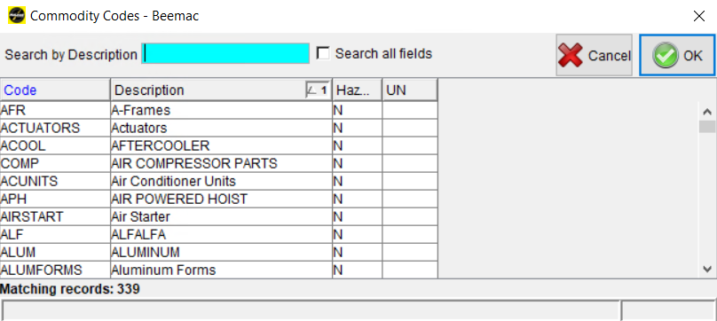
3. Click the magnifying glass to search for the commodity code for the freight the driver will pick up and deliver.

Slide 16
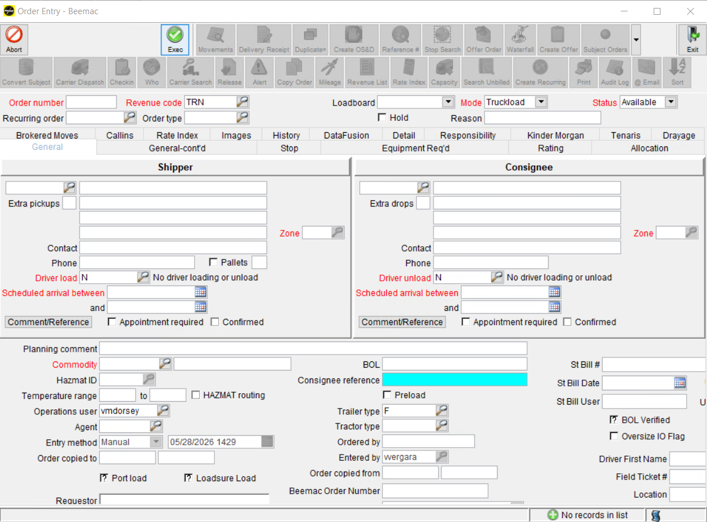
4. Enter the Consignee Reference.
Here goes the Load ID number from the Customer Release or the PO number from the Customer Release

Slide 17
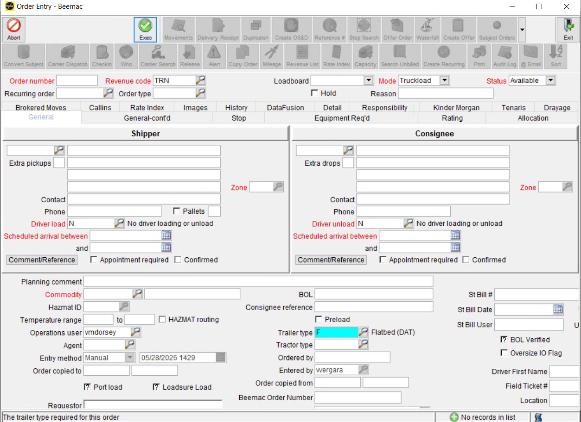
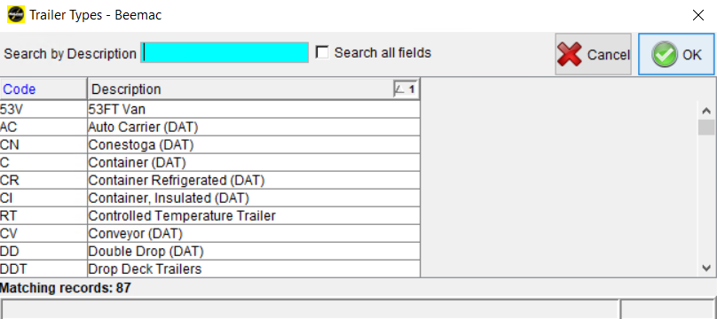
5. Select the Trailer type required for this order.

Slide 18
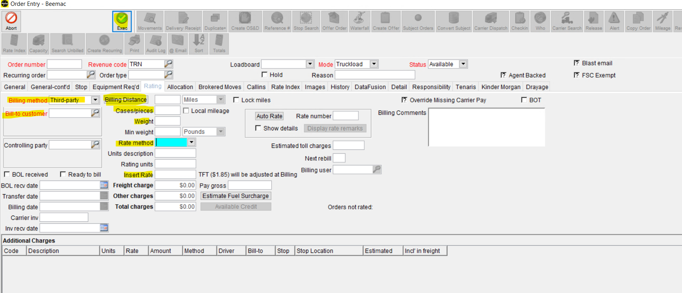

Slide 19
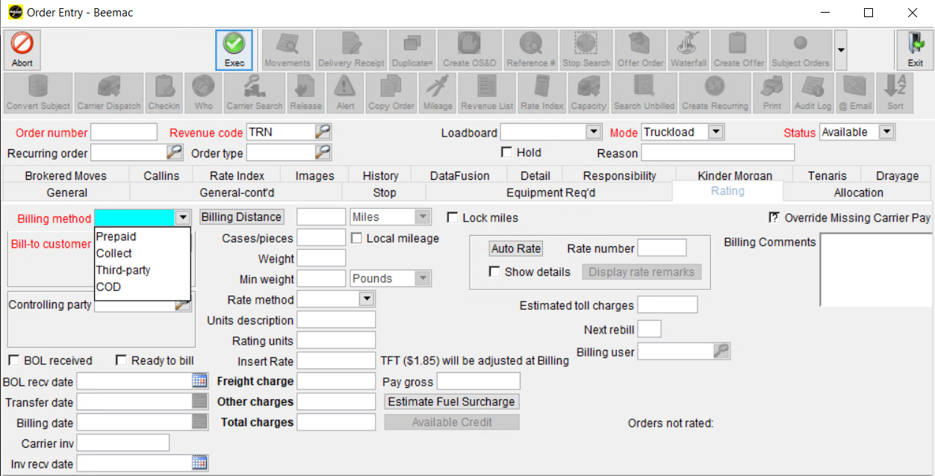
6. Billing method.
Will always be Third party

Slide 20
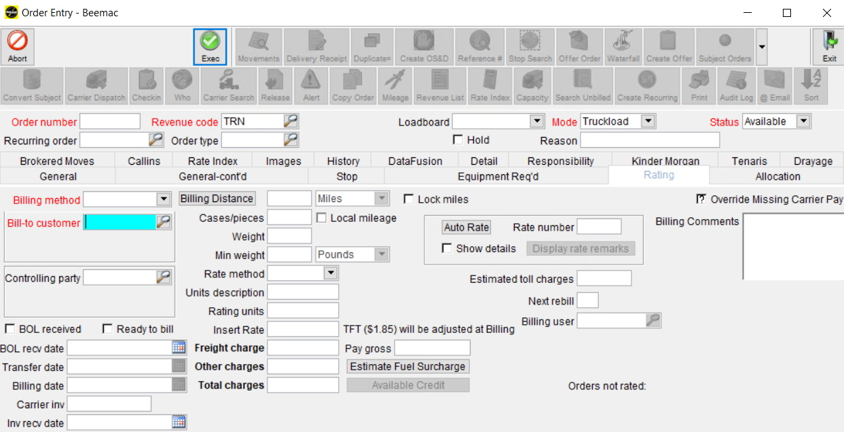
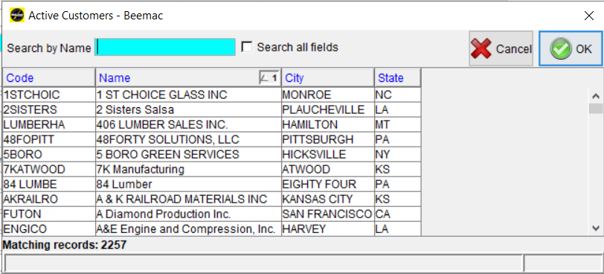
7. Click the magnifying glass to search for the Customer this order will be billed.

Slide 21
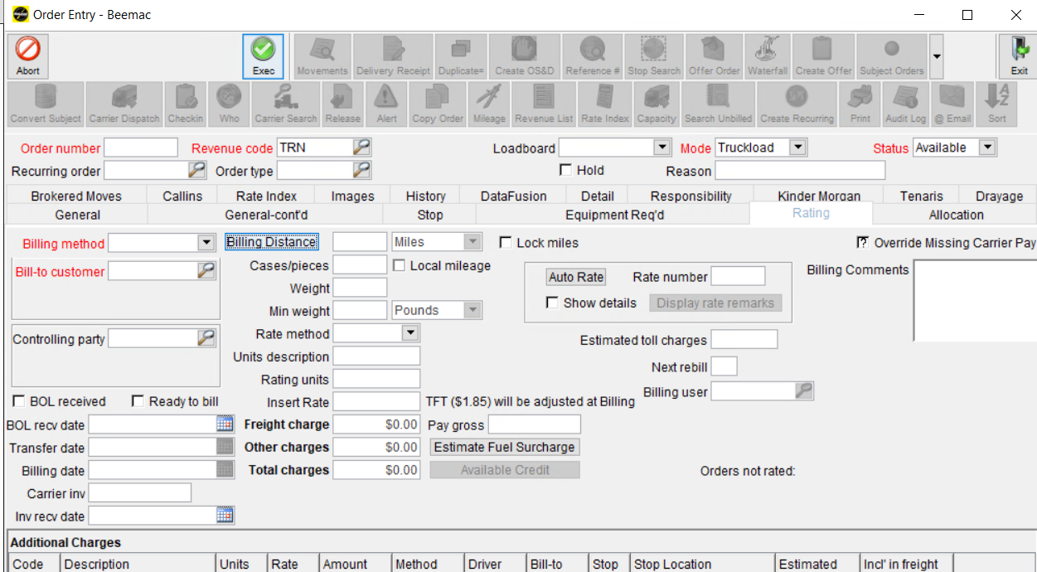
8. Click Billing Distance. Mcleod will calculate the miles from the pickup to the delivery location

Slide 22
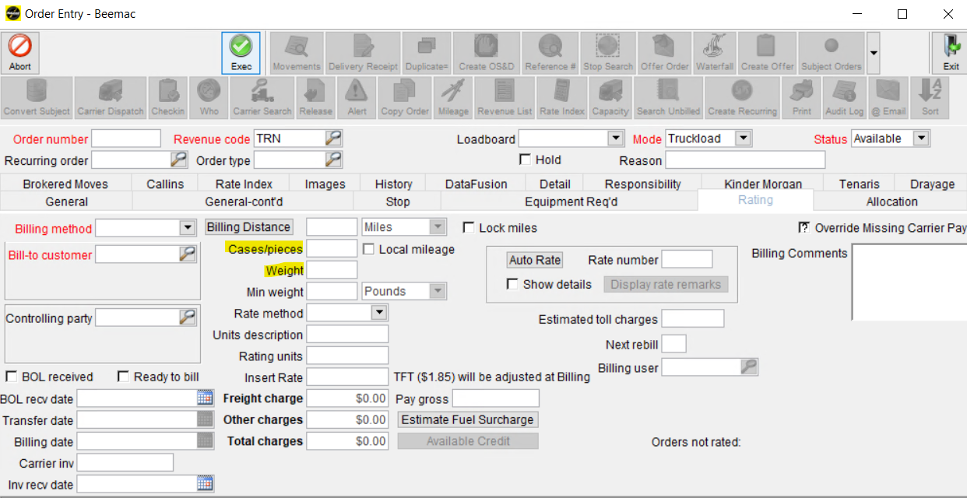
9. Enter cases of pieces for this order.
10. Enter the actual Weight for this order.

Slide 23
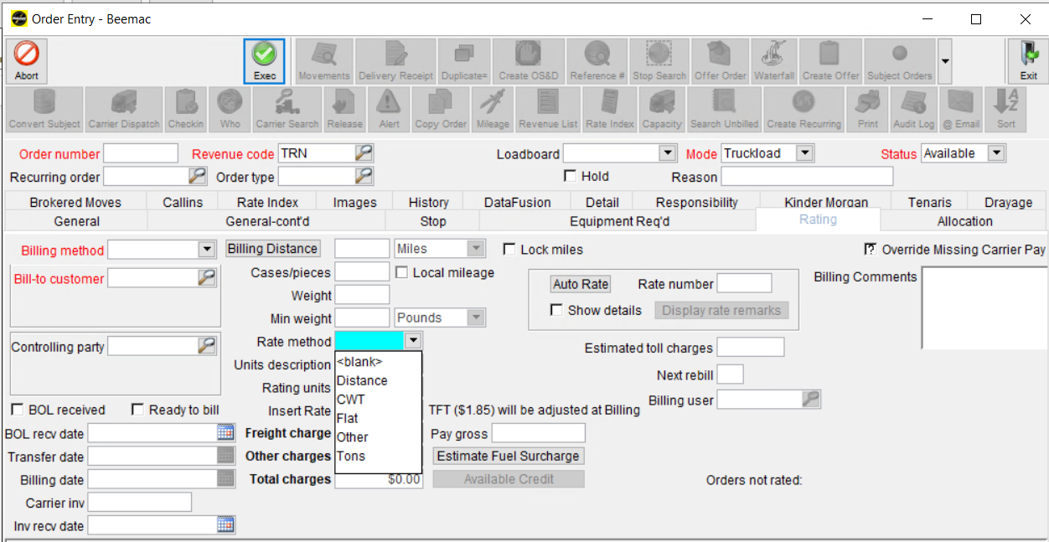
11. Select the Type of Rating calculation applied to this order.
Most of the times will be by FLAT

Slide 24
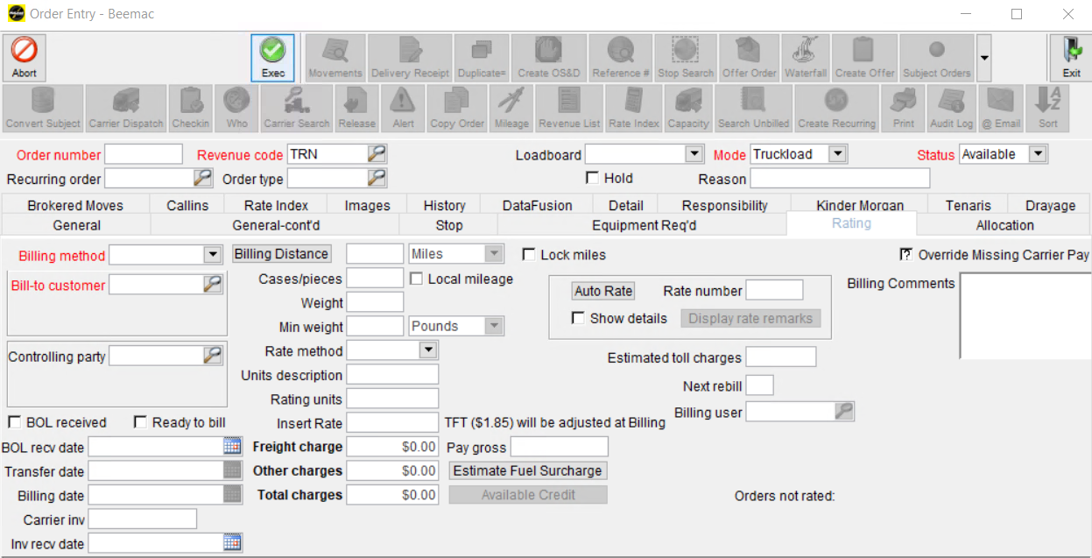
12. Insert the rate the customer rate.

Slide 25
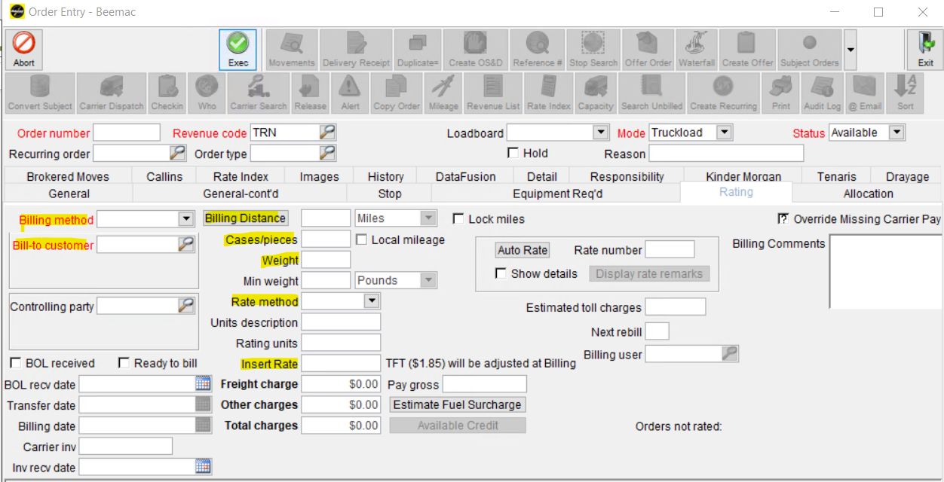
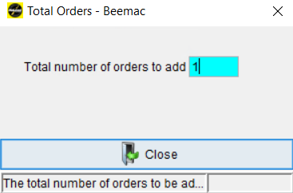
Once you enter all the required details Click Exec.
Total Orders box with pop up, enter the number of order entry you need and Click Close.

Slide 26
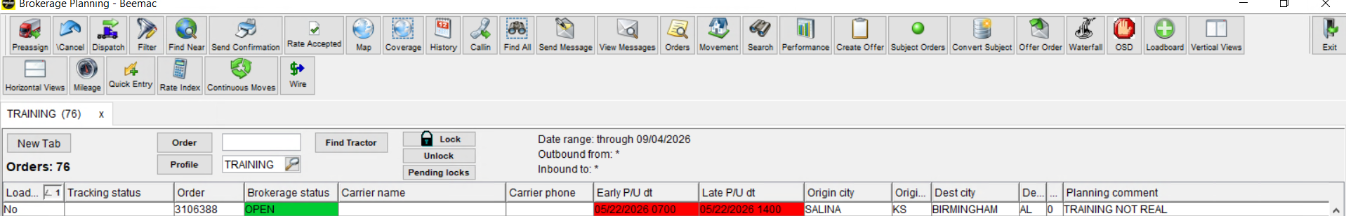
After a load has been built and put into brokerage planning you will then work on the load out of this screen. Brokerage planning is the most useful, versatile screen in McLeod.
I recommend always having this screen open as we do everything off this screen.

Slide 27
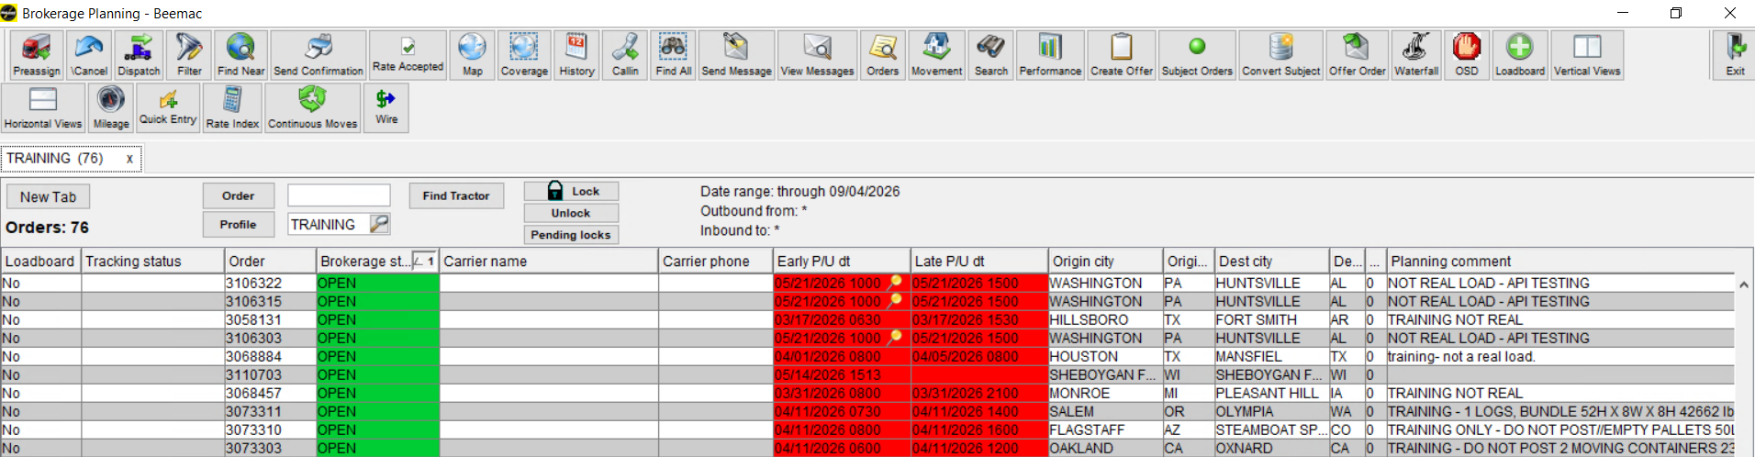
LOAD POSTING
Once the order entry is in Brokerage Planning, to post it (make it available for carriers), select the lane. Once it is selected, click the LOADBOARD icon at the top of the page.
The loadboard status will change from “NO” to “Loadboard.”
It will take 3 to 5 minutes for the load to be posted on Truckstop, DAT, and Parade.

Slide 28
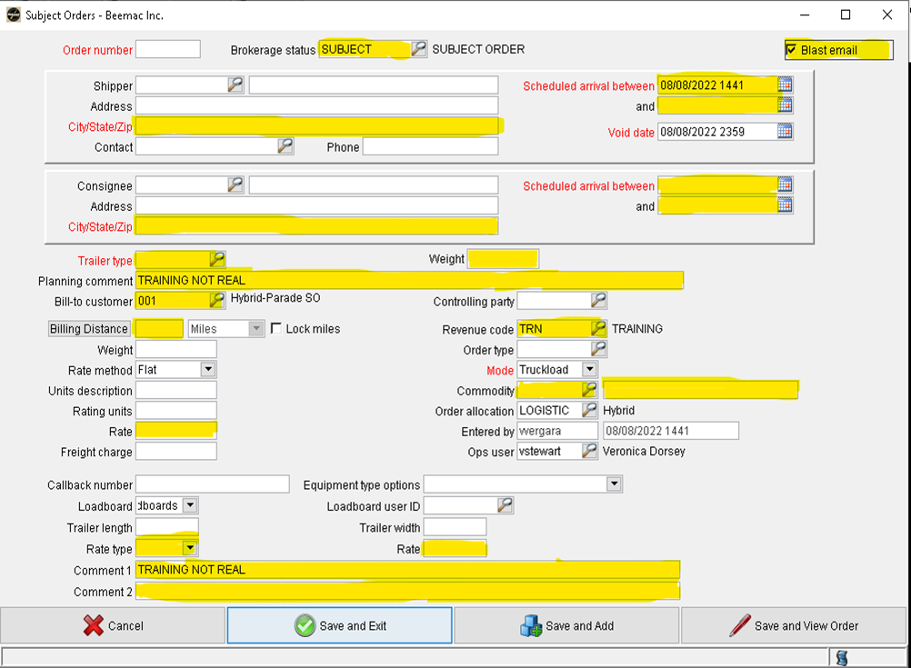

To quickly post a load before it is built or to post a load out as different cities to get more views you will use the ‘Subject Orders’ button at the top of the brokerage planning screen. In this pop-up, you will enter enough information to quickly post the load. At the top, you will enter the pickup and delivery city and state along with the date and times. Beneath you need to enter the trailer type which you can select by the magnifying glass button.
In the planning comments, you will put a brief, sellable description of the load.
Ex: 10K INSULATION, TWO 8FT TARPS, LOADS 7-5, DEL NEXT DAY@8A - $1298
Make sure the ‘Revenue Code’ field is correct and enter the commodity which you can select by the magnifying glass button.
Change the ‘Loadboards’ drop down to say Loadboards. Change the ‘Rate type’ drop down to flat. Enter the rate and a small description in the ‘Comment 1’ field that you want the driver to see on the load once it posts to the Loadboards.

Slide 29
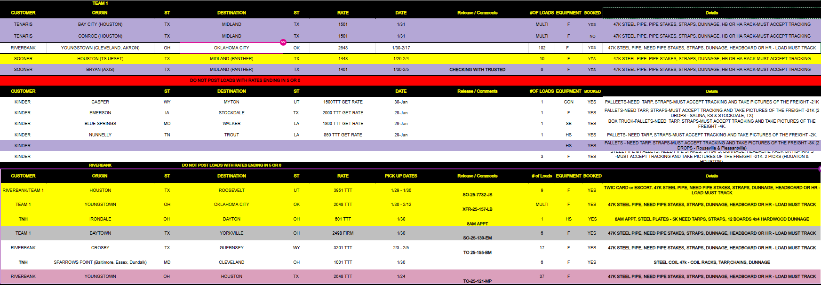

Slide 30
RATE CONFIRMATION

Slide 31

Once you have confirmed all the dispatcher’s information you are then required to get the driver's name and phone number. We track every single load via the TRUCKER TOOLS APP.
When you are booking a carrier on a load you must explain to them that the driver must have a smartphone and must accept tracking before a rate con will be sent. No one is exempt from tracking.
If they cannot/do not accept terms of tracking, they cannot have the load
Once you get the driver's name and phone number you write the following information down:
•Lane
•MC/DOT
•Dispatch name & phone number
•ETA to pickup
•Driver name & phone number
•Rate sold

Slide 32
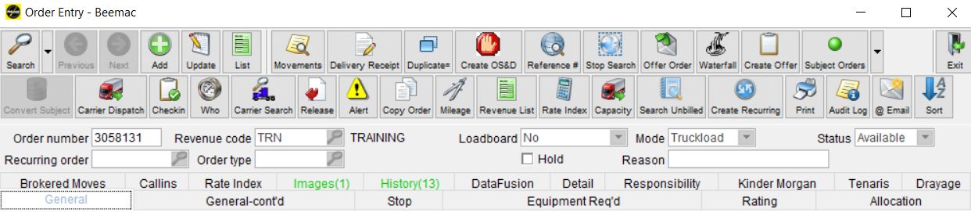
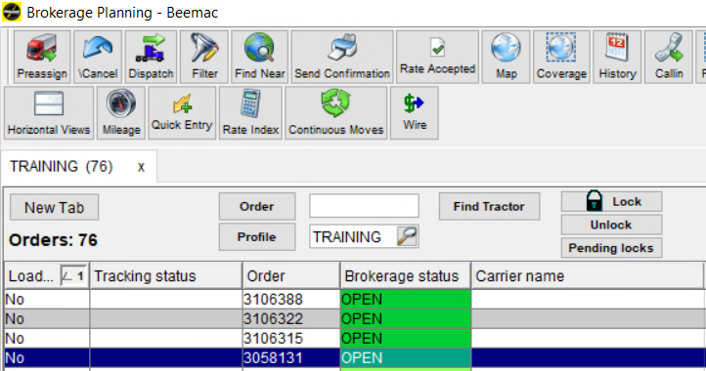
WHO TO OPEN THE CARRIER DISPATCH WINDOW
By opening the load in order entry and selecting the ‘Carrier Dispatch’ button.
By double-clicking on the ‘Brokerage Status’ of a load.
By clicking on the ‘Dispatch’ button in Brokerage Planning

Slide 33
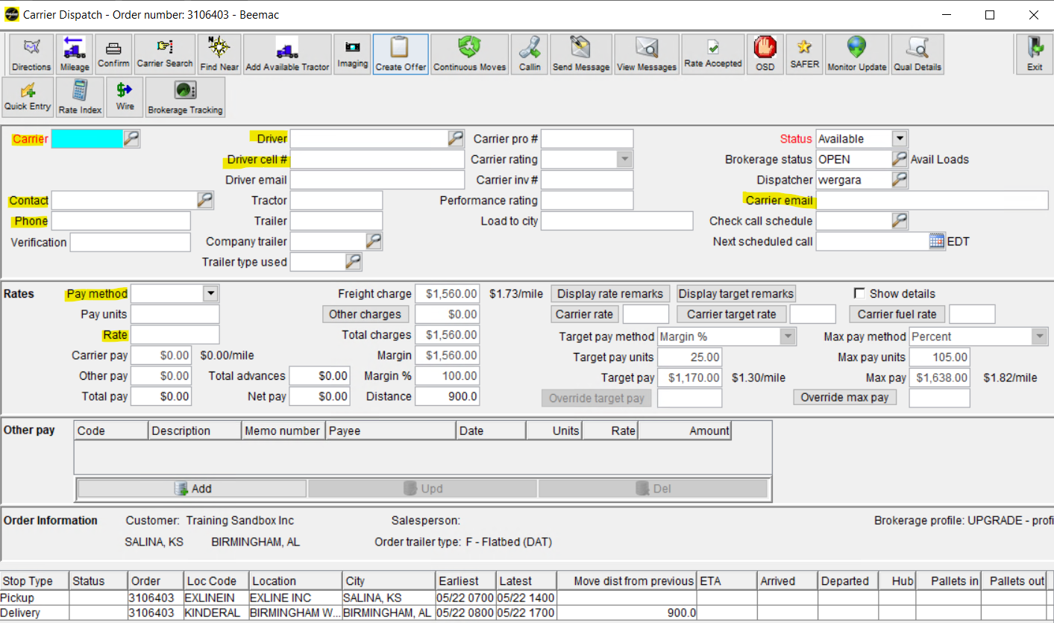

Slide 34
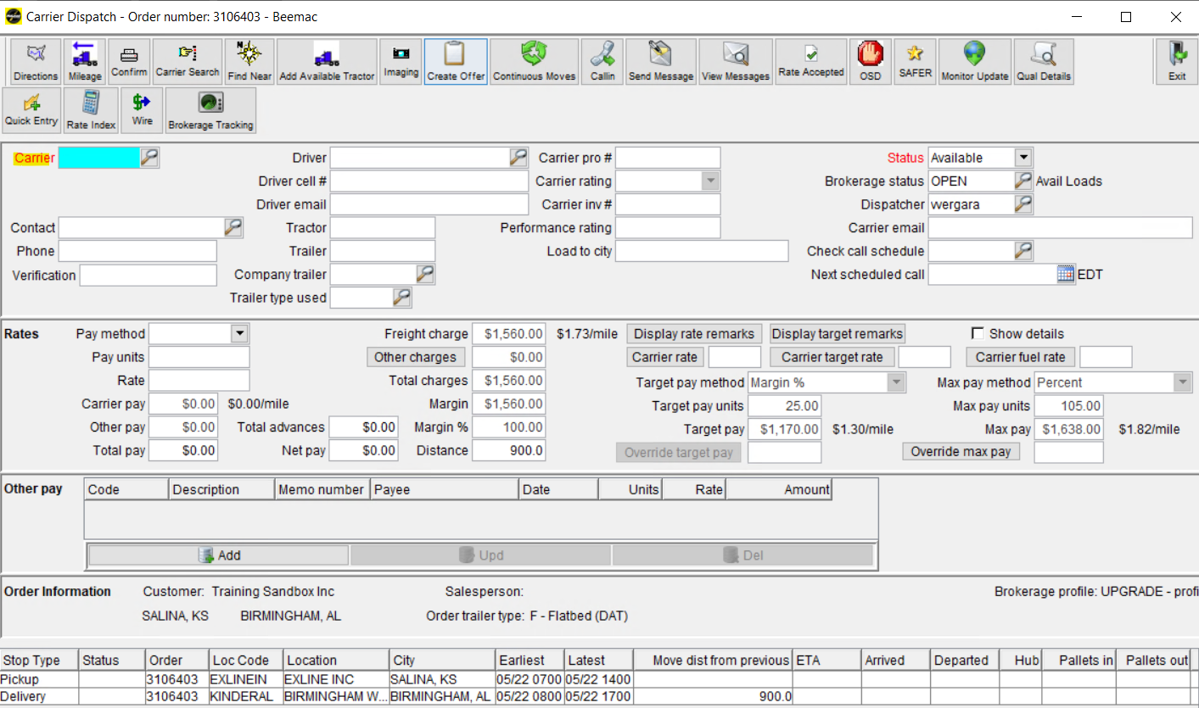
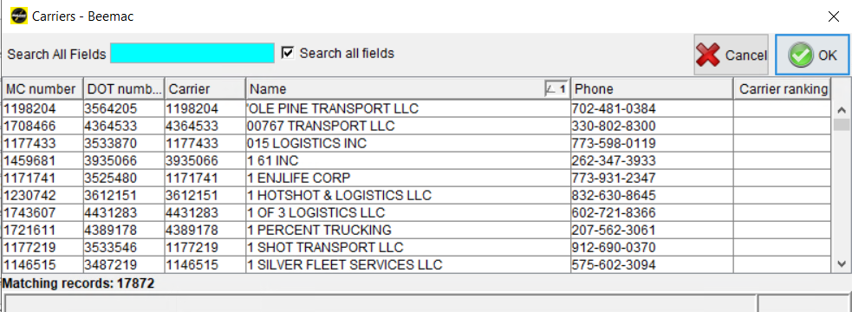
1.Click the magnifying glass to select the carrier.
You can search for the carrier by name, MC, or DOT the number 1 indicates the filter you are using for the search.

Slide 35
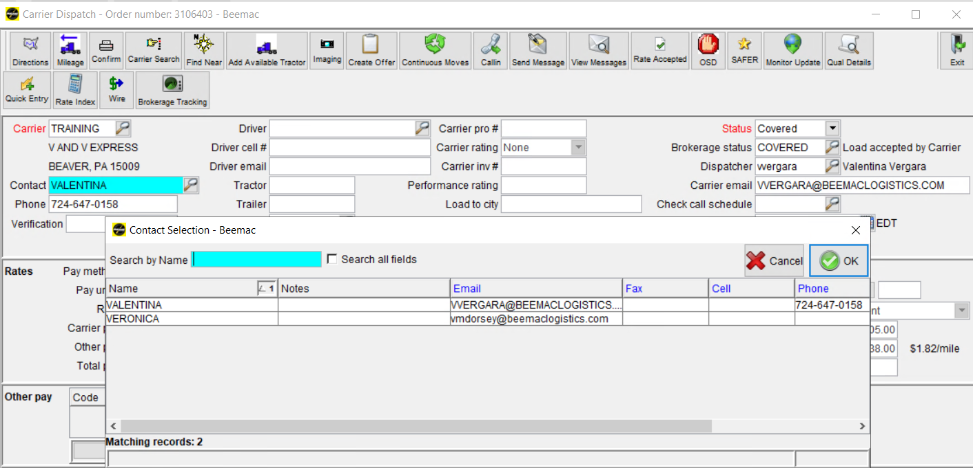
2. Click the magnifying glass to select the dispatcher from the carrier in charge of the load.
If the information is already on file, choose from the list. If not, contact carriersetup@beemaclogistics.com so they can add the new Dispacher.

Slide 36
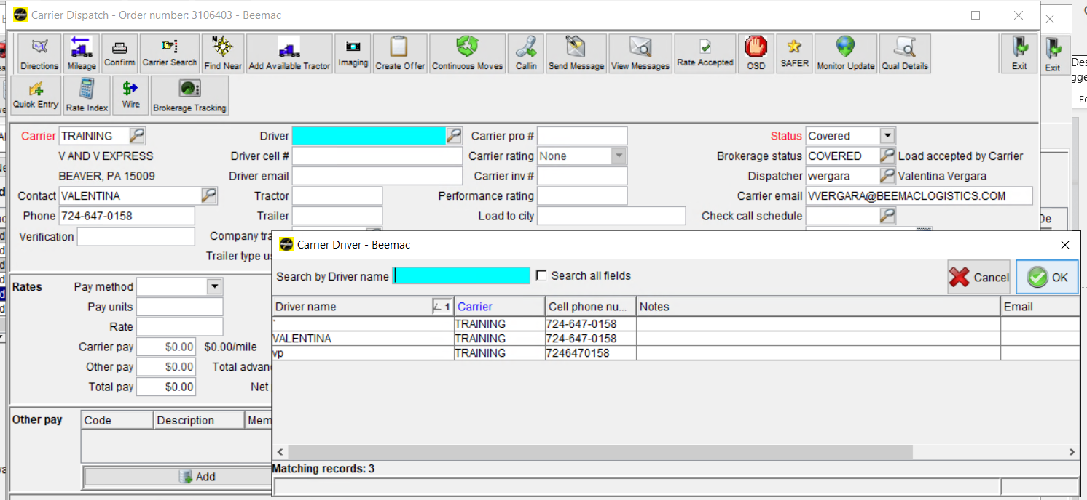
3. Click the magnifying glass to select a new driver name.
If the driver is listed, you can choose one; if not, go ahead and manually add the name and phone number.

Slide 37
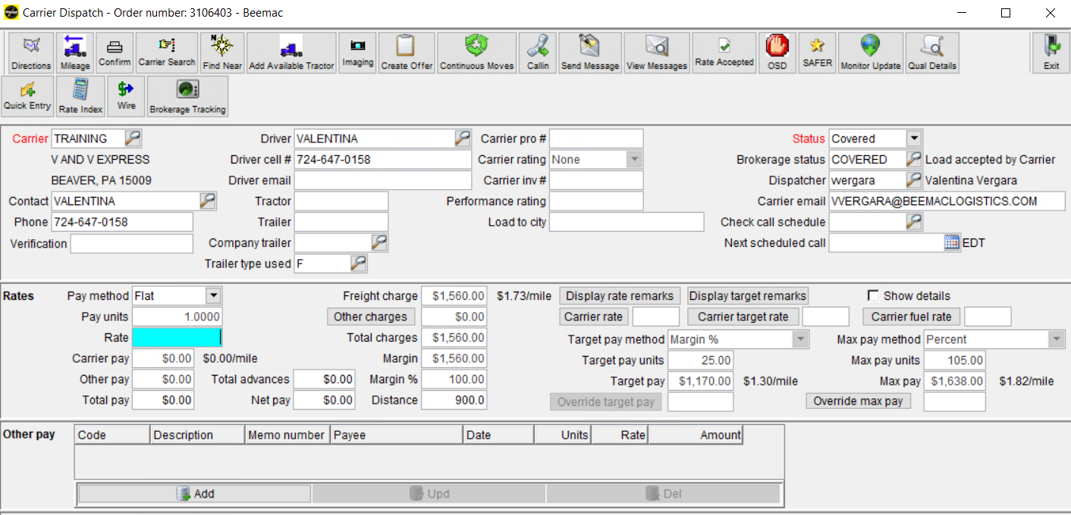
3. The pay method will be FLAT.
4. Enter the rate agreed upon with the driver/dispatcher to pick up and deliver the load.

Slide 38
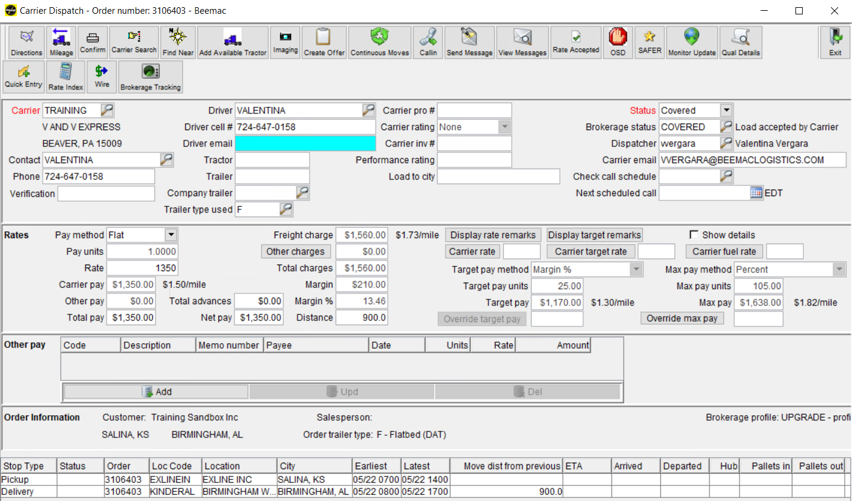

Slide 39
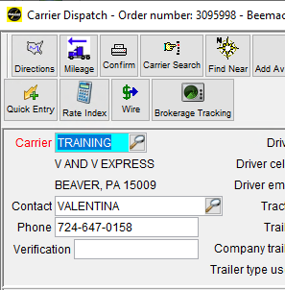
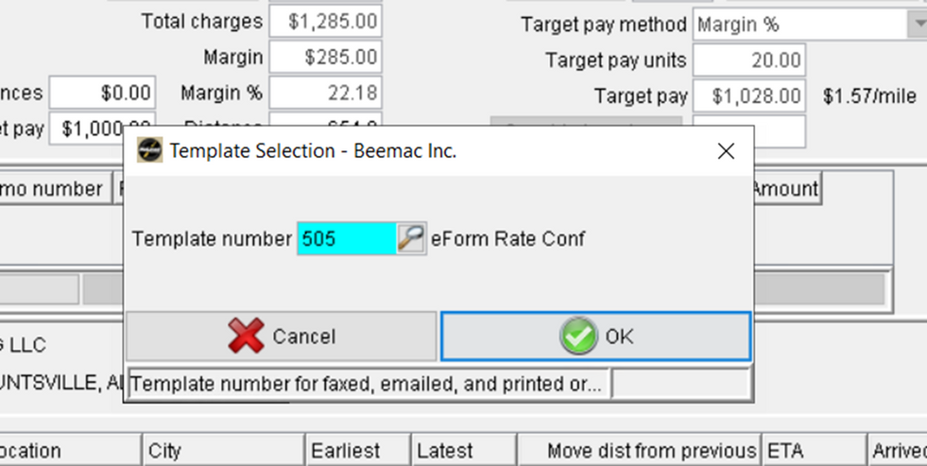
SENDING A RATE CONFIRMATION
Once the Carrier information is added,
click the “Confirm” button at the top.
Electronic link (Template 505)
PDF (Template 499)
Then, click on ‘OK’ to confirm.

Slide 40
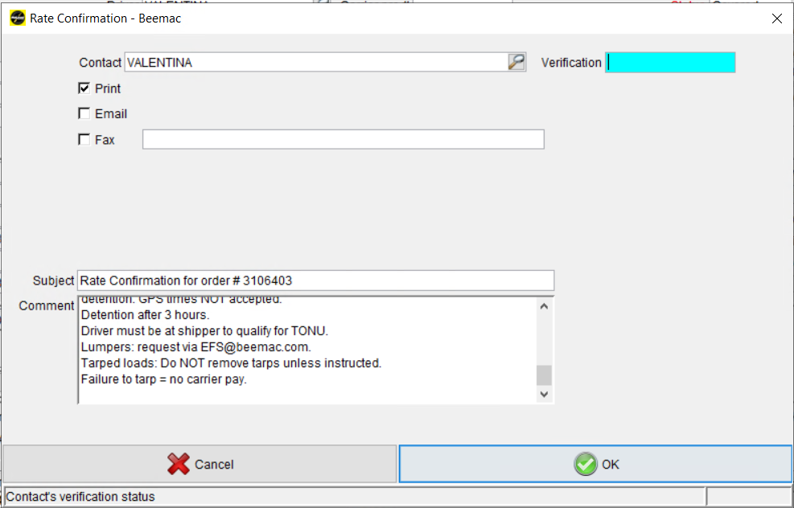
Check the comments box, if you need to add more details or delete something this is the time to do it.
Then, click on ‘OK’ to confirm.

Slide 41
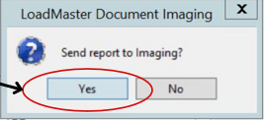
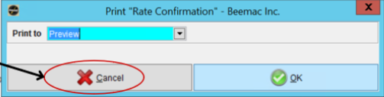
Click ‘Yes’ to send to imaging.
Click ‘Cancel’ on the preview screen to exit - Preview isn't necessary unless you want to check your work

Slide 42
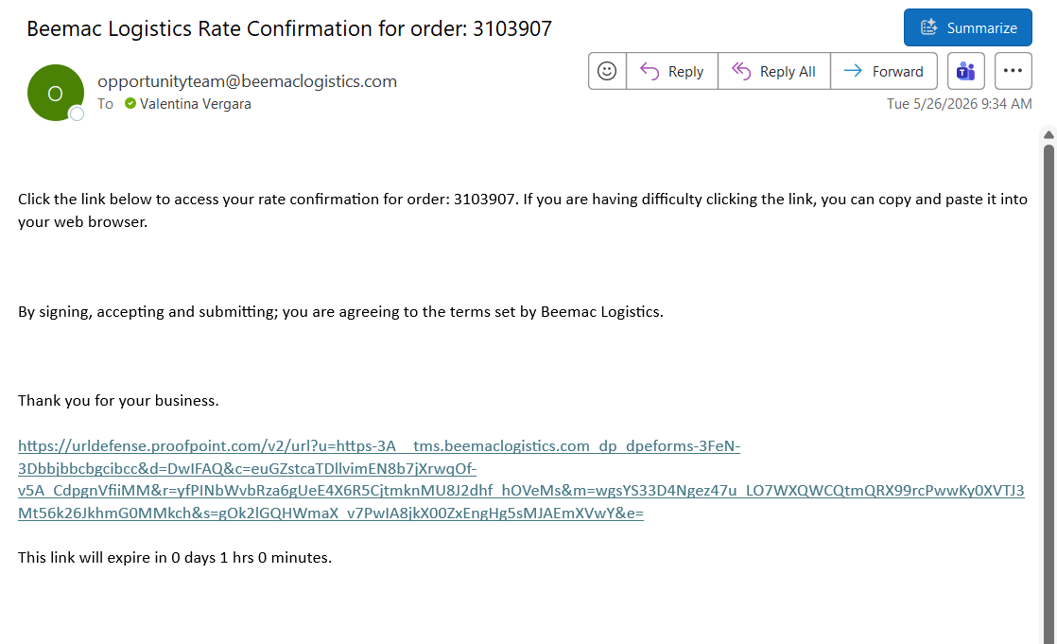
The carrier will receive an email with a link to review and accept the rate confirmation. Please note that if the email is incorrect in the system, it will not deliver to the carrier.
The sender will receive emails when the load is accepted, declined, or timed out.
Please note that there is a 1-hour expiration on the link.

Slide 43
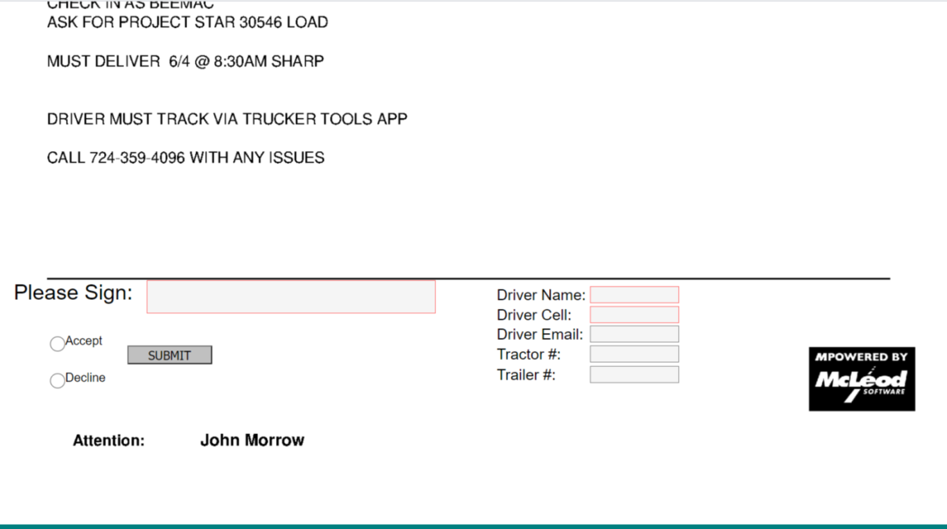
Carriers will see all the information when they click the link.
At the bottom they will need to sign, accept, and enter the driver’s name and cell number.
These are required fields. It will auto-populate in McLeod once entered and accepted.

Slide 44
TRACKING

Slide 45
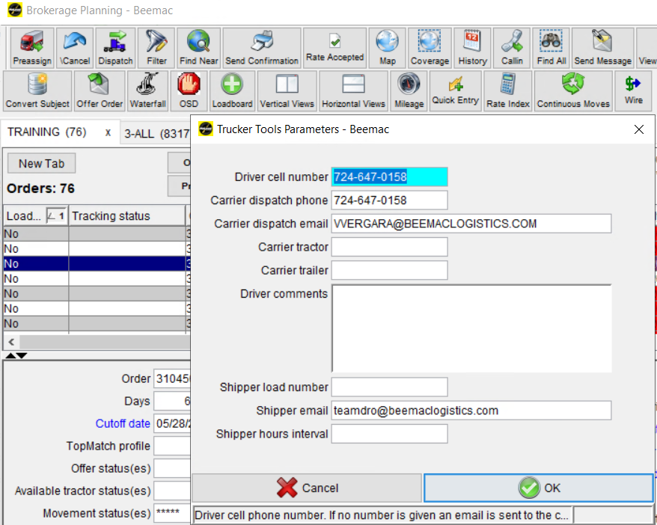
SENDING THE TRACKING LINK
Double-click the empty Tracking Status tab, and the Trucker Tools parameters will pop up.
Click OK to send the link.

Slide 46
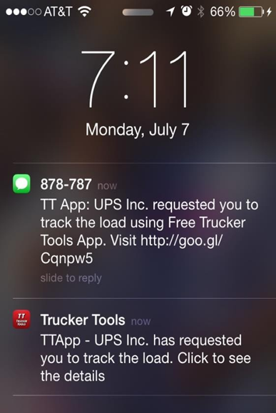
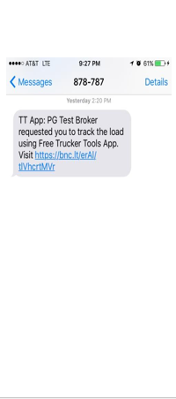
TRUCKER TOOLS

Slide 47
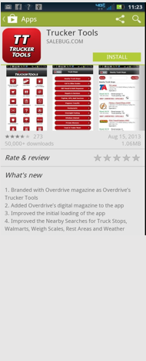
The link takes to App Store.
Ask driver to Install/Download Trucker Tools App.
Driver has to Install/Download Trucker ToolsApp & then, Open and Allow it to track location.

Slide 48




Slide 49

The driver can send the documents directly to the broker.
Driver can scan PODs and other documents.

Slide 50

BROKERAGE STATUS
Once a load has been dispatched to a carrier the tracking process must start. The first step in the tracking process is to receive acknowledgment of the rate confirmation. Either via email or a signed rate confirmation (preferred but not required.)
The tracking team will use several different load statuses throughout the life of the load. These are the most common:
LOADING
1
3
Confirmed driver is on-site to load.
  1
  3
PROGRESS
2
Confirmed driver is loaded and rolling.
UNLOADING
Confirmed driver is on-site for delivery.
We have a team dedicated to tracking the pick-up and delivery. This team is only to track pickups and deliveries. They will utilize the Trucker Tools app as well as calling and emailing the carrier.
DELIVERED
Confirmed driver is unloaded, and the load has clean POD.

Slide 51

REMINDERS
Please remember that while we have a Tracking team, the final responsibility for confirming pickups and deliveries falls on you. If you receive a call or email out of your shift requesting confirmation of a pickup or delivery, you must forward it to afterhours@beemac.com. The subject line must include “AFTERHOURS TRACKING REQUEST MM/DD”.
FOR HOT LOAD COVERAGE AFTERHOURS – Email hotloads@beemaclogistics.com. The email must include the following information: equipment requirements (tarp size, number of straps, chains, dunnage, coil racks, etc.), commodity and weight (piece count), shipping and delivery hours (FCFS or Appointment), maximum rate, and any other important detail.

Slide 52

STATUS A LOAD IN MCLEOD

Slide 53

When you receive updates on the load, you must update the status in McLeod.
Double-click the Arrived and Departed box. A Stops box will open.
Click the calendar to add
Dates & times

