Slide 1


Auxiliary
Training
Negotiating
(Carriers)

Slide 2

Agenda
  Type of Call: Inbound
  Type of Call: Outbound
  Building Smarter Carrier Relationships
  Selling Smart & Communicating Effectively

Slide 3

Type of Calls: Inbound
Carrier-Initiated Load Inquiry (Part 1)
Definition: Carrier is calling in because they saw the load posted and want or need it
Leverage: You hold leverage, as they want something you have.
Tactic: Never accept the carrier’s first offer unless it’s exceptional
Prep Work:
  Check lane history in your system
  Know what this lane typically pays before responding
Use data to respond with confidence (Greenscreens, Lane History SSRS):
  “We’ve ran this 12 times in the past 30 days for $788 so that is my best. Do you want me to send it over?”
  “This is a contracted lane that we run multiple times a week for $788 so if you can’t do it for that, I’m going to have to move on”

Slide 4

Type of Calls: Inbound
Carrier-Initiated Load Inquiry (Part 2)
Handling Negotiation:
  Be patient if the carrier keeps going back and forth
  Work the conversation until you're confident they won’t meet your rate
  Use language that creates a sense of urgency or loss on their side
Quote to close out low-ball offers:
  “Hey sir like I said, $788 is my top dollar on this one and if you can’t do it for that I have to hop off. The phones are ringing.”
Posture Reminder:
  While they may offer something you need (a truck), don’t sound desperate
  Maintain control—never fully show your cards on an inbound call

Slide 5

Type of Calls: Inbound
Quotes to try
  “We’ve been moving them all week for $752, we can’t go up just for one load”
  “$1,203 and it’s yours. I have the release in front of me right now and I’ll send it over. Do you want it or not?”
  “I already have someone who can grab it for $2,100. So, $2,074 is the best I could do”
  “I have someone checking on their driver and calling me right back. I can’t hold this for you very long”
  “If you can take both I can probably get you $693”

Slide 6
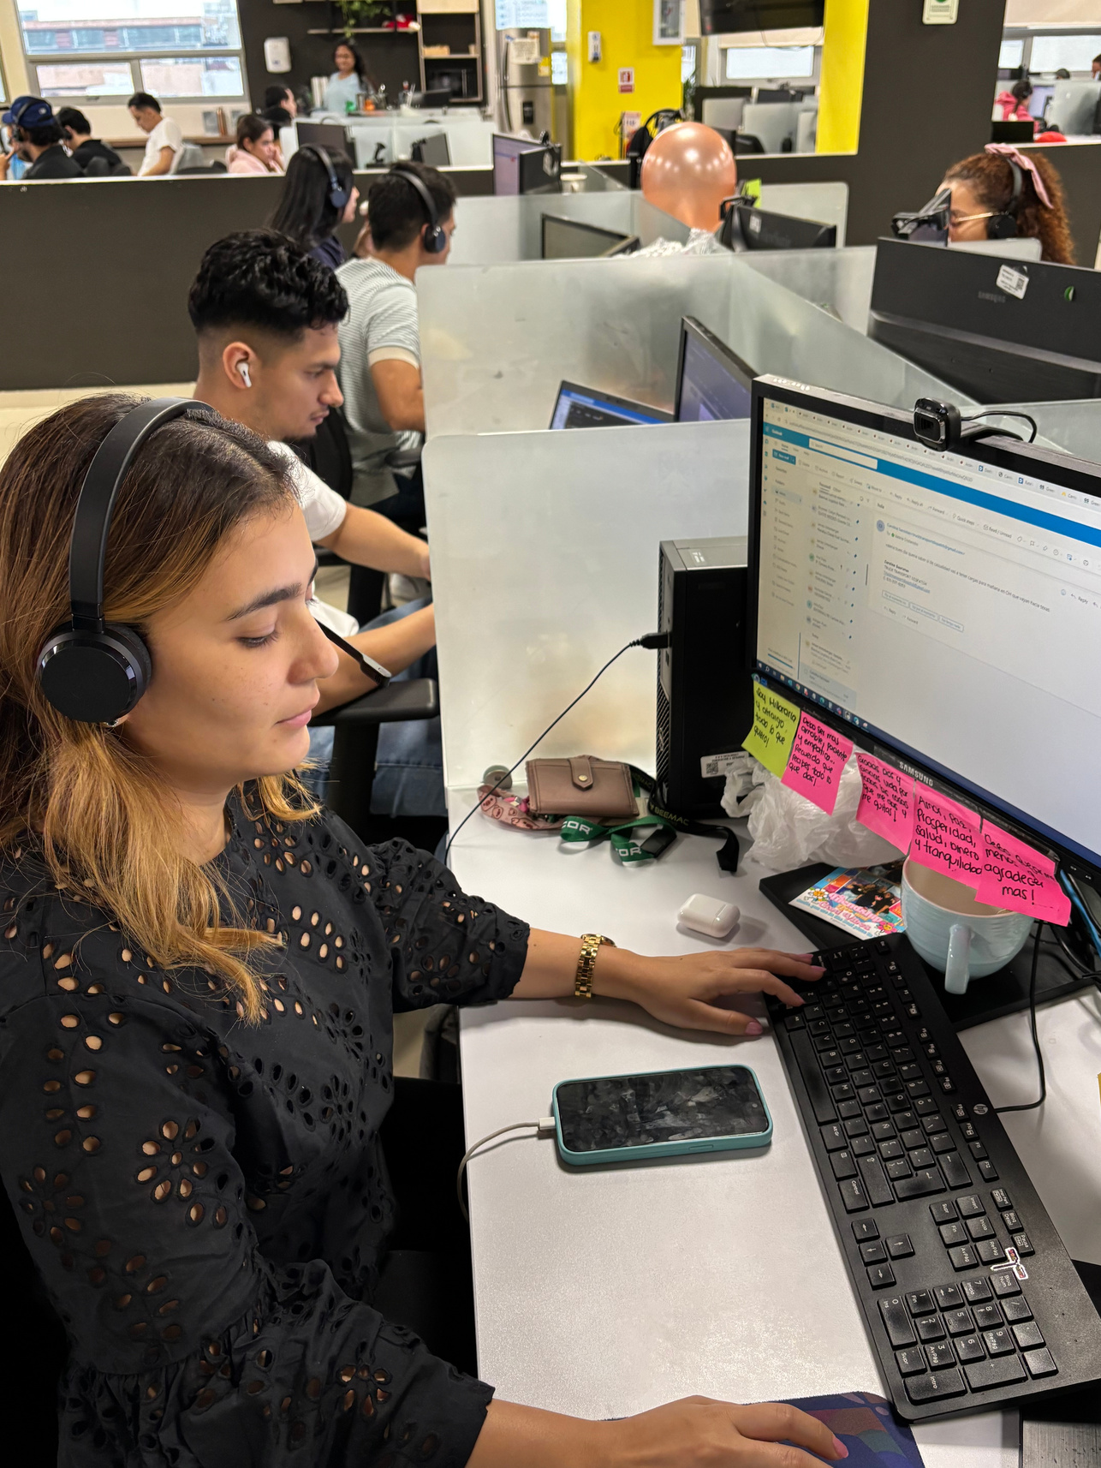
Type of Calls: Outbound
Strategy & Preparation
Purpose of the Call:
  We’re reaching out because a carrier has posted a truck that could be a match for one of our loads. In these cases, the carrier often has the upper hand
Preparation is Key:
  Research lane data thoroughly before the call using all available tools.
  Know current and historical market rates
Carrier Insight:
  They may have already seen our load posted and chosen not to engage.
    This often means they’re holding out for a better opportunity or a higher rate
Tactical Expectations:
  Their starting rate will likely be high
  Their minimum acceptable rate may still exceed our budget
  Be ready to sell value beyond price (e.g., lighter load, convenient timing)

Slide 7

Type of Calls: Outbound
Negotiation & Execution
Selling the Load:
  Highlight attractive aspects:
  “This one is under 30,000 lbs and is easy on, easy off. I also have another load 26 miles from delivery heading to X”
When Urgency is a Factor:
    If the load must move, prioritize securing the truck
    Don’t lose a viable option over a small rate gap
Always Get a Rate:
    Even if it’s high and you walk away, now you know your options.
    You may need to circle back.
Negotiation Mindset:
    Not every call follows the same pattern
    Stay confident and always negotiate down
    Act as if you hold the cards
    Apply Week 1’s negotiation tactics

Slide 8

Negotiation Tactics
  Don’t negotiate in $100 increments
  End your rates in a random number, not always 5 or 0
  Split out accessories such as stop-offs or scale tickets
  Deadhead strategy
  Don’t just meet in the middle, stand your ground
  Inbound calls vs outbound calls
  He who speaks first in a negotiation loses
  Embrace the silence
  Avoid carrier tricks (flinch, pause)
  Sympathize without giving in
  Sell attractive details of the load (lightweight, 24 hr, loading, booked load, etc.)

Slide 9

Building Smart Carrier Relationships
1. Relationship Building During Calls
  Don’t just focus on the current load. Ask:
    Where are they usually getting empty?
    Where do they prefer to go?
    What do they like to haul?
  This insight helps you align future loads more efficiently
  Knowledge = negotiating power
  Utilize Parade to build the carrier profile
2. Load Linking & Backhauls
  Always check for nearby loads at the consignee’s location
  Ask:
    Can Beemac offer a reload that same week? (Continuous Haul)
    Is there a backhaul opportunity to get the driver home?
  This increases loyalty and long-term carrier retention

Slide 10

Selling Smart & Communicating Effectively
1. How You Sound Matters
  Tone & Attitude:
    Stay polite and professional
    Be assertive, not rude—carriers will test you
  Sense of Urgency:
    Be strategic; urgency can be used against you
    Plan:
      When’s the pickup?
      How far is the truck?
      When is it empty?
2. Negotiation Tips
  Don’t always lower the margin—sell the service, yourself, and Beemac
  Avoid round numbers (0’s and 5’s):
    Use specific figures like: “I can do $1,361.33 that's every penny I have in
    the load”

Slide 11

Checklist Before Booking
  If carrier agrees to a rate of 15% or higher margin, green light to book load
  If contractual freight, use your knowledge of the account and discretion to approve rate
  Run Greenscreens & SSRS Lane History at a range of 365 days to check seasonality differences
  Don't overpay unless you need to
  Ask for help/approval when needed!

Slide 12

Thank You!

