Slide 1
SETTING UP A CARRIER
BEEMAC HAS PARTNERED WITH A COMPANY CALLED HIGHWAY. THEY WILL HANDLE THE ONBOARDING, MONITORING
AND DOCUMENT RETENTION FOR BEEMAC LOGISTICS.
WHY? VERY SIMPLE. THE LANDSCAPE OF TRUCKING IS CHANGING VERY QUICKLY. GO HIGHWAY OFFERS SERVICES THAT WILL
HELP US CONTINUE TO GROW INTO THE FUTURE.
USE ALL THE TOOLS AVAILABLE TO YOU TO DETERMINE IF THE CARRIER IS RIGHT FOR YOU. WE ARE FINDING A LOT OF
CARRIERS ARE DOUBLE BROKERING LOADS, NOT ARRIVING ON TIME OR NOT AT ALL THIS IS A MAJOR PROBLEM IN OUR
INDUSTRY.
YOU ARE THE FIRST LINE OF DEFENSE!!
THIS PRESENTATION IS ONLY A QUICK GUIDE INTO WHAT HIGHWAY CAN DO FOR US.

Slide 2
GUIDLINES
MUST HAVE AN ACTIVE USDOT NUMBER.
AUTHORITY MUST BE NO LESS THAN 26 DAYS.
IF THE CARRIER HAS AN MC NUMBER, THAT NUMBER TAKES PRIORITY IN DETERMINING ELIGIBILITY.
MUST HAVE A NONE OR SATISFACTORY SAFETY RATING.
MUST CARRY $1,000,000 AUTO LIABILITY AND $100,000 CARGO. IF A REEFER LOAD THAT REQUIRES TEMP CONTROL, THEN THE CARREIR MUST HAVE REEFER BREAKDOWN INS LISTED ON THE CERT. HIGH VALUE LOADS, THE CARRIER IS RESPONSIBLE FOR ANY ADDITIONAL INSURANCE COSTS.
MUST SIGN AND ACCEPT THE BEEMAC CONTRACT WITHOUT ALTERATIONS. ( in highway)
PROVIDE A W-8/OR W-9 THROUGH THE HIGHWAY ONBOARDING
COMPLETE THE HIGHWAY ONBOARDING.

Slide 3
GO HIGHWAY CUSTOMER SERVICE INFORMATION
We offer support via email 24/7. We offer support via phone lines during business hours.
Monday – Friday 7am – 7pm CT;
Saturday 8-5 PM CST.
"Broker Support: Assigned implementations representative.Carriers:
Phone: 906-HIGHWAY
(b) Email: service@highway.com
(c) Web: https://highway.com >> Contact Us "
HIGHWAY ALSO HAS A YOU TUBE SITE FOR VIEWING
We have a number of video resources available on our Highway YouTube website.
ANY ONBOARDING ISSUES, PLEASE CONTACT GO HIGHWAY.

Slide 4
EACH OF YOU WILL RECEIVE AN EMAIL VERIFYING YOUR HIGHWAY ACCOUNT.
ONCE YOU LOG IN, IT MAY SEND YOU A VERIFICATION CODE TO YOUR BEEMAC EMAIL.
ENTER THE CODE AND YOU ARE READY TO BEGIN.
HERE IS A LINK TO VIEW THE ONBOARDING PROCESS.
https://www.loom.com/share/e6b26fee0aef474197a407999a52c33d
AS ALWAYS, ANY INQUIRES PLEASE INCLUDE THE MC/DOT NUMBER IN YOUR EMAIL.

Slide 5
PROCEDURES
CHECK CARRIER 411 AND HIGHWAY FOR ANY NEGATIVE REPORTS.
CHECK MCLEOD TO SEE IF ACTIVE OR INACTIVE. CHECK COMMENTS FOR ANY NEG REPORTS, IF ACTIVE AND CARRIER CODE IS IN RED, CHECK INSURANCE. ACTIVE CARRIERS ARE EXEMPT FROM SENDING AN INVITE THROUGH GO HIGHWAY.*
CHECK HIGHWAY TO SEE IF THE CARRIER HAS UPDATED INSURANCE. IF SO, THEN CM JUST NEEDS TO UPDATE.
IF INACTIVE OR NOT IN MCLEOD, LOOK TO SEE IF THEY PASS OUR GENEAL FREIGHT RULE SETS. IF THEY PASS, SEND AN INVITE. MAKE SURE THE EMAIL IS ON THE APPROVED LIST. IF NOT, YOU CAN SEND THIS LINK TO THE CARRIER . https://highway.com/go/beemac-trucking OR ADD THE EMAIL IN THE INVITE
IF THEY FAIL ANY OF THE GEN FREIGHT RULES, SEND THE INVITE AND ALERT THE CARRIER WHAT WILL BE NEEDED DURING ONBOARDING. ONCE THE INVITE HAS BEEN SENT, THEN IT IS UP TO THE CARRIER TO COMPLETE. IF THE CARRIER HAS PROBLEMS OR ISSUES, THEY ARE TO CONTACT HIGHWAY SUPPORT.
IF INVITE IS SENT BY LINK, CC CARRIER MANAGEMENT ON THE EMAIL
YOU CAN VIEW THE CARRIERS PROGRESS BY ENTERING THE MC/DOT IN GO HIGHWAY OR BY CLICKING CONNECTIONS>IN PROGRESS,OR> ON HOLD TO FIND YOUR CARRIER.
IF YOU RECEIVE AN ONHOLD EMAIL, LOOK AT THE CARRIER IN GO HIGHWAY TO SEE WHAT HAS FAILED AND/OR INCOMPLETE. AT THAT TIME GO DIRECT TO THE CARRIER AND REQUEST THE REQUIRED DOCUMENTS.
ONCE CARRIER SUCCESSFULLY COMPLETES THE ONBOARDING, YOU WILL RECEIVE A COMPLETED EMAIL. ( IF THE CARRIER HAS USED THE LINK, YOU WILL NOT RECEIVE THE COMPLETED EMAIL. ( THAT’S WHY CM IS CC’D) AT THAT TIME IT WILL BE ACTIVE IN MCLEOD WITHIN 10 MIN. ONCE UPLOAD HAS BEEN COMPLETED.
INACTIVE CARRIERS IN MCLEOD ONCE THE ONBOARDING HAS BEEN COMPLETED, WILL NEED CM TO MANUALLY ACTIVATE THE CARRIER.
ALL EMAILS TO CARRIER MANAGEMENT SHOULD INCLUDE THE MC/DOT NUMBER.

Slide 6
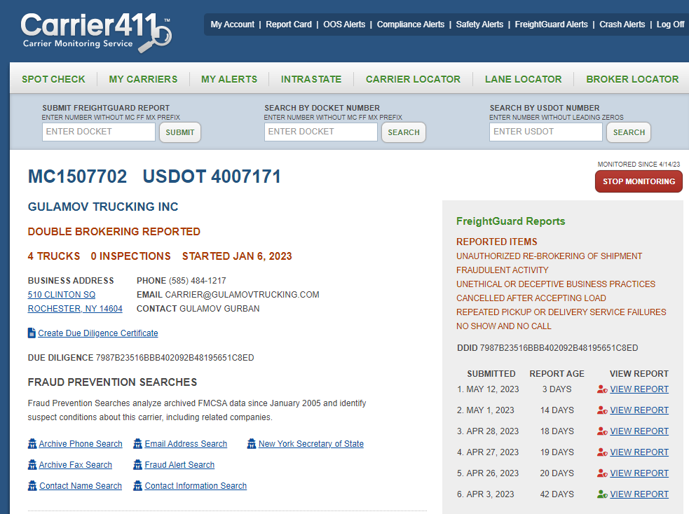
CHECK CARRIER 411
LOOK AT EVERYTHING.
4 TRUCKS NO INSPECTIONS
THIS SHOULD BE A RED FLAG!
5 MONTHS AUTHORITY AND
MANY REPORTS.
THIS CARRIER WILL NOT BE
APPROVED!!
TAKE THE EXTRA 10 SECONDS.
WILL SAVE YOU AND THE COMPANY
IN THE LONG RUN.

Slide 7
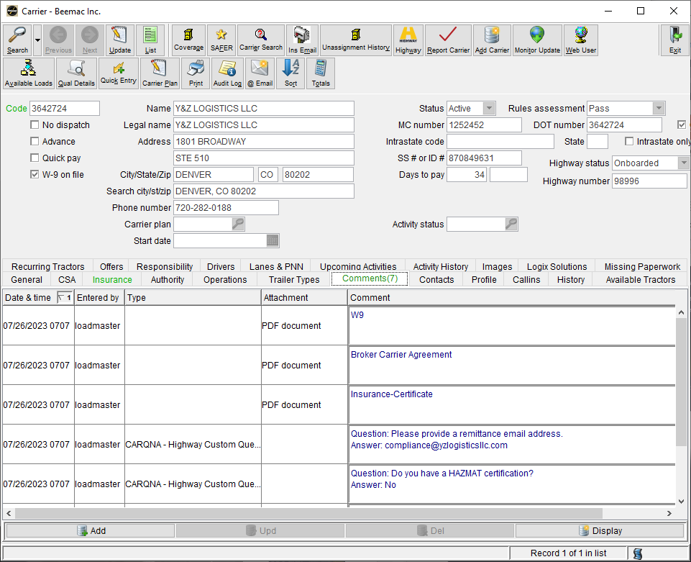
ENTER MC/DOT
NO LEADING ZERO’S
CHECK STATUS
CHECK COMMENTS

Slide 8
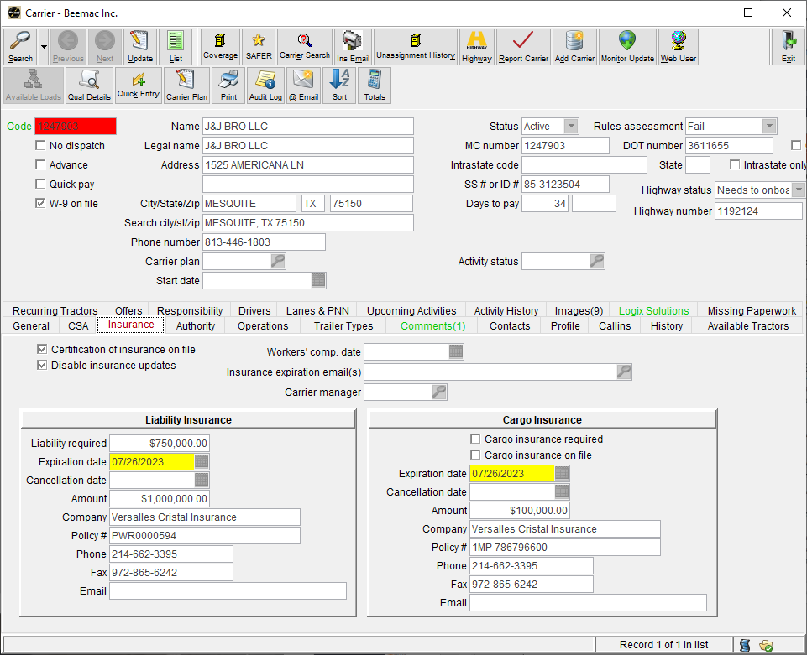
IN RED
CHECK STATUS. INACTIVE
CARRIERS NEED TO
BE SENT AN INVITE
CHECK COMMENTS FOR
NEG REPORTS
CHECK INS TO SEE WHEN
INS EXPIRES
YELLOW = 30 DAYS OUT
RED=EXPIRED

Slide 9

GO TO HIGHWAY.COM

Slide 10
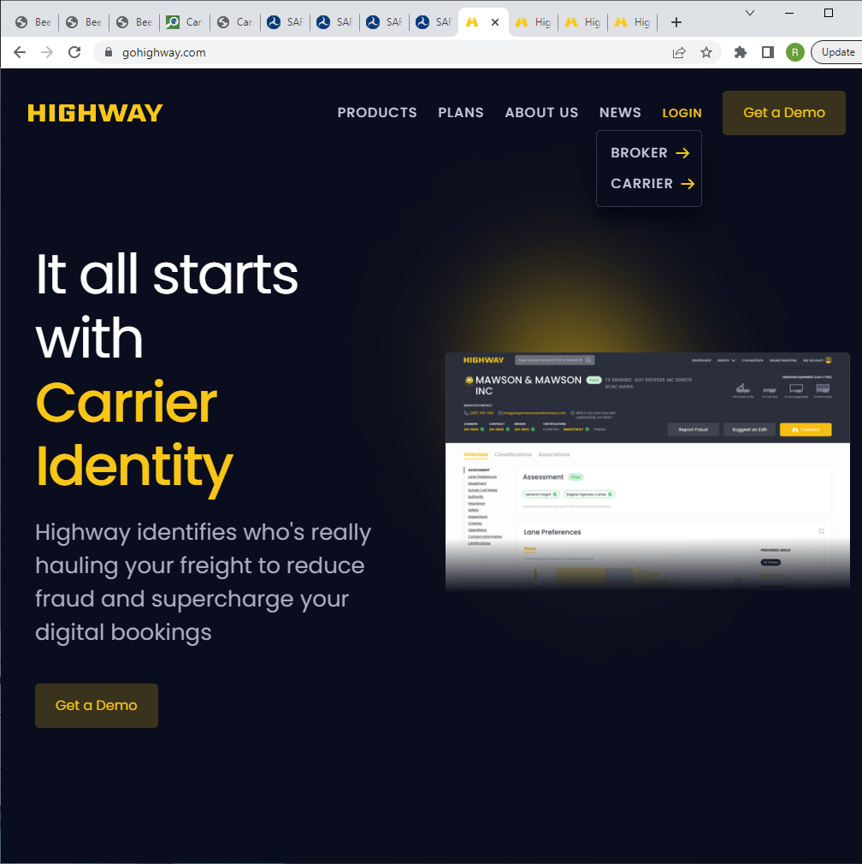
LOGIN
BROKER
ENTER YOUR EMAIL IF IT
PROMPTS YOU TO.
MAY SEND A VERIFICATION
CODE FOR YOU TO CONTINUE

Slide 11
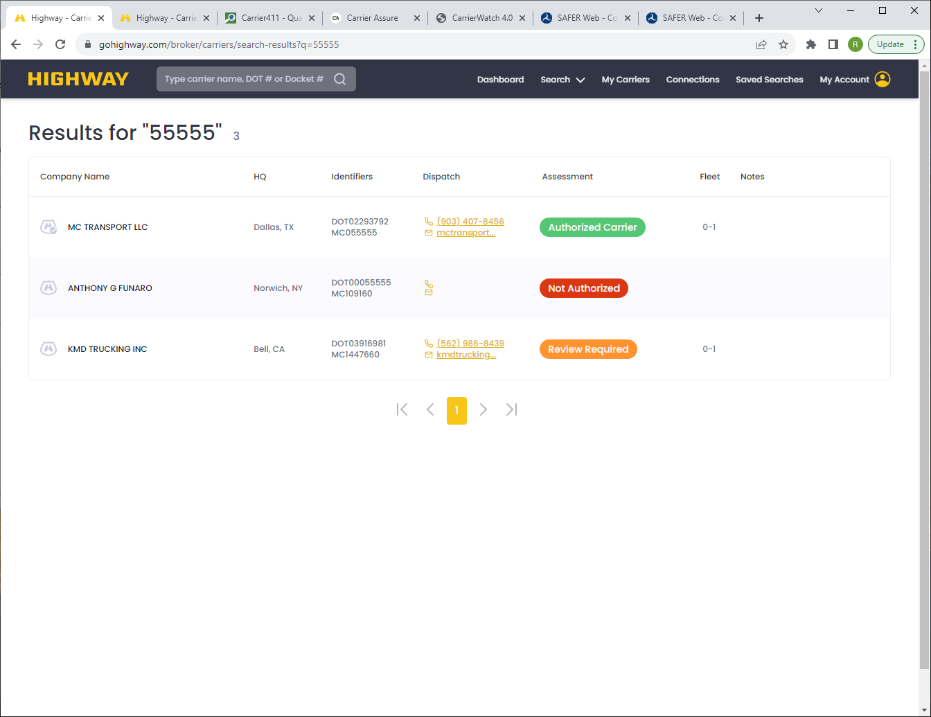
ENTER THE MC, DOT OR
NAME HERE. HIT ENTER
SELECT THE CARRIER YOU
ARE LOOKING FOR

Slide 12
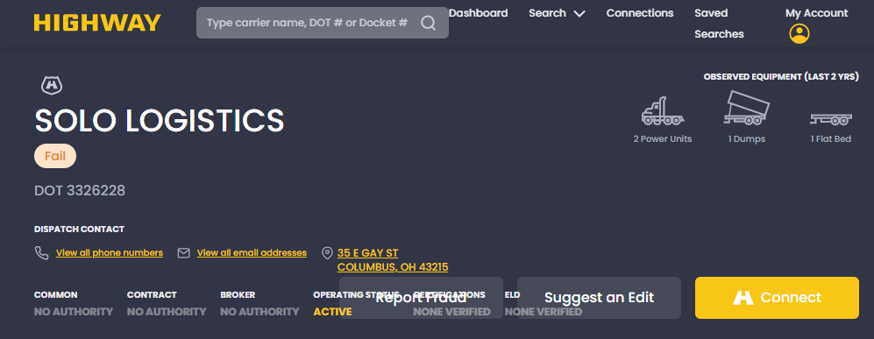
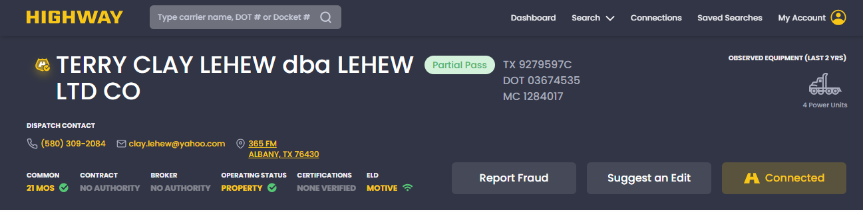
LOOK UP YOUR CARRIER
IF CARRIER SHOWS A GREY SHIELD, THEN THEY ARE NOT IN THE GO HIGHWAY NETWORK.
GOLD SHIELD= IN THE GO HIGHWAY NETWORK
GOLD CHECKMARK= IN THE BEEMAC NETWORK ( IF NO CHECKMARK, THEN NEED TO SEND AN INVITE)
THERE ARE 4 CATEGORIES.
PASS= PASSED ALL RULES
FAIL= FAILED SOME OR ALL RULES
PARTIAL PASS=PASSED MOST RULES
INCOMPLETE=SOME RULES HAVE NOT BEEN COMPLETED.

Slide 13
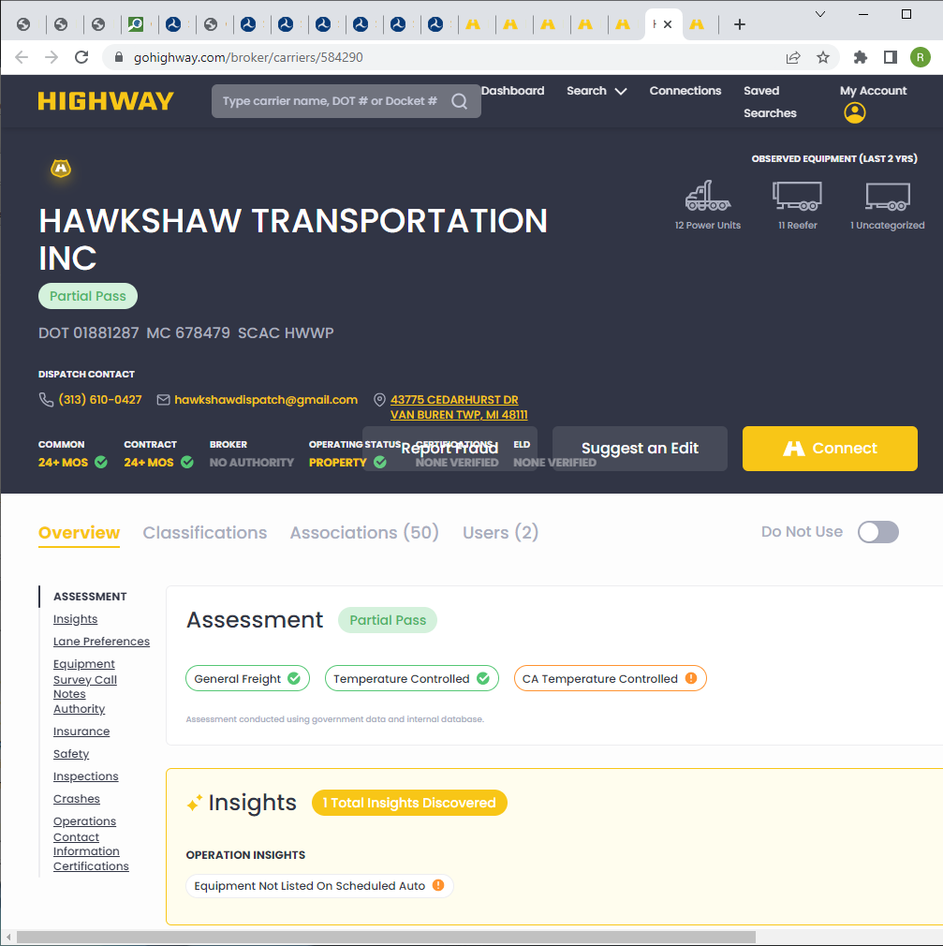
WHAT DO THESE MEAN AND CAN I SEND AN INVITE?
IF A CARRIER SHOWS PASS OR PARTIAL PASS, SEND THE INVITE.
CLICK ON CLASSIFICATIONS TO SEE THE DETAILED RULES THAT HAVE PASSED OR FAILED.
THERE ARE SOME RULES WE WILL NOT OVERIDE.THIS IS TO PREVENT FRADULENT ACTIVITY AND LACK OF INSURANCE COVERAGE TO NAME A COUPLE.
ALWAYS LOOK AT THE FAILED RULES BEFORE SENDING THE INVITE. ALERT THE CARRIER TO SUBMIT THE REQUIRED DOCUMENTS DURING THE ONBOARDING PROCESS. IE., CAB CARD,TITLE,DL.
IF THE INSURNACE SECTION IS INCOMPLETE, ALERT THE CARRIER TO HAVE THEIR INSURANCE CO SEND A COPY OF THE CERT TO HIGHWAY.
INSURANCE@CERTS.HIGHWAY.COM

Slide 14
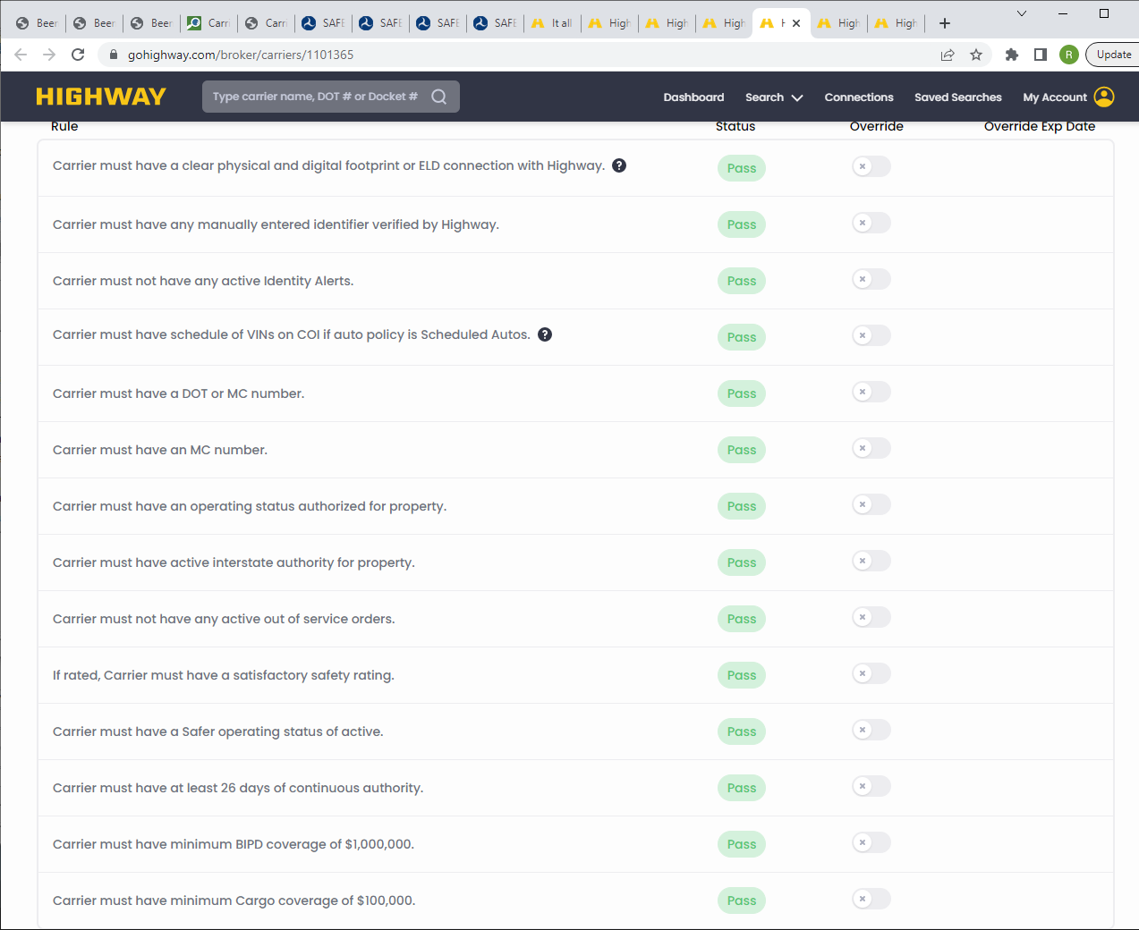
UNDER THE GENERAL FREIGHT
CLASSIFICATION:
THESE RULES MUST PASS FOR A
CARRIER TO BE ONBOARDED.
CARRIER HAS 2 OPTIONS.
SUBMIT THEIR TRUCK TITLE,
CAB CARD AND DRIVERS LICENCE
OR CONNECT THEIR ELD TO
HIGHWAY. IF THEY SUBMIT THE DOCS
THEN WE CAN OVERIDE.
DOT ONLY CARRIERS WILL NEED
TO BE CHECKED FOR AUTHORITY
DATES. ONCE APPROVED CM
WILL HAVE TO DO AN OVERIDE ON
SOME OF THE RULE SETS
FOR THE INVITE TO PROCEED.
THE MC AUTHORITY TAKES
PRECEDENCE IN DETERMINING
ELIGIBILITY.

Slide 15
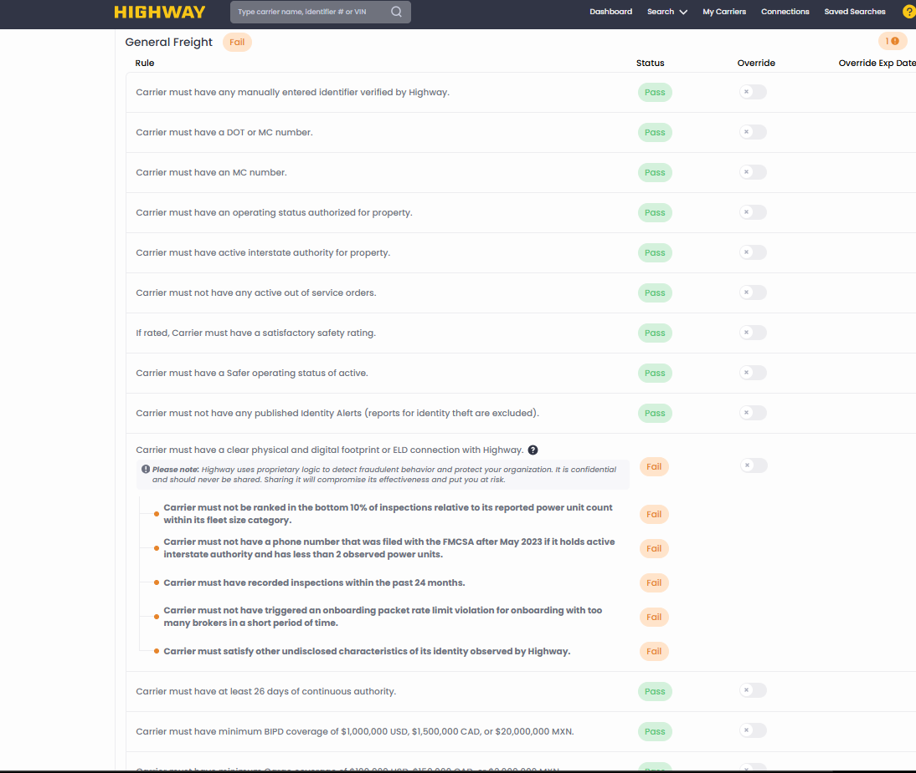
ELD RULE FAILED
TWO OPTIONS:
CONNECT THEIR ELD WITH HIGHWAY
PROVIDE DOCUMENTS
CAB CARD/ TRUCK REGISTRATION
TITLE TO THE TRUCK
DRIVERS LICENCE
ONCE RECEIVED WE MATCH THE VIN
TO WHAT IS LISTED ON THE CERT IN HIGHWAY.

Slide 16
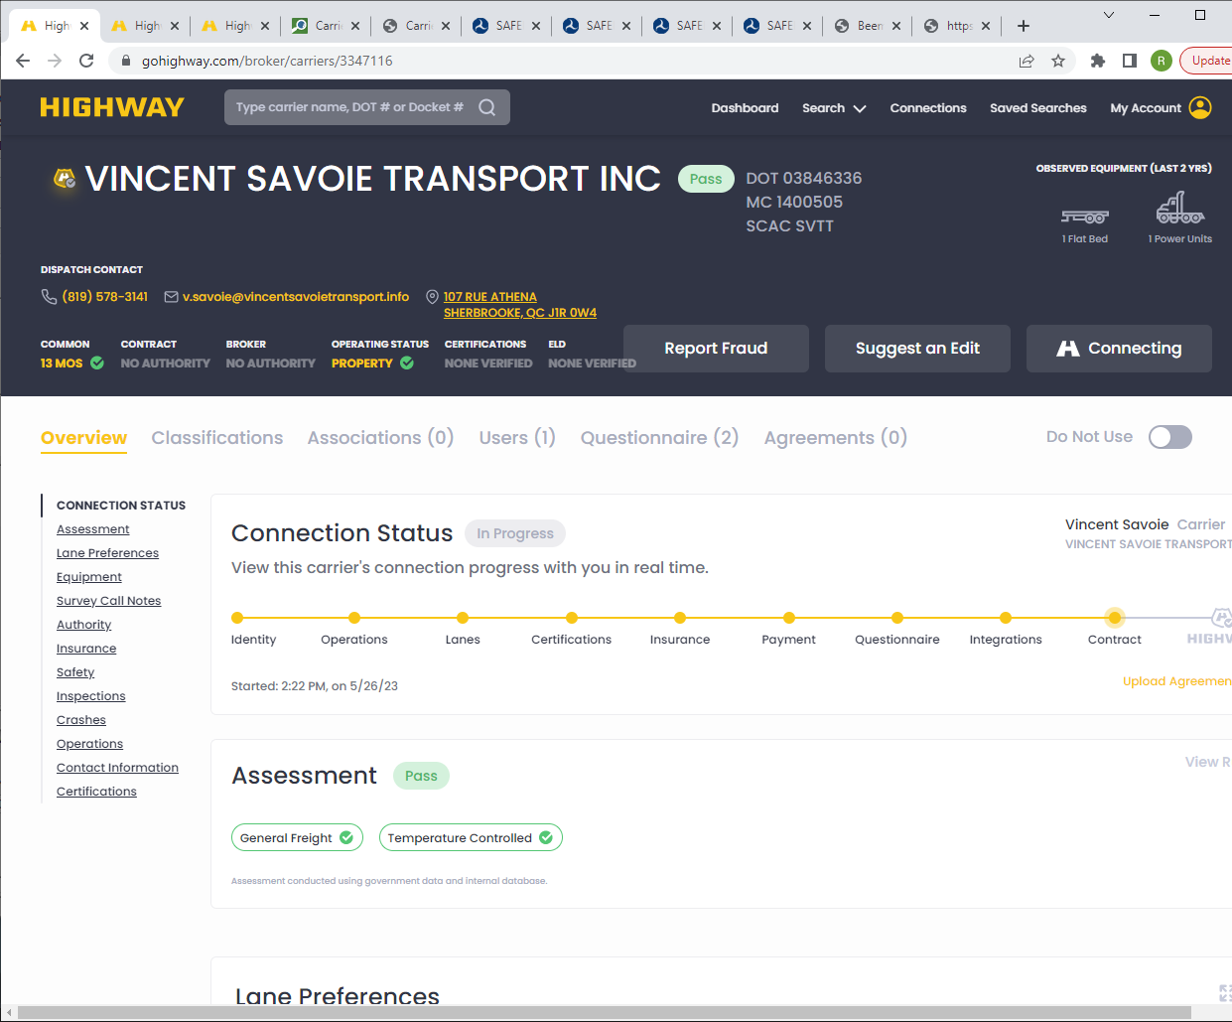
CHECK THEIR PROGRESS
THIS ONE STILL NEED TO SIGN THE
CONTRACT.
NO W9 OR CONTRACT SIGNED YET
IF THERE IS A (2) THEN THEY HAVE
SUBMITTED A W-9 AND THE SIGNED
AGREEMENT

Slide 17
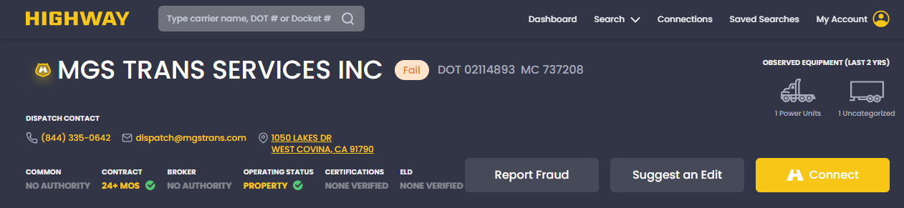
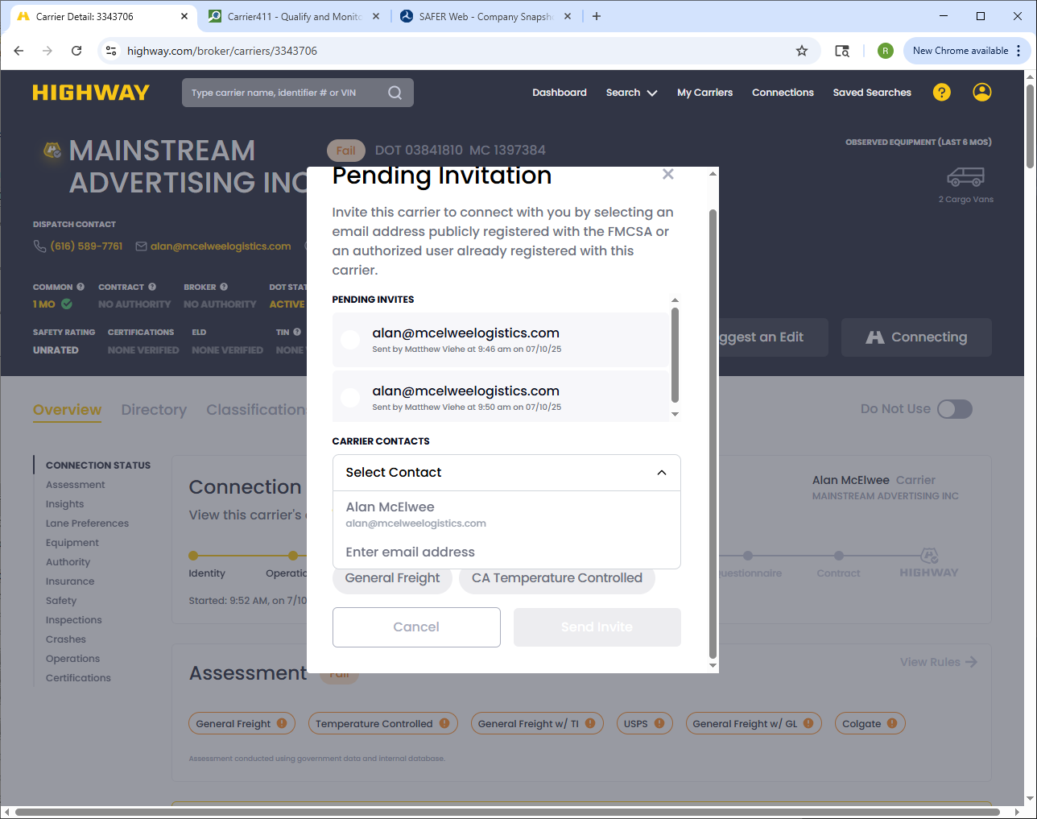
TO SEND AN INVITE:
CLICK ON CONNECT
A LIST OF APPROVED EMAILS WILL APPEAR.
IF THE EMAIL IS DIFFERENT, THEN YOU MAY
INVITE ANOTHER WAY.
EMAIL THIS LINK TO THE CARRIER https://highway.com/go/beemac-trucking
PLEASE NOTE: THE CORPORATE CONTACT WILL GET A VERIFICATION CODE. IN ORDER FOR THE PERSON TO PROCEED, THEY MUST ENTER THAT CODE. THIS IS A FRAUD PROTECTION SERVICE. ONBOARDING WILL NOT CONTINUE UNTIL THAT CODE HAS BEEN ENTERED. WE WILL NOT SUBSTITUTE A PDF TO CIRCUMVENT THIS PROCESS. THEY MUST COMPLETE THE GO HIGHWAY ONBOARDING.
THERE IS ALSO AN ENTER EMAIL BOX. YOU CAN PLACE THE EMAIL THERE.

Slide 18
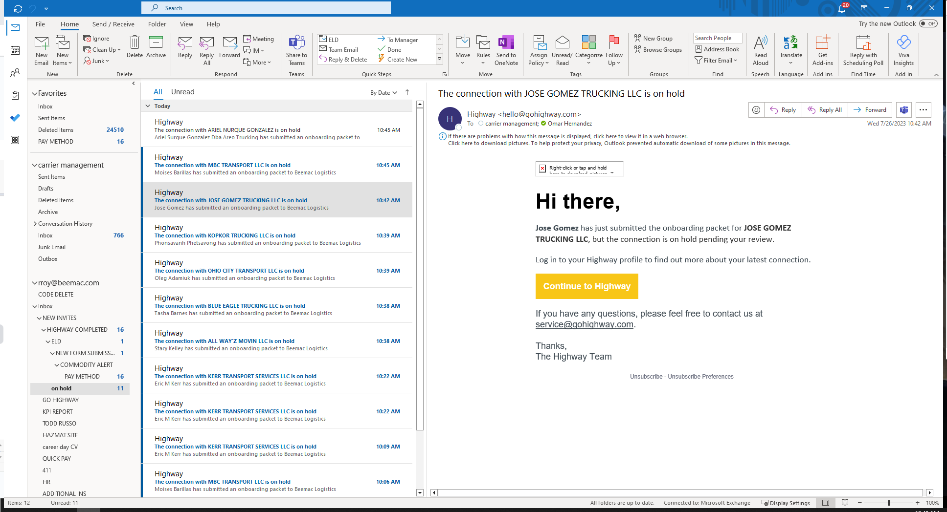
ON HOLD EMAIL:
CARRIER HAS SIGNED THE
CONTRACT AND PROVIDED
THEIR W-9.
THEY ARE STILL NOT
PASSING SOME RULES
AND/OR
SOME ARE STILL INCOMPLETE.
CHECK IN HIGHWAY TO SEE
WHAT IS STILL NEEDED.

Slide 19
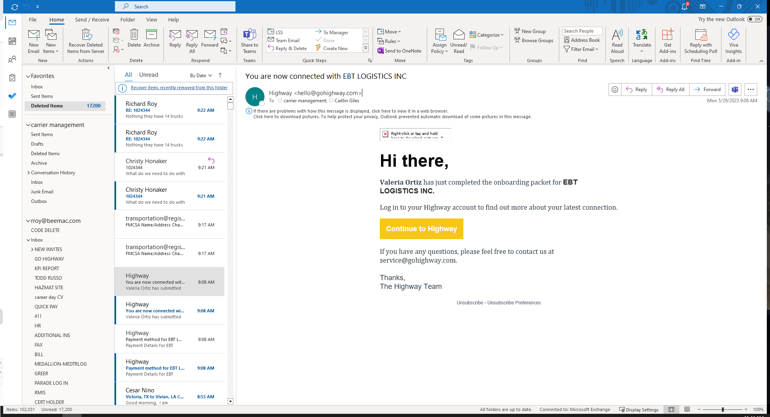
ONCE YOU RECEIVE
THIS, IT WILL THEN GO TO MCLEOD. MAY TAKE UP TO 10 MIN.
IF SENT THROUGH
THE CONNECT BOX,
YOU WILL GET THE
EMAIL

Slide 20
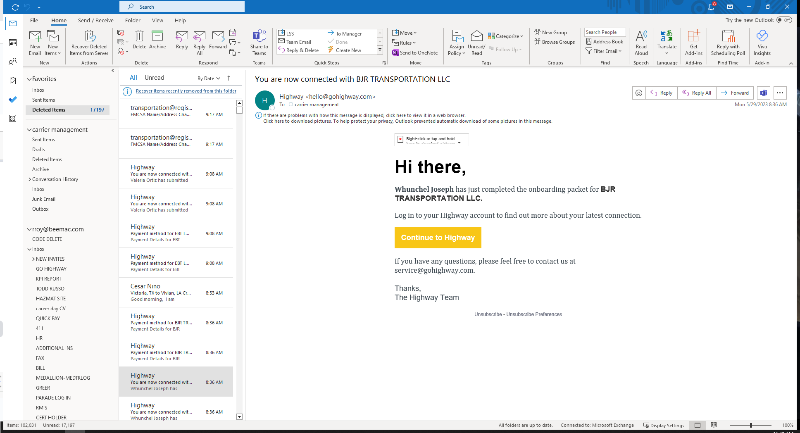
ONBOARDED THROUGH
THE LINK.
ONLY SENT TO CM.
THAT’S WHY WE ASK TO
BE CC’D WHEN LINK IS
SENT.

Slide 21
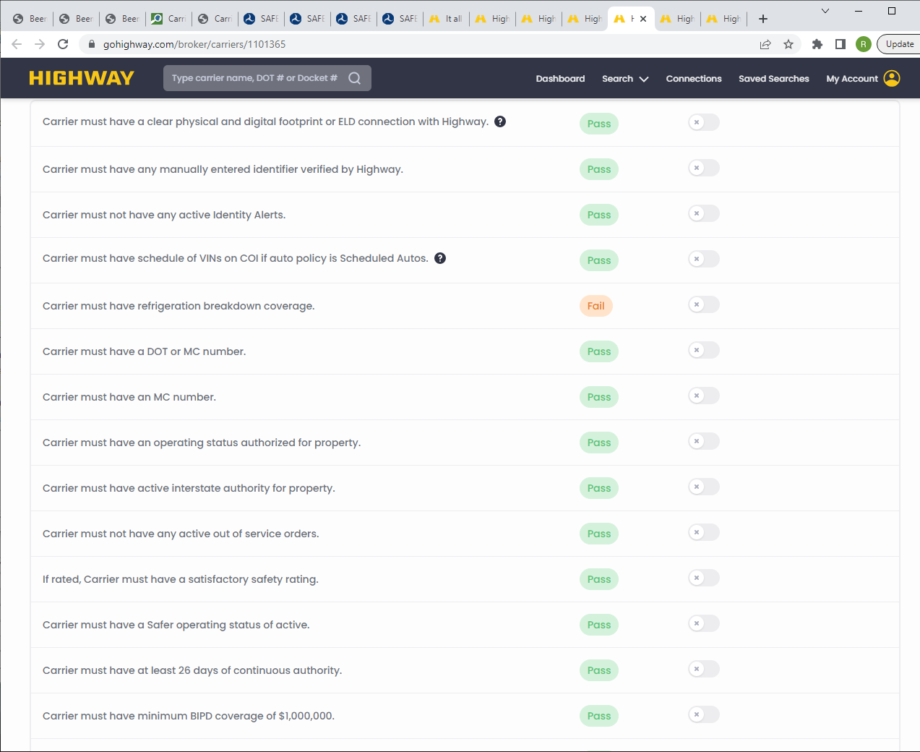
TEMPERATURE CONTROLLED RULES
IF YOU ARE HAULING REEFER
LOADS THAT REQUIRE REEFER
BREAKDOWN INS, YOU CAN SEE
IF HIGHWAY HAS THAT
INSURANCE CERT.
PLEASE NOTE:
IF GO HIGHWAY DOES NOT
POSESS THE INSURANCE CERT,
WE CAN ONLY ACCEPT IT FROM
THE INSURANCE COMPANY.
ANY CERTS FROM THE CARRIER
WILL NEED TO BE VERIFIED.
THIS WILL NOT BE OVERRIDEN
UNTIL VERIFIED.

Slide 22
NEW REEFER RULES
THERE ARE NEW RULES FOR REEFER LOADS.
TO BE AUTOMATICALLY APPROVED CARRIERS MUST HAVE 3 POWER UNITS OR MORE.
MUST CARRY REEFER BREAKDOWN INS.
MUST PROVIDE TRUCK AND DRIVER INFORMATION IF REQUIRED TO DO SO.
IF LESS THAN 3 POWER UNITS, CARRIERS MAY BE CONSIDERED. WE WILL NEED THE BELOW INFORMATION:
Before any temp controlled override can be approved, we need these questions answered.
Customer name
Type of cargo, commodity
Value of the load
Special instructions for the load
Carrier's MC#
- Load #
- Description of Goods:
- Description of Packaging:
- Weight:
- If special handling, has this been communicated to the carrier?:
-Temperature the trailer must be kept at:
Pick up and Delivery dates:
Screen shot of 411
Please keep in mind that we still have the 3-truck minimum policy on these loads. Approval will not be immediate.
Other factors will have to be determined before an approval can be granted.
Carriers that use progressive ins or their subsidiaries, and have less than the required power units, will not be approved.

Slide 23
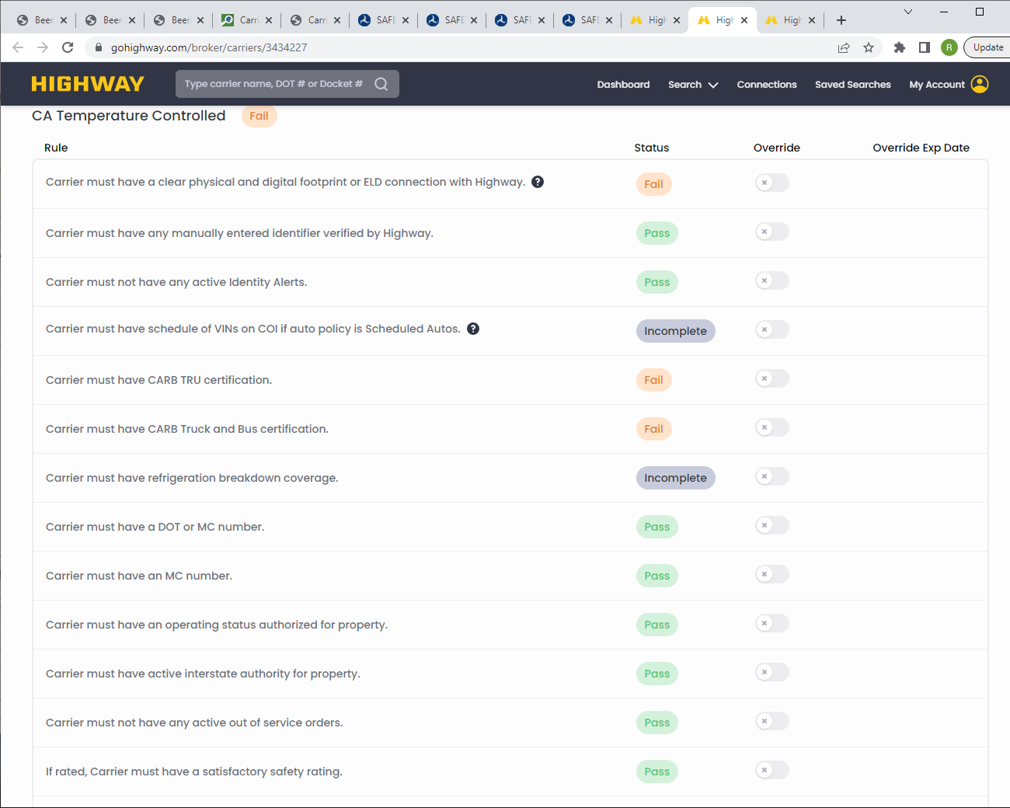
CALIF TEMP RULES
IF YOU ARE SHIPPING CALIFORNIA
LOADS, CARRIERS MUST HAVE CARB
CERTIFICATIONS. IF THEY DO NOT,
THE BROKER CAN ALSO BE FINED.
WE WILL NOT OVERIDE THESE RULES

Slide 24
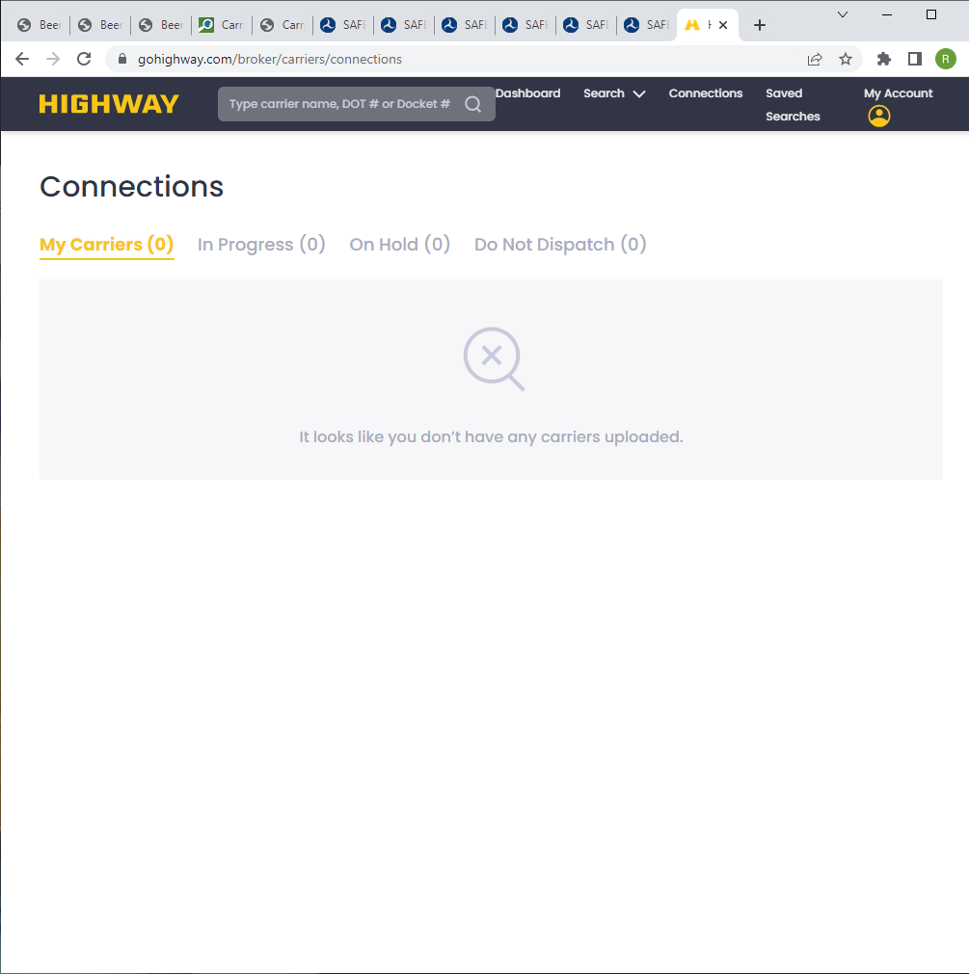
ONCE AN INVITE IS SENT, YOU CAN CHECK THE PROGRESS BY GOING TO
CONNECTIONS
CLICK ON IN PROGRESS
3. ON HOLD= CARRIERS MAY HAVE COMPLETED THE SET UP BUT MAY NOT ELIGIBLE UNTIL THEIR AUTHORITY HAS REACHED THE SPECIFIED TIME.
4. DO NOT DISPATCH= DO NOT USE LIST.

Slide 25
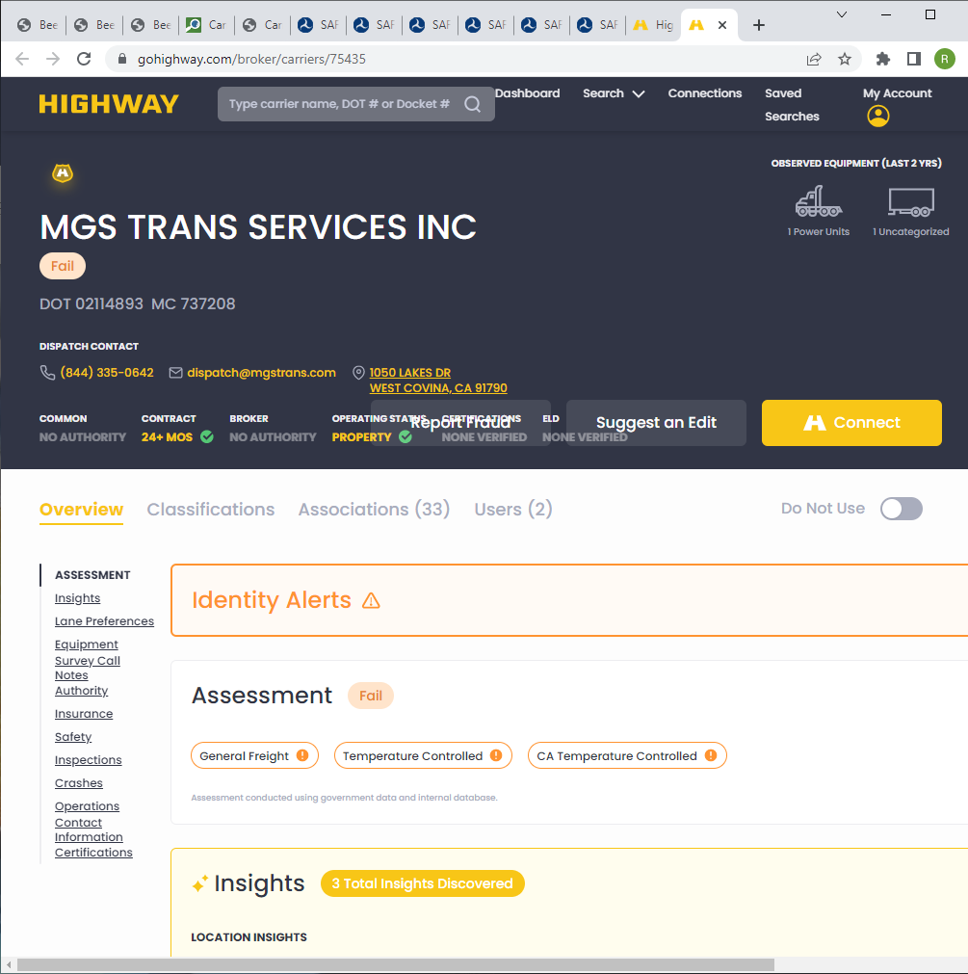
INSURANCE CERTS CAN BE VIEWED BY
CLICKING THE INSURANCE SECTION. IF HIGHWAY HAS THE CERT ON FILE IT
CAN BE VIEWED BY CLICKING VIEW CERT
YOU WILL BE ABLE TO SEE WHAT
COVERAGES THAT CARRIER HAS.
THOSE OF YOU THAT ARE USING
SPECIALIZED CARRIERS SUCH AS
REEFER BREAKDOWN, AUTO HAULING,
PRODUCE, ETC. THOSE COVERAGES CAN
BE VIEWED. IF THE COVERAGE IS NOT
LISTED, DON’T BOOK THE LOAD UNTIL
WE HAVE A CERT THAT SHOWS THE
COVERAGE AND IT IS VERIFIED.
( NEXT SLIDE)
IF NO CERT IS ON FILE, IT WILL HAVE TO
BE VERIFIED.

Slide 26
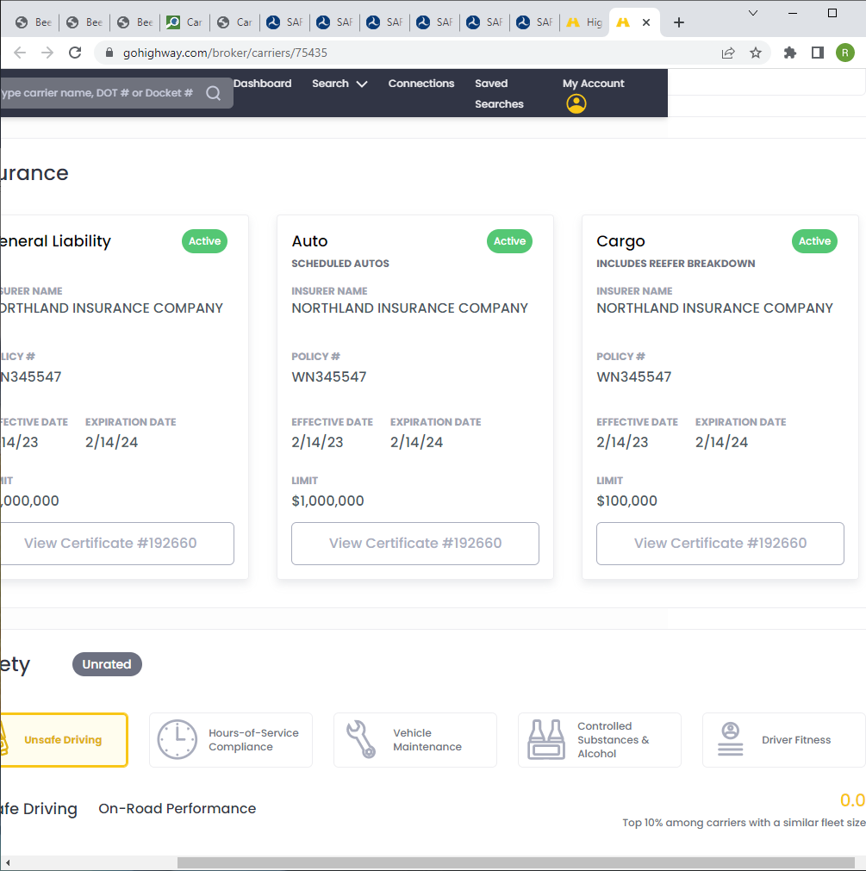
CERT IS ON FILE
AMOUNTS OF COVERAGE

Slide 27
PROBLEM CARRIERS:
IF YOU ARE HAVING ISSUES WITH A CARRIER DUE TO DOUBLE BROKERING, THEFT OF A LOAD OR HOLDING A LOAD HOSTAGE,
YOU WILL NEED TO DO THE FOLLOWING:
ON YOUR HIGHWAY PAGE CLICK REPORT FRAUD AND ENTER THE PROBLEM. GO HIGHWAY WILL THEN INVESTAGATE THE
ISSUE.
PUT NOTES IN MCLEOD
FILE A CARRIER 411 REPORT
NOTIFY CARRIER MANAGEMENT SO WE CAN INACTIVATE IN MCLEOD AND PUT ON THE DNU LIST IN GO HIGHWAY.
EMAIL HYBRIDCLAIMS@BEEMAC.COM

Slide 28
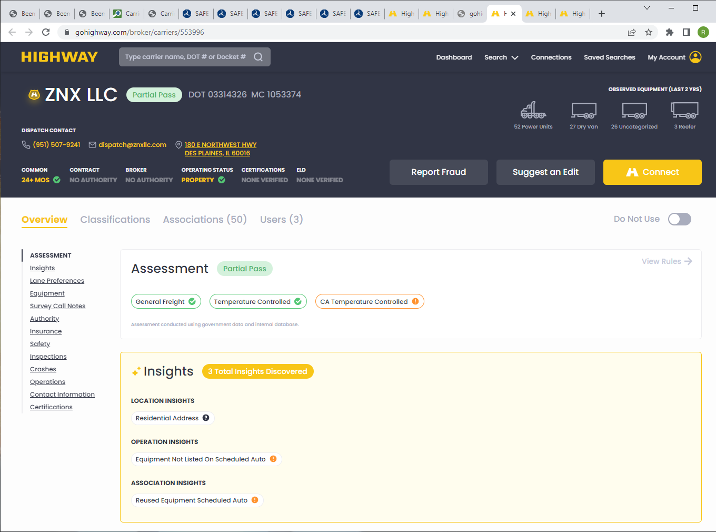
CLICK REPORT FRAUD

Slide 29
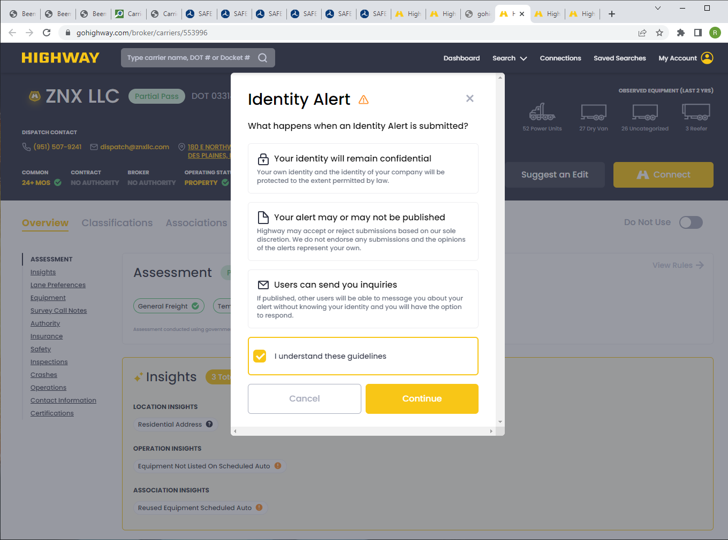
CLICK I UNDERSTAND
THEN CONTINUE

Slide 30
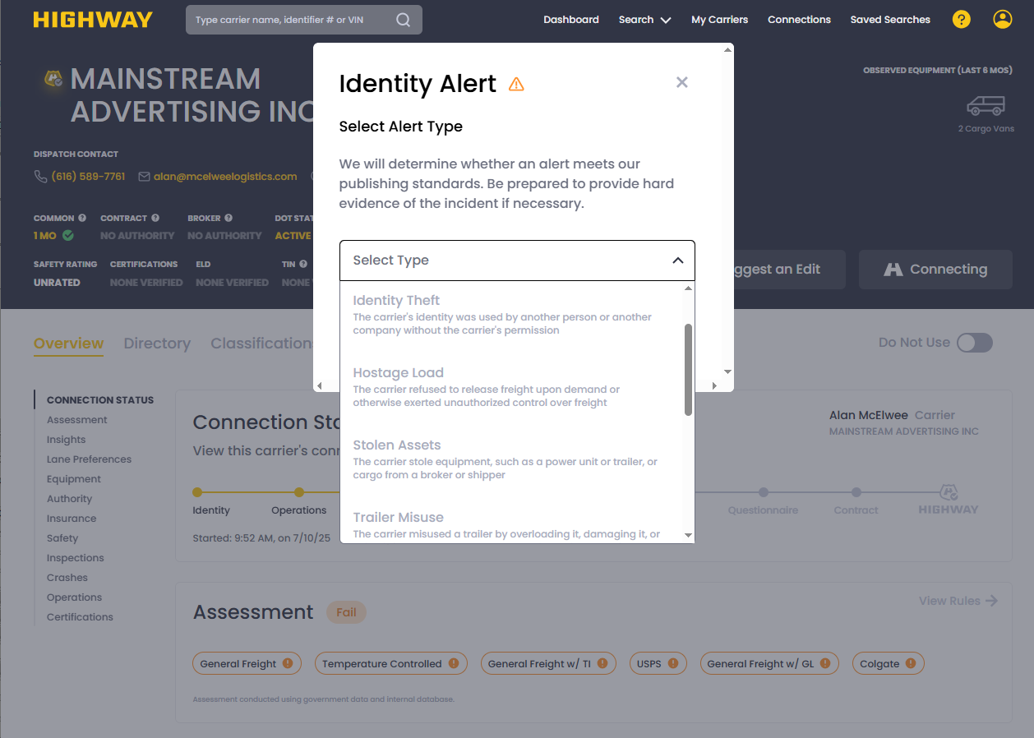
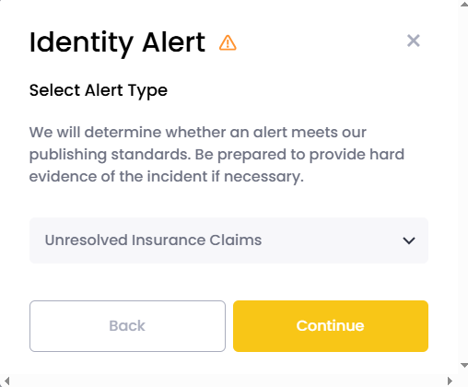
CHOOSE YOUR ALERT
THEN CONTINUE

Slide 31
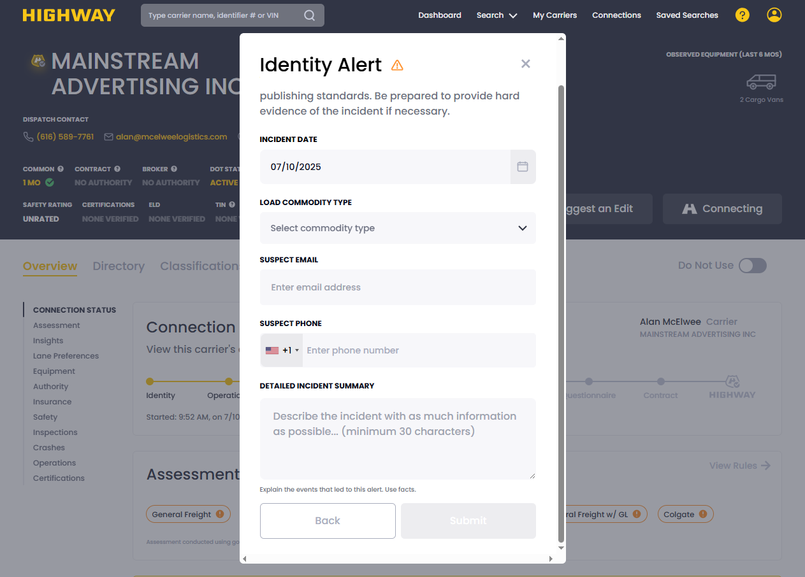
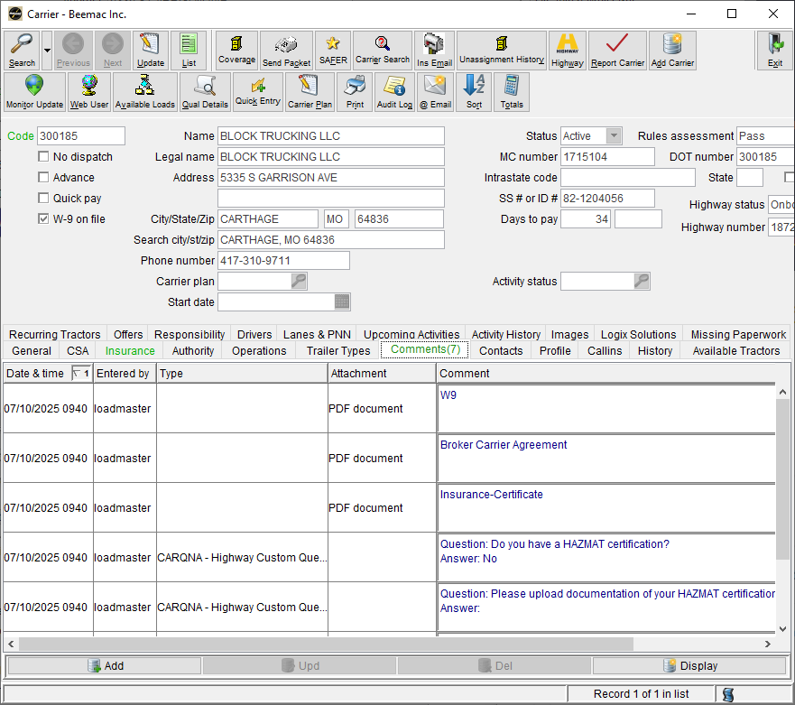
ENTER THE DATE AND DETAILS TO THE
SUMMARY
THEN SUBMIT
THEN ENTER A CARRIER 411 REPORT
AND ENTER ALL COMMENTS IN THE CARRIER
SCREEN IN MCLEOD

Slide 32
FAQ’S
HOW LONG IS THE INVITE ACTIVE FOR?
A. THERE ARE NO TIME LIMITS FOR INVITES AT THIS TIME.
WHAT IF A CARRIER IS HAVING ISSUES ONBOARDING?
A. THEY ARE TO CONTACT HIGHWAY. PHONE: 906-HIGHWAY (906-444-4929) OR service@highway.com
3. WHAT ARE THEIR HOURS?
A. We offer support via email 24/7. We offer support via phone lines during business hours.
Monday – Friday 7am – 7pm CT;
Saturday 8-5 PM CST.
HOW LONG WILL THE UPLOAD TAKE?
A. ANYWHERE FROM 3-8 MIN DEPENDING ON THE NUMBER OF CARRIERS WAITING IN THE QUEUE.
DO WE STILL NEED TO CHECK CARRIER 411?
A. YES. THIS IS ANOTHER TOOL TO USE. IF CM SEES A NEGATIVE REPORT OF DOUBLE BROKERING, THE CARRIER WILL NOT BE APPROVED.
ARE THERE ANY CHANGES IF MCLEOD GOES DOWN?
NO. ALL PROCEDURES WILL STAY IN PLACE. INVITES WILL STILL BE SENT THROUGH GO-HIGHWAY. ONCE MCLEOD IS BACK ONLINE, INFO WILL BE UPLOADED.
WHAT IF HIGHWAY GOES DOWN?
A. YOU WILL BE INSTRUCTED TO SEND OUT PDF PACKETS FROM CARRIER MANAGEMENT.
8.5WHAT ABOUT INACTIVE CARRIERS IN MCLEOD?
A. FIRST CHECK THE HIGHWAY SITE TO DETERMINE IF THEY ARE IN OUR NETWORK. THE GOLD CHECK MARK WILL SHOW YOU THEY ARE REGISTERED. IF THEY ARE NOT, CHECK CARRIER 411. IF NO ISSUES THEN SEND THEM AN INVITE..

Slide 33
MORE FAQ’S
9. HOW ABOUT NEW INVITES AFTER HOURS?
A. HIGHWAY HAS 24/7 EMAIL SUPPORT. We offer support via phone lines during business hours.
Monday – Friday 7am – 7pm CT;
Saturday 8-5 PM CST.
10. DO WE REACTIVATE CARRIERS?
ONLY IF THEY HAVE PASSED THE HIGHWAY RULES AND THEY ARE REGISTERED IN THE HIGHWAY NETWORK.
LOOK FOR THE GOLD CHECKMARK IN THE CARRIER PROFILE IN GO HIGHWAY. OLDER CARRIERS IN MCLEOD MAY HAVE A
GREY CHECKMARK.
11. WHERE DOES THE INFO IN GO HIGHWAY COME FROM?
INFO IS POPULATED FROM THE FMCSA WEBSITE, INTERNALLY WITHIN HIGHWAY
12. DO WE STILL HAVE A 30 DAY AUTHORITY POLICY?
YES, WE DO, HOWEVER, WE HAVE GRANTED A 4 DAY GRACE PERIOD. WE WILL ONLY APPROVE 26 DAYS.
IF A CARRIER IS IN MCLEOD, WILL WE HAVE TO SET THEM UP AGAIN?
INACTIVE CARRIERS WILL HAVE TO BE ONBOARDED THROUGH THE HIGHWAY SYSTEM SO THEY CAN BE MONITORED.
WE MAY ASK SOME OF THE ACTIVE CARRIERS TO GO THROUGH THE ONBOARDING. THAT WAY WE CAN GET UPDATED
INFORMATION.
ALWAYS READ THE COMMENTS IN MCLEOD!!

Slide 34
14. WHAT IF A CARRIER WANTS TO CHANGE THEIR INFORMATION.
WE NEED AN UPDATED W-9 WITH THE CORRECTIONS THEY WANT TO MAKE.
15. WILL WE RECEIVE AN EMAIL FROM CM WHEN A CARRIER HAS COMPLETED THE ONBOARDING?
A. ONLY IF WE HAVE BEEN CC’D WHEN SENDING OUT THE LINK. ONCE A CARRIER COMPLETES THE ONBOARDING USING THE CONNECT BOX, YOU ALONG WITH CM RECEIVES THE EMAIL. IT IS ACTIVE AT THAT TIME IN MCLEOD. KEEP REFRESHING THE CONNECTIONS IN GO HIGHWAY TO SEE UPDATED INFO. REMEMBER IT CAN TAKE UP TO 10 MIN TO UPLOAD INTO MCLEOD.

Slide 35
ON HOLD= means carrier has signed the contract, but still missing docs. Check the overview for the failed or incomplete rules.
ELD DOCUMENTS= cab card/owners’ card, insurance card, Title to the truck and driver’s license. Will accept drivers license and
any of the others.
INCOMPLETE= means go highway does not have a cert on file and has not verified the carrier’s insurance.
INACTIVE IN MCLEOD= an invite needs to be sent through go highway. Unless on the DNU list. Always check the comments.
Once onboarding is complete, CM will have to activate.
ACTIVE IN MCCLEOD= those carriers are monitored in go highway. We may just need updated documents.
IDENITY ALERT= go highway internal alerts from other go highway customers. Similar to 411. If these fail, we will not override.
NEW CARRIERS= new carriers once they have completed the onboarding and you have received the completed email,
will become automatically active in McLeod within 10 min. Please keep checking McLeod.
DOT ONLY CARRIERS= give us a heads up when you send out an invite. These need special overrides once they have completed
the onboarding if they are eligible.
INSURANCE CERTS= certs that come from an insurance company we can automatically update. If a cert comes from the carrier
, then it will need to be verified.
SPRINTER VANS/BOX TRUCKS= when these fail the ELD rule we still need docs. Driver's license, and vehicle owners' card, or
insurance card. They still must carry the same insurance coverage. $1,000,000 auto liability and $100,000 cargo.

Slide 36
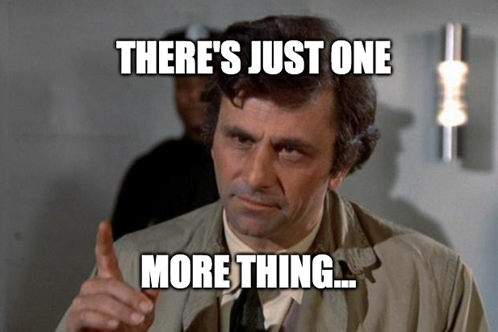
OR TWO
S

Slide 37
SO, WHAT HAS HAPPENED SINCE 2023?
THE INDUSTRY HAS SEEN A LOT OF CHANGES SINCE WE HAVE PARTNERED WITH HIGHWAY. GOOD AND BAD.
BEEMAC LOGISTICS HAS GROWN INTO A LEADING AND TRUSTED COMPANY IN THE BROKERAGE FIELD.
MORE CARRIERS ARE AVAILABLE TO HAUL OUR FREIGHT. THERE ARE AN ESTIMATED 2 MILLION CARRIERS IN THE UNITED STATES.
THE BAD?
SCAMMERS. BAD ACTORS ARE ATTEMPTING TO STEAL LOADS BY HACKING INTO CORPORATE EMAILS, POSING AS LEGITIMATE DISPATCHERS AND JUST PLAIN LYING.
WHAT ARE WE DOING?
WELL, IT ALL STARTS WITH YOU. TRUST YOUR GUT. IF THE DISPATCHER JUST TAKES THE LOAD FOR THE POSTED RATE AND DOESN’T NEGOTIATE, SOMETHING MAY BE UP.
ALWAYS LOOK AT YOUR CALLER ID. IS IT A DIFFERENT NUMBER THAN WHAT IS LISTED IN HIGHWAY?
IF THE PERSON CLAIMS THEY WORK FOR THE CARRIER BUT SAYS “YOU CAN SEND IT TO THE CORPORATE EMAIL”, LETS VERIFY IT FIRST.
ASK FOR THE TRUCK REGISTRATION/CAB CARD. SCAMMERS SHOULDN’T HAVE THOSE DOCUMENTS.
ALL NEW CONTACTS AND CHANGES MUST BE VERIFIED BY CARRIER SERVICES (NEW NAME FOR CARRIER MANAGEMENT) VIA VERBAL CONFIRMATION FROM A VERIFIED CONTACT FOUND IN HIGHWAY, OR THE FMCSA SITE. IF WE DO NOT GET A VERBAL CONFIRMATION THEN WE WILL NOT ADD IT.

Slide 38
AT THIS TIME, CARRIER MANAGEMENT WILL NOT RECEIVE ANY EMAILS WHEN AN INVITE IS SENT. SO, WE WILL NOT KNOW
WHO SENT OUT THE INVITE. GO HIGHWAY IS IN THE PROCESS OF MAKING THIS FEATURE AVAILABLE TO US.
IF THE YELLOW CONNECT BUTTON IS USED, WE WILL BE ABLE TO SEE THE WHO SENT THE INVITE ONCE THE ONBOARDING
HAS BEEN COMPLETED OR ON HOLD.
IF THE LINK IS USED DUE TO A CHANGE IN EMAILS, CM WILL NOT KNOW WHO SENT THE INVITE. IF YOU USE THE LINK, LET
CM KNOW ALONG WITH THE MC/DOT IN THE SUBJECT LINE.
PLEASE CHECK MCCLEOD TO SEE IF YOUR CARRIER HAS BEEN ACTIVATED OR IF THERE ARE ANY COMMENTS
BEFORE EMAILING CARRIER MANAGEMENT.
INSURANCE CERTS SUBMITTED FROM CARRIERS MUST BE VERIFIED FROM THE INSURANCE COMPANY!!
NOA’S GO TO beemac@noa.triumphpay.com
PAYMENT INQUIRES GO TO INFO@TRIUMPHPAY.COM
INSURANCE CERTS GO TO CM AND insurance@certs.gohighway.com
CARRIER ISSUES SERVICE@HIGHWAY.COM
GO HIGHAY CARRIER LINK https://highway.com/go/beemac-trucking
CARRIER ISSUES WITH SET UP SUPPORT@HIGHWAY.COM
* NOTE; some of these will change after the integration has been completed.

Slide 39
RECAP
CHECK 411 AND HIGHWAY FOR ANY REPORTS
CHECK MCLEOD COMMENTS FOR ANY REPORTS
LOOK AT THE FAILED RULES IN HIGHWAY BEFORE SENDING OUT THE INVITE. KNOW WHAT DOCUMENTS YOU NEED.
TRUST YOUR GUT. IF A CARRIER IS NOT NEGOTIATING RATES OR SEEMS IMPATIENT AND WANTS THE LOAD, BE SKEPTICAL.
ASK FOR A TRUCK REGISTRATION OR A CAB CARD TO VERIFY THE VIN WITH THE INSURANCE IN HIGHWAY.
INACTIVE CARRIERS IN MCLEOD, UNLESS SHUT OFF FOR OTHER REASONS, NEED TO BE ONBOARDED AGAIN IN HIGHWAY. ONCE THE ONBOARDING HAS BEEN COMPLETED, CARRIER SERVICES WILL CALL FOR A VERBAL VERIFICATION THAT THEY ARE ACTUALLY BOOKING A LOAD WITH BEEMAC.
READ THE COMMENTS IN MCLEOD!!!!
ALL NEW CONTACTS MUST BE VERBALLY VERIFIED BY CARRIER SERVICES.
REEFER RULES. 3 OR MORE POWER UNITS. OVERRIDES CAN BE GRANTED BUT THE FORM MUST BE FILL OUT WITH THE
REQUIRED INFO.
9. CARRIER SERVICES MAY MAKE A CARRIER INACTIVE AFTER YOU HAVE ALREADY ASSIGNED THEM. CHECK THE COMMENTS IN MCLEOD.

Slide 40
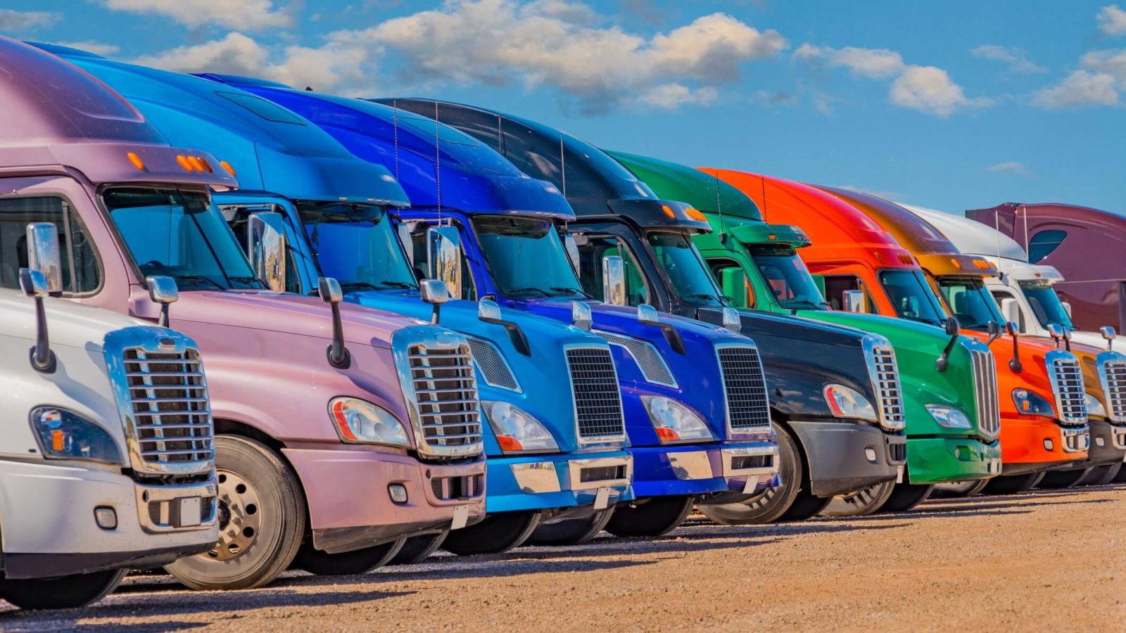


WELCOME AND GOOD LUCK

