Slide 1
Team DRO/USPS SOP

Slide 2
Overview
General
Tracking and customer updates
EDI and building loads
Accessorial payments
Recoveries
Rating
Extraordinary situations
USPS paperworks▼

Slide 3
General
Main customer: USPS (United States Postal Service)
Customer code: USPSWA
Commodity: Mail (Non palletized)
Weight: 25.000 lbs. max.
Trailer type: 53 ft Van – Team drivers required over 570 miles.
Broker: DeAndre Robinson
Contact: teamdro@beemac.com
USPS is an independent agency responsible for providing mail and package delivery services across the country.
Route #: 002VU

Slide 4
Tracking and customer updates
Must check on all loads scheduled to pick up during the same and next day. On weekends must track through Monday.
Do not leave loads in UNLOADNG status when delivered. See more
All delays must be informed to Team DRO and USPS, no matter how small the delay is.
Always leave detailed planning comments including date, time, update and initials. See more
Update brokerage status accordingly
Do not change brokerage status to LOADING or UNLOADNG without confirming that truck is on side and has checked in.

Slide 5
EDI and building loads
USPS loads come through EDI. All loads must be accepted and built. Click here for EDI building guide
There will be cases when a system issue might delay EDI and the person in charge will need to manually build a load using the Load Tender PDF format. Click here for manual building guide

Slide 6
Accessorial Payments
An accessorial payment is an additional charge in logistics for extra services beyond standard transportation, such as loading, unloading, or detention.
Truck Order Not Used (TONU)
Detention
Layover
Driver Assist

Slide 7
TONU
Truck Order Not Used.
Valid when:
A truck shows up on time and load gets cancelled last minute.
Cancellation notice is sent within 4 hours prior to pick up time.
For recovery trucks. Hipervinculo del hipervinculo
NOT valid when:
Cancellation notice was sent over 4 hours prior to pick up time.
Truck arrives late at the pickup location, causing the cancellation of the load.
Sending a solo driver to a team run.
Not having the correct number of straps and e-tracks, causing the rejection of the truck.

Slide 8
TONU Rates
To customer: $400 USD.
Carrier pay: $150 USD (Per truck)
Note: TONU can be paid out of our pocket in the following situations:
We receive a timely cancellation notice from the customer but never advise the carrier, and drivers find out when they are already at the shipper.
We send a late truck (possibly a recovery) and the trip gets cancelled when the truck is on site. Not to be confused with a late ETA.
Out of pocket TONU:
To customer: $0 USD
To Carrier: $150 USD (Per truck)
How to set up a TONU

Slide 9
Detention
Detention is a fee charged when a truck is kept waiting too long for loading or unloading.
Detention procedure:
Carrier must be on tracking. Non-negotiable.
Request Late Slip
If no late slip was provided, request BOL or POD with in & out times printed or handwritten
Once this information is gathered, please let the carrier know that it will be handled by the morning team.
If they wish to know more about our DTN policy, they can find it in their rate confirmation.
If the load is still in transit, please leave a planning comment on the load that suggests DTN.
If the load is delivered, change it to DTN status.

Slide 10
Layover
Layover is a fee charged when a truck is kept waiting for loading or unloading for over 24 hours.
Layover is valid when:
Drivers are on tracking throughout the whole trip.
Drivers spend over 24H at a customer’s facility.
Follow the same DTN procedure for Layovers.

Slide 11
Driver Assist
Driver assist refers to when a driver helps load or unload cargo.
Usually, the dispatcher or driver will request a driver assist fee. No document needs to be gathered, and tracking is not necessary to approve or deny this accessorial.
This fee must not be charged to USPS and will always be paid out of our pocket.
Rate: $75 USD (Per truck)
How to add a driver assist fee

Slide 12
Recoveries
Must look for a recovery truck when
ETA is over 30 minutes late
A carrier gives back a load
An enroute truck faces a breakdown and causes ETA to be either too late or unclear
A truck is stuck at the previous receiver and the pick-up time is too close
A solo shows up for a team load
A truck doesn’t have enough straps and/or e-tracks
There is no communication with the carrier and therefore cannot confirm if the truck is on site or not
How to look for a recovery truck

Slide 13
Rating
Tools:
Greenscreens (main) ▼
DAT Rateview ▼
Carrier Search (On Mcleod) ▼

Slide 14
Extraordinary Situations
Drivers arrive at the shipper, and they are told that there is no load
Load is cancelled and shipper is nor providing paperwork
For multistop loads only: Drivers arrive at the 1st shipper, and they are told to go empty to the next stop
For 1 pick and 1 drop loads: Drivers are told to go empty to the receiver.
Trailer gets fully unloaded in the middle of a multistop trip
Transloading a load
Repowering a load
Sending a recovery truck due to lack of communication with the original carrier
Accidents
Other events

Slide 15
Brokerage Status for delivered loads
Disclaimer: Do not close any loads unless you have the correct paperwork and there aren’t any additional fees to be paid.
NEED_POD: Use this when you have been informed about the completion of a load but have not received or requested paperwork.
PODREQ: Use this status when you have confirmed that a load is delivered and requested the POD to the carrier either via phone, email or SMS.
PODCHECK: Use this when a load is delivered, and you receive the paperwork but don’t feel comfortable closing it.
DTN: Use this status when after a load has been delivered, the carrier requests a DTN fee. Make sure to follow the DTN procedure

Slide 16
Planning Comments
Brief explanation with the most detailed and recent updates on a load.
Planning comments must include:
Date of the comment
Description of the update
DR/DP depending on who the update was given by (driver/dispatcher)
Your initials
Time in military format (24:00) and Eastern time.
Example:
10/14 Loaded and Rolling per DR - JL 14:19
For more efficient comments, please review the abbreviations

Slide 17
Abbreviations for planning comments
Feel free to use these to keep your comments short and concise
L&R : Loaded and Rolling
ETA: Estimated time of arrival
GFOTP: Good for on time pick-up
GFOTD : Good for on time delivery
TRK: Truck
TRL : Trailer
BRKDWN: Breakdown
DNC: Do not close
DTN: Detention
@: To replace "at"
PREV: Previous
DEL: Delivery
PU: Pick-up
GTG: Good to go

Slide 18
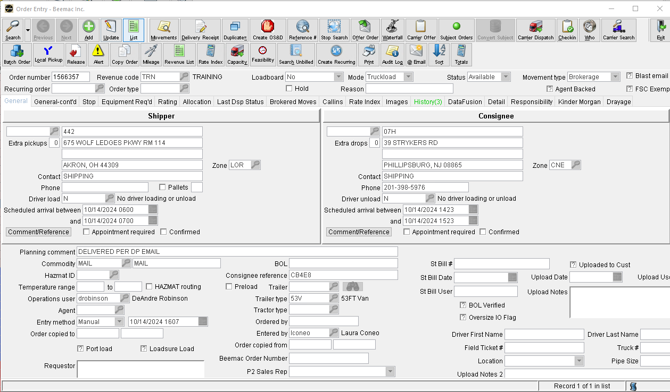
How to set up a TONU

Slide 19
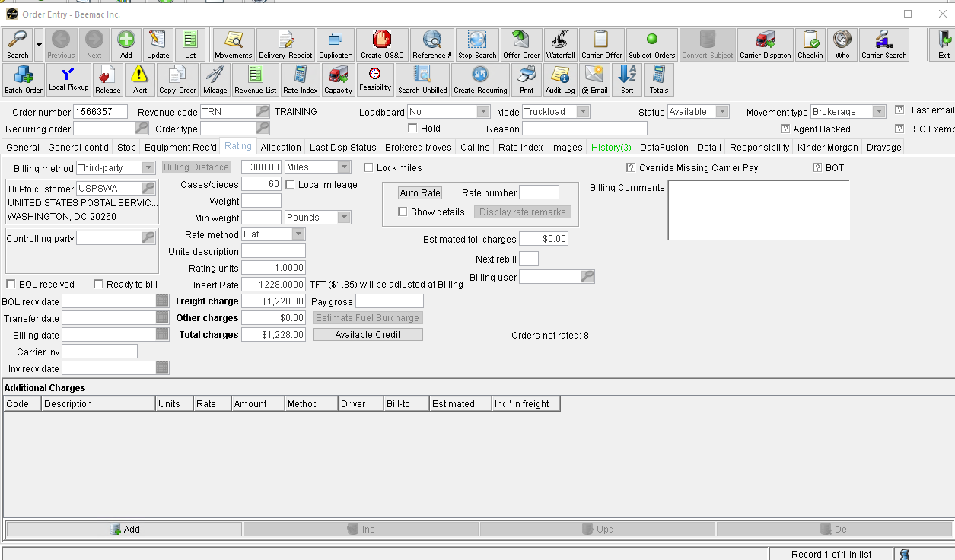
Delete customer rate

Slide 20
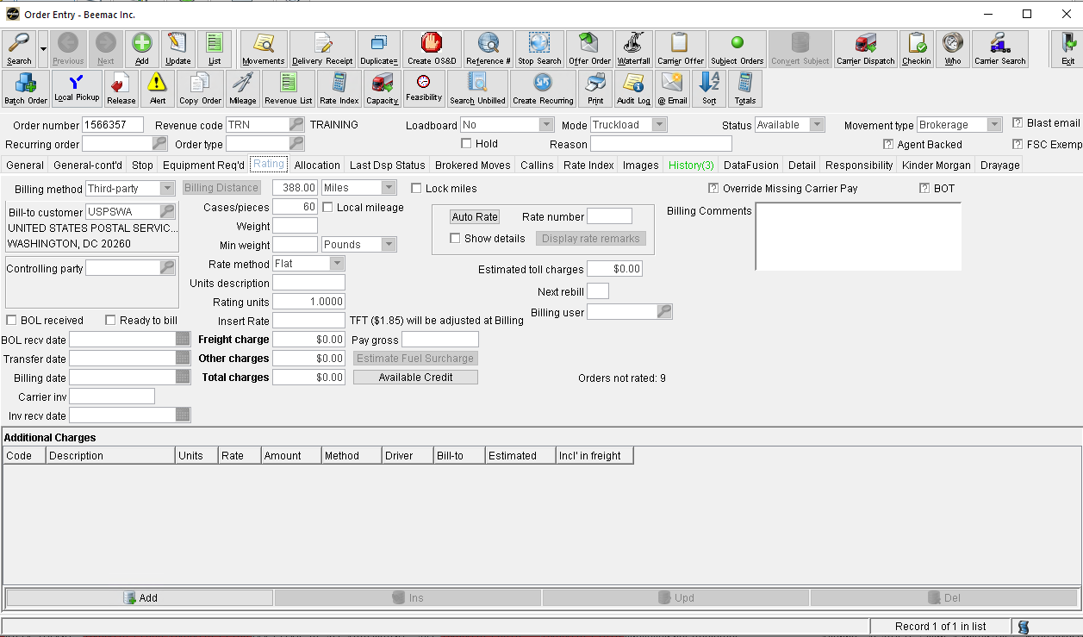

Slide 21
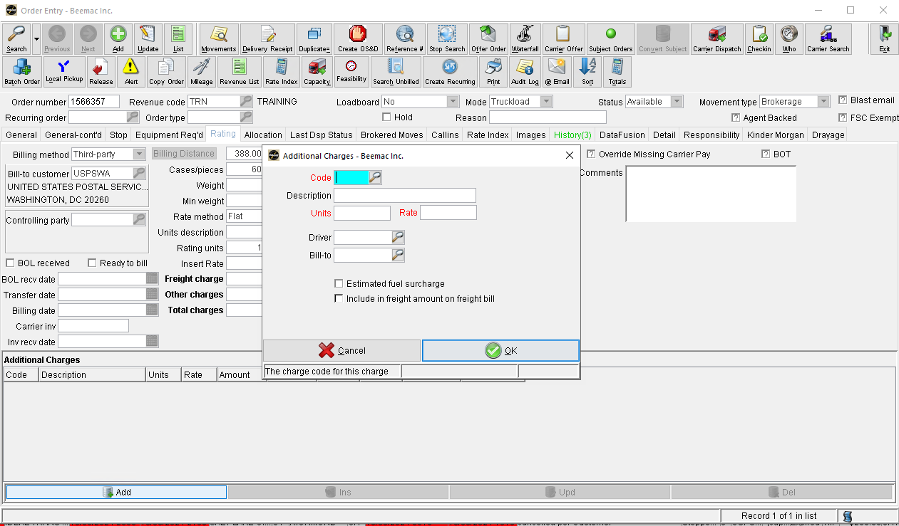
Use code TNU

Slide 22
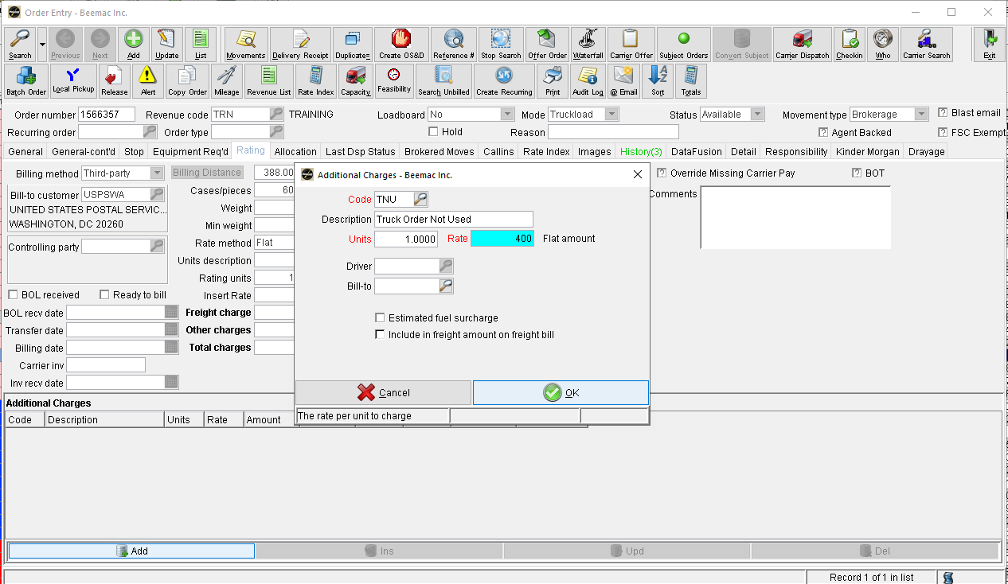
Charge $400
Save changes

Slide 23
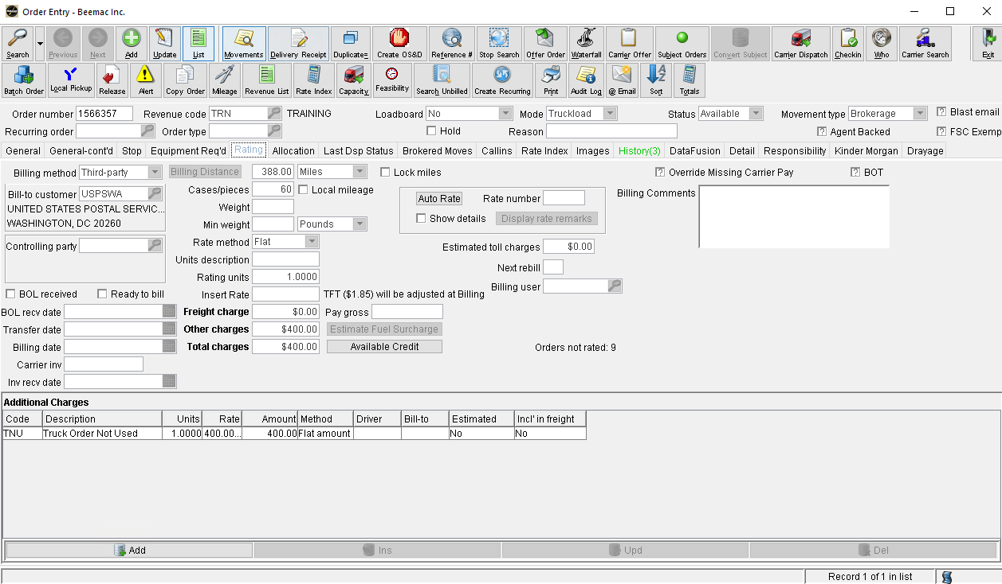
Go to Carrier Dispatch

Slide 24
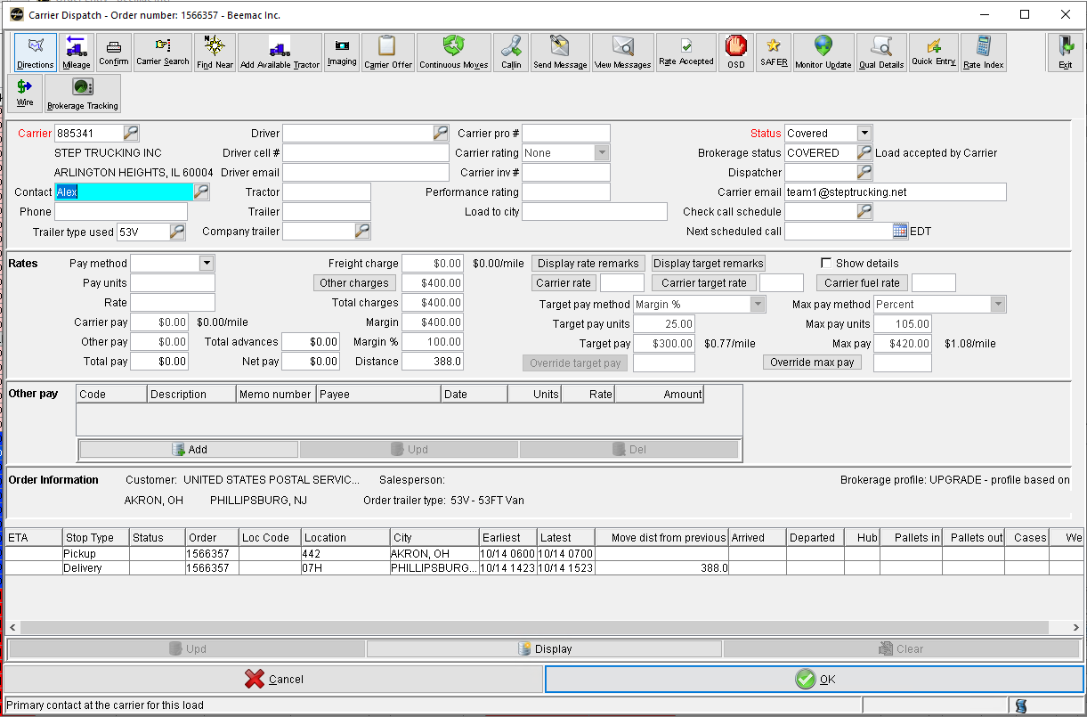
Delete carrier rate

Slide 25
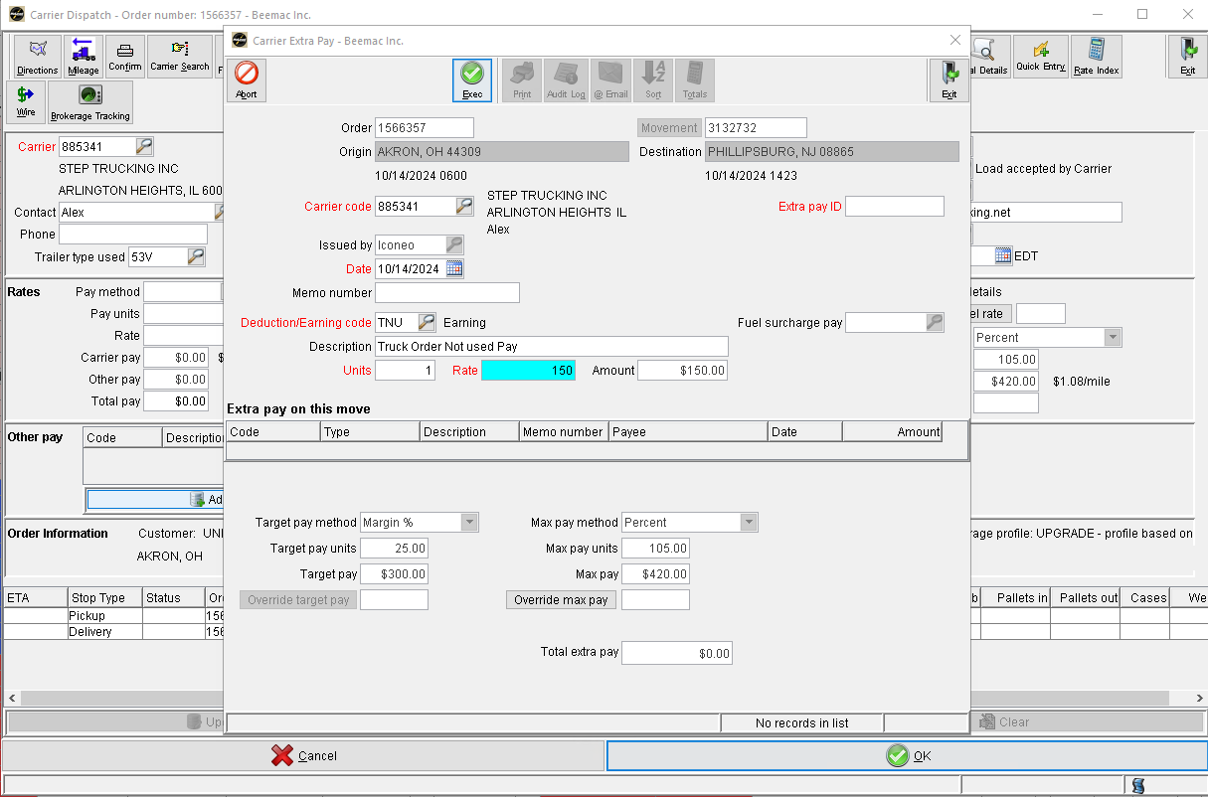
5. Save Changes
1. Add issue date
2. Use code TNU
3. Units: 1
4. Carrier pay: $150

Slide 26
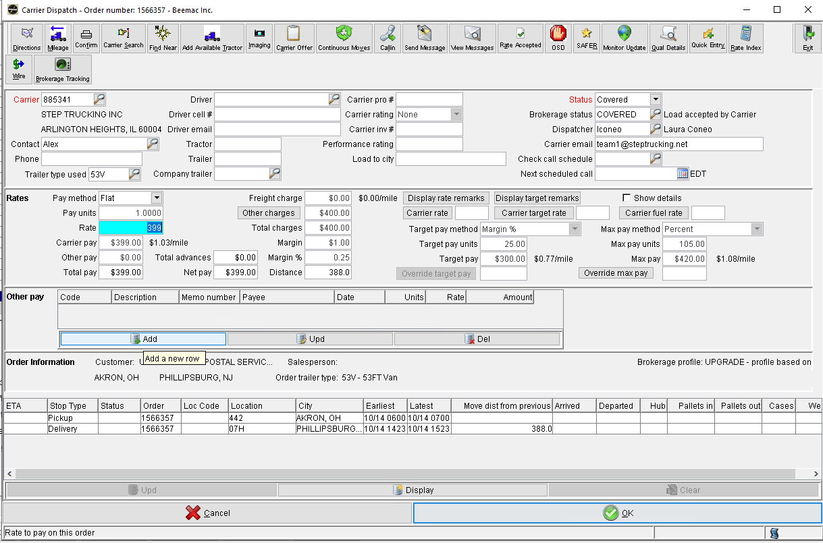
How to set up a driver assist fee
On the Carrier Dispatch screen, look for other pay and click ‘Add’

Slide 27
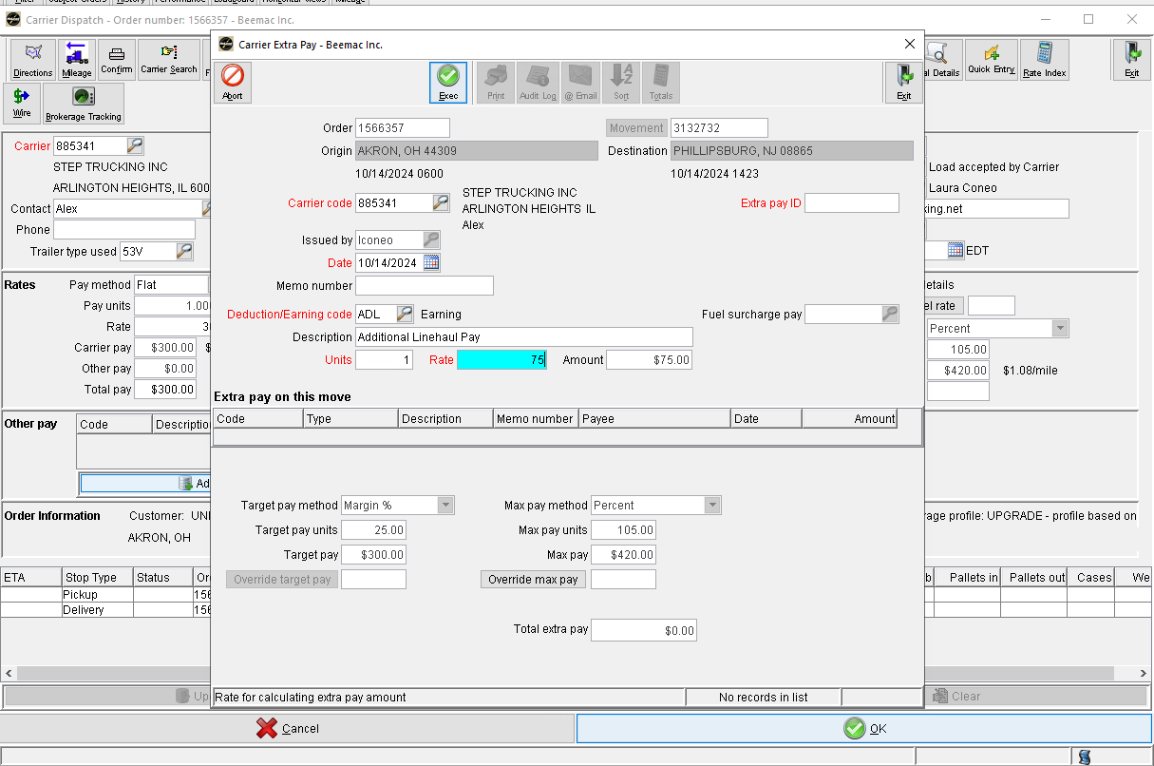
5. Save Changes
1. Add issue date
2. Use code ADL
3. Add a description. In this case, use “Driver Assist”
4. Units:1 Rate: 75

Slide 28
Select Load Tender Express to see the awarded loads on EDI

Slide 29
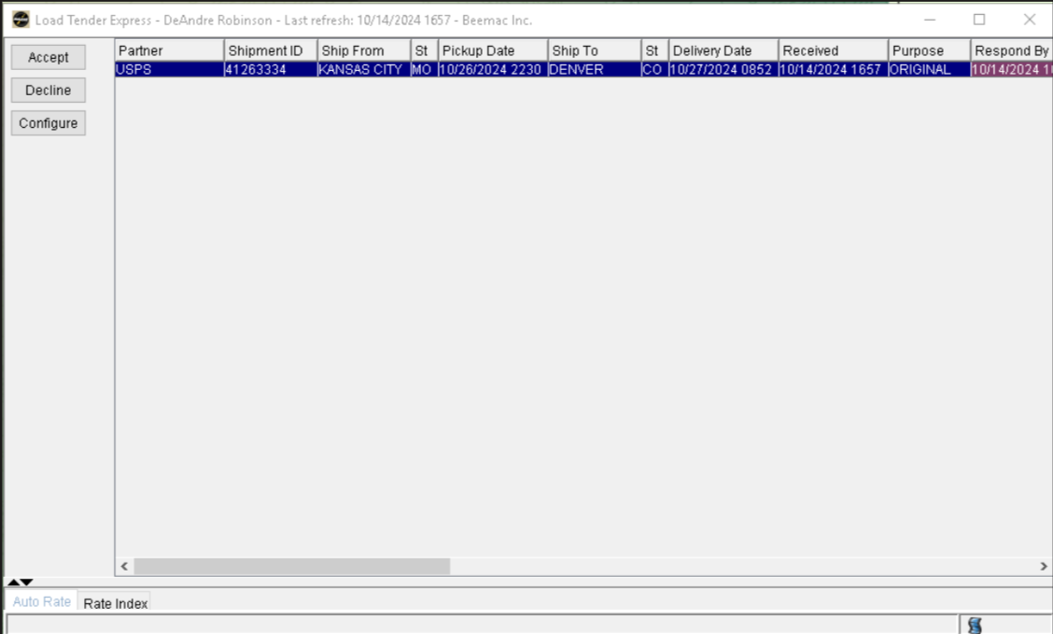
Loads that need to be built will show in red color and with “original” on the purpose tab.
Select the load and click in “accept”

Slide 30
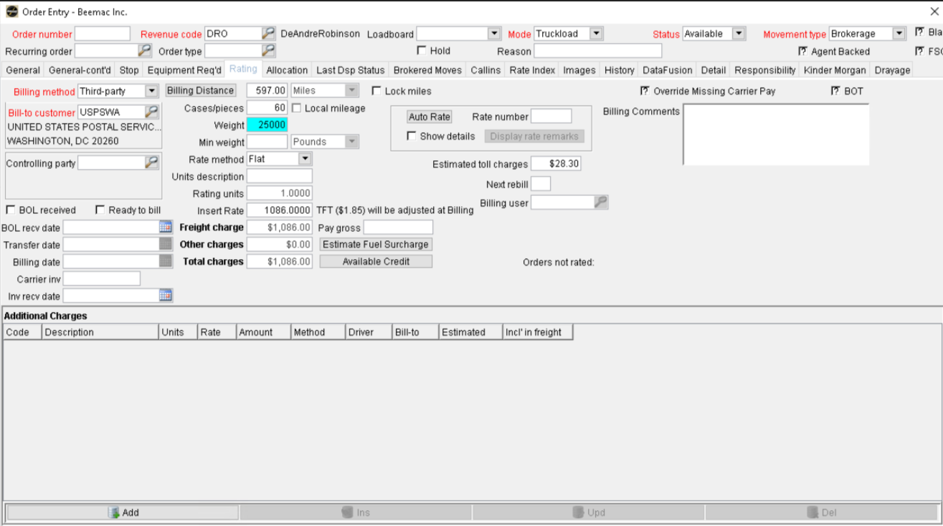
On rating tab change Billing Method to “Third-party”
Movement type will show in “asset” by default, needs to be changed to “brokerage” NO EXCEPTIONS
Change the weight to 25000 NO EXCEPTIONS for USPS loads.

Slide 31
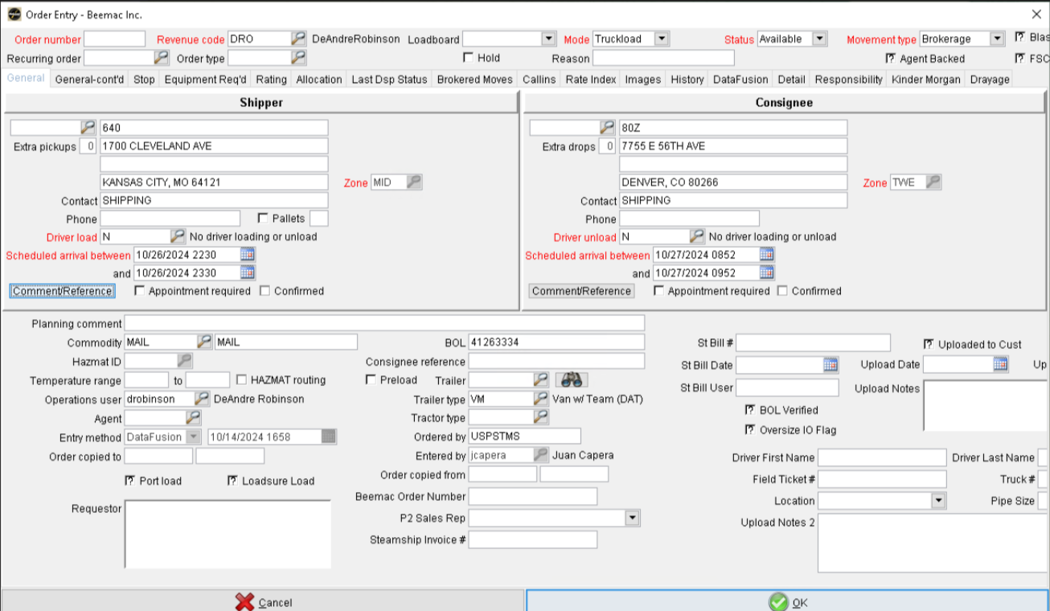
In General tab go to Comment/Reference

Slide 32
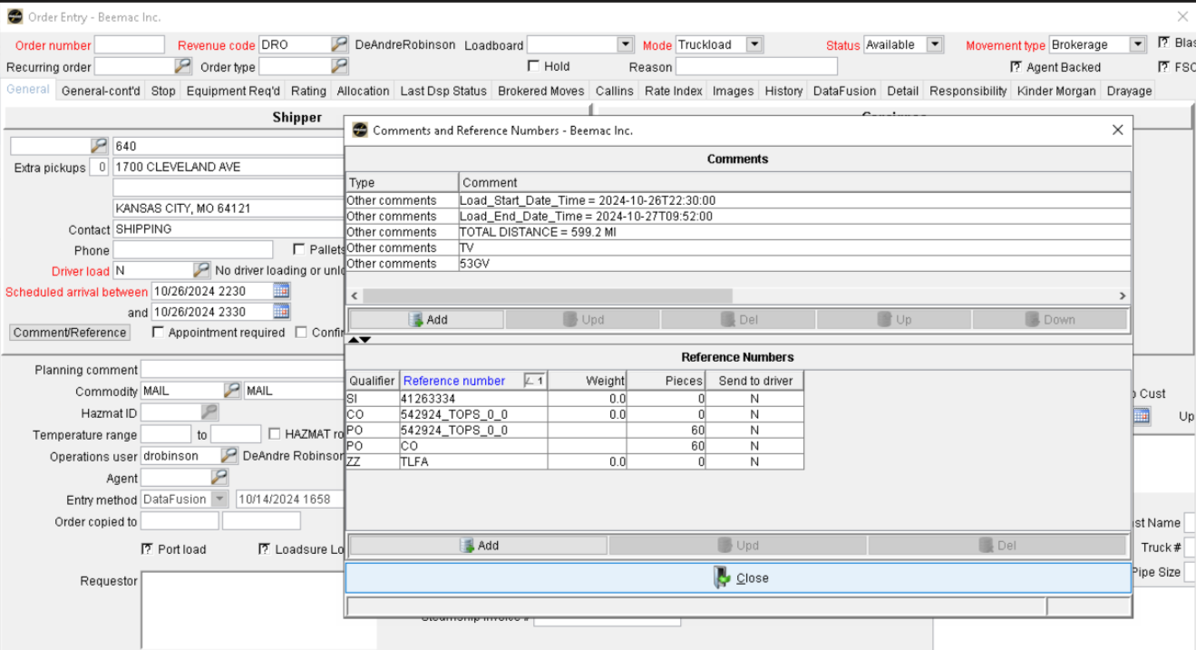
Delete all the highlighted in “Comments”
In Reference Numbers delete all the highlighted in yellow EXCEPT the SI qualifier.

Slide 33
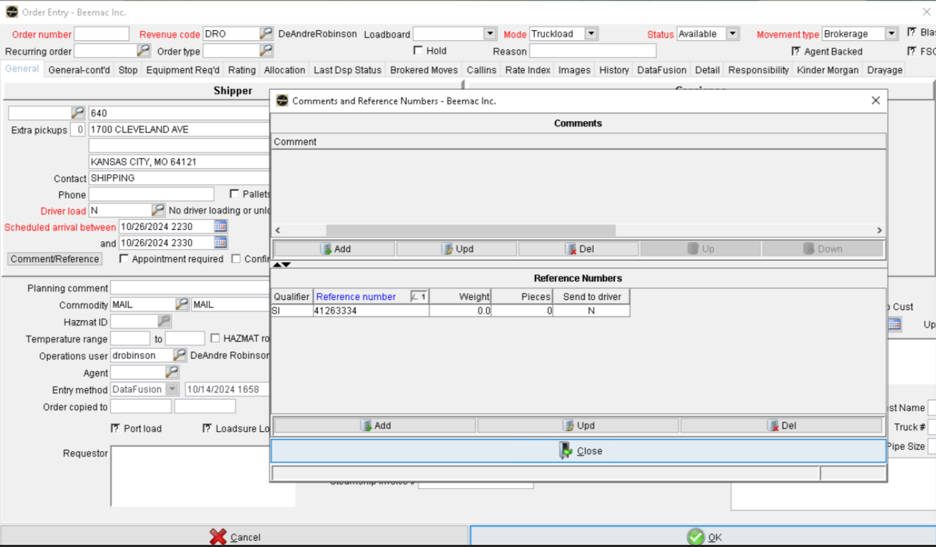
Open the SI qualifier

Slide 34
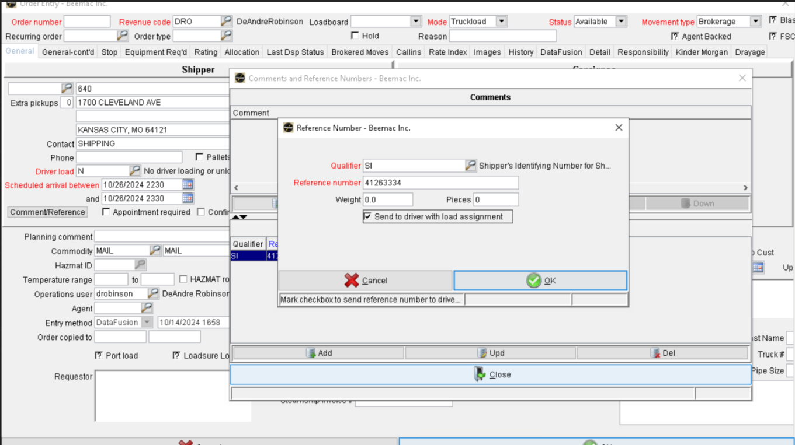
Mark the check box and click OK.

Slide 35
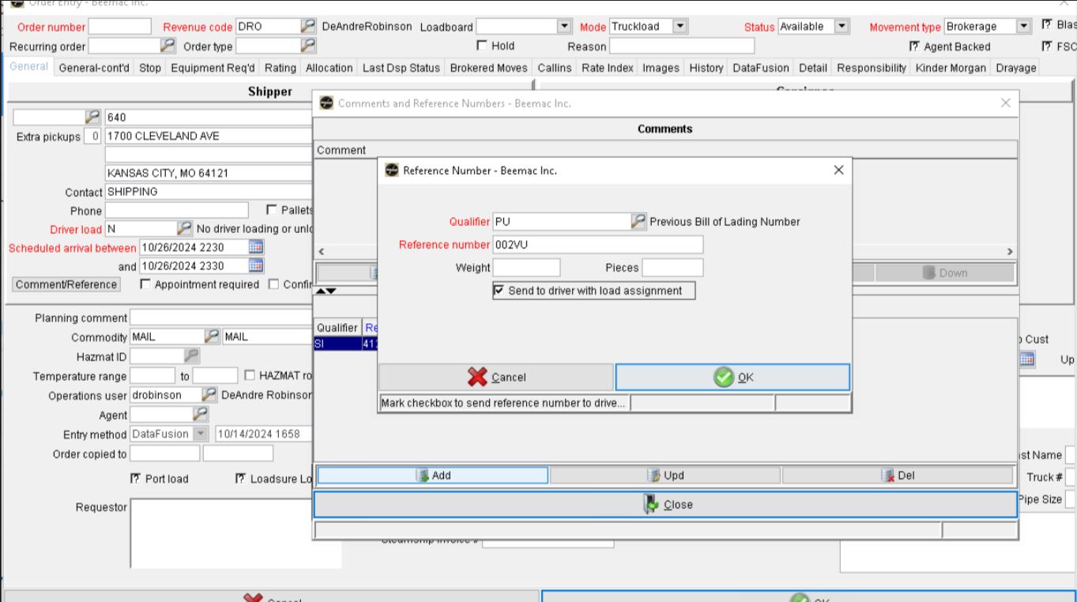
Put on Qualifier “PU”
Reference number will always be 002VU
Mark the check box and click OK
Click on Add

Slide 36
Put the Trailer type: if the load has 560 miles or less, it’s for a solo driver, use the code 53V / If it has more than 560 miles, it’s for a team, use the code VM.
After all the information has been set up, click OK

Slide 37
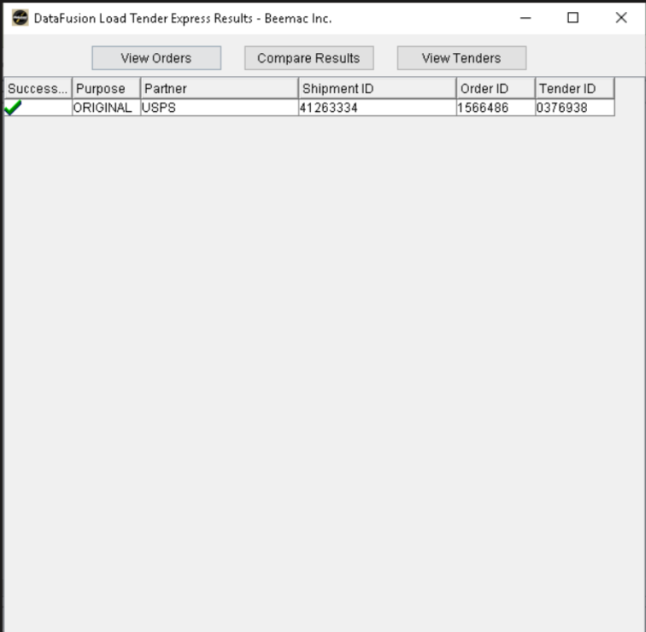
This window will display showing the load number under the tab “Order ID”

Slide 38
How to look for a recovery truck
A recovery truck needs to be found when:
The original carrier can’t pick on time for any reason
A critical ETA is received
The carrier does not comply with the customer’s requirements and any other situation that affects the usual operation.

