Slide 1
WELCOME TO HYBRID GLOBAL LOGISTIS SERVICES, LLC.
D.B.A BEEMAC LOGISTICS

Slide 2
HYBRID GLOBAL LOGISTICS, LLC
who we are
Hybrid Global Logistics LLC is an exclusive agent of Beemac Logistics. Since 1984, the Beemac brand has grown into a premier multi-modal full service transportation and logistics provider offering truckload, LTL, intermodal, air, ocean, warehousing, and specialized hauling services to customers throughout North America.

Slide 3
HYBRID GLOBAL LOGISTICS, LLC
what we do
Beemac is a third-party logistics provider (3PL.)
We connect our customers that have products that need shipped with carriers that can transport the product where it needs to go.

Slide 4
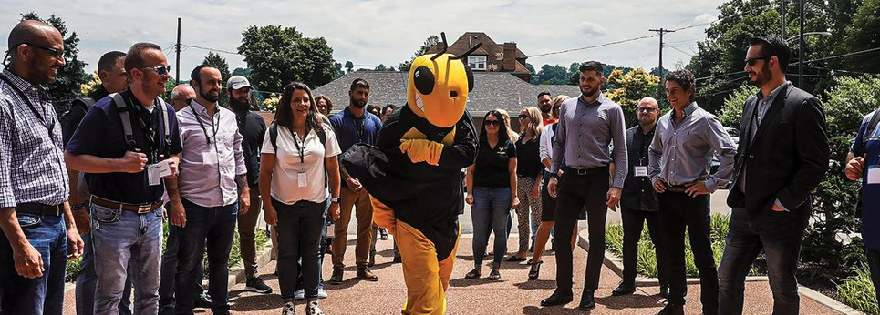
HYBRID GLOBAL LOGISTICS, LLC
BEEMAC
LOGISTICS
40 YEARS OF INDUSTRIAL LOGISTICS EXPERIENCE, BORN OF AN ASSET-BASED STEEL HAULER
THE MOST COMPREHENSIVE ASSET-BASED INDUSTRIAL-FOCUSED LOGISTICS NETWORK IN NORTH AMERICA, SERVING ALL MODELS OF TRANSPORTATION
FULL-SERVICE LOGISTICS OFFERING
ON DEMAND CAPACITY ACROSS ALL MODES, MANAGED SERVICES AND 3 PL SOLUTIONS
COST EFFECTIVE BROKERAGE SOLUTIONS
CUSTOMIZED INBOUND MANAGEMENT / MRO PROGRAMS
40,000 CONTRACT CARRIERS
LOGISTICS ENGINEERING AND SUPPLY CHAIN SONSULTING SERVICES
JOINT VENTURE WITH MERCURY LOGISTICS / MUTUAL OWNERSHIP OF MERCURY TRANSPORTATION
BEST IN CLASS TECHNOLOGY AND VISIBILITY TOOLS
INDUSTRY TRAINED EXPERTS WITH DEEP ROOTS IN OIL AND GAS LOGISTICS

Slide 5
HYBRID GLOBAL LOGISTICS, LLC
beemac trucking
TOP 20 LARGEST FLATBED/HEAVY HAUL CARRIERS IN THE USA (RANKED BY TRANSPORT TOPICS MAGAZINE 2022
HEADQUARTED IN AMBRIDGE, PA
32 TERMINALS ACROSS THE US/NATIONWIDE SERVICE
550+ TRUCKS/800+ FLATBED TRAILERS
STEP-DECKS, DOUBLE DROPS, STRETCH, RGNS, DRY VANS, HOT-SHOTS AND PNEUMATICS
OVER DIMENSIONAL/HEAVY HAUL DIVISION WITH DEEP EXPERTISE/IN-HOUSE PERMITTING, ROUTING, ESCORT SERVICES

Slide 6
HYBRID GLOBAL LOGISTICS, LLC
services portfolio
BEEMAC TRUCKING
BEEMAC LOGISTICS
BEEMAC MATERIAL HANDLING & WAREHOUSING
BEEMAC CHARTERING & MERCURY TRANSPORTATION
BEEMAC PORT SERVICES
•500+ trucks
• Flatbeds
• Step decks, double drops, RGNs
• Stretch
• Pneumatic
• Hot Shot
• Over dimensional/ pilot
• Full-service logistics offering
• On demand capacity across all modes, Managed
Services and 3PL Solutions
• Cost effective brokerage solution
• Inbound management / MRO programs
• 44,000 contract carriers
• Carrier management
• Logistics engineering and Supply Chain
consulting
• Leetsdale, PA, Midland, TX and Houston, TX
• 5 fully managed Pipe yards
• 75 acres combined
•Inspection Services
•Inventory management
•Mobile Forklift services
• Worldwide service of bulk
and break-bulk commodities
• Working with over 2,000
shipowners worldwide
• Operations team to manage
all aspects of the loading
shipment, and unloading
• Turn-key multi-modal
solutions bundling
• Port of Leetsdale, PA / Houston, TX
• 45-Ton overhead river crane in Leetsdale, PA
• Barge and rail car transloading
• Direct Discharge Port of Houston
• Indoor/Outdoor storage space

Slide 7
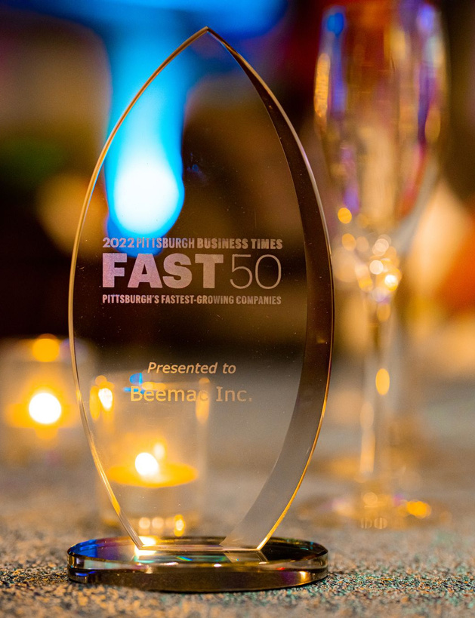
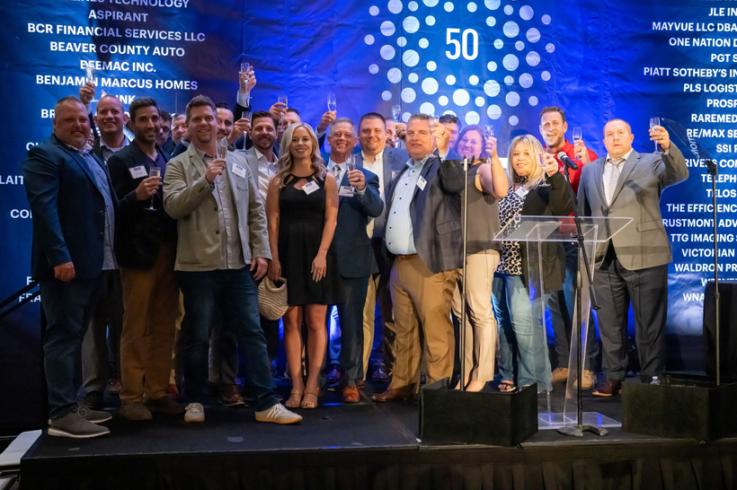
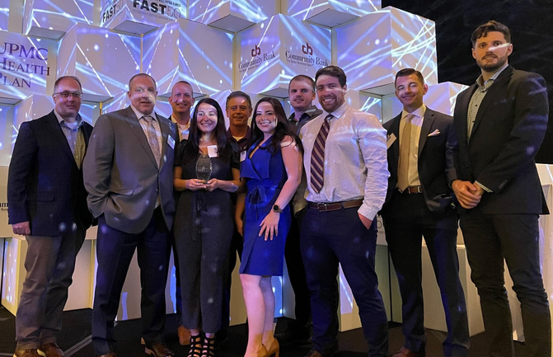
HYBRID GLOBAL LOGISTICS, LLC
achievements & awards
2024 & 2023 Accomplishments:
Ranked 51st Top Freight Brokerage Firms in the U.S. by Transport Topics 2024.
Named a winner of the Pittsburgh Post-Gazette’s “Top Workplaces 2024” Award.
Ranked No. 2972 on the Inc. 5000 list 2023.
Top 500 Largest For-Hire Carriers by Freight Waves 2023.
Ranked 9th in the 2023 Pittsburgh Business Times “Fast 50” Award.

Slide 8
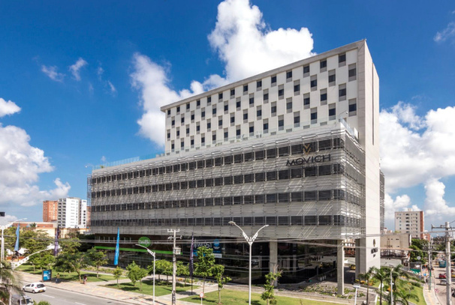
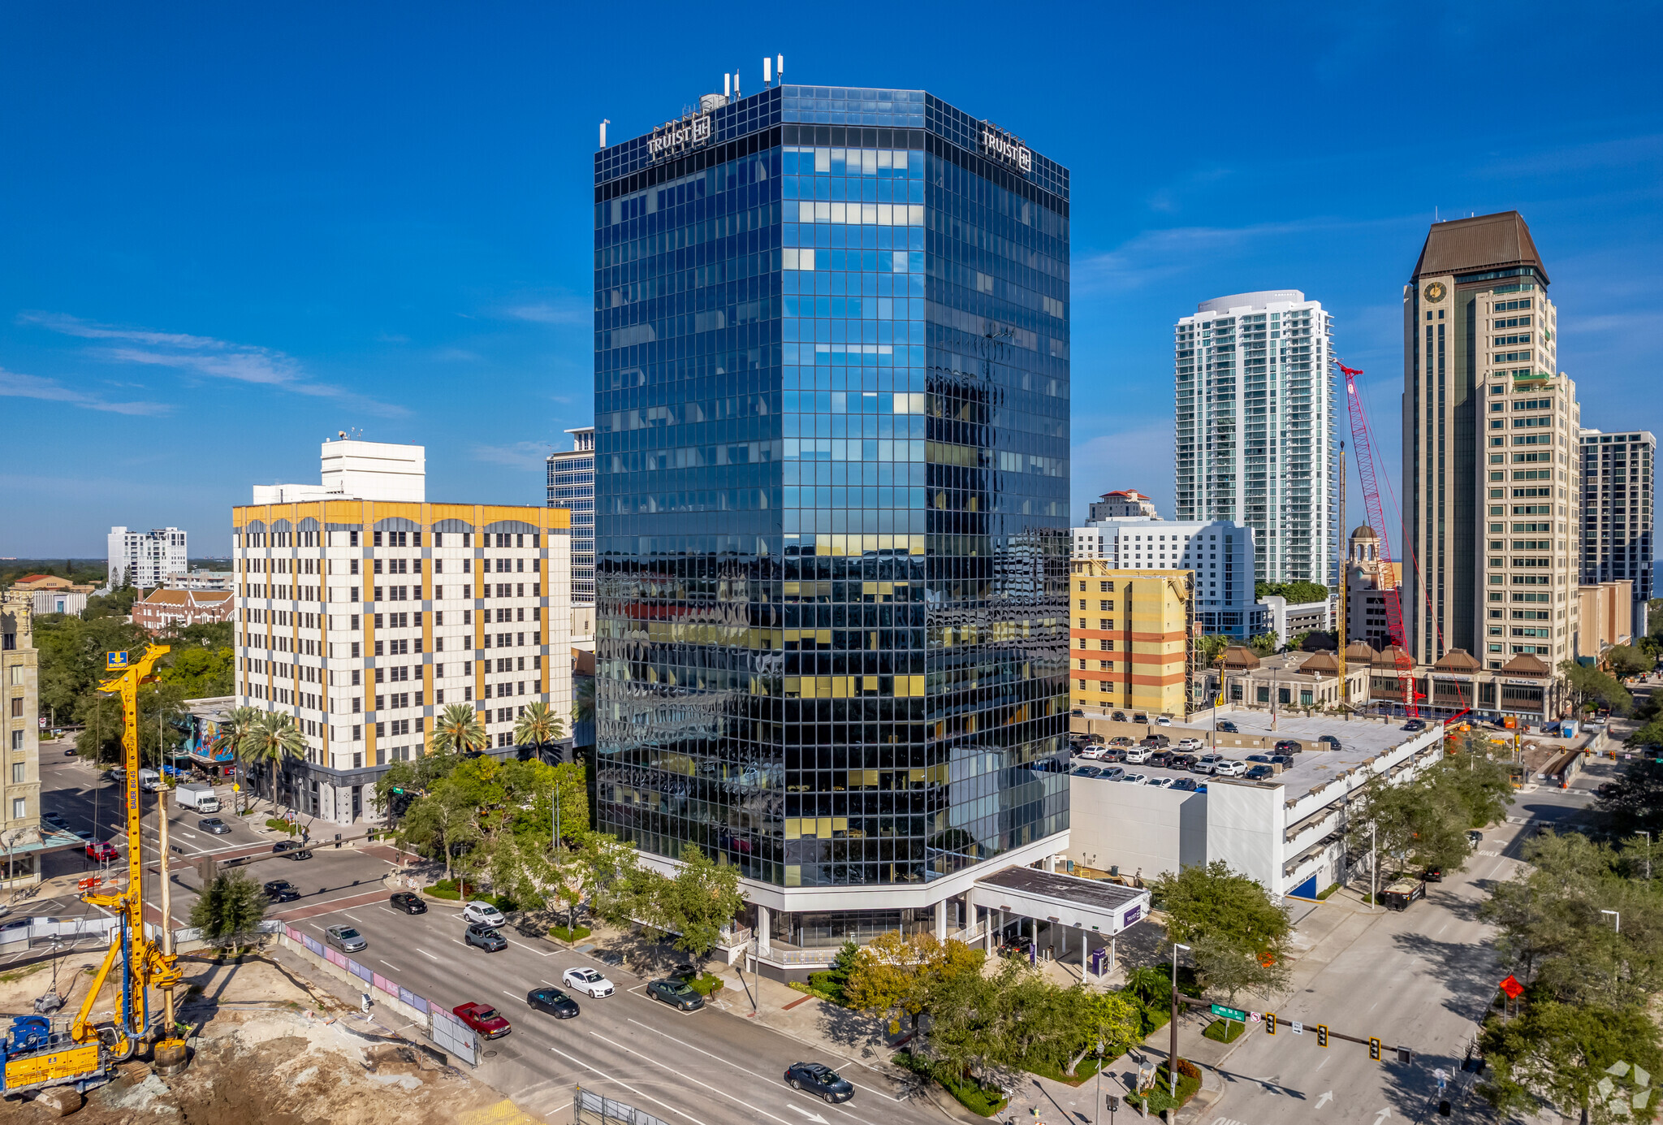
HYBRID GLOBAL LOGISTICS, LLC
our offices
BEAVER, PENNSYLVANIA
999 3RD STREET, BEAVER, PA 15009
Established: 2016
BEEMAC LOGISTICS HEADQUARTERS
PITTSBURGH, PENNSYLVANIA
HISTORIC D.L. CLARK BUILDING
503 MARTINDALE STREET, PITTSBURGH PA15212
Established: 2018
HOUSTON, TEXAS
10350 RICHMOND AVE, HOUSTON, TX 77042
Established: 2019
ST. PETERSBURG, FL
200 CENTRAL AVENUE, ST. PETERSBURG FL 33701
Established: 2022
BARRANQUILLA, COLOMBIA
CALLE. 94 #51B - 43, RIOMAR, BARRANQUILLA, COLOMBIA
Established: 2018

Slide 9
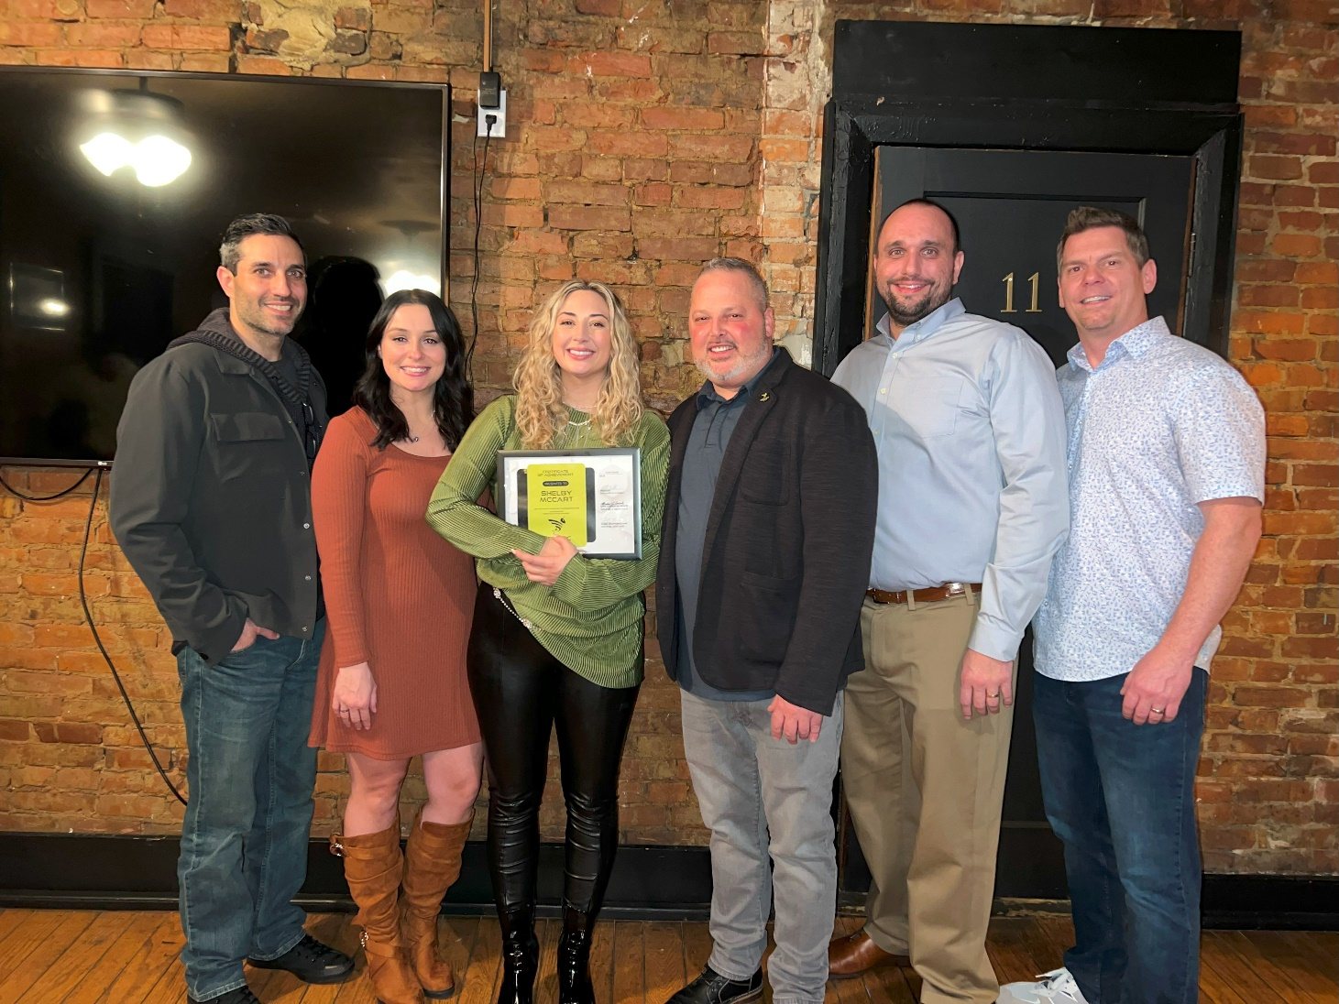
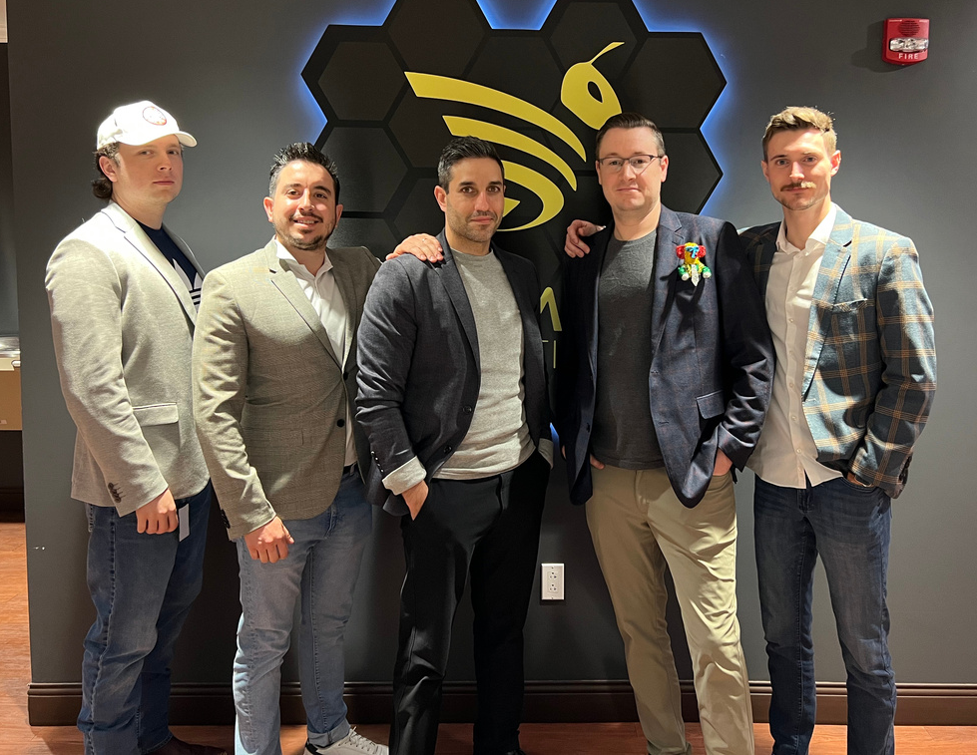
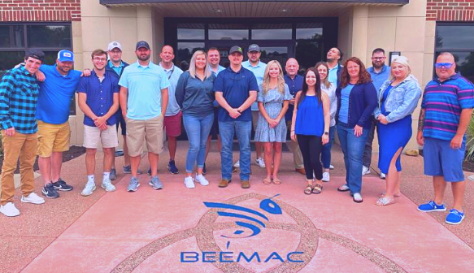
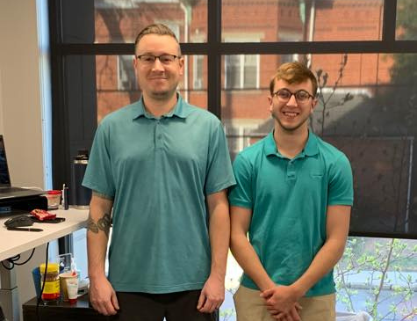
HYBRID GLOBAL LOGISTICS, LLC
beaver

Slide 10
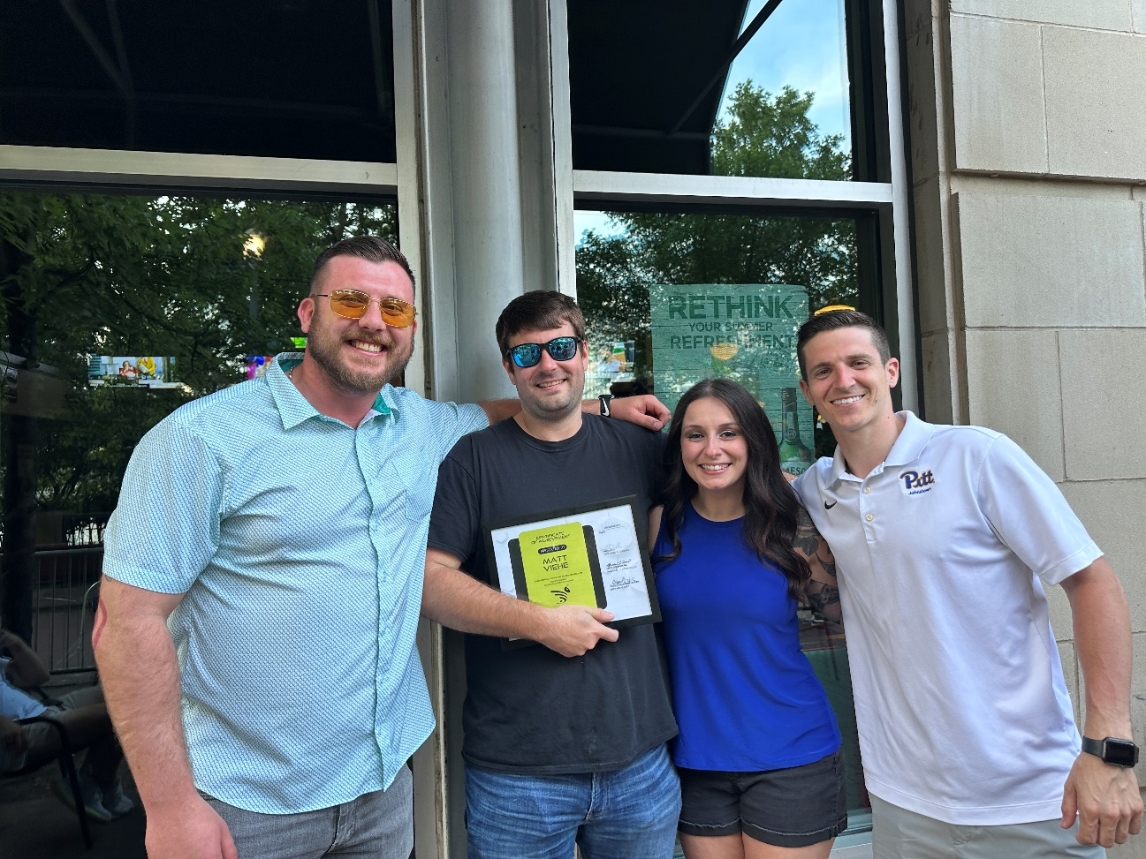
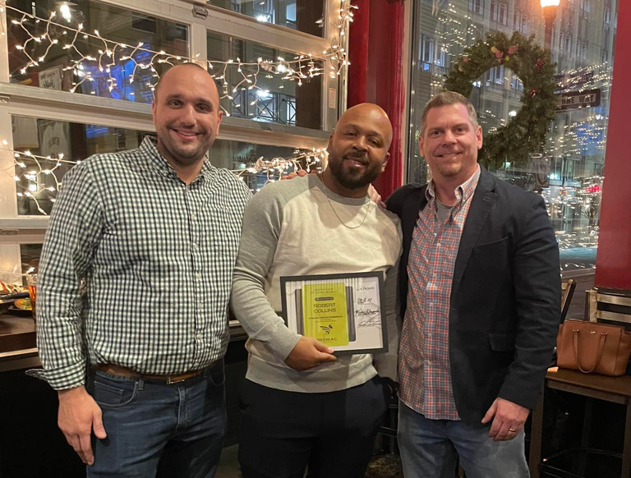
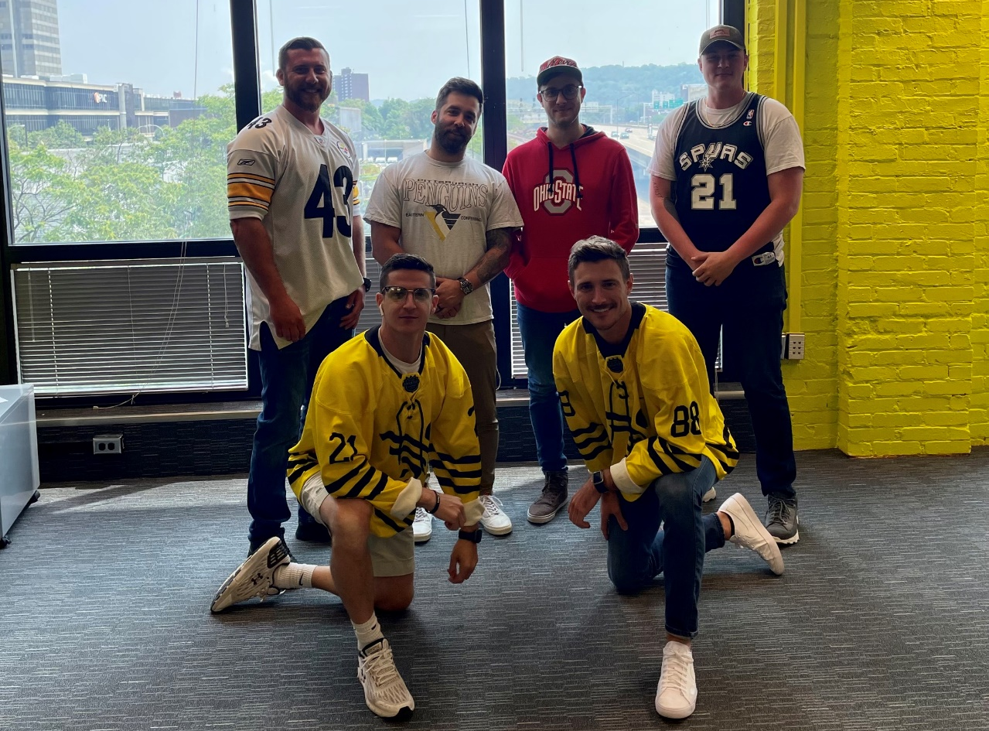
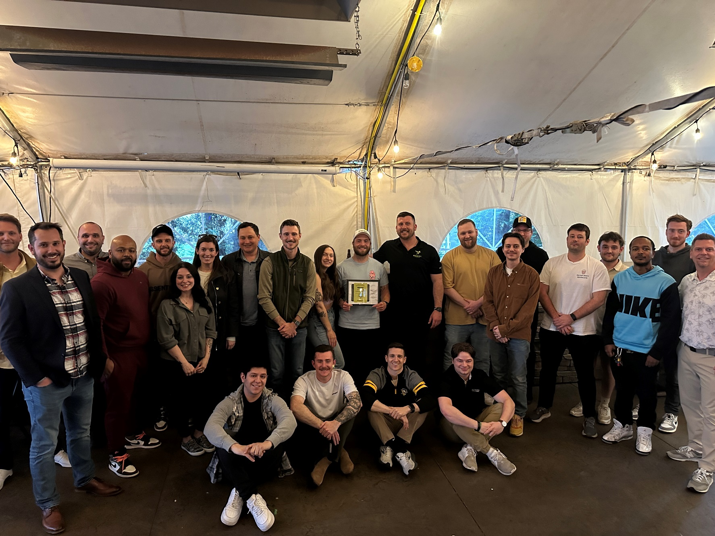
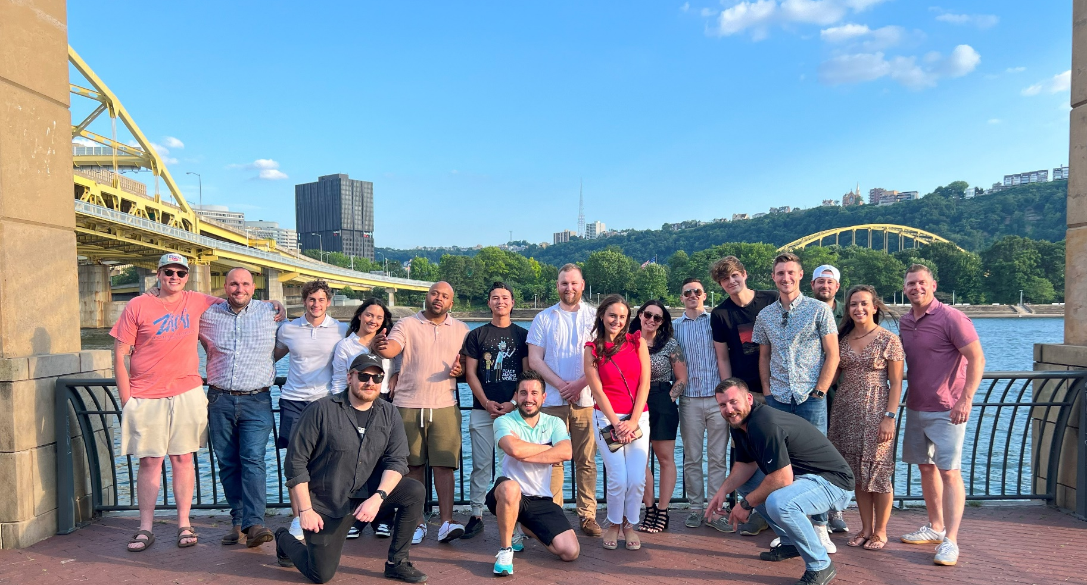
HYBRID GLOBAL LOGISTICS, LLC
pittsburgh

Slide 11
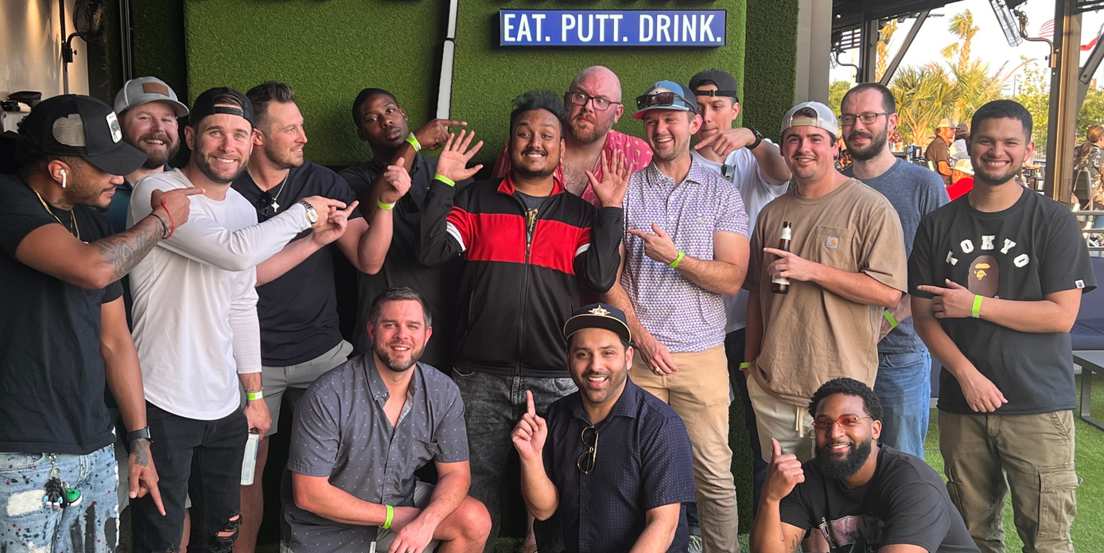
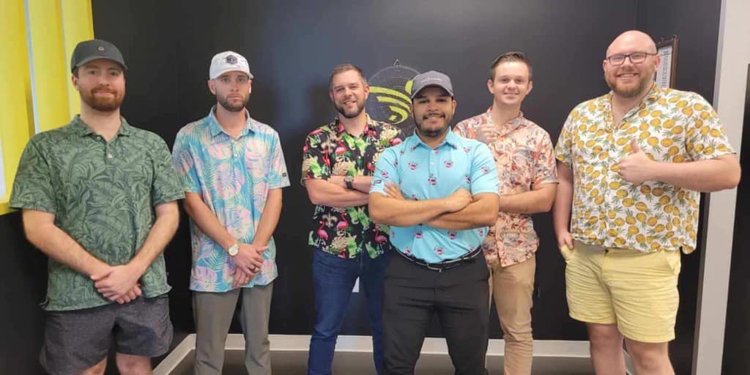
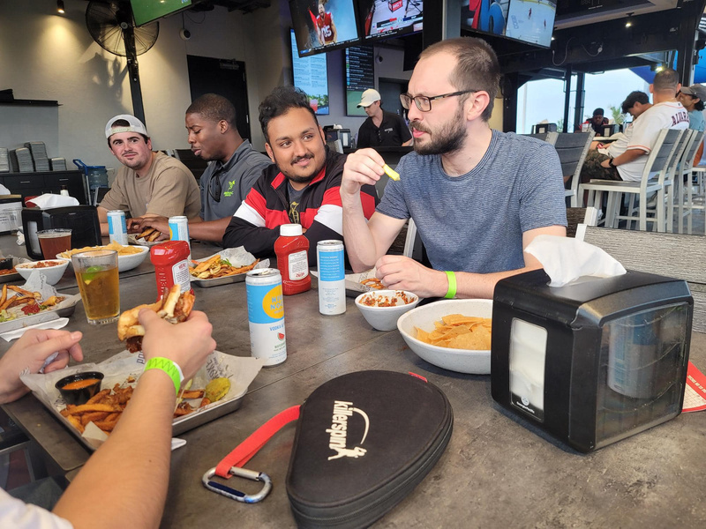
HYBRID GLOBAL LOGISTICS, LLC
houston

Slide 12
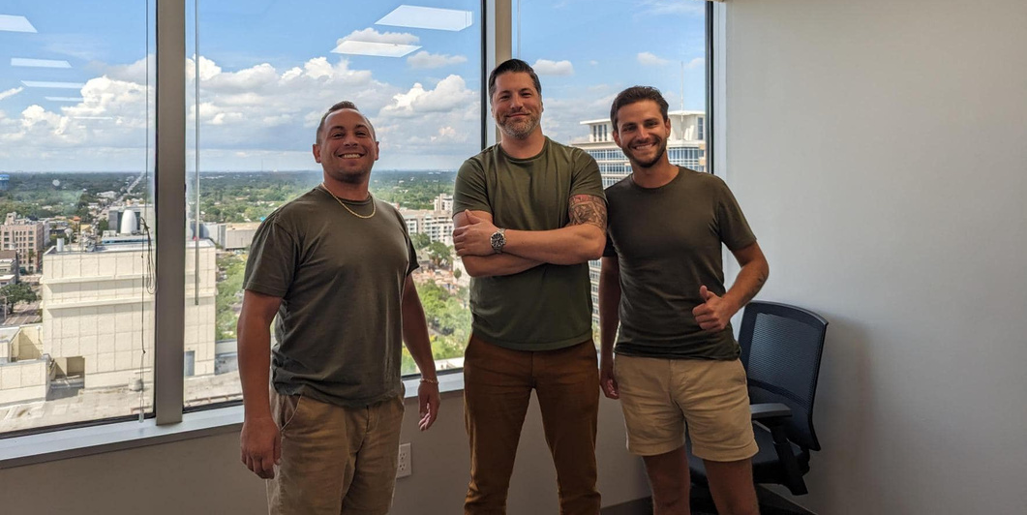
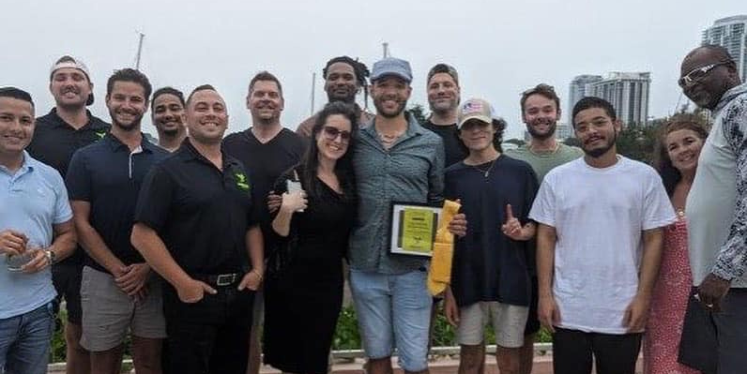
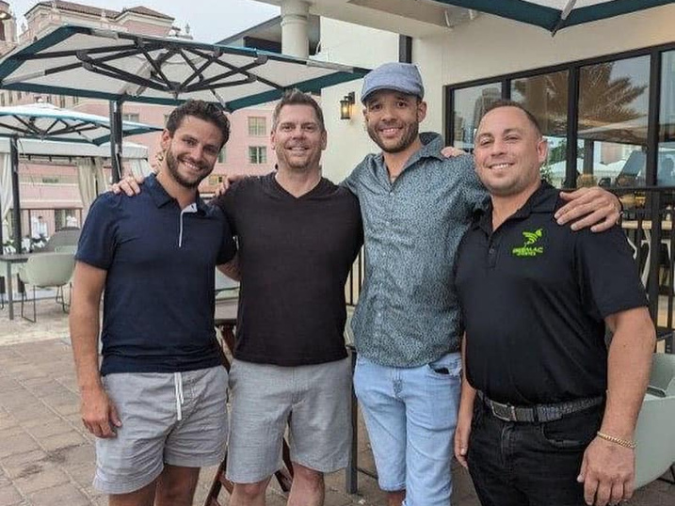
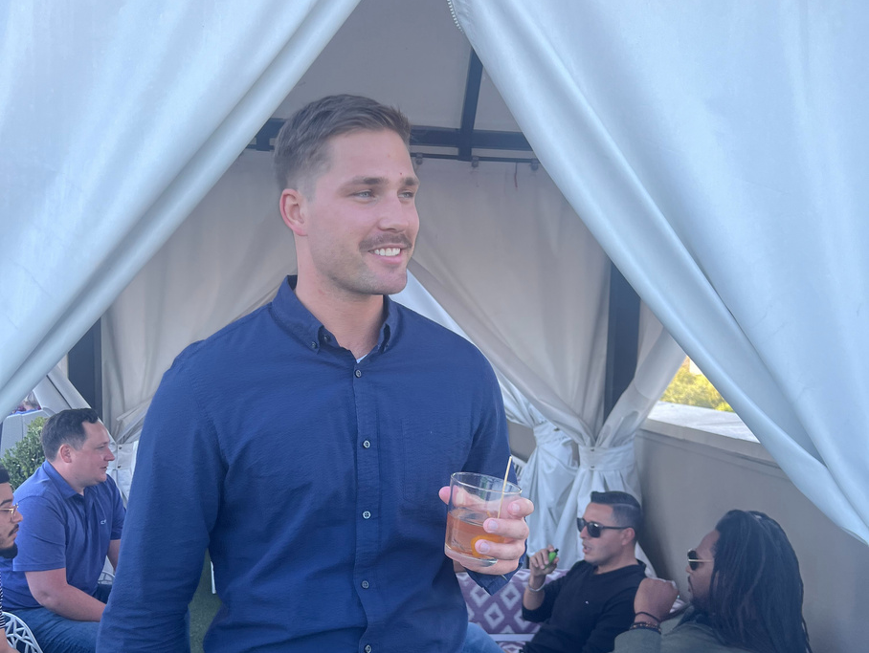
HYBRID GLOBAL LOGISTICS, LLC
st. petersburg

Slide 13
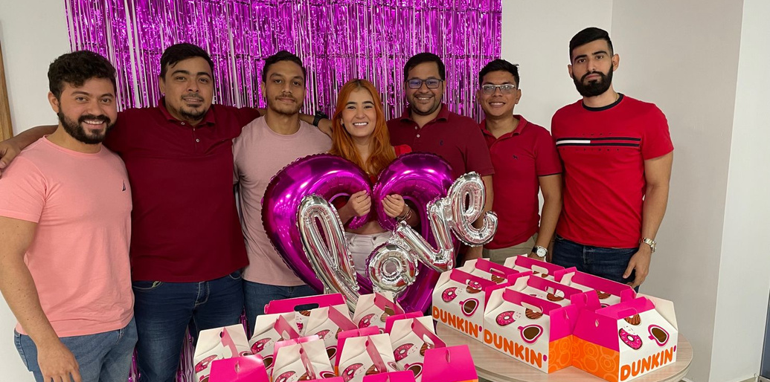
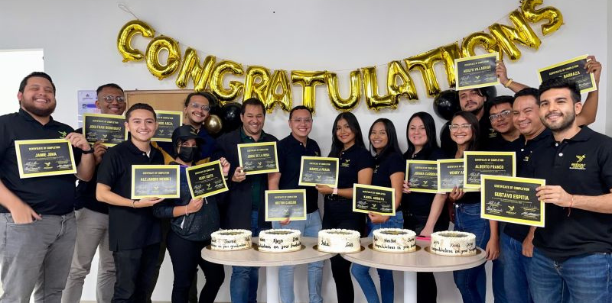
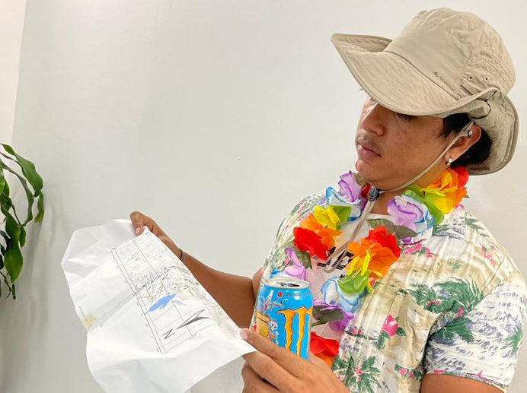
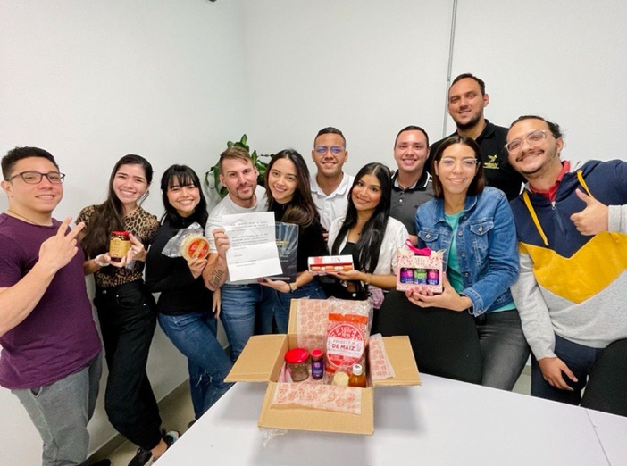
HYBRID GLOBAL LOGISTICS, LLC
barranquilla

Slide 14
HYBRID GLOBAL LOGISTICS, LLC
relief swarm
We focus on emergency relief response and community initiatives at all times.

Slide 15
HYBRID GLOBAL LOGISTICS, LLC
RICK MACKLIN
Hybrid global logistics
LOREN
DWORAKOWSKI
BEEMAC TRUCKING WAS FOUNDED IN 1984 BY RICHARD MACKLIN. HE NOW SERVES ON THE BOARD OF DIRECTORS FOR BEEMAC INC. AND AS PART OWNER OF BEEMAC LOGISTICS.
LOREN DWORAKOWSKI SERVED AS THE PRESIDENT AND CEO OF BEEMAC INC. HE NOW SERVES AS THE CHAIRMAN OF THE BOARD FOR BEEMAC INC AND PART OWNER OF BEEMAC LOGISTICS.

Slide 16
HYBRID GLOBAL LOGISTICS, LLC
RICH
CASOLI
MICHAEL CERAVOLO
MIKE
NIGRO
CHUCK
KUZNIEWSKI
PRESIDENT
CHIEF
COMMERCIAL OFFICER
SENIOR VICE PRESIDENT OF OPERATIONS
SENIOR VICE PRESIDENT OF TALENT AND CULTURE
NATALIE
HENNINGS
JON
KALCHTHALER
MARSHALL
GREER
ALLAN
HUTCHINSON
beemac logistics leadership
DIRECTOR OF CUSTOMER EXPERIENCE
SENIOR VICE PRESIDENT OF SALES
SENIOR VICE PRESIDENT OF SALES
DIRECTOR OF STRATEGIC PLANNING

Slide 17
HYBRID GLOBAL LOGISTICS, LLC
our customers

Slide 18
HYBRID GLOBAL LOGISTICS, LLC
logistics industry by the numbers
$5 TRILLION IN ANNUAL REVENUE (10% OF AMERICA'S GDP)
$35 BILLION IN FEDERAL, STATE AND HIGHWAY USE TAXES PER YEAR
EXPECTED TO GROW 19% IN THE NEXT 10 YEARS
$14.5 TRILLION IN VALUE OF SHIPPED GOODS PER YEAR
$39 BILLION PER DAY
$459,791 PER SECOND

Slide 19
Follow us on social media
LinkedIn
Instagram
Facebook

Slide 20
Thank
you

