Slide 1
PARADE TRAINING
MARCH 2024

Slide 2
CORRECT LINK AND PROFILE UP TO DATE:
New URL: app.parade.ai
If you are using the “old link” please start using the new link. The old link will no longer be available soon
Make sure your profile is set up under the correct Revenue code(s) so that you can see all your loads
Under Loads tab, on the left, your REV codes will show. If you have multiple, or need some added, Jeremy or Tanner can do that for you.

Slide 3
HOW LOADS ARE ENTERED INTO PARADE:
As soon as a load is built in Mcleod, the load enters the Parade environment.
Carriers who are active in the TMS will be able to view loads in the Beemac private portal (if they have been set up with Parade)
Best practice is to make sure your carrier has the full green circle
For maximum freight exposure, Beemac users can click the load board flag in Mcleod. This action triggers Parade to post the load to the 19 syndications (load boards) they are partnered with. Mcleod will still post our loads to Truckstop and DAT when clicking “load board” in the TMS

Slide 4
“BOOK NOW” RATE AND WHAT THE LOAD IS “POSTED” FOR:
Hierarchy of “Book Now” rate:
1.Load board rate from general continued
2.Target rate (25%)
3. If no rate listed and no customer rate listed, no BN rate
Load board rate is $2689 in Mcleod
Book now rate is $2689 in Parade

Slide 5
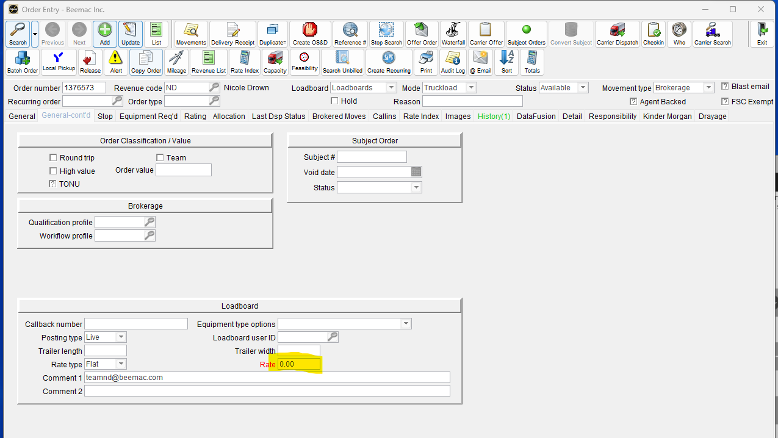
If you leave the rate “blank” in general continued with no rate, the “book now” rate will be 25% as long as there is a customer rate entered in TMS. This rate will show on the load boards as well.
In this example, customer rate is $2075
Load is posted with no rate in TMS
Book now rate is $1556.25
If you wish to truly post a load with “No rate” – make sure there is no rate in load boards field, and no customer rate in Mcleod. This will reflect in Parade and the load boards as a load with no rate
You can also manually change the book now rate directly in Parade

Slide 6
SOURCING CARRIERS THROUGH PARADE:
Sourcing Tab
Sourcing tab goes back one year looking at historical data(there is a column to show 90 days to help define further)
The search includes a radius (75 miles @ PU and 100 @ DEL)
The results will show carriers who ran a similar lane in our network and/or has had available capacity that matches that lane

Slide 7
EXAMPLE LANE: PITTSBURGH, PA TO CHICAGO, IL FOR FLATBED
Your Carriers are defined as: in Network carriers

Slide 8
SENDING BLAST EMAILS
Select all, and copy email addresses – this will quickly copy all the carrier contact emails for you to BCC a blast email to and offer a load to
You can only copy the emails from “your carriers”

Slide 9
PUBLIC CARRIERS ARE ALSO AVAILABLE
Public Carriers (additional capacity sources) are defined as: carriers who could be a good fit for that lane that are either in network or out of network. This data is also supplied with inspection data from FMCSA.
Please note if you find an out of network carrier you will have to onboard them on the TMS

Slide 10
DIRECT MATCHES – FOUND UNDER LOADS
Direct matches are defined as live capacity sources based on the following signals defined below:

Slide 11
SUGGESTED MATCHES
Suggested Matches are defined as potential capacity that has came from historical signals. (Same signals from the sourcing tab).

Slide 12
PAST SIMILAR LOADS
Defined as: carriers that have ran this lane before within a built-in radius

Slide 13
REPLYING TO CARRIER QUOTES
Receive notification Via email:
You can reply via email
Click accept, counter or decline
Customer rate needs to be entered in TMS for a load to be “Bookable”
Subject orders are not bookable

Slide 14
All Beemac users will have final say when booking a carrier and will still need to send a rate con from Mcleod

Slide 15
ENTERING LANE PREFERENCES AND TRUCK POSTINGS
Ask every carrier you talk to what their lane preferences are and enter them below:

Slide 16
Survey
Auto Accept Under Max (AAUM)

