Slide 1
Customer Service

Slide 2
Customers
CONTACT-Daily contact is a requirement of good customer service. Phone calls are best, but emails and/or texts can work as well. Often, we only think of contact when we are completing a task or need something. The reality is that the best contact is sometimes just to say hi! This will go a long way in building relationships. Learn a bit about them but be sure to keep it professional.
Quotes- Be prompt and thorough. Requests should be addressed within 15 minutes of receipt
Shipments- Read and understand all releases. Ask questions about the expectations and provide feedback. BEE the expert. Understand what you are being hired to do
Releases- contact shippers to confirm relevant information:
Pick up number
Commodity
Piece count and weight
How they load
Hours and appointment requirements
Accessorial (tarping, PPE, lumper, etc. and expectations)
Pickups and Deliveries – updates should be given when the loads are confirmed shipped and delivered. The customer should never have to ask.
POD’s – supply your customer with the documents as soon as you can. This will make their job easier, and get billing done quicker.

Slide 3
Carriers
Carriers are often not thought of in the same light as our customers. Our carriers are the life blood of our business and without them we cannot do what we do. Treat them with respect and help them to do their job as well as you want to do yours!
Provide all details about the shipment
Commodity
Hours/Appointments
Requirements
Expectations
Rate
Provide all of your contact information – they should not have to guess about who they are dealing with, and there is more than one person with the same name. Identify yourself!
Confirm all of their contact information (driver name and phone as well- this is imperative for tracking and knowing how to update your customers)
Schedule all appointments
Enter all of the above on the rate confirmation. Be sure to include phone numbers as well. Doing all of the above and not adding it to the rate confirmation does not do anyone any good!
Provide all documents needed to load or unload (BOL, customs docs, delivery orders, packing slips, etc.)

Slide 4
Coworkers
Our coworkers are an extension of us when it comes to providing service to customers and carriers. In order to provide the best service possible, we must rely on each other and treat each other with respect. We cover freight for each other. We tap into each others experiences to help with our own.
Answer all calls – TWO RING MAX
Sell each load as if its your own
Take detailed messages
Share ideas, rates, knowledge

Slide 5
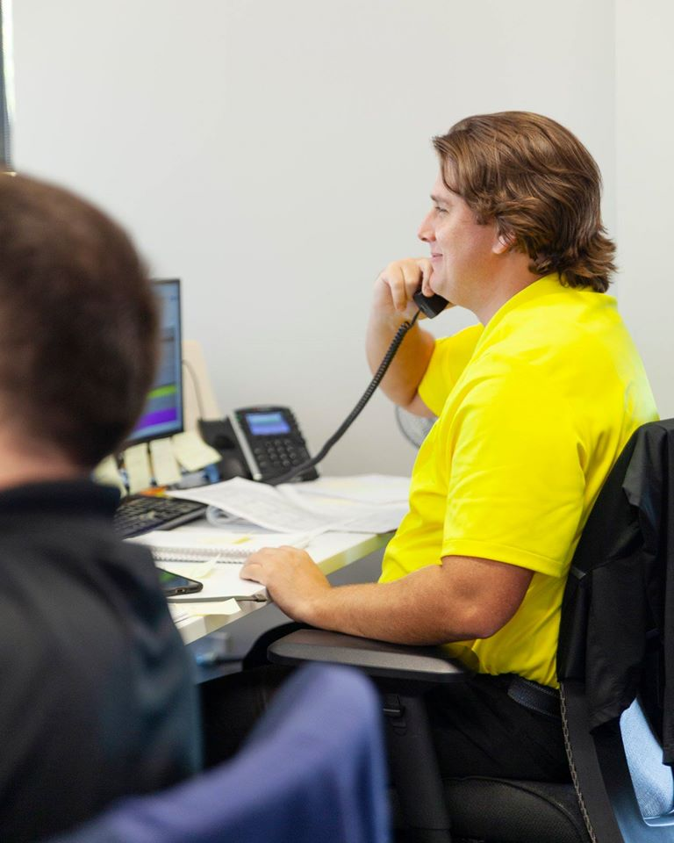
Front Stage Vs. Back Stage
Front Stage- our presence in the office and on the phone.
Always being “show ready”
Back Stage-support areas, training & conference rooms.
Walk the floor like a customer; are there any conversations that should be back stage

Slide 6
Needs
To best understand customer service overall we have to take a look at needs!
Basic Needs- applies to everyone; food, water, shelter, air, etc.
Business Needs
Internal-paychecks, benefits, safety, comfortable working conditions
External-consistent communication, detailed information, follow up
How do we determine our customer’s needs?
By listening closely and asking questions!

Slide 7
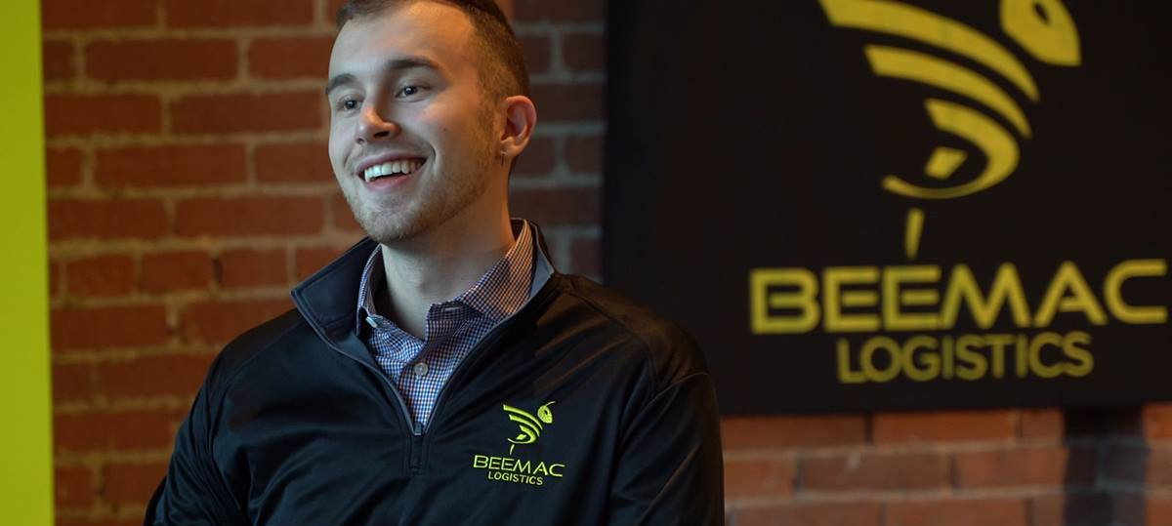
Wants
Now lets take a look at wants!
What is it that most people want on a personal level?
-To feel welcome, understood, comfortable and appreciated!
So what are our wants for our customers and carriers?
-They want accuracy, what has been promised, assistance, attention, accessibility, and polite/interested interactions!
We can’t just assume we are meeting the wants, expectations, and needs of our customers and carriers. We need to be PROACTIVE not reactive.

Slide 8
Emotions
Emotions are how we gauge successful customer service!
People react well to positive situations and poorly to negative situations.
Consider the following scenario:
Take a regular customer that you’ve been working with for several months. During every interaction that you had control over, you’ve provided excellent customer service. Today, the customer calls in about a tricky situation that you have no control over. Is this customer more likely to be understanding of the issue at hand?
YES! It is important to know what you want your customer’s experience to be at the emotional level, and now that you’ve laid the ground work for exceptional customer service they will be more likely to be understanding and work with you during a difficult situation.

Slide 9
Stereotypes
To better understand our customers and carriers, we must understand what the stereotypical perceptions are.
People often think of salespeople as liars, bad listeners, greedy, easily replaced, and that they only look out for themselves.
Now think about what we WANT our customers to think about us!
We are organized and knowledgeable
We are trustworthy and honest
We are respectful, courteous, friendly, and willing to help
We provide quality service
We communicate well
So how can we begin to project POSITIVE stereotypes?…

Slide 10
Stereotypes
How can we begin to project POSITIVE stereotypes?
Make GREAT first impressions with your attitude
View customer service as a part of your job and not an interruption to your job
Understand your customers’ and carriers’ needs/wants/expectations
Understand that our company goals and your personal goals are intertwined as we both enjoy success and prosperity

Slide 11
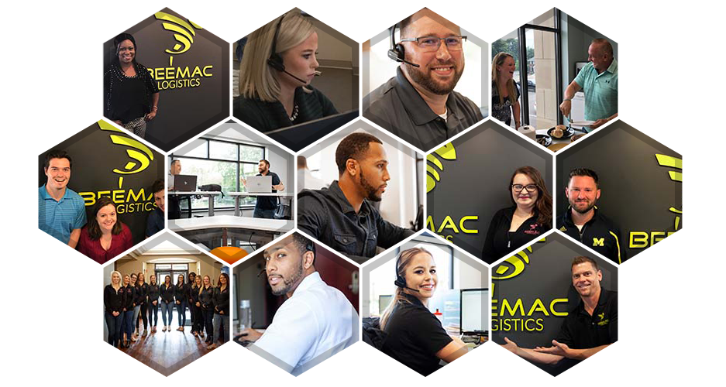
Customer Service & Communication

Slide 12
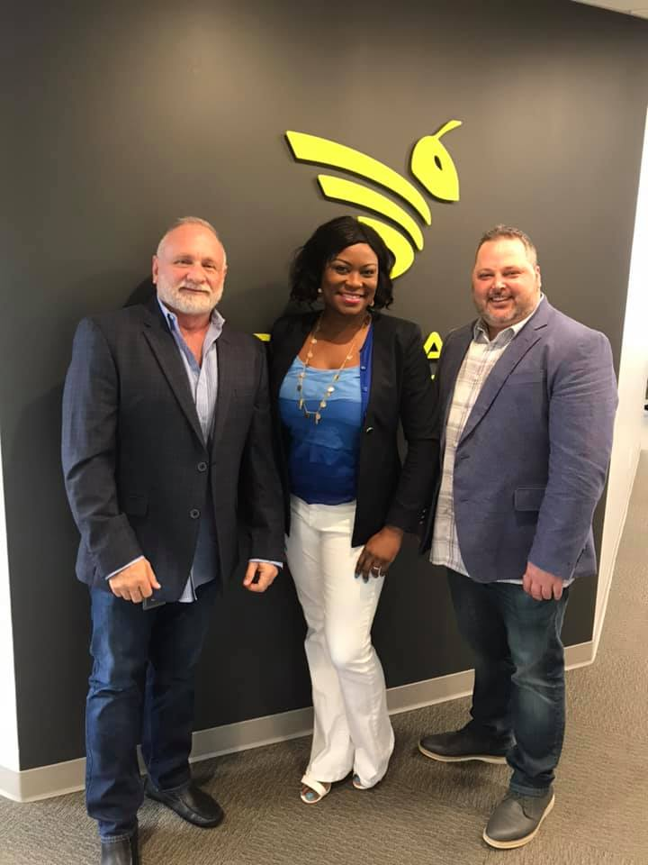
Communication
We are ALWAYS communicating!
Everything we do communicates an attitude, a style or emotion.
The way we are dressed, how we make an entrance into a room, our handshake, eye contact, facial expressions, gestures, posture, our emails, verbiage in voicemails and tone of voice on phone calls all create an image.
Does your image portray good customer service?

Slide 13
Communication
REMEMBER-Good customer service starts with the minute you pick up the phone either as the caller or the receiver!
Studies suggest that tone of voice can account for 86% of phone communication while the words we use account for approximately 14%.
A lack of emotional sensitivity to voice tones can create communication problems, especially over the phone as the listener does not have the luxury of seeing you and your body language. When paying attention to tone, concentrate primarily on changes in the voice qualities of the person you are listening to!

Slide 14
Communication Telephone Techniques
Don’t Say
Do Say
He hasn’t come in yet
She’s on her coffee break
He left early today
She’s sick today
He’s on vacation for the next two weeks
I believe he went to the bathroom
I don’t know
We can’t do that
He’s not in the office at the moment
She’s away from her desk at the moment
He’s out of the office until tomorrow
She’s not in the office today
He’s out of the office for the next two weeks
He’s away from his desk, how may I help you
Let me find out for you
Let me tell you what I can do

Slide 15
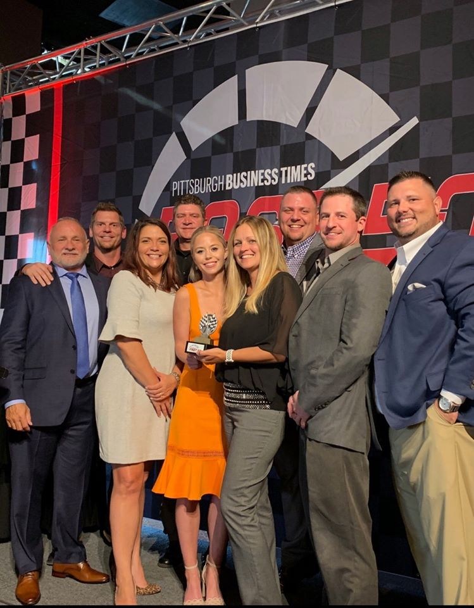
Customer Service Moments of Truth
A moment of truth occurs when a customer comes into contact with a company and forms or changes their opinion about the quality of that company’s products or services.
There are THREE outcomes for every moment of truth!
Lets learn MORE!

Slide 16
Three Outcomes For Every Moment of Truth
Neutrality: This is what often occurs during customer interactions. This is neither good or bad customer service; it is just neutral. During this moment the customer’s basic expectations were met. Customers who experience neutrality feel satisfied but will not reward the company with loyalty. These customers are only your customers because they haven’t found a better company.
Misery: This is created each time you fail to meet the customer’s expectations. Often, misery results in negative or damaging opinions of the company and encourages the customer to speak to others about their experience. The end result of a misery moment can include negative word-of-mouth discussions, damage to the company’s reputation, and loss of customers. For every miserable moment of truth that a customer receives they tell approximately 11 people!
Magic: This is created when you EXCEED the customer’s expectations. Service must be truly outstanding and employees must go above and beyond the customer’s expectations to create that moment of magic. Magical moments can lead to positive word-of-mouth discussions, increased profits, improved reputation, repeat business, and new business!

Slide 17
Why Are Moments of Truth So Important
They are unexpected, and therefore REMEMBERED
They exceed expectations
They create world class service
They create LOYAL customers and carriers

Slide 18
Bringing Quality of Service to Life
CARE: Attitude is everything! Care about your customers and carriers in a sincere way and show that you actually value each one as an individual. Care about your organization by gaining and maintaining a reputation following high ethical values.
THINK: Find ways to go from good to GREAT! You can always learn more. Read, ask questions, learn from experts, pay attention. Become an expert at making excellent customer service one of your top priorities.
ACT: Act on what you’ve learned and take your customer service to the next level. There is always room for improvement in every situation. Remember that YOU have the power to do something well. Envision what you want and work hard to reach your goals. Be engaged!

Slide 19
Customer Service
ANY QUESTIONS/COMMENTS???

