Slide 1


AVRL GENERATION & BEEMAC
DECISION-MAKING TECHNOLOGY
2.15.24

Slide 2

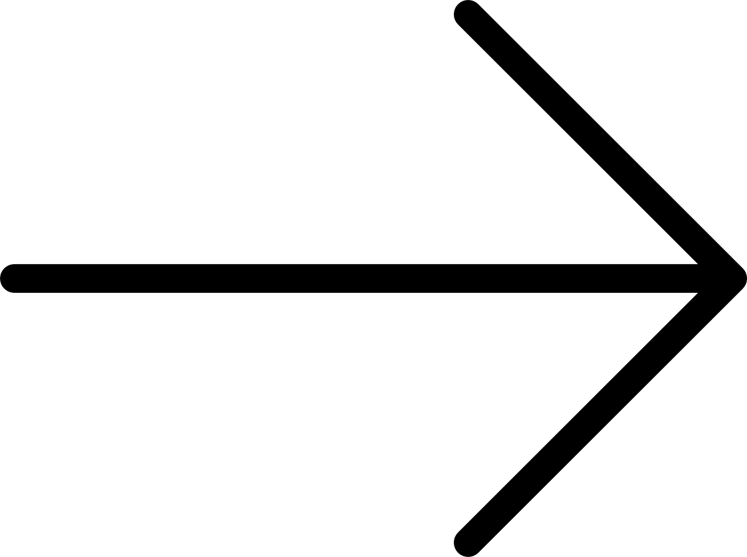
AUTOMATIC BIDDING – WHY
Beemac did a deep dive into our accounts and identified a gap between loads being offered and loads being bid. We believed that opportunity to be as high as 10,000 loads a week that were not being bid.
The main factors we identified leading to the gap in loads bid are:
  TIME – some accounts are posting 100’s of loads per hour, quoting them all would be a full-time job by itself having to manually switch between the TMS and Greenscreens
  FEAR – inherently we are more comfortable moving freight we know and are comfortable with. Automation removes that fear and opens door into freight opportunities otherwise avoided
  DATA VISIBILITY – we now have visibility into all loads our customers offer via a TMS, what we bid, what we won, what we lost – critical data points to make strategic sourcing decisions and equip you to provide solutions to your customer

Slide 3
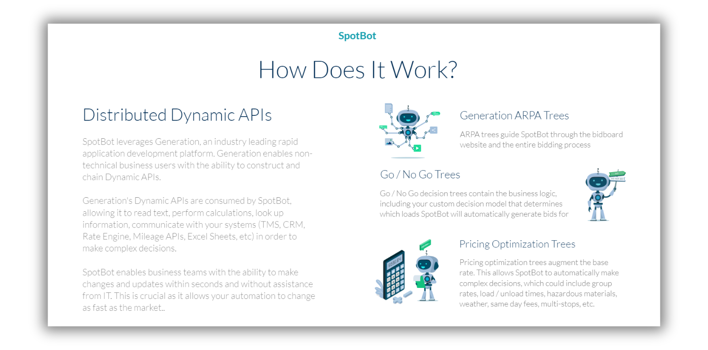
AUTOMATIC BIDDING – HOW

Slide 4
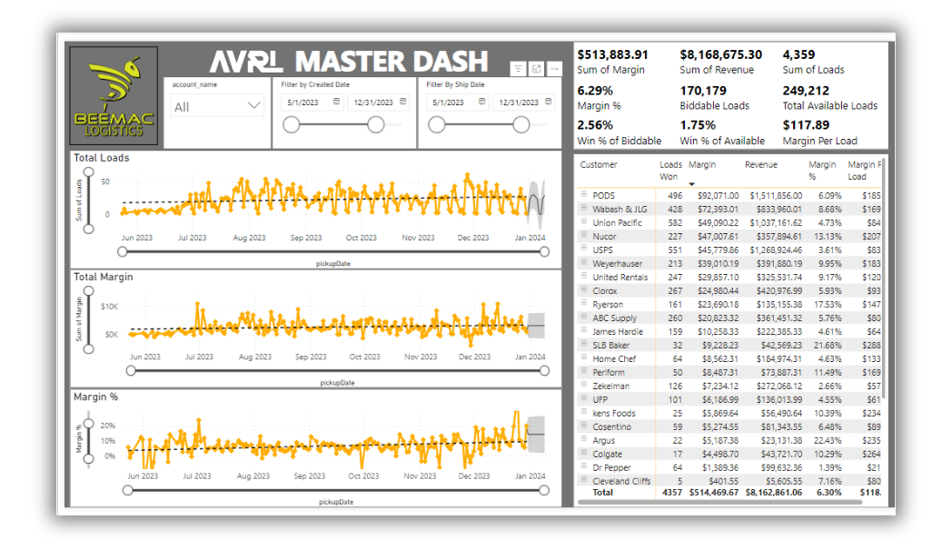
DOES IT WORK?
249,212 Total available loads
170,179 Biddable loads
$513,884 Margin
6.30% Margin %

Slide 5
IDENTIFY & ONBOARD AN ACCOUNT
  Identify the account and relay login information to avrl@beemac.com or Natalie/Allan
    TMS based
    Auction/Bid environment
  Schedule intake call
  Test account
  Turn on account
  Monitor automation and tweak logic

Slide 6
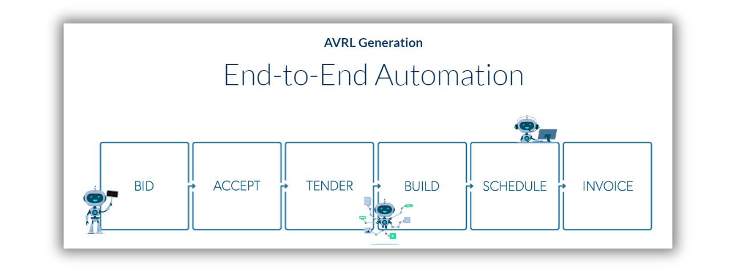

Slide 7
THANK YOU

