Slide 1
ELD
STANDARD OPERATION PROCEDURE
TRUCKER TOOLS

Slide 2
Load Tracking is crucial because it provides a clear roadmap for developing and implementing effective tools that can greatly impact the trucking industry.
Definitions:
ELD: Electronic Logging Device
TT: Trucker tools
PU: Pickup
DEL: Delivery

Slide 3
Load Track
You can see 3 different colors on the Early PU or Early DEL columns in the board if the carrier is tracking with the Trucker Tools app.
YELLOW: this color means he must be aware of the window time of the load because tracking can be late or is almost time to be at the Pickup location
ORANGE: this color means that the carrier won't be able to arrive on time due to the distance.
RED: this color means that the PU time has arrived and the carrier still not at the PU location

Slide 4
Installation of the application
1. Driver receives a text message. Ask the driver to click the link.
2. The link takes you to App Store/Play store, please ask the driver to Install/Download Trucker Tools App.

Slide 5
How to start tracking
2. The driver will be able to see the basic information of the load.
1. Click Load track to view Load Track Details
The driver will be able to view information such as the PU#, dispatch comments, how to contact the broker, the button to start tracking and the stops he must make (#1 PU and #2 DEL).
Every load is different so, the information will have other cities, states and sometimes additional stops to PU or Drop

Slide 6
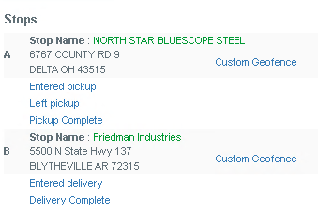
3. This is the Window the driver will see after they start to track the load, trucker tools will be able to inform you once the truck is at the perimeter of the PU or DEL location.
The driver can mark as "completed" once the truck is loaded or unloaded, he can end the track once the load is complete, he can pause the Track and he can send the documents such as the BOL or the POD via Trucker tools.

Slide 7
Send Comments “Two-way Communication”
The driver can also send comments via trucker tools to communicate with the broker, and you can also send texts to the driver via Trucker tools. This is called “Two-way communication with the Driver.”

Slide 8
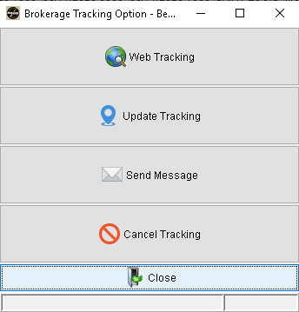
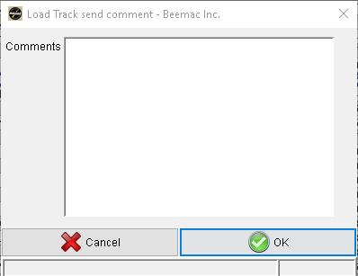
This is the broker part of the message, click on send message, write the text you will send to the carrier and click “ok”.

Slide 9
Scan documents
To scan any document, the driver must click on “Scan document” use the device to take the picture and set the Title, then click on send or rescan if the picture is not properly scanned.

Slide 10
Example of how is scanned and cropped the document.
a

Slide 11
Details of the load
The driver also can specify the information of the load, as the Pieces, the weight, the BOL# or POD#

Slide 12
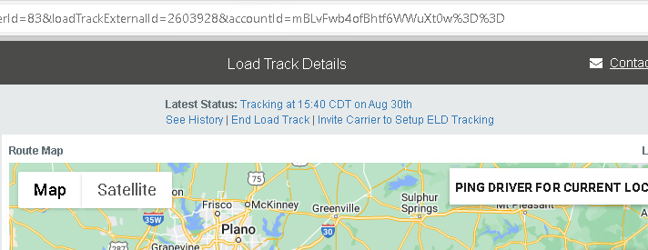
Invite Carrier to Set up the ELD (Electronic Logging Device)
1. You must click on “Invite Carrier to Set up ELD Tracking.

Slide 13
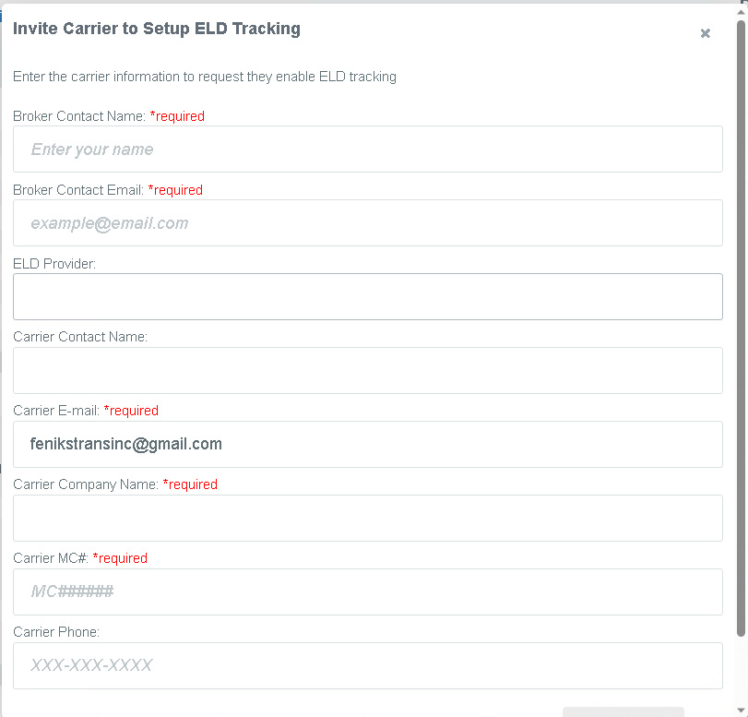
2. You will fill out the Broker contact name (a better option would be if you set your team group name), the broker contact email address (Team email address so that the group can see all the emails), the ELD provider (Motive, Samsara or other device), the carrier contact name, the carrier Email, the Carrier company name, it's important to set the MC# and the carrier phone number, then click submit.

Slide 14
3. Carrier will receive an email like this, please tell them to click on “Click here to set up ELD tracking.”

Slide 15
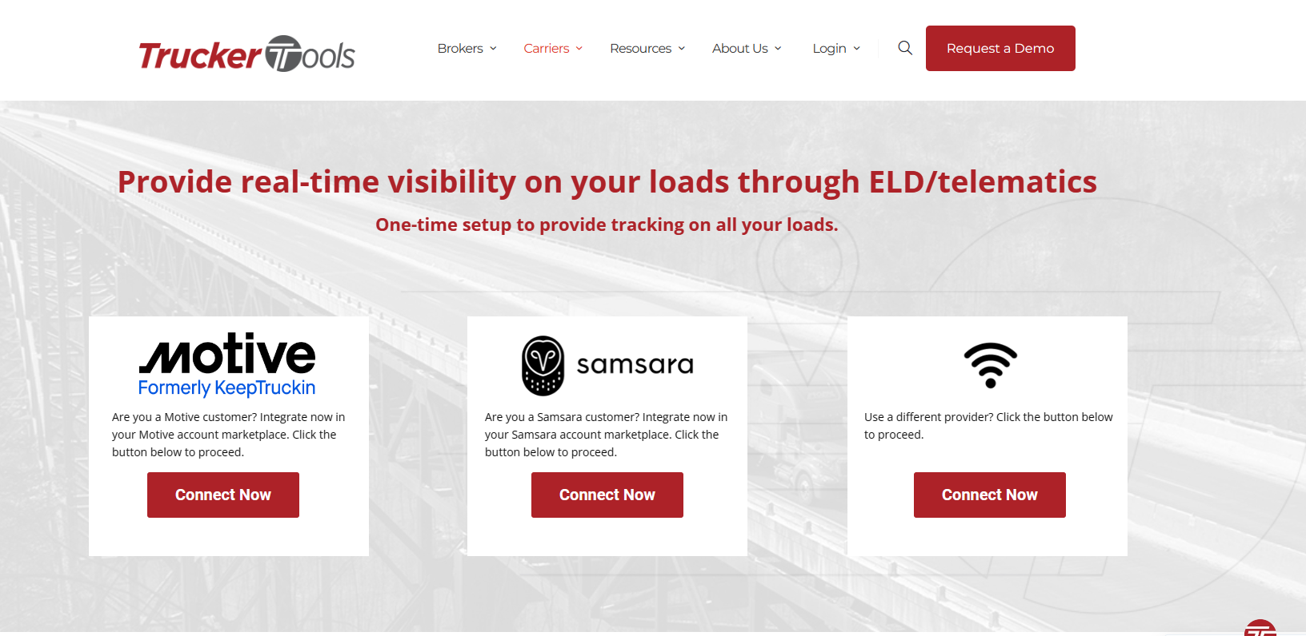
4. The carrier will be redirected to the Trucker tools webpage.
Please be aware that if the carrier has Motive or Samsara as ELD providers, they will need all the information required given by the provider at the moment of the setup, specific information such as codes or numbers for the profile. If the driver is setting up for the first time, please tell them to click on Connect now and “use different provider.”

Slide 16
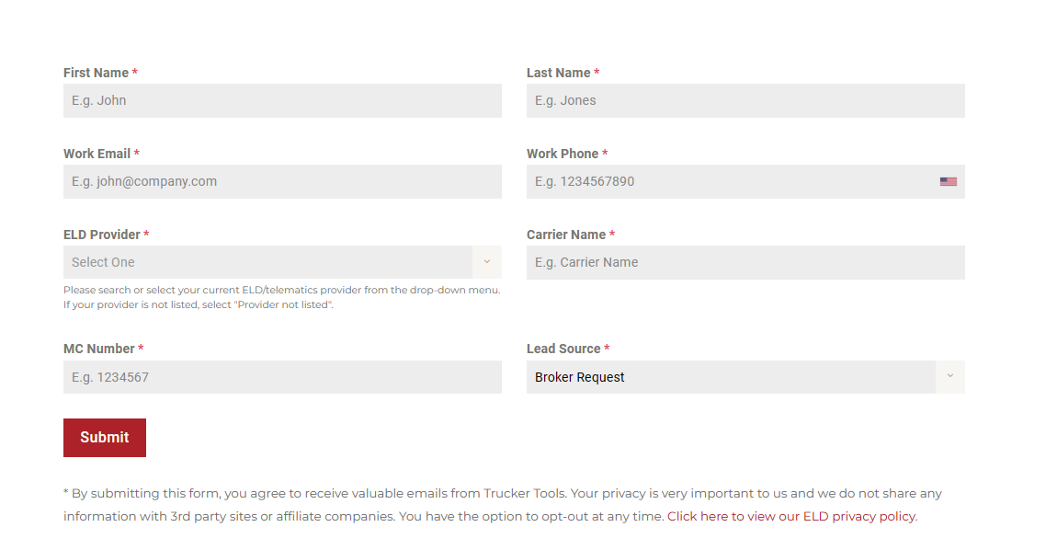
5. After the carrier clicks on "Connect Now", they will be redirected to fill in the information to set their profile and continue to track as ELD. (Please remember to let the carrier know about setting “BROKER REQUEST” on the Load source part of the information)

Slide 17
6. Once the process has been completed, on the Trucker tools portal in McLeod, you will have to click on “Change to ELD tracking.”

Slide 18
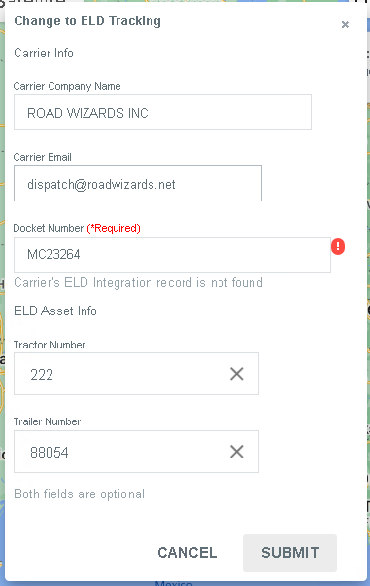
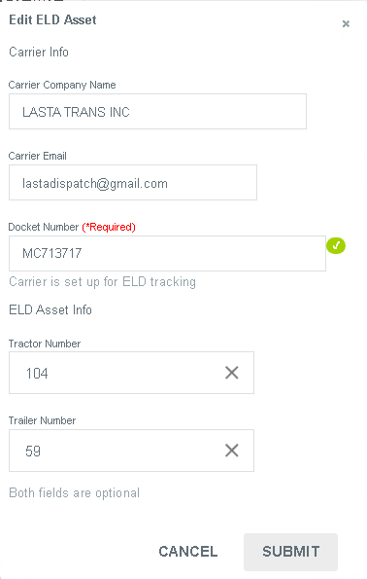
7. You will be able to see this window, If you see a Green checkmark, you only must ask for the trailer and truck number and set the MC, click on submit and the change will be made. Wait around 10 min to see the tracking working properly at McLeod.
NOT READY TO USE ELD
READY TO USE ELD

Slide 19
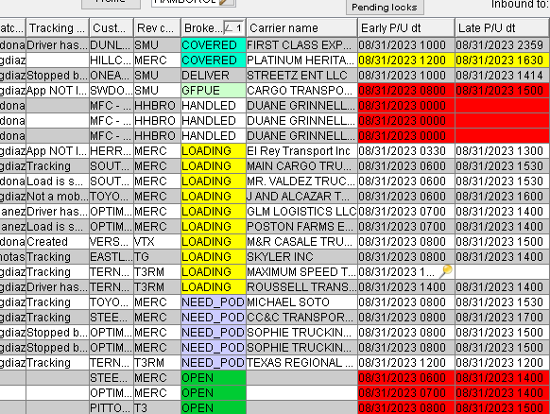
Send link for the Load Track
Double click on the empty space of
the tracking column

Slide 20
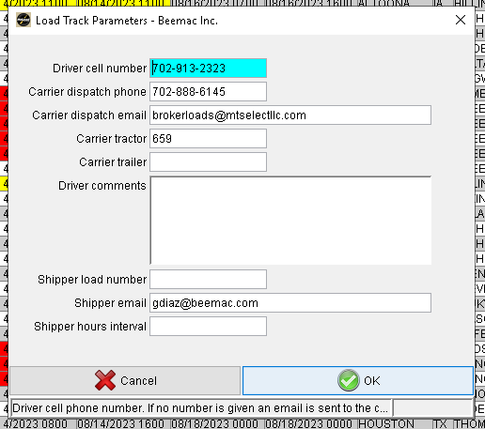
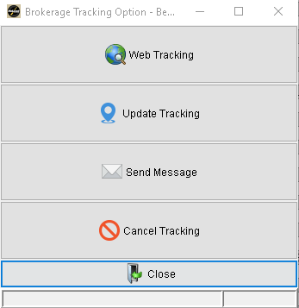
Please confirm that the driver and dispatcher numbers are correct.
In the driver comments section, you can set a specific text that
you would like the driver to read and click “ok.”
Once you have sent the tracking link and the carrier accepts it,
you will be able to read “Tracking” in the column,
If you double click on the column you will be able to see this window
and then click on “web tracking.”

Slide 21
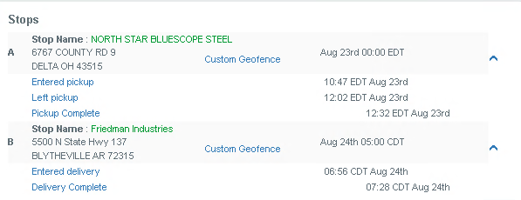
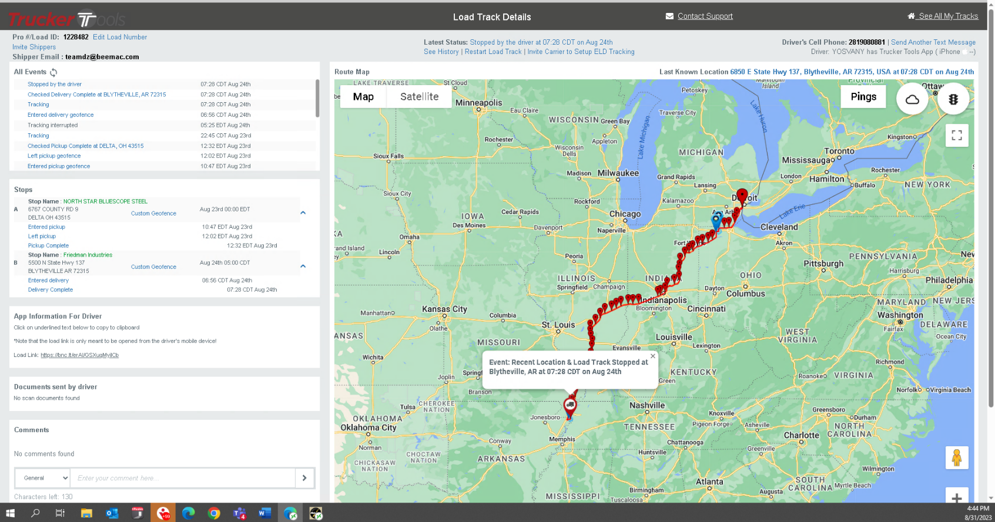
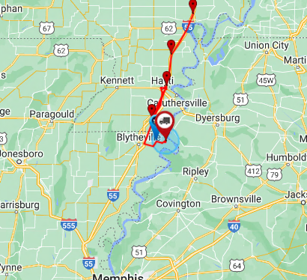
Now you will be able to see this window (the trucker tools portal).
You will be able to see on maps where the truck is and if the driver
has arrived at the shipper or the receiver.

Slide 22
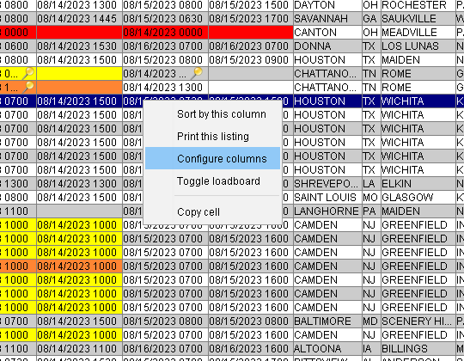
How to filter columns on the board
Right Click on any part of the columns and click “Configure columns.”

Slide 23
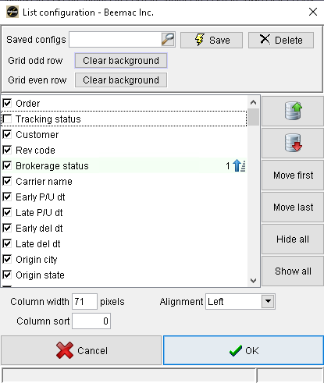
You will be able to see this window and you need to look for the “TRACKING STATUS" Check box and activate it to see the tracking column on the board.
The order of the check box in this window, is the order of the columns you will see on the board.

