Slide 1
TRACKING LOADS through Mcleod
BEEMAC LOGISTICS

Slide 2
Trucker Tools App
Highlights:
The ultimate app for Truckers on the road
More than 20 features and functionalities including
Real-time fuel prices, most accurate truck stop
guide, truck specific routing and fuel optimizer
Weigh scales, rest areas, truck wash locator, weather and more
~450,000 Truckers
Free App for the Truckers
A Trusted Brand with Truckers

Slide 3
Load Track Process
Load Track Use Case
Step 1:
Dispatchers & Brokers post Load Track in McLeod TMS software (or our web portal)
Step 2:
Driver receives text message with the link to open or install the App and see Load Track details
Step 3:
App automatically starts tracking and will send location updates every 5-15 mins along with pickup & delivery alerts
Step 4:
Dispatchers & shippers view the route map and pickup & delivery alerts in TMS software (& website)
Typical day looks like….

Slide 4
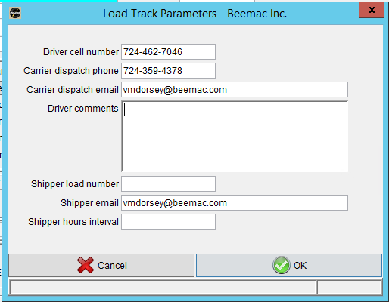
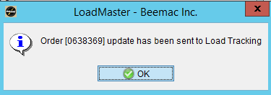
HOW TO SEND A TRACKING REQUEST THOUGH MCLEOD TO THE DRIVER
ENTER IN DRIVER INFORMATION THEN CLICK BROKERAGE TRACKING

Slide 5
TRACKING STATUS COMMUNICATION VIA EMAIL

Slide 6
Driver receives a text message. Ask driver to click the link
Ask the Driver to click the link in Text Message

Slide 7
The link takes to App Store. Ask driver to Install/Download Trucker Tools App
Driver has to Install/Download Trucker Tools App & then, Open and Allow it to track location

Slide 8
Click Load Track to see Pickup Number and Load Track Details
Click Load Track to see Pickup Number for the load

Slide 9
See Pickup Number and START TRACK
Load Pickup Number
Dispatch Comments
Start Track Anytime
Call Dispatch
Stop
Details

Slide 10
Load Track via McLeod
The Broker Planning Screen will show the Status of Load Track
Broker Planning Screen
Load’s HIGH LEVEL status
information will appear here

Slide 11
Load Track via McLeod
Once the tracking has begun, Load Track button appears on
Movement Screen and Order’s Brokered Moves Tab
Movement Screen

Slide 12
Load Track via McLeod
Load Track button appears on Order’s Brokered Moves Tab
Order’s Brokered Moves Tab

Slide 13
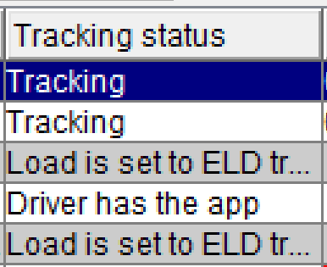
Load Track via McLeod
Click on Brokerage Tracking to see additional options while tracking. The “Web Tracking” option will populate your Load Track dashboard.
Tracking Options

Slide 14
Load Track via McLeod
Dispatchers can view the route map and track details

Slide 15
After delivering the load, END TRACK
Driver should check the events for each stop
Dispatch Comments for the Stop
After delivering the load,
END TRACK

Slide 16
Driver Comments: Two-way communication with the Driver
Two-way
comments

Slide 17
Document Scan: After delivering the load, the Driver can scan POD etc.
Driver can scan PODs and other docs

Slide 18
Scan Documents

