Slide 1
Rates & Negotiations
UNDERSTANDING, CALCULATING, AND USING THEM TO YOUR ADVANTAGE

Slide 2
NEGOTIATION TRAINING
During this session we will be discussing the following:
Some of the verbiage used to sell freight; what do you say?
How do you counteroffer? What do you anticipate Carriers to say?
What are some of the concerns Carriers have while you are negotiating?
What are some best practices used to lock in a Carrier?
Understanding profit margin and how to make it work for you.
Understanding the rates and how to use them.
Role playing different scenarios and Feed back.

Slide 3
rates
UNDERSTANDING, CALCULATING, AND USING THEM DAILY

Slide 4
Different Types of Rates
Flat
Just a number- not based on weight or miles
Per Mile
Rate based on the number of miles traveled
Per Hundredweight
(CWT) Rate based on the weight of the load in hundreds of pounds

Slide 5
Flat rates
Don’t need calculated
$800, $1,550, $3,726, etc.
Make sure you say “All inclusive!”
Per Mile
Multiply your rate per mile by the number of miles on the load
If the rate is $2.15 and the miles on the load are 745, your equation is:
$2.15 x 745 = $1,601
Per Hundredweight (CWT)
Divide the weight of your load by 100 and multiply that by your rate
If the rate is $1.79 CWT and the weight on the load is 42,000 lbs., your equation is:
(42,000/100) = 420 x $1.79 = $751
Sometimes your CWT rate may include a minimum weight (MIN). That means that the rate is based on the load being AT LEAST a specific weight
If the actual weight of the load is less than the min, you use the min
If the actual weight of the load is more than the min, you use the actual weight
If you use the example above with a 45 min: The actual weight of the load is 42,000 lbs., which is less than the min- so you use the min for your equation:
(45,000/100) = 450 x $1.79 = $805

Slide 6
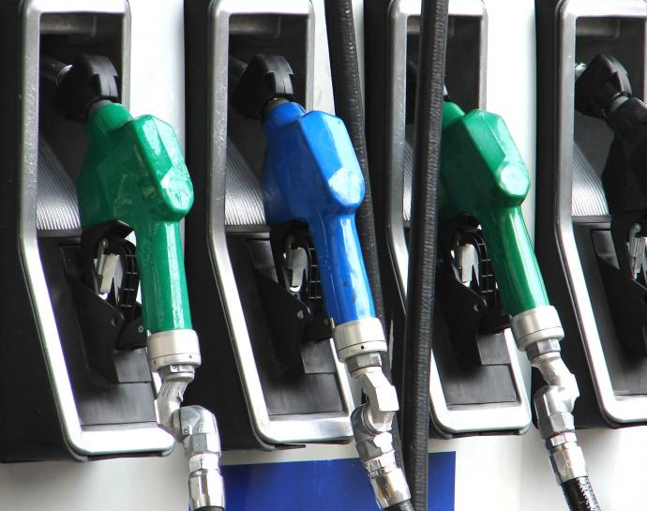
Accessorials
Any line item that is added onto a rate is an ‘accessorial’
Tarp charges
Driver Assist
Stop offs (rule of thumb is $50 per stop)
Scale tickets
Lumper fees
Fuel
Fuel is an accessorial added on to the base rate (or line haul)
Can be added in one of two ways- percentage or cents per mile
If your line haul rate is $765 and the fuel is 24%, your equation is
$765 + 24% = $948 OR $765 X 1.24 = $948
If the line haul rate is $765 and fuel is $0.24 per mile, and the miles on the load are 432, your equation is:
$765 + ($0.24 x 432) = $868
Most customers will provide you with their own fuel table, or we can determine based on the market.

Slide 7
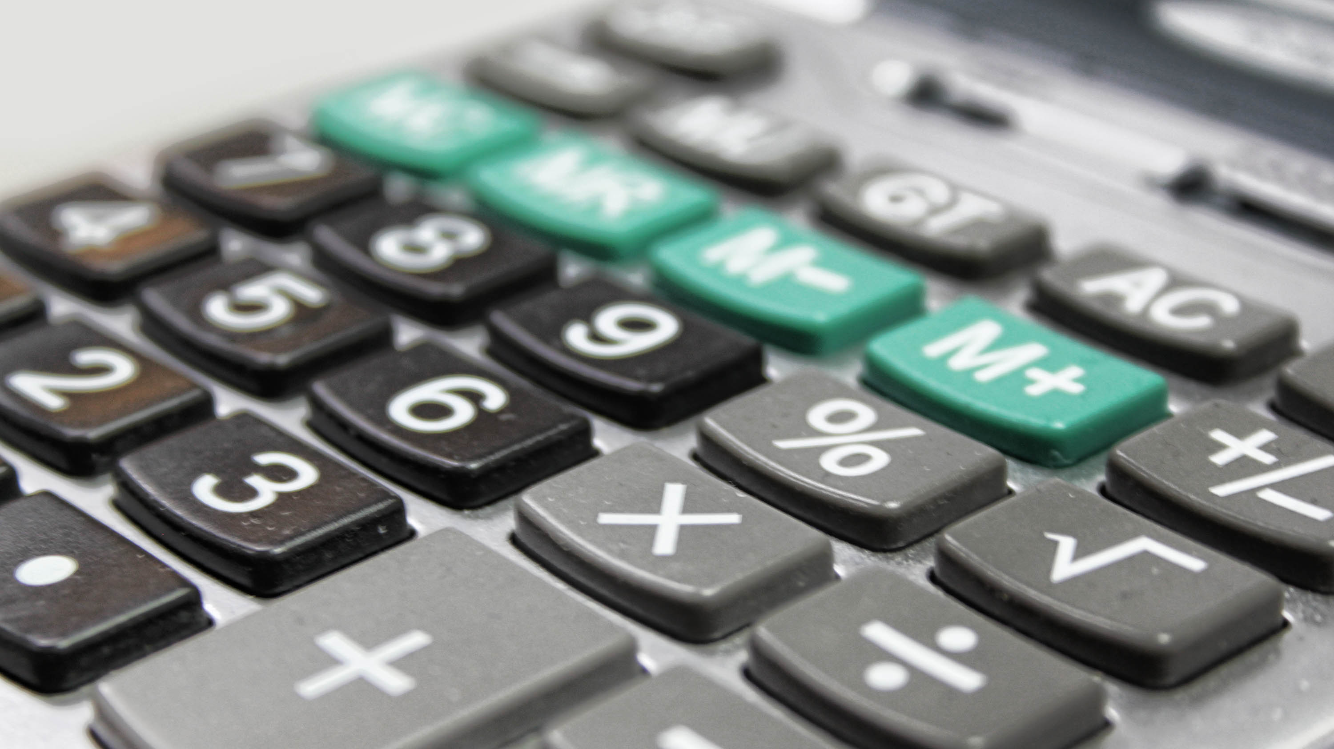
Using rate in your daily tasks
Calculating margin %
Your margin $ is the difference between what you’re getting from the customer and what you’re paying the carrier
To calculate the percentage, you take your margin dollars and divide it by the shipper rate
If you’re making $60 on a load, and the shipper is giving you $350, your equation is $60/$350 = 17%
Marking things down
One of the first things you’ll be doing on the floor is posting loads to the open market
You’ll be given a shipper rate and told to mark it down a certain percentage
If your shipper rate is $749, and you’re marking it down 13%, your equation will be $749 x .87 = $651
Marking things up
Occasionally you’ll be starting with a carrier rate, or may receive a higher bid and have to adjust
You’ll have a carrier rate, as well as a margin percentage you’d like to obtain
If your carrier is asking for $832 and your target margin % is 15, your equation is $832/.85 = $978

Slide 8
BECOMING A CONFIDENT NEGOTIATOR
Whatever the all-in rate may be, you can confidently negotiate and make the most money. Keep in mind that the slightest change in which you negotiate can make a huge difference. Instead of constantly asking your manager to approve a carrier rate, try creating a table like the above.
Anything in the red zone or lower may require manger approval.

Slide 9
Negotiating
MAKING THE MOST OUT OF YOUR SHIPMENTS

Slide 10
The Art of Negotiating
In a negotiation, what are we really looking for? SATISFACTION.
Regardless of the outcome, if both parties are satisfied- then it is a good deal
You also aren’t always negotiating $$
Time
Weight
Future business
A win/win is when both parties are satisfied with the transaction. But a win/win/win is when a new value is uncovered that didn’t exist prior to this deal

Slide 11
Negotiation Tactics
Don’t negotiate in $100 increments
End your rates in a random number, not always 5 or 0
Split out accessorial such as stop-offs or scale tickets
Deadhead strategy
Don’t just meet in the middle, stand your ground
Inbound calls vs. outbound calls
He who speaks first in a negotiation loses
Embrace the silence
Avoid carrier tricks:
Flinch
Pauses
Sympathize without giving in
Sell attractive details of the load
Light weight, 24 hr. loading, booked load, etc.

Slide 12
Quotes to try
We’ve been moving them all week for $752, we can’t go up just for one load.
$1,203 and it’s yours. I have the release in front of me right now and I’ll send it over. Do you want it or not?
I already have someone who can grab it for $2100, so $2,074 is the best I could do.
I have someone checking on their driver and calling me right back. I can’t hold this for you very long.
If you can take both I can probably get you $693.

Slide 13
EXAMPLES OF SAVINGS BY MARGIN $$

Slide 14
Examples of savings by .05 per mile or per cwt
.05 x 250 miles = 12.50 savings x 250 = 3125 extra per month
3125 x 12 = $37,500 per year
Negotiation also starts at location of load / area
Tools to track / report to show these results

