Slide 1
Searching For Trucks

Slide 2
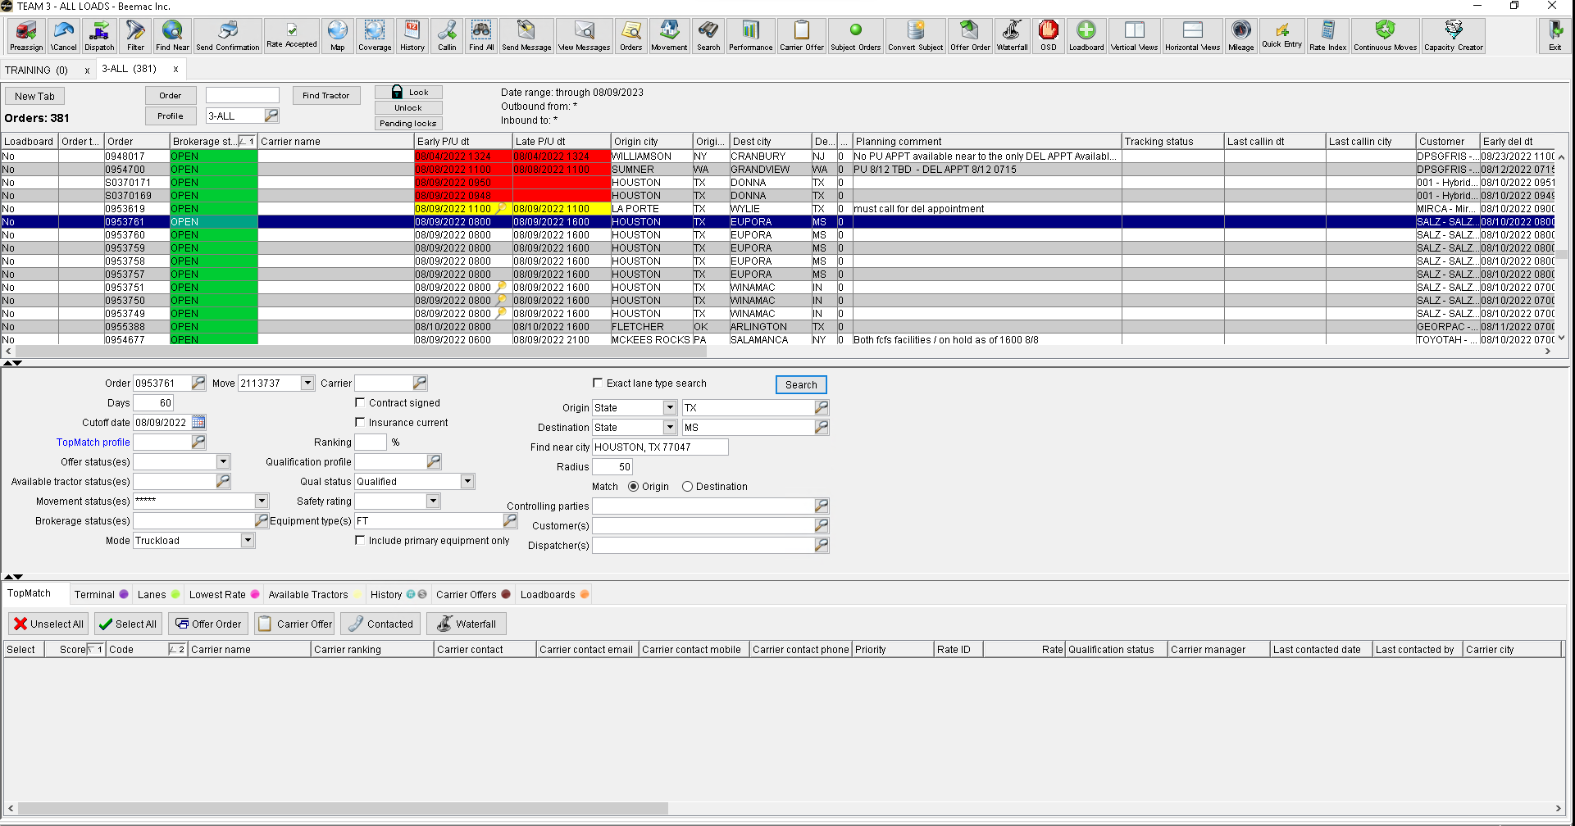

Slide 3
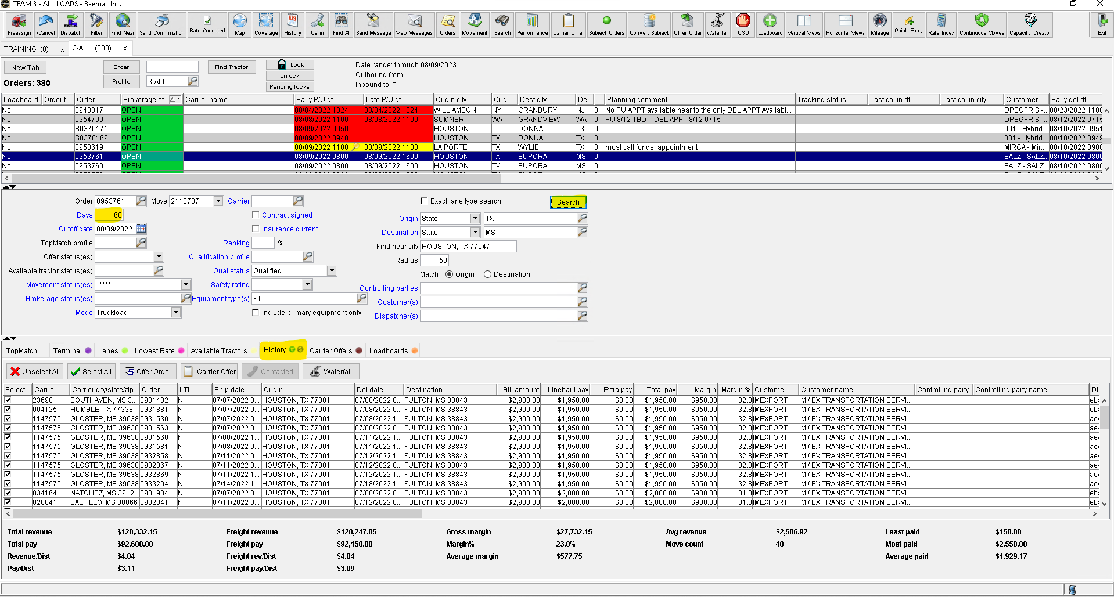
From Brokerage planning, highlight the load you are working on.

Slide 4
click Search
It will default to 60 Days
It will default to 50 Miles
Below are the available trucks that meet the search criteria selected

Slide 5
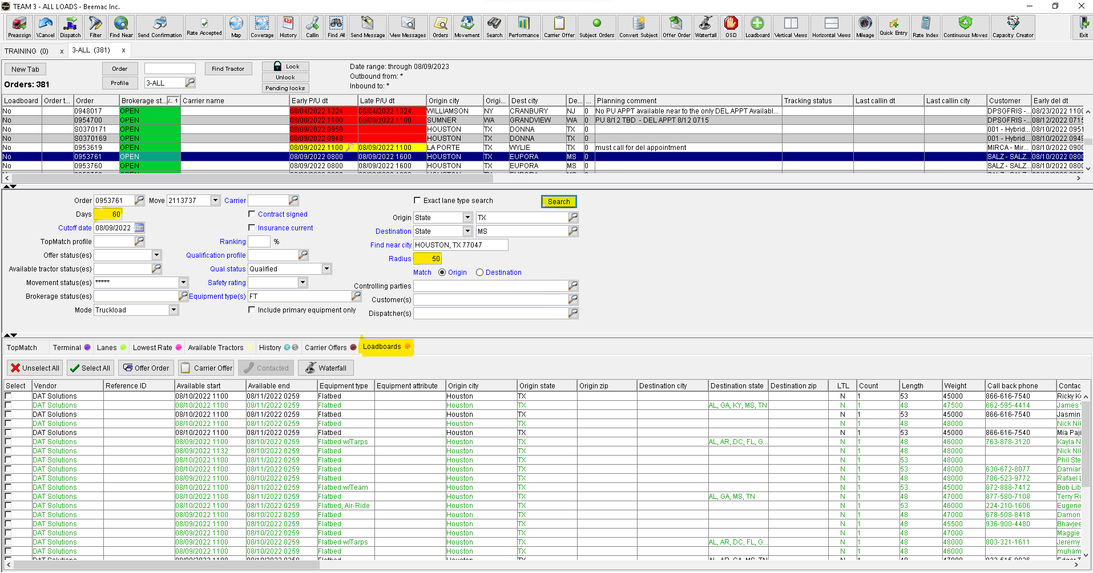
click Search
It will default to 60 Days
It will default to 50 Miles
Below are the available trucks that meet the search criteria selected
Results will populate below.
If highlighted Green, the carrier is already set up with Beemac.
If black, carrier is not active with Beemac. Columns can be sorted by or configured as desired.

Slide 6
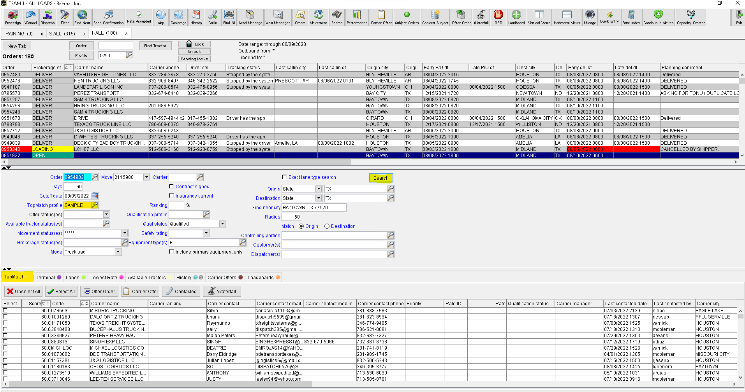
Sending a Blast Email using Mcleod
From the brokerage planning select the Order Entry you will use to send the blast
Topmatch profile box select SAMPLE
CLICK Search
A list of carriers will populate
3. Make sure TopMatch tab is selected

Slide 7
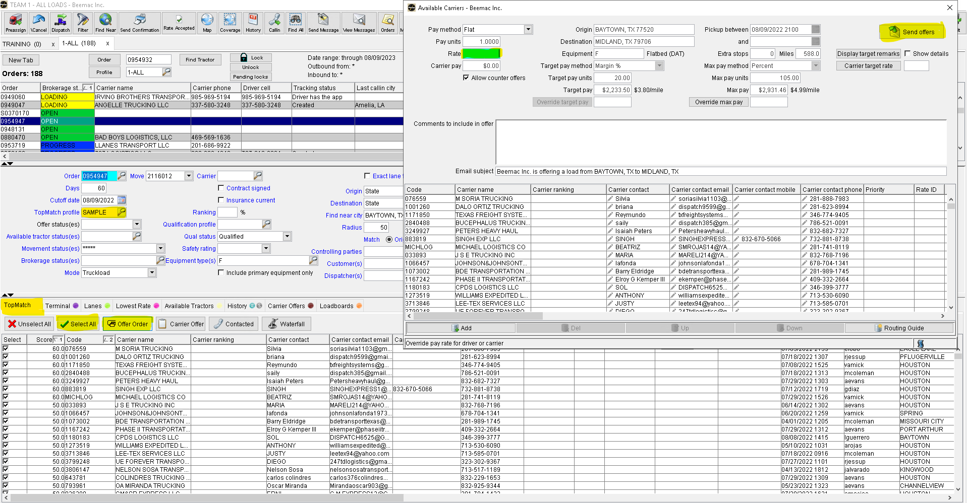
Sending a Blast Email using Mcleod
You can select one by one the carriers you want to send a blast offer or you can click on SELECT ALL
Click on OFFER ORDER and the Available Carrier's box will pop up
Insert the Rate you're offering on this load , you can also add more Comments
Click SEND OFFERS
All carriers from the list will receive an email will the offer
From the brokerage planning select the order entry you will use to send the blast
In the Tomatch profile select SAMPLE
make sure Tpmatch tab is selected
CLICK search
A list of carriers will populate

Slide 8
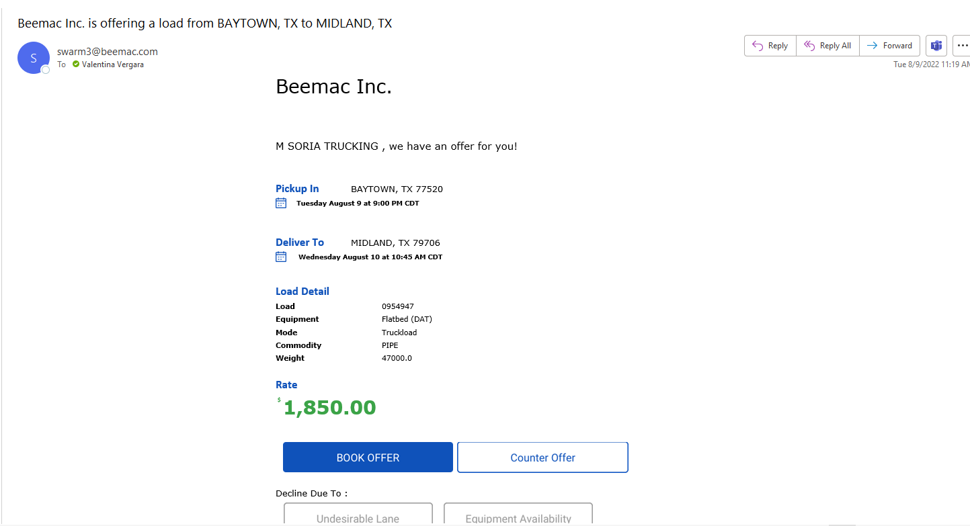
Sending a Blast Email using Mcleod
Dispatcher will receive an email with
Pu, Del, Load Detail and the rate offered
The dispatcher can
BOOK OFFER
COUNTER OFFER
DECLINE THE OFFER
From the brokerage planning select the order entry you will use to send the blast
In the Tomatch profile select SAMPLE
make sure Tpmatch tab is selected
CLICK search
A list of carriers will populate
If the dispatcher click on book offer the status of the Order Entry will change to Covered and will be ready to send the rate Con, tracking link.

Slide 9
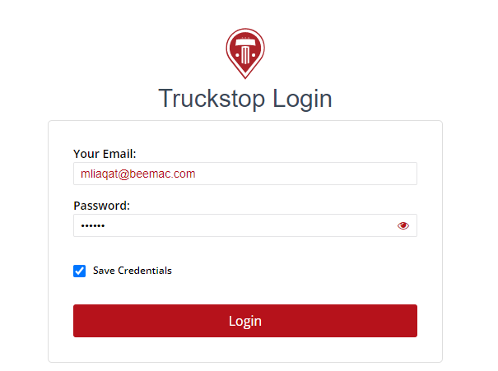
Searching for trucks using Truck Stop
Enter your username and password provided by your team

Slide 10
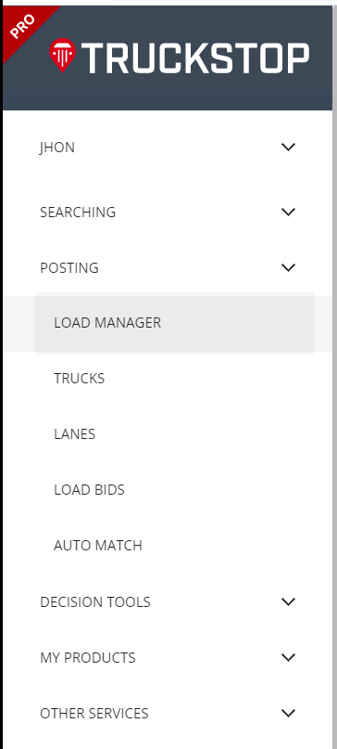
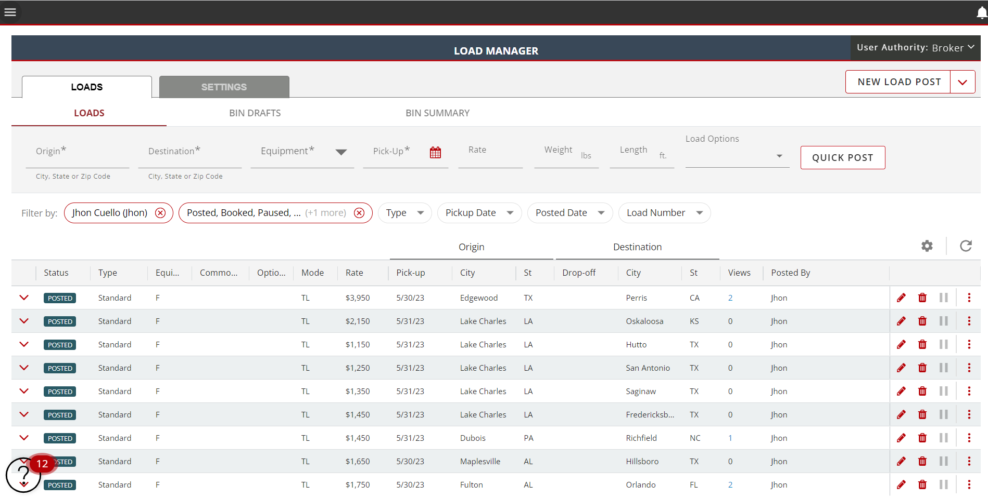

Slide 11
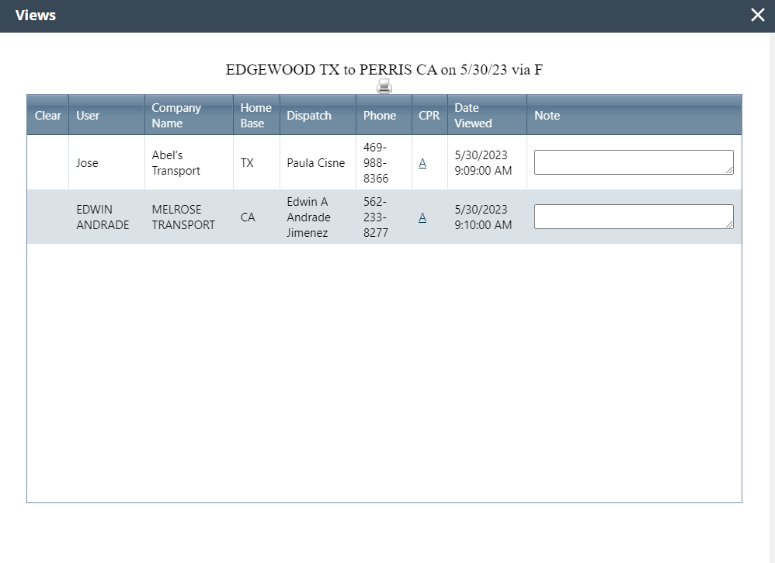

Slide 13
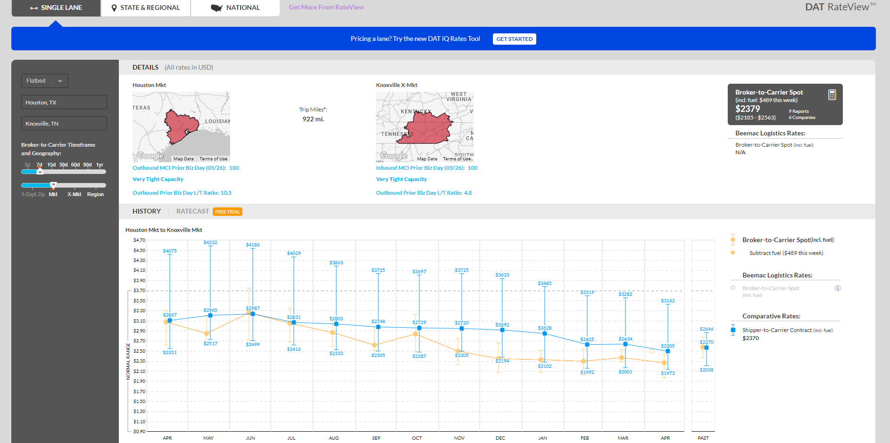

Slide 14
