Slide 1
Phone Etiquette & Email Signature

Slide 2
Do do this…
Smile: this changes the tone of your voice and makes you sound positive
Speak Clearly and Concisely
Be Enthusiastic
Courtesy: “Treat others they way you want to be treated”
Tone: Many times, it is not what you say, but how you say it
Take Notes: Helps you remember important points
Listening : is more important than speaking

Slide 3
Don’t do this…
Frown
Sound Tired
Ramble

Slide 4
keys to good listening
Limit your talking
Can’t talk and listen at the same time
Don’t Interrupt
A pause doesn’t always mean the individual is finished speaking
Use discretion if an interruption is needed
Taking back control of the phone call
Concentrate
Focus on the conversation/caller. shut out outside distractions and personal concerns

Slide 5
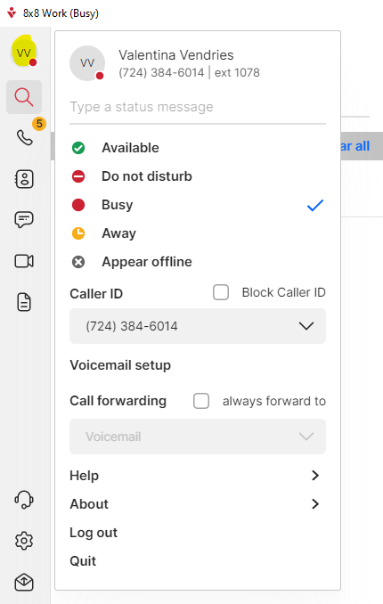
8x8

Slide 6
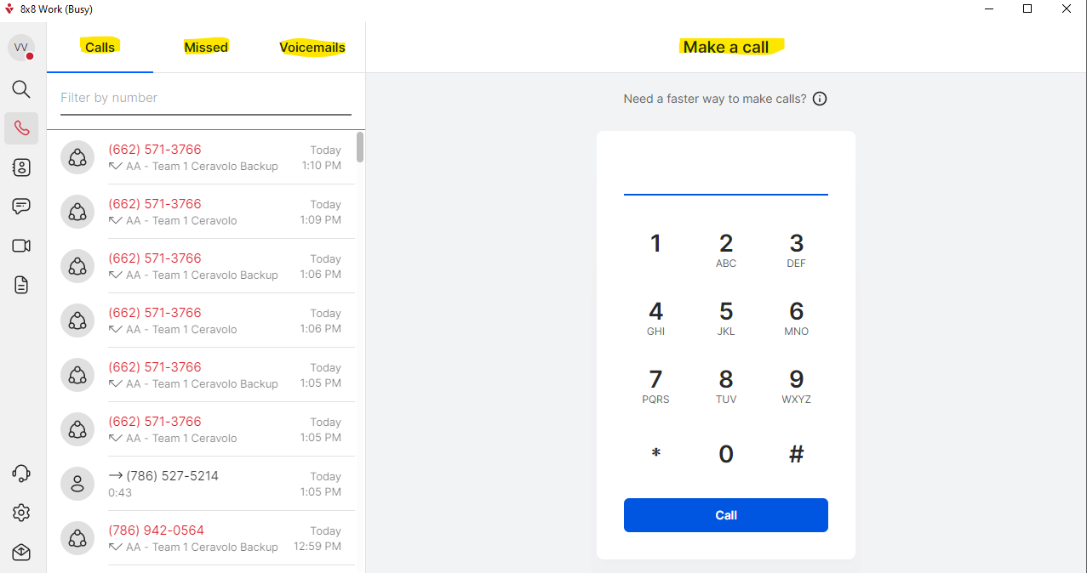
8x8

Slide 7
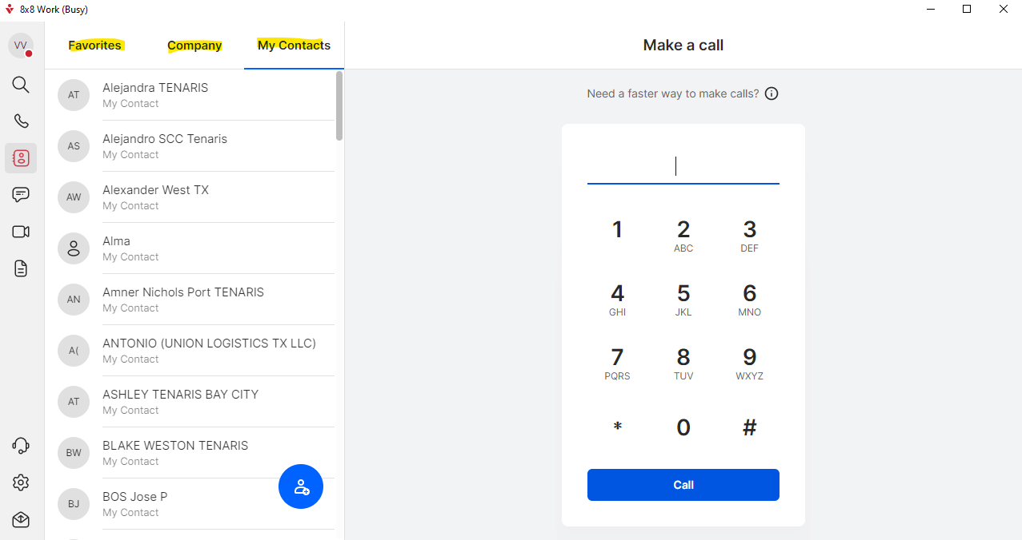
8x8

Slide 8
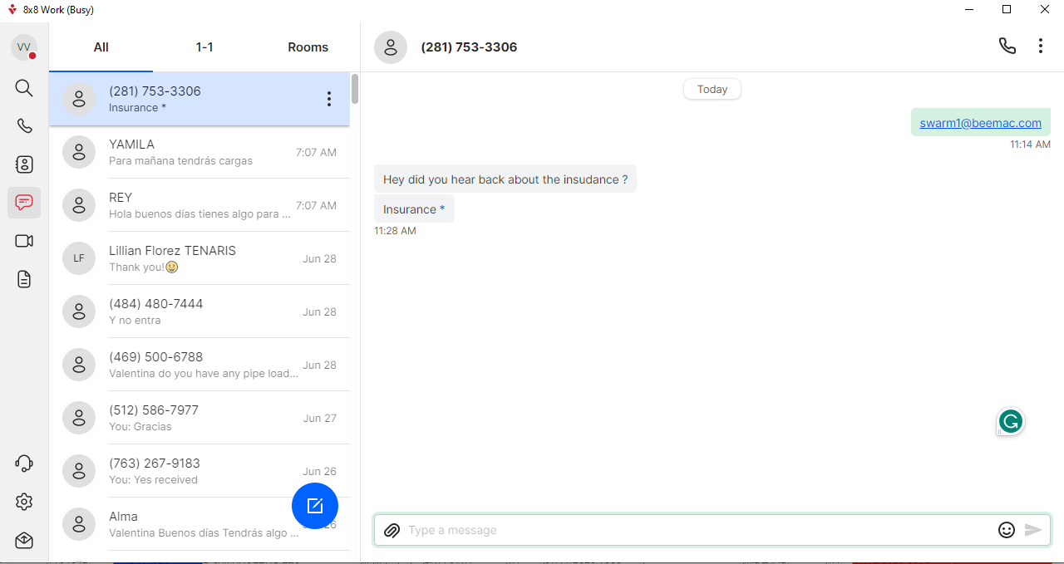
8x8

Slide 9
Download 8x8 work

Slide 10
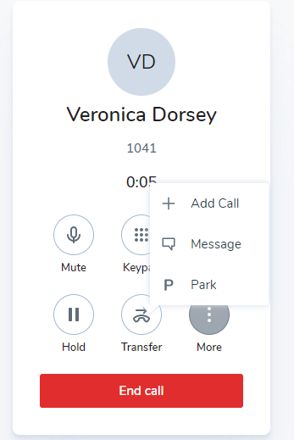
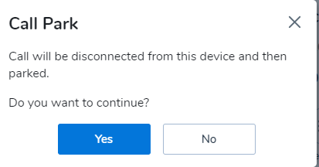
Park an active Call
the answering machine will tell you the extension
461/462/463

Slide 11
Structure of an Email
Emails to customers need to answer these questions ; Who / What / Where / When / Why / How
This can be done all in one or two sentences. It is important to do it in as few as possible, so that the information does not get lost in a cluster of fluff.
Greeting :
Example
Good Morning / Afternoon / Evening, Persons Name
5. How:
How the situation will be fixed, the needed outcome
4. When:
First started occurring/when to expect delivery/how long will the truck will be fixed) (Why ; Will this affect on time deliver? Is this causing issues for the driver?)
3. Where:
Location of the issue
2. What:
The situation, not a story but reality
(Breakdown, detention, issue locating material, releases)
1. Who :
(Parties affected) Driver / Shipper /Consignee
Good Afternoon, John Doe (GREETING)
The driver (1) for release #123-456 suffered a breakdown.(2) We are sending in another truck(1) to Pipe Yard 1.0 (3) and will arrive at 1200 NOON (4).
Driver will make OTD. Please let us know of any question, comments, or concerns.(5)
Very Respectfully,
Valentina Vergara.

Slide 12
Email Signature
1. Go to your outlook, click on NEW EMAIL
2. Go to Insert , click on Signature , click on Signatures…

Slide 13
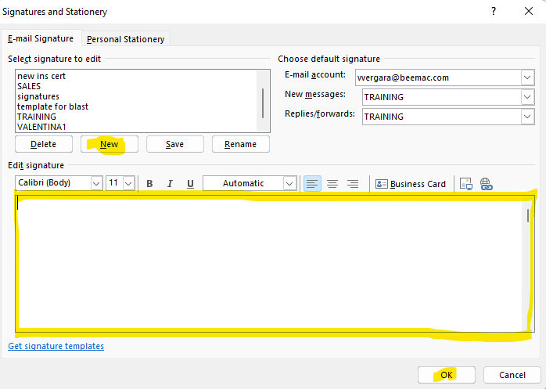

Slide 14
Industry abbreviations
O/O = Owner Operator
OTD = On Time Delivery
EOD = End of Day
EOW = End of Week
FTL = Full Truck Load
TBD = To be determined
TBH = To be honest
TGIF = Thank God its Friday
BOL = Bill of Lading
POD = Proof of Delivery
JT = Joint
ST = STRETCH TRAILER
LTL = Less than [Truck]load
EDI = Electronic Data Interchange
NP = No Problem
DIY = Do it Yourself
FYI = For your information
MC/MT = Motor Carrier
APB = All-points Bulletin
JIT = Just in Time
TTYL = Talk to you later
ETA = Estimated Time of Arrival
PLT = Pallet
CONG = CONESTOGA

Slide 15
IMPORTANT REMINDERS
Do not send to many blast emails per day or you will be blocked
This CONFIDENTIALITY NOTE goes out with every email
CONFIDENTIALITY NOTICE: This email, including any attachments, is intended solely for the use of the individual or entity to which it is addressed and may contain confidential and privileged information. If you are not the intended recipient, any disclosure, copying, or distribution of this email or the information contained herein is strictly prohibited. If you have received this email in error, please notify the sender immediately and delete this message from your system.

