Slide 1

SYSTEM TRAINING

Slide 2
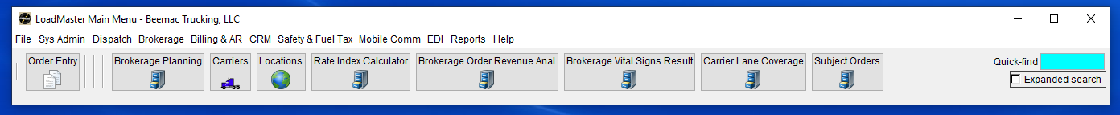
Enter a new Order
Select ‘Order Entry’ from your LoadMaster toolbar

Slide 3
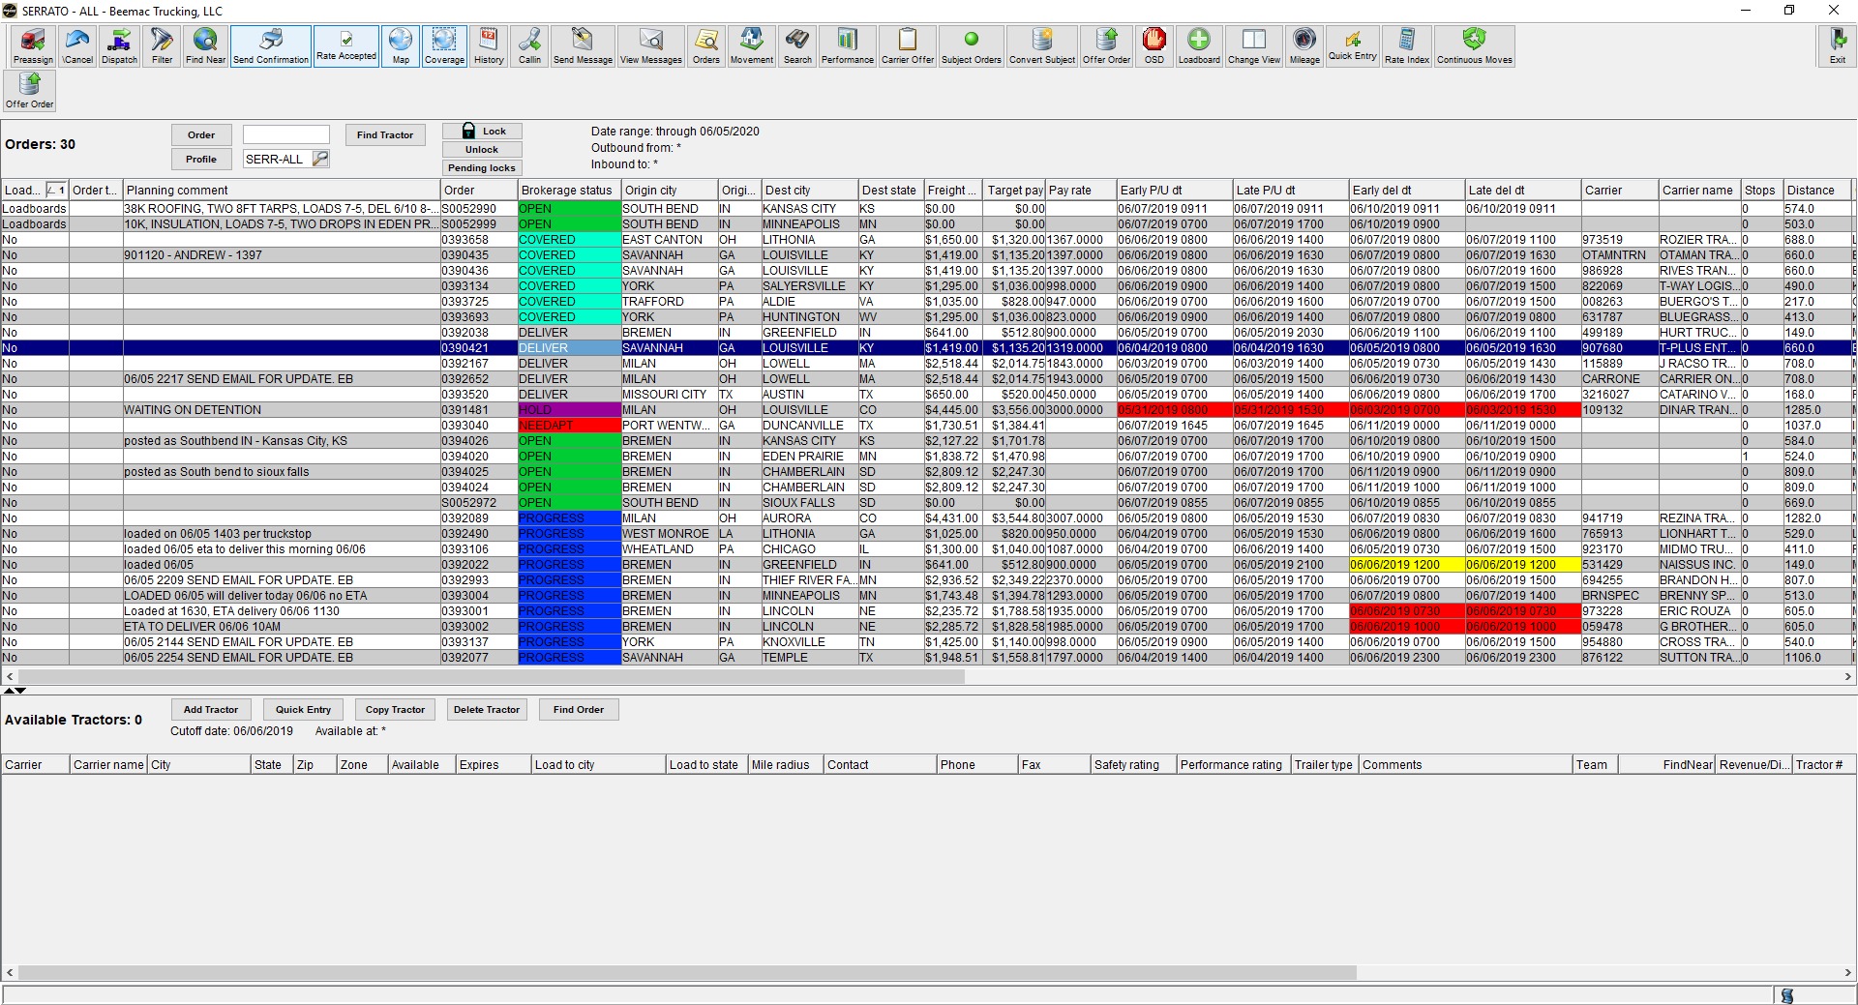
Brokerage planning
After a load has been built and put into brokerage planning you will then work on the load out of this screen. Brokerage planning is the most useful, versatile screen in McLeod. I recommend having this screen open at all times as we do everything off this screen.
In brokerage planning you will sell loads, cover loads, call out on trucks, search open freight, confirm pick-up and delivery, dispatch, and send rate confirmations. Every where you click on this screen opens a new pop-up that does something different.

Slide 4
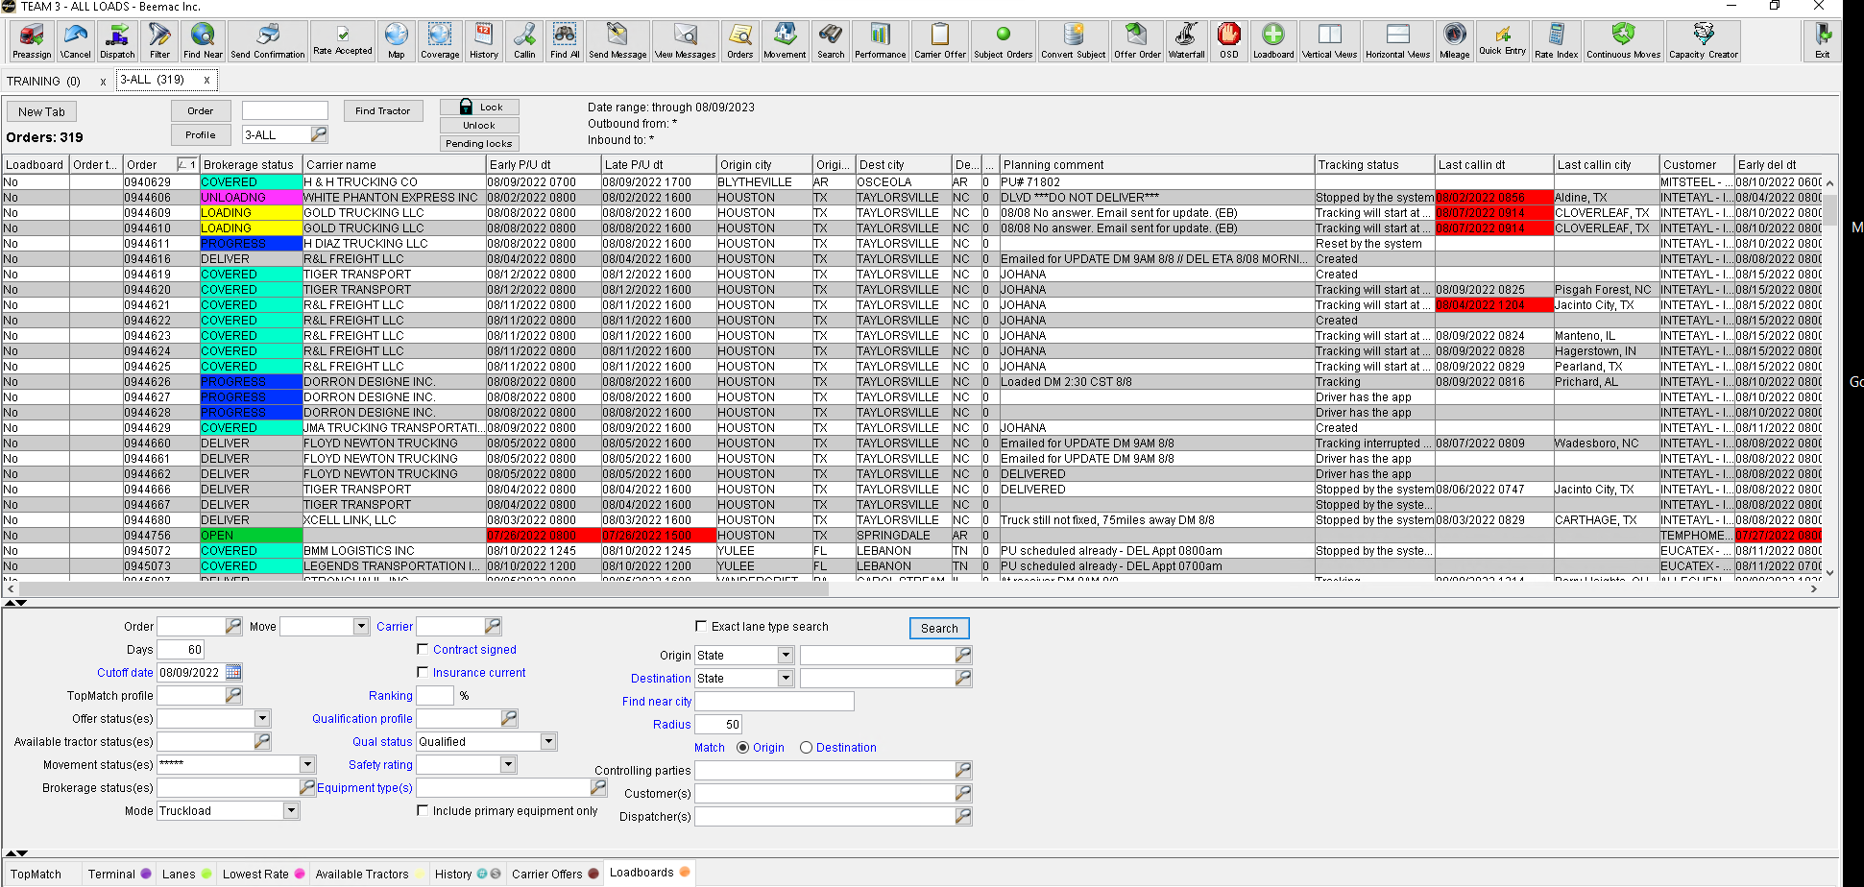
You can click on any header to organize the loads.
Double clicking on the order number will open the order entry screen.
Double clicking on the Brokerage status will open the dispatch screen.
Double clicking on the pick-up or delivery city or state will open the movements screen
Double clicking on the carrier code or carrier name will open the carrier screen

Slide 5
Recap – life cycle of a load
Get customer release/ load tender
Build load / add to brokerage screen
Post load
Cover load
Confirm carrier information/ set up carrier
Send Carrier rate confirmation
Send driver tracking
Confirm pickup & delivery
Repeat...

Slide 6
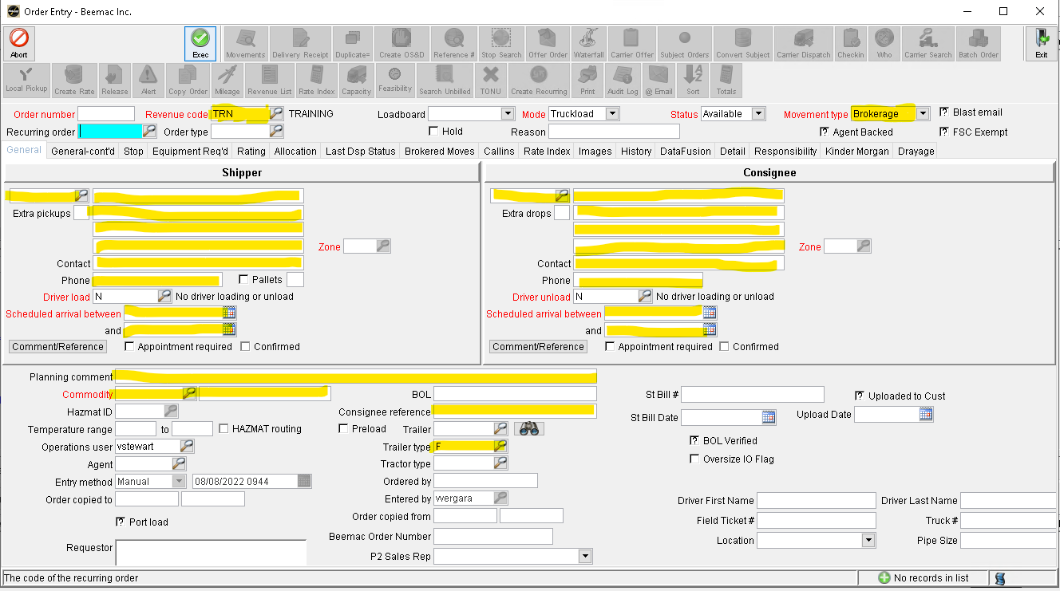
Enter a new Order
Select the Green ‘Add’ button to enable the fields below then enter load information.
Yellow highlighted areas are the minimum required fields

Slide 7
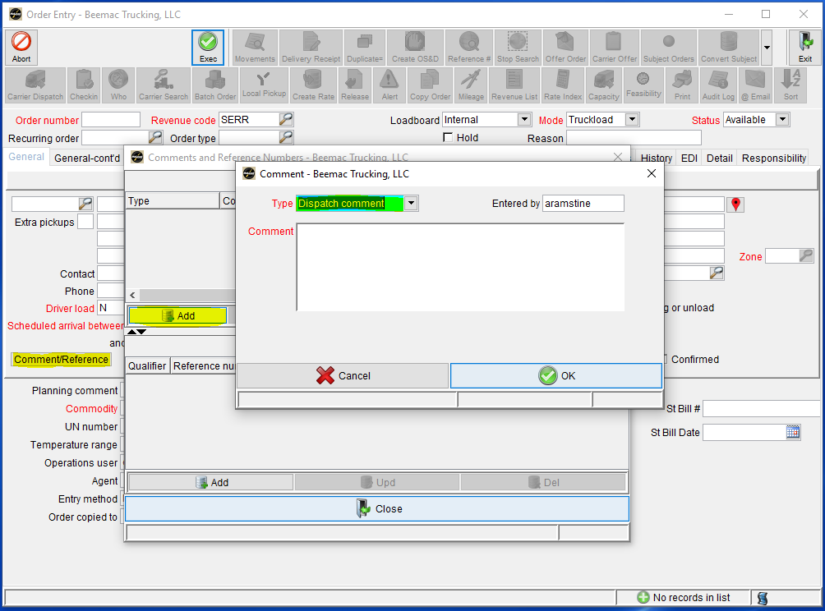
Enter a new ORDER – dispatch comments
After you are done entering information into the ‘General’ tab of your ‘Order Entry’ screen you will select the ‘Comments/References’ button under the Shipper address. You will get a pop-up window, select ‘Add’ and get another pop-up window.
In the pop-up window the ‘Type’ is ‘Dispatch comment’
In this screen you will enter any and all information that your driver will need to get loaded. You will enter any special information or directions as well as any numbers, commodity description, or special equipment the driver may need.
Please see the load building document printed for you for a general layout of how dispatch comments are to be built

Slide 8
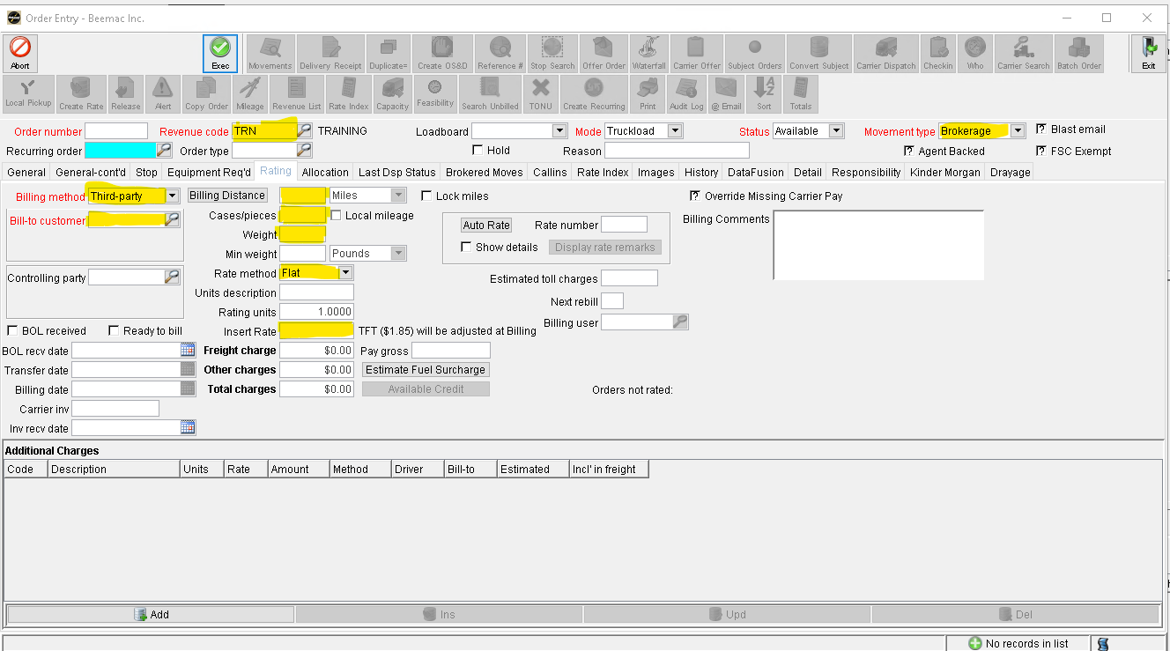
Enter a new ORDER – RATING TAB
If you know the piece count for you load you will enter it in the ‘Cases/pieces’ field. Under that you will enter the exact weight of this load. It is very important that you enter the load weight correctly.
Move to the ‘Rate Method’ drop down menu and select the method that your customer is paying by, usually it is a flat rate. However, you can also rate by hundredth weight and distance.
Enter your shipper rate in the ‘Rate’ field. The shipper rate is the rate that the customer is paying you.

Slide 9
Recap – life cycle of a load
Get customer release/ load tender
Build load / add to brokerage screen
Post load
Cover load
Confirm carrier information/ set up carrier
Send Carrier rate confirmation
Send driver tracking
Confirm pickup & delivery
Repeat...

Slide 10
Posting
Select ‘Subject Order’ from your LoadMaster toolbar

Slide 11
You can post and refresh posted loads through brokerage planning. When you build a load and switch the Loadboard status to ‘Loadboards’ the load will automatically post once it is executed. To refresh the load you will select the ‘Loadboards’ button at the top of the screen. This will pull the load down and change the loadboard status to ‘No.’ There is a 3-5 minute delay for refreshing.
If you want to bump the rate or make a change to the post you must first remove the post from the loadboard, make the changes, and then repost the load. You can take a post down and repost by clicking on the ‘Loadboard’ button.

Slide 12
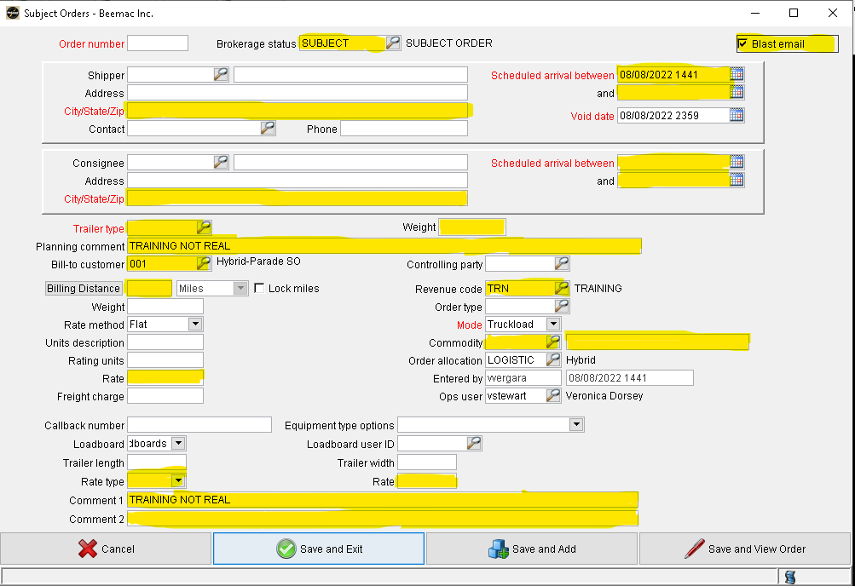
Posting – subject orders
To quickly post a load before it is built or to post a load out as different cities to get more views you will use the ‘Subject Orders’ button at the top of the brokerage planning screen. In this pop-up you will enter enough information to quickly post the load. At the top you will enter pickup and delivery city and state along with date and times. Beneath you need to enter the trailer type which you can select by the magnifying glass button.
In the planning comments you will put a brief, sellable description of the load.
Ex: 10K INSULATION, TWO 8FT TARPS, LOADS 7-5, DEL NEXT DAY@8A - $1298
Make sure the ‘Revenue Code’ field is correct and enter the commodity which you can select by the magnifying glass button.
Change the ‘Loadboards’ drop down to say loadboards. Change the ‘Rate type’ drop down to flat. Enter the rate and a small description in the ‘Comment 1’ field that you wan the driver to see on the load once it posts to the loadboards.
FLAT

Slide 13
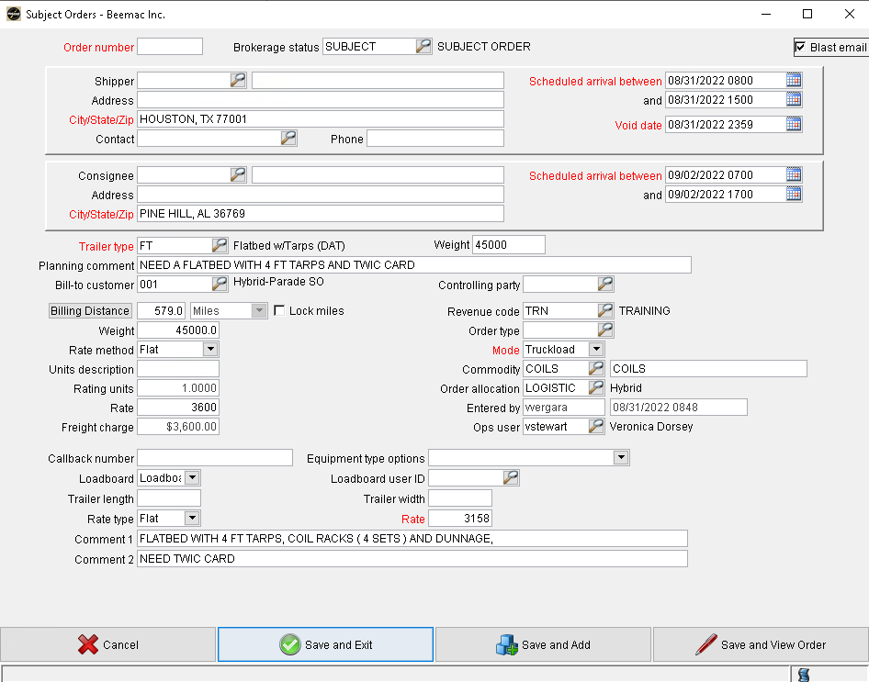
HOUSTON, TX TO PINE HILL,AL
FLATBED WITH 4 FT TARPS, COIL RACKS ( 4 SETS ) AND DUNNAGE, DRIVER NEED TWIC CARD
45000LBS
PU 8/31 FROM 8AM TO 3PM / DEL 9/2 FROM 7AM TO 5PM
CUSTOMER RATE 3600 / TTT 3158

Slide 14
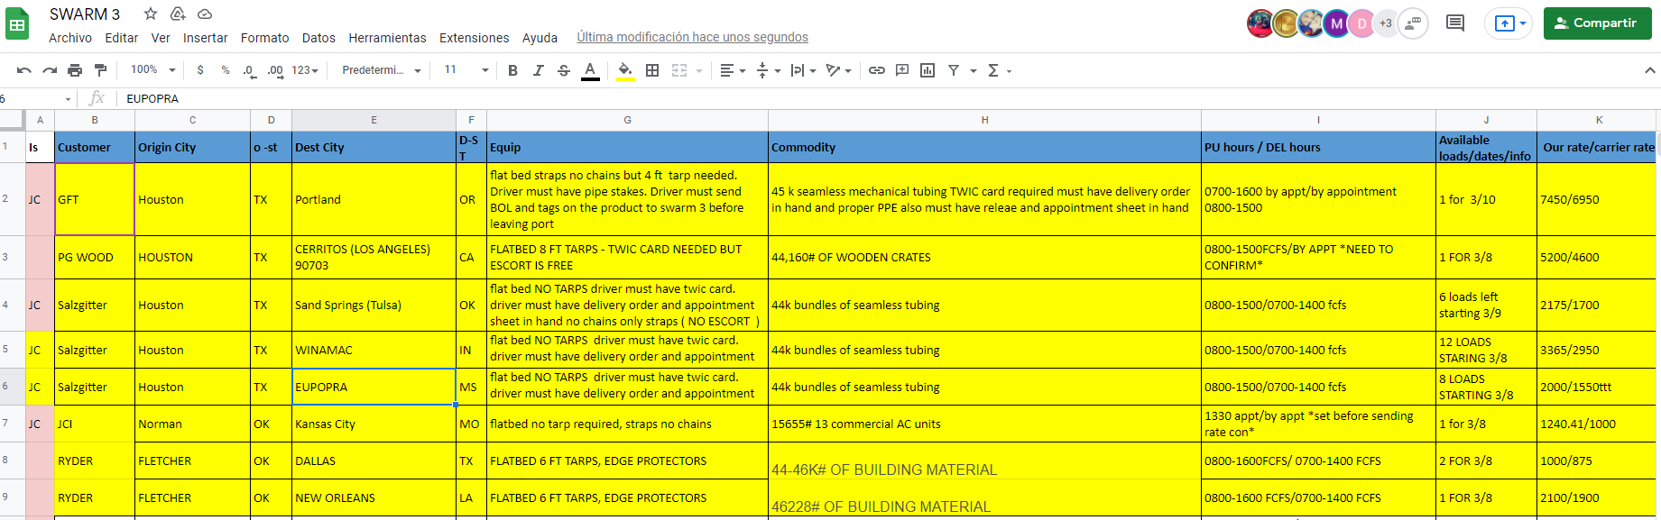
This is how a spread sheet looks like

Slide 15
Search loads to sell in brokerage planning
When you are taking phone calls and a carrier calls in to book a load you must search the load in Brokerage Planning to sell the load. First you will need to open the Brokerage Planning profile ‘ALL-OPEN’
You can search in this screen multiple ways. You can sort the freight via city and state and look for the load that way. You can ask the carrier for the reference number on the post. You will type that into the ‘Order’ field and hit enter.
You can also double click on the city title and type the name of the pick-up city in, and the screen will automatically take you to all the loads loading out of this city.

Slide 16
Recap – life cycle of a load
Get customer release/ load tender
Build load / add to brokerage screen
Post load
Cover load
Confirm carrier information/ set up carrier
Send Carrier rate confirmation
Send driver tracking
Confirm pickup & delivery
Repeat...

Slide 17
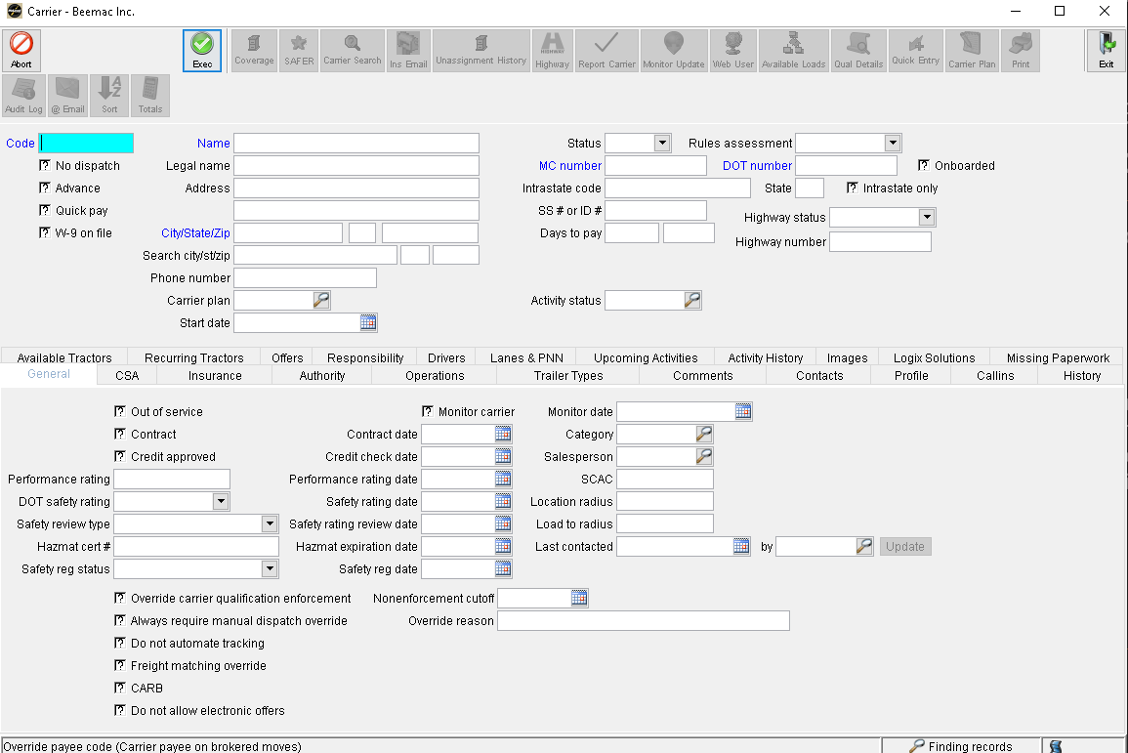
Booking a carrier and checking their information
To book a carrier you must follow these steps:
Get MC/DOT to search carrier
Check that the carrier is in good standing, we don’t need insurance or a new carrier packet.
To do this you will open the carrier screen and select the ‘Search’ button then enter the MC or DOT in the appropriate fields. Select execute and wait for information to populate if the carrier is set up or you will get an error stating the carrier is not set up.

Slide 18
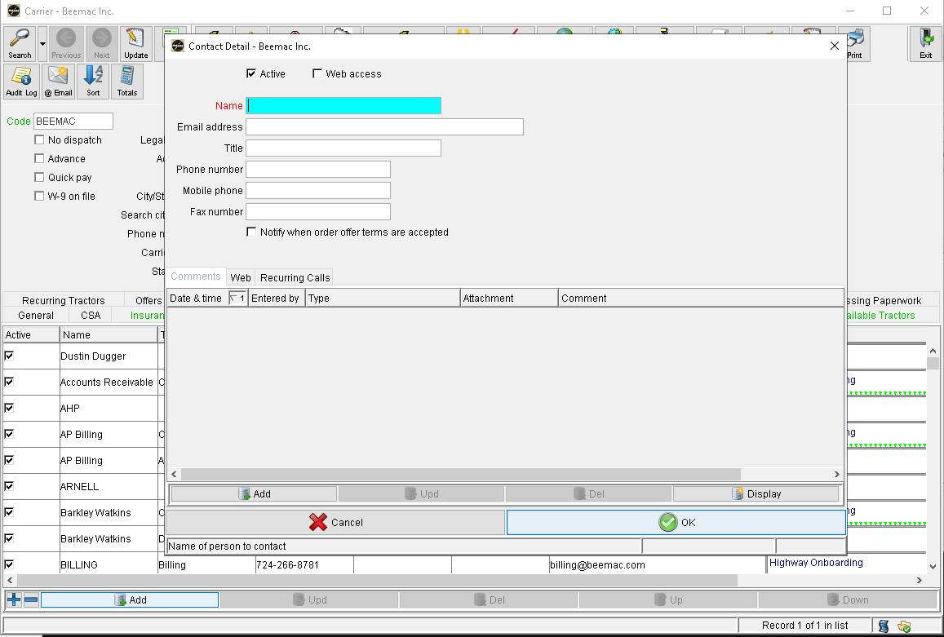
Booking a carrier and checking their information
•Go to the contact tab to view the dispatcher’s information.
Verify that the person you are speaking with is listed as a dispatcher with the company.
If you need to add a new dispatcher, go through the GO HIGHWAY process and verification of adding a new dispatcher. This will prevent fraud.
Go Highway will add the new dispatcher if approved.

Slide 19

Booking a carrier and getting driver information
Once you have confirmed all the dispatcher’s information you are then required to get driver name and phone number. We track every single load via the TRACKER TOOLS . When you are booking a carrier on a load it is important that you explain to them that the driver must have a smart phone and must accept tracking before a rate con will be sent. No one is exempt from tracking. If they cannot/do not accept terms of tracking, they cannot have the load.
Once you get the drivers name and phone number you write the following information down:
Lane
MC/DOT
Dispatch name & phone number
ETA to pickup
Driver name & phone number
Rate sold

Slide 20
Recap – life cycle of a load
Get customer release/ load tender
Build load / add to brokerage screen
Post load
Cover load
Confirm carrier information/ set up carrier
Send Carrier rate confirmation
Send driver tracking
Confirm pickup & delivery
Repeat...

Slide 21
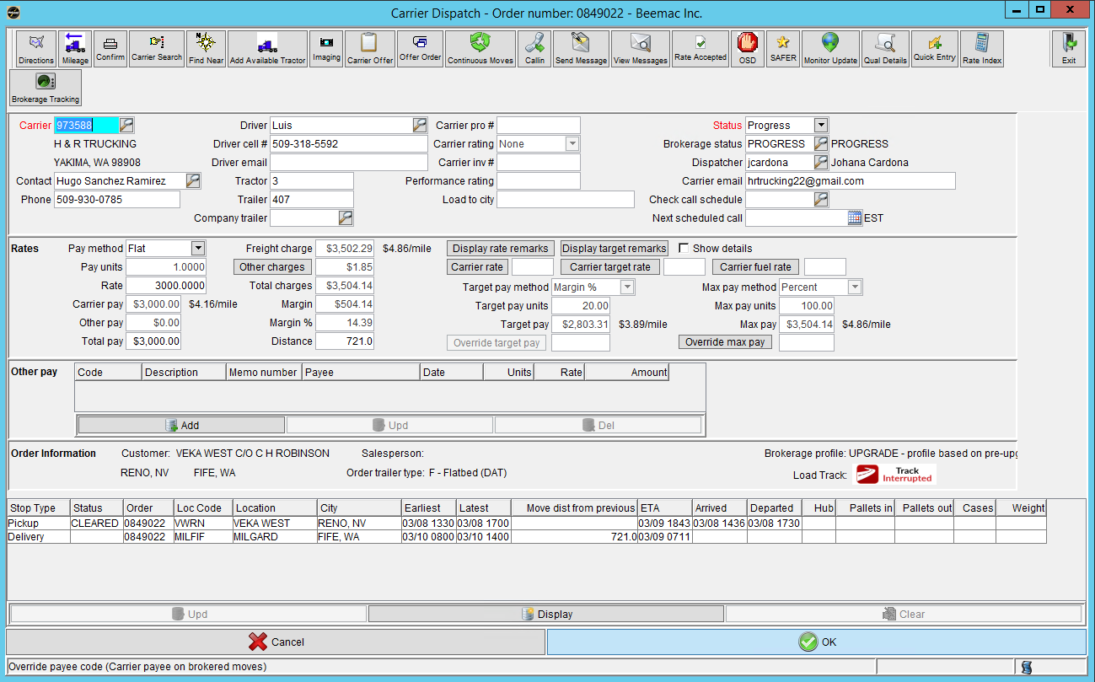

Slide 22
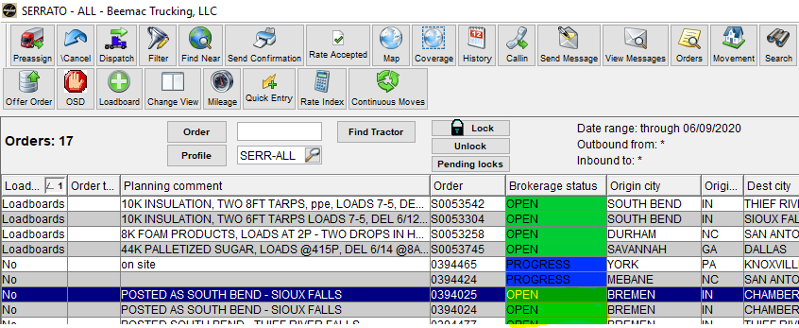
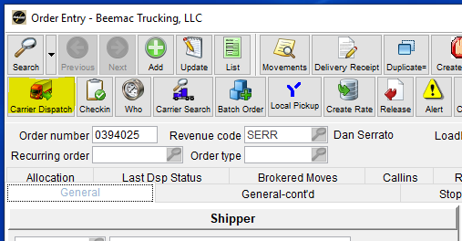
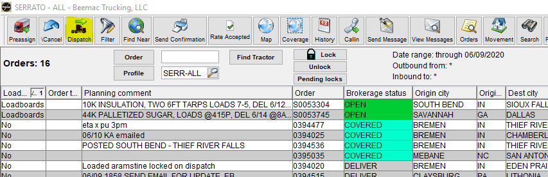
Sending a rate confirmation
You can do this four ways:
in Brokerage planning using the ‘Send Confirmation’ button
By double clicking on the ‘Brokerage Status’ of a load
By opening the load in order entry and selecting the ‘Carrier Dispatch’ button.
By clicking on the ‘Dispatch’ button in Brokerage Planning

Slide 23
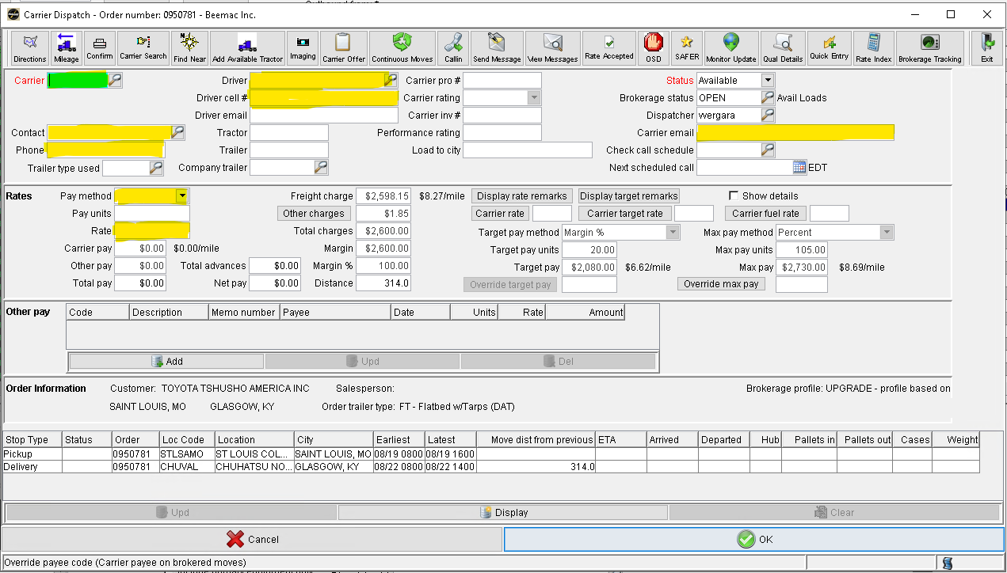
Sending a rate confirmation
In the Carrier dispatch screen, you will enter the carrier code in the ‘Carrier’ field. This can be their MC/DOT number or a different code. you can also search for the carrier's name, mc or dot # by clicking on the magnifying glass. Next you will verify the dispatcher’s name, number, and email. You can change to a different dispatcher in the system by clicking on the magnifying glass.
Under the ‘Rates’ section you will select ‘Flat’ under Pay Method and then enter the carrier rate in the ‘Rate’ field.
Click the “Confirm” button at the top.
FLAT
You can also enter the Driver name and phone number in this screen if you have this information.

Slide 24
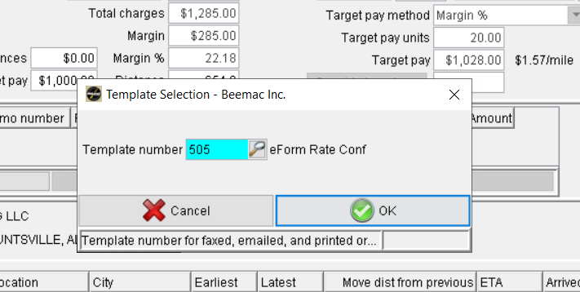
Click on Confirm click ok
( electronic link 505 )
( PDF LINK 499 )

Slide 25
Leave the Print option selected and do NOT click the email check box, just click “OK”

Slide 26
Click Yes to send to imaging

Slide 27
Click cancel on the preview screen to exit - Preview isn't necessary unless you want to check your work

Slide 28
Click OK to exit the screen

Slide 29

Once the rate confirmation is sent, the brokerage status will go from OPEN to Covered.
If a carrier declines the load, you will see a brokerage status of DECLINED
**Remember to not click the email check box while using template 499 or there will be no terms and conditions nor a place for them to sign**

Slide 30
Carrier will receive an email with a link to review and accept the rate confirmation. Please note that there is a 1 hour expiration on the link. Please note that if the email is incorrect in system it will not deliver to the carrier. Sender will receive emails when load is accepted, declined or timed out.

Slide 31
Carrier will see all information when they click the link and at the bottom they will need to sign, accept and enter driver’s name and cell number. These are required fields. The driver info will auto-populate in McLeod once entered and accepted.

Slide 32
Recap – life cycle of a load
Get customer release/ load tender
Build load / add to brokerage screen
Post load
Cover load
Confirm carrier information/ set up carrier
Send Carrier rate confirmation
Send driver tracking
Confirm pickup & delivery
Repeat...

Slide 33

Using trucker tools For tracking

Slide 34
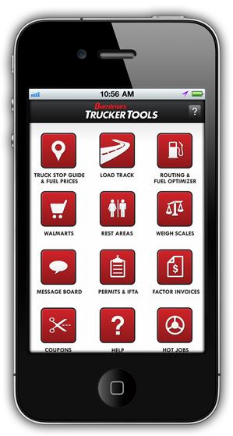
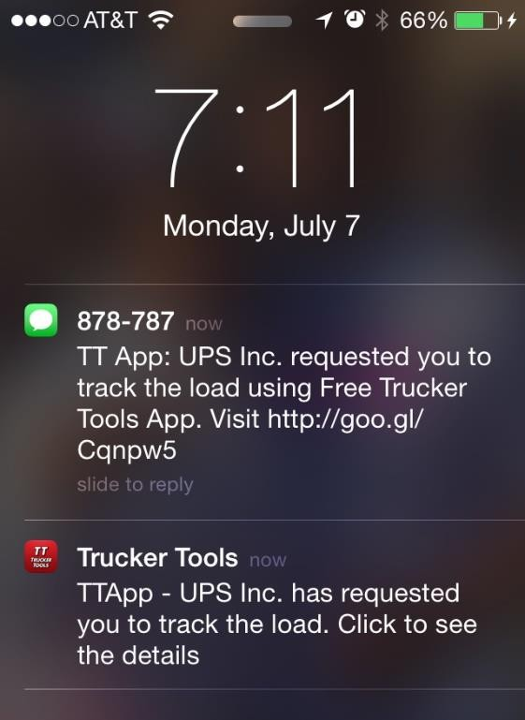
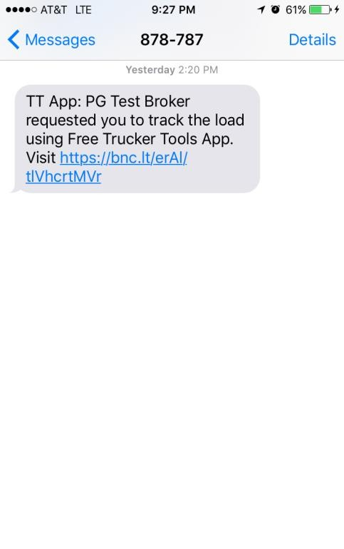
Driver receives a text message. Ask driver to click the link
Ask the Driver to click the link in Text Message

Slide 35
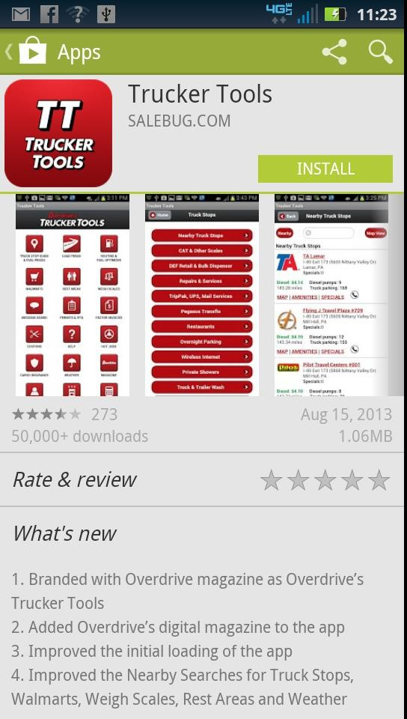
The link takes to App Store. Ask driver to Install/Download Trucker Tools App
Driver has to Install/Download Trucker Tools App & then, Open and Allow it to track location

Slide 36
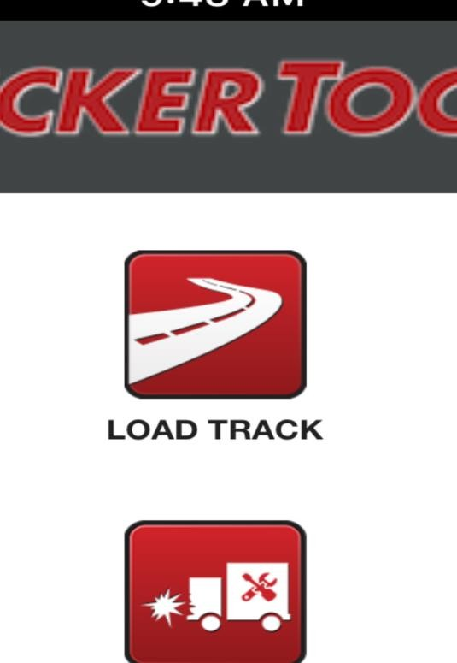
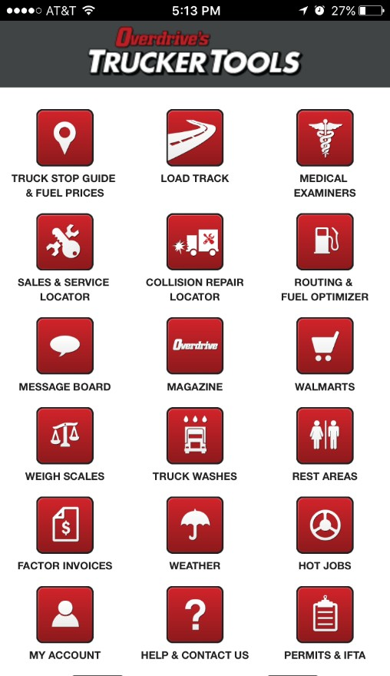
Click Load Track to see Pickup Number and Load Track Details
Click Load Track to see Pickup Number for the load

Slide 37
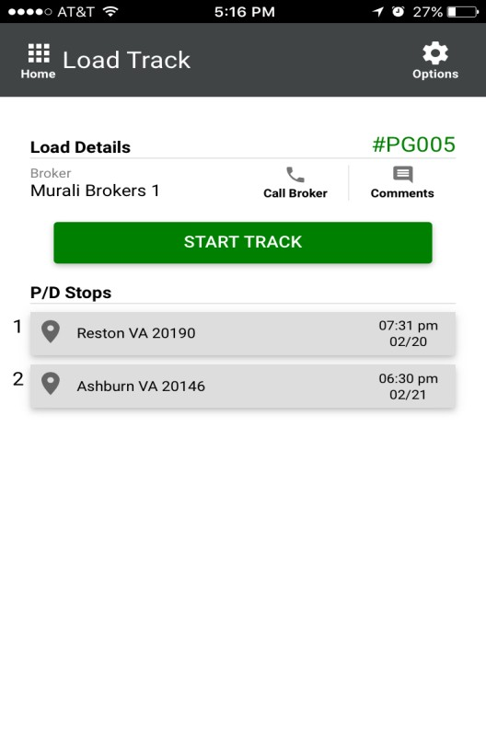
See Pickup Number and START TRACK
Load Pickup Number
Dispatch Comments
Start Track Anytime
Call Dispatch
Stop
Details

Slide 38
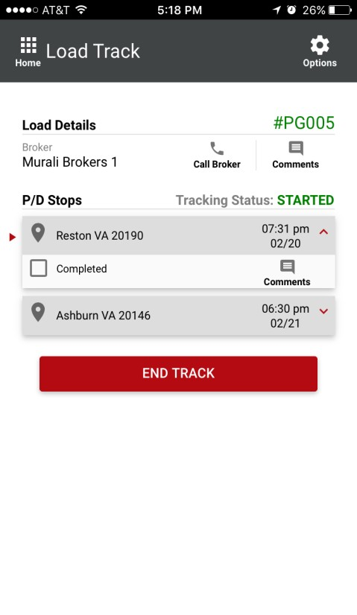
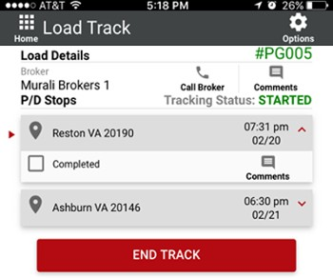
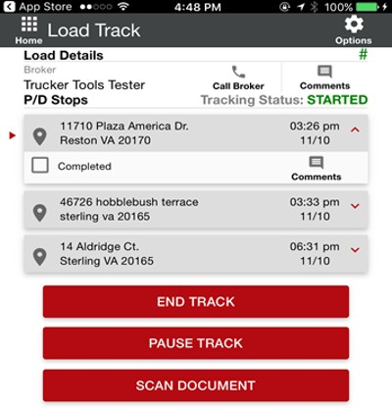
After delivering the load, END TRACK
Driver should check the events for each stop
Dispatch Comments for the Stop
After delivering the load,
END TRACK

Slide 39
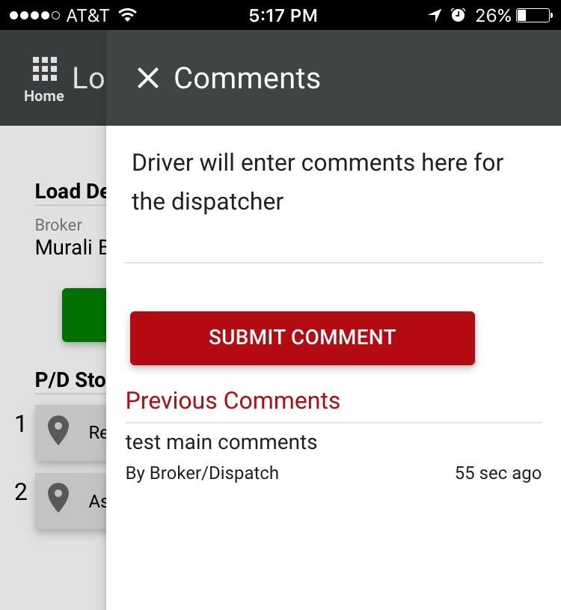
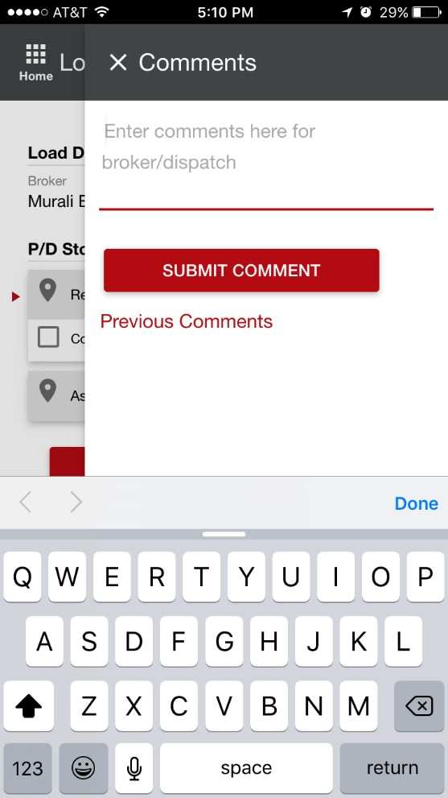
Driver Comments: Two-way communication with the Driver
Two-way
comments

Slide 40
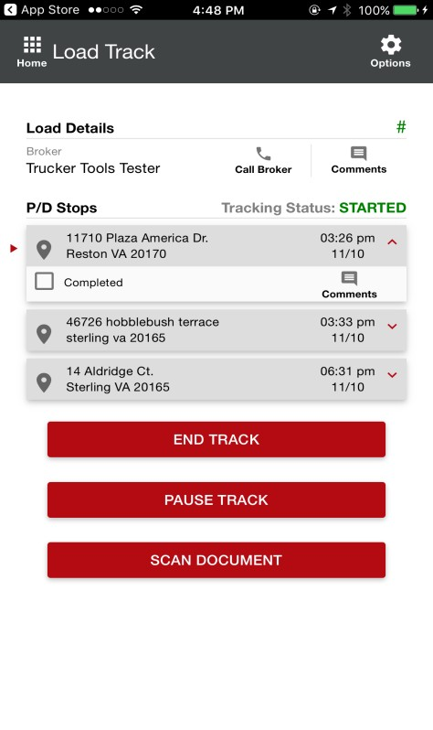
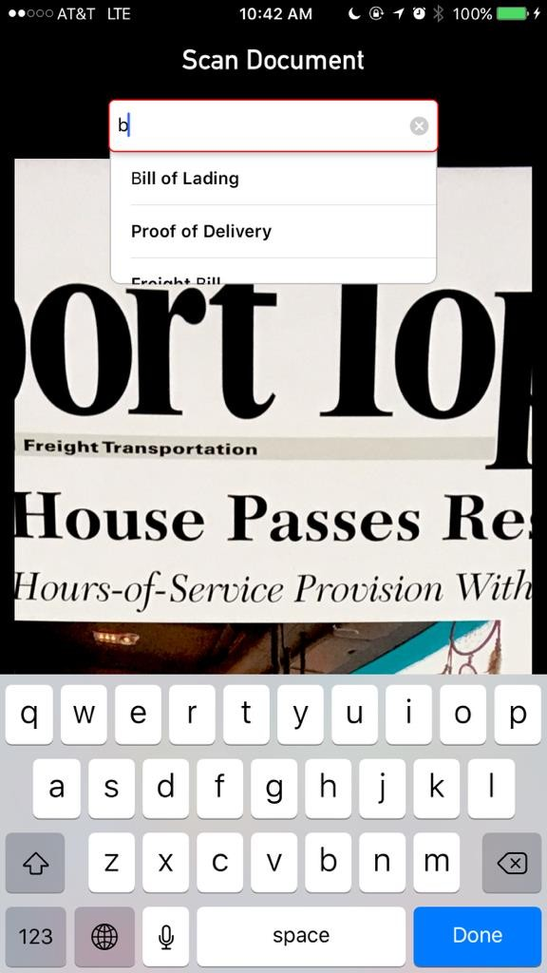
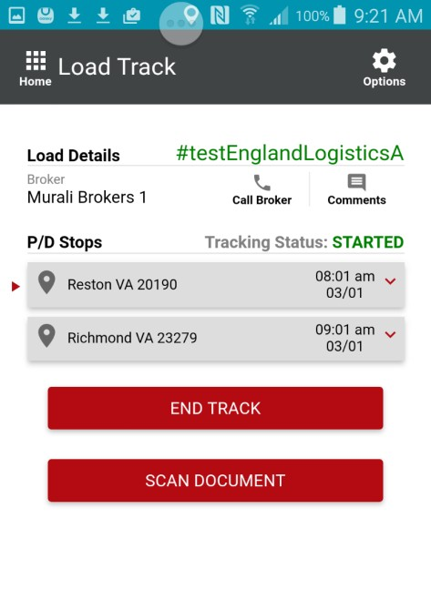
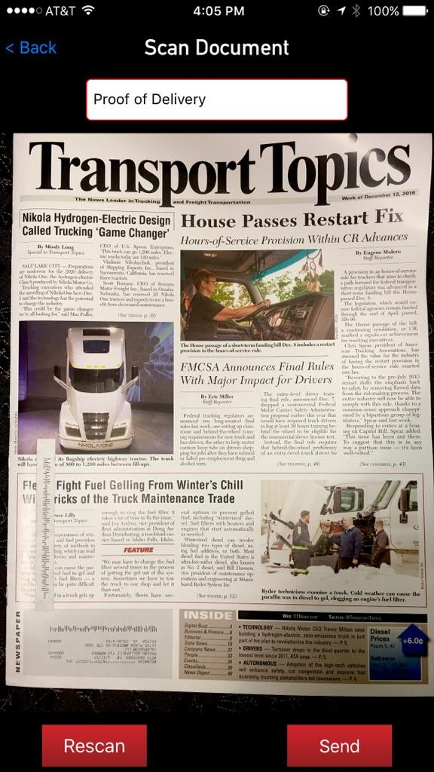

Document Scan: After delivering the load, the Driver can scan POD etc.
Driver can scan PODs and other docs

Slide 41
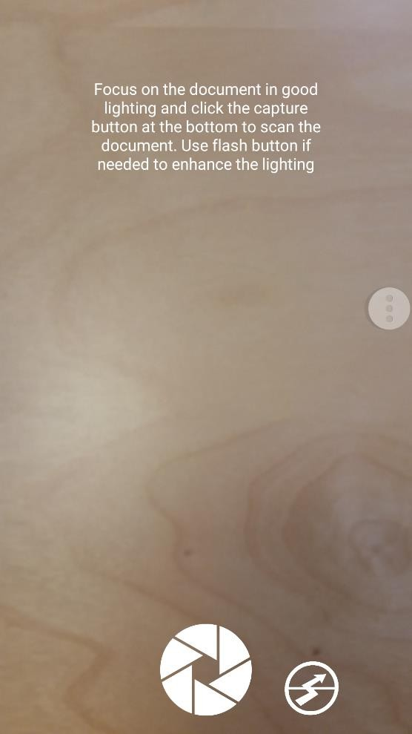
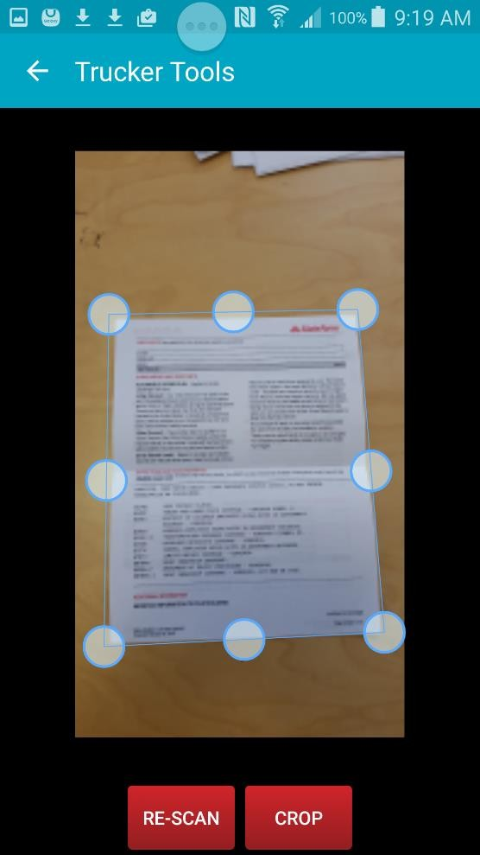
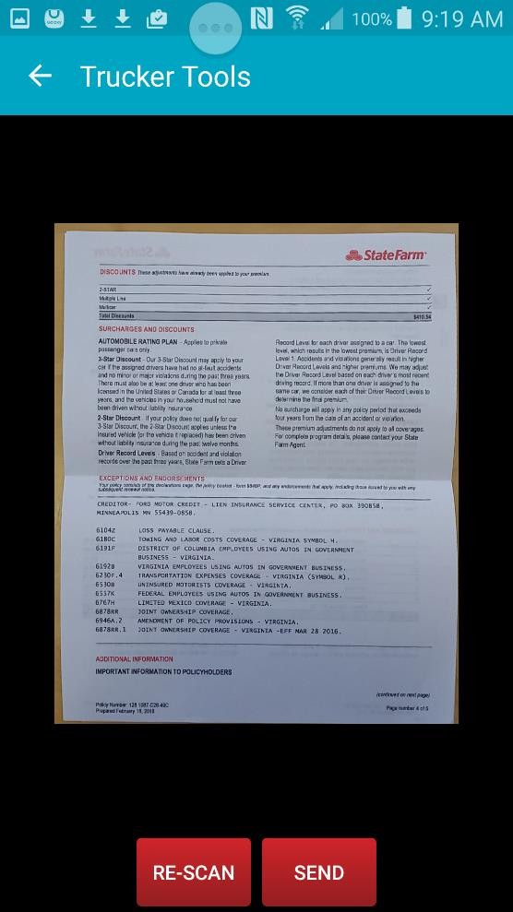
Scan Documents

Slide 42
Recap – life cycle of a load
Get customer release/ load tender
Build load / add to brokerage screen
Post load
Cover load
Confirm carrier information/ set up carrier
Send Carrier rate confirmation
Send driver tracking
Confirm pickup & delivery
Repeat...

Slide 43
Tracking a load
Once a load has been dispatched to a carrier the tracking process must start. The first step in the tracking process is to receive acknowledgment of the rate confirmation. Either via email or a signed rate confirmation (preferred but not required.)
We have a team dedicated to tracking the pick-up and delivery. This team is only to track pickups and deliveries. They will utilize the Trucker Tools app as well as calling and emailing the carrier.
The tracking team will use several different load status throughout the life of the load. These are the most common:
Loading confirmed driver is on-site to load
Progress confirmed driver is loaded and rolling
Unloading confirmed driver is on-site to delivery
Delivered confirmed driver is unloaded, and load has clean POD

Slide 44
Please remember, though we have this ( Tracking team ) ultimately the confirmation of pickups and deliveries is your responsibility. If you receive a call or an email for confirmation of pickup or delivery you will send an email to Afterhours@beemac.com with the order number in the subject and in the body explain picked up or delivered and they will push it through the system.

Slide 45
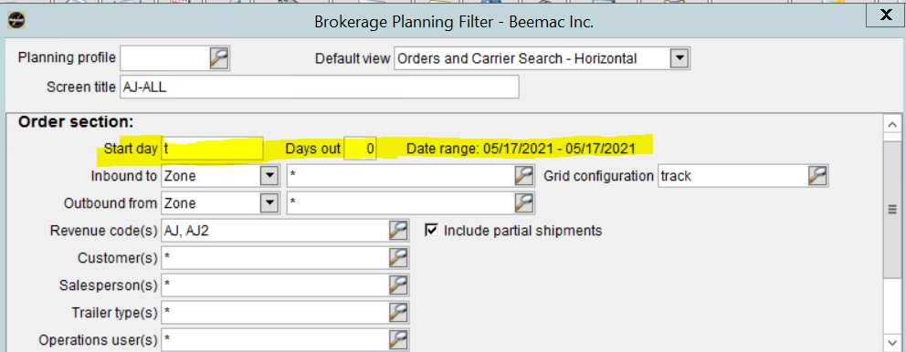
How to Filter Brokerage Planning
At the top of your brokerage planning screen, click the filter button:

Slide 46
You can choose to only look at today’s loads by entering a “t” in the start day and a “0” in the days out. This will make the board a little easier to look at for just today’s shipments.

Slide 47
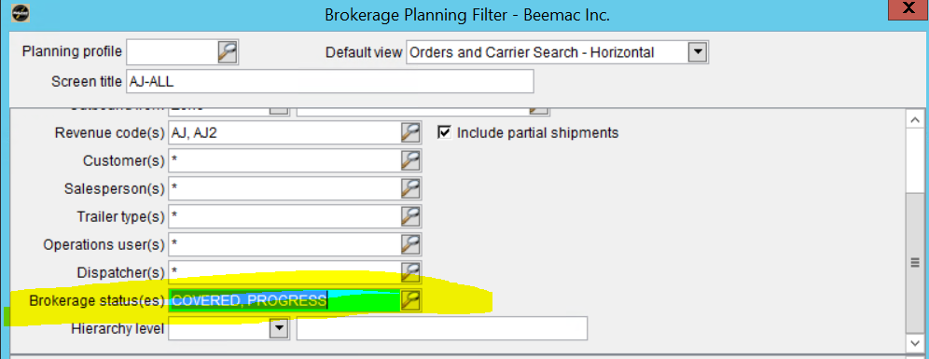
Tracking pickups and deliveries
you can enter COVERED, PROGRESS in the Brokerage Status(es) section to only show those needed to make check calls on.

Slide 48
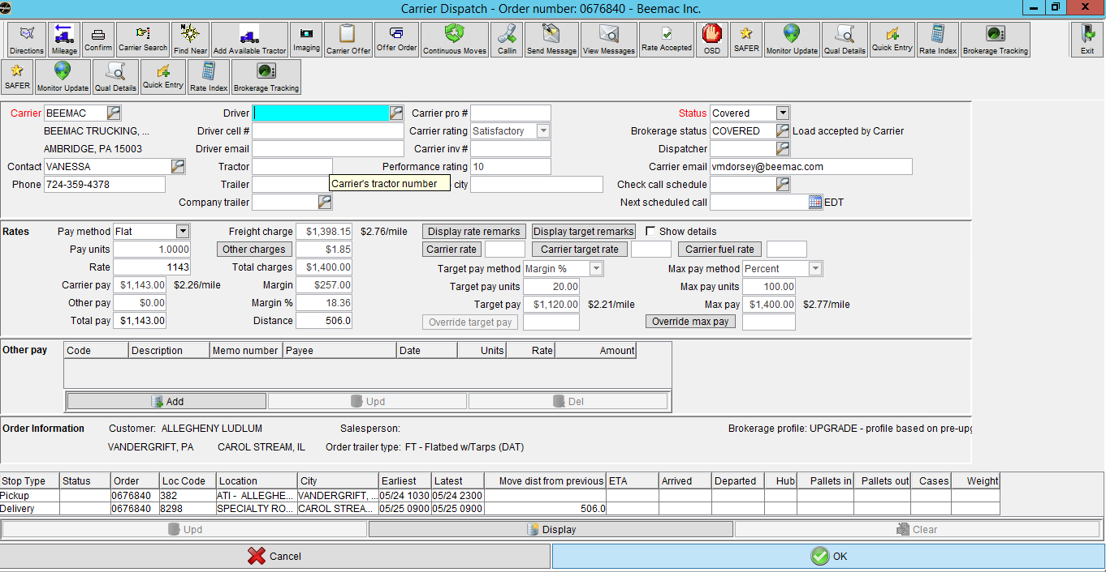
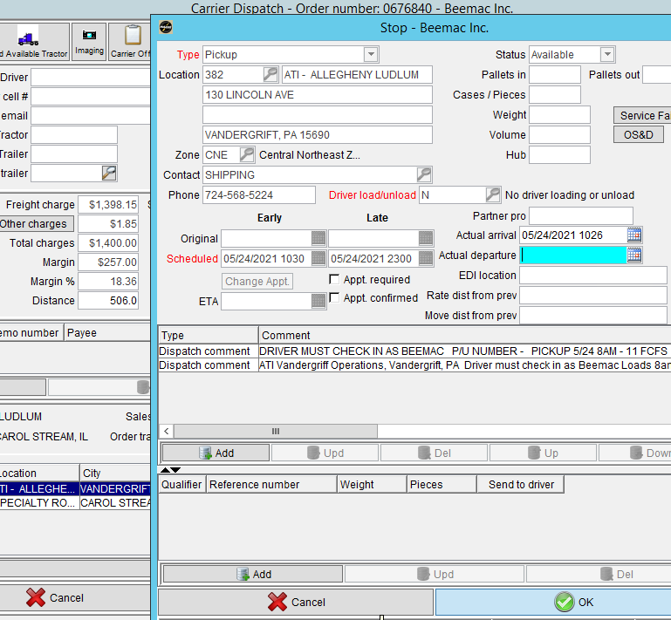
How to status a load in the system as loaded and delivered.
From your Carrier Dispatch screen, double click on the open box where it says “Arrival”, a another screen will open up fill in the date and time of actual arrival and departure and click ok to save it. Once the truck is empty, repeat the same process for the delivery part. Please Note: Once you have statussed a load as delivered in the system you cannot make any changes to the load.

Slide 49
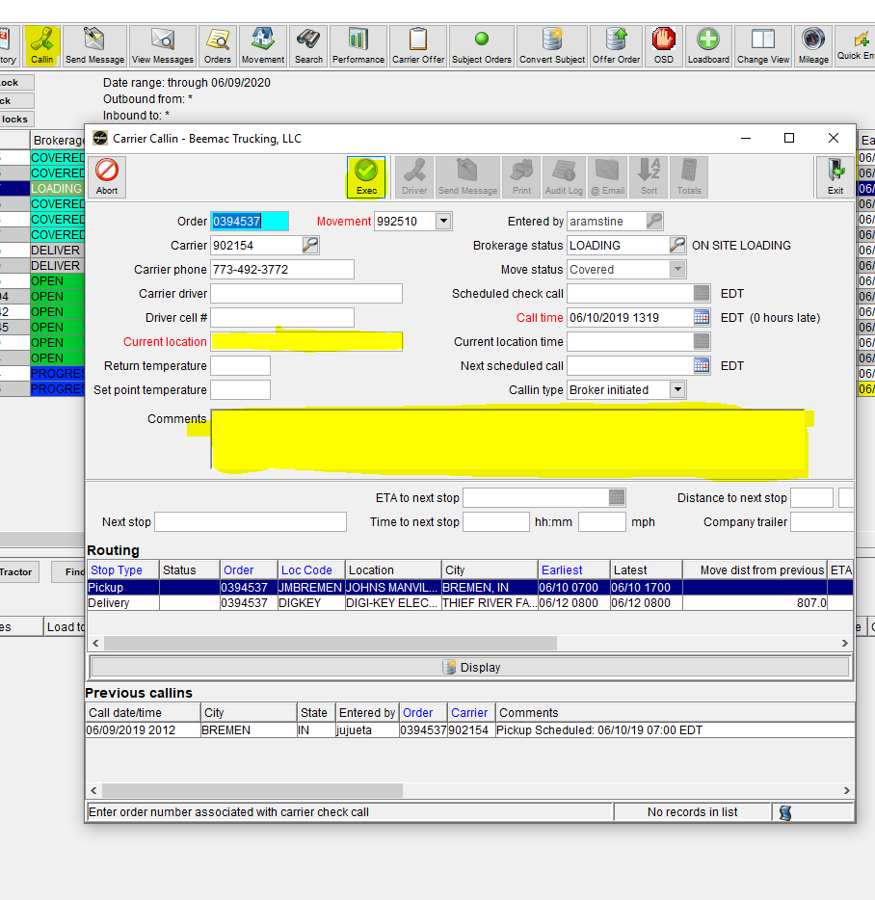
CALL-IN
Should a carrier call in with an update on location you will enter that into the “Callin’ button at the top of the Brokerage Planning screen. This will open a pop-up that will prompt you to enter the carrier location in the ‘Current Location’ field.
You can also enter notes in this screen. Any and all carrier contact should be documented on this screen. This prevents us from contacting a carrier over and over again. If the carrier does not answer the phone you still need to note it in the ‘Callin’ screen.
You can open this screen and see when the tracking team has last contacted a carrier.

Slide 50
Recap – life cycle of a load
Get customer release/ load tender
Build load / add to brokerage screen
Post load
Cover load
Confirm carrier information/ set up carrier
Send Carrier rate confirmation
Send driver tracking
Confirm pickup & delivery
Repeat...

