Slide 1

EQUIPMENT OVERVIEW
UNDERSTANDING THE INDUSTRY

Slide 2
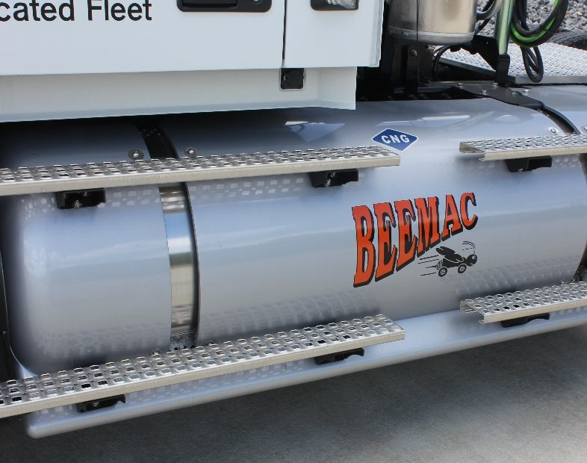
Introduction
During this presentation, we’ll dive into the different types of equipment used by Beemac company trucks, as well as our carrier partners, and the different modes of transportation that we offer.
We will also discuss the use of each trailer type, the commodities that they can haul, and any specific requirements that you need to know to do your job correctly!
Lastly, we will compare the different types of equipment and modes of transportation while keeping your customer’s #1 concern in mind… time vs. money.

Slide 3
Before we start…
Some numbers to remember:
Maximum Gross Vehicle Weight (GVW) is 80,000 lbs
  This includes the weight of:
    Tractor
    Trailer & any equipment (tarp, dunnage, etc)
    All of the cargo
Maximum legal width is 102”
Maximum legal height (from ground to top) is 13’6”
Keep in mind that these are the specifications to keep a load within LEGAL limits. There are instances where our customers have requests that will exceed these, in which case we will look into permits and other options.

Slide 4
Ways to load
Fork Side
Fork Rear
OHC

Slide 5
Open deck equipment
-FLATBED-SIDEKIT-CONESTOGA-CURTAINSIDE-STEPDECK-DOUBLE DROP-RGN-STRETCH DECK-

Slide 6
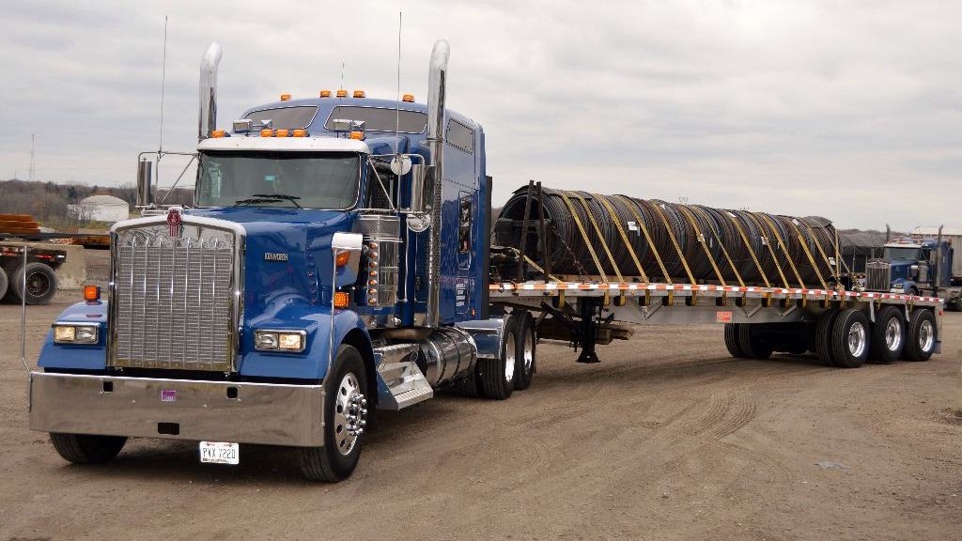
Flatbed
Open deck trailer to carry a wide variety of commodities
Loading:
  Fork side, fork rear, or OHC
Dimensions & Capability:
  Weight: Typically scales 46-48,000
  Length: 48’, 53’, or 40’ Hotshot
  Width: 96” or 102”
  Height: 8.5’ of material
  Legal Overhang
    48’ can have up to 4 ft. off of the back, and 3 off the front (if they don’t have a bulkhead)
    53’ cannot have legal overhang

Slide 7
Flatbed- Packaging
Skids
Bundles
Pieces

Slide 8
Flatbed- Equipment
Tarps
Chains
Straps

Slide 9
Flatbed- Equipment
Pipe Stakes
Coil Racks
Dunnage

Slide 10
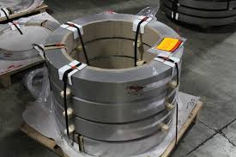
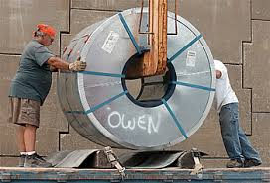
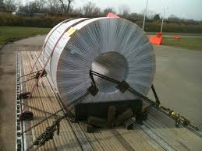
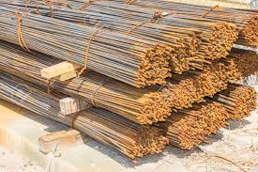
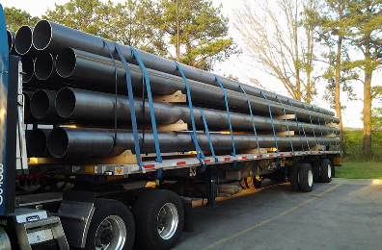
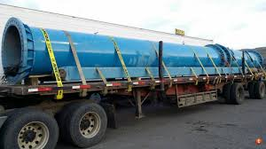
Flatbed- Common Commodities
Coils
  Skidded
    On a pallet
    Loaded with a forklift
  Stand-up
    Eye to the side
    Eye to the rear (Shotgun)
Rebar
  Dunnage
  No-tarp
Pipe/Tube
  Pipe Stakes
  Straps, Chains, etc.
  Dunnage
Skidded Coil
Eye to the sky
Stand-up Coil
Eye to the side
Stand-up Coil
Eye to the rear
Bundled rebar with dunnage
Loads of Pipe/Tube

Slide 11
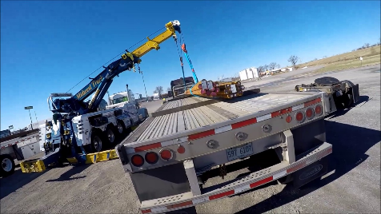
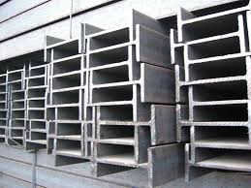
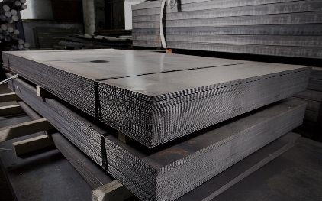
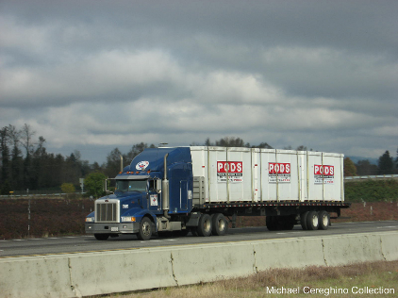
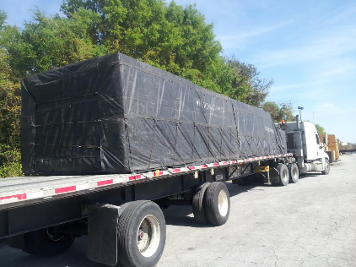
Flatbed- Common Commodities
Bar/Beams
  Dunnage
  Tarp
Sheets/Plate
  Tarp
Lumber
  May require 8’ drop tarps
  May require shorter tarps, or none at all
Equipment/Containers
Steel beams being loaded onto a flatbed with an OHC
Sheet metal on skids
Lumber- always find out whether or not they need tarped!
PODS containers on a flatbed

Slide 12
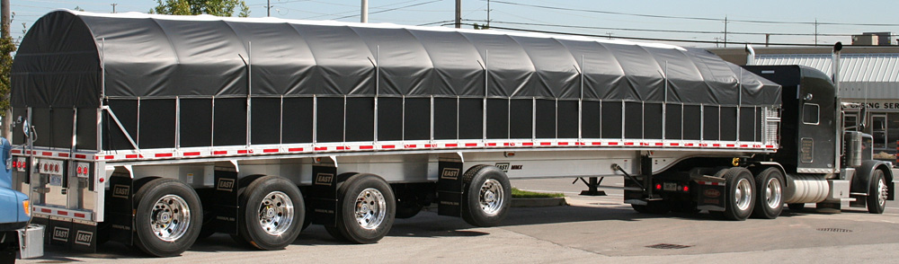
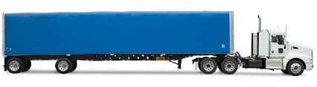
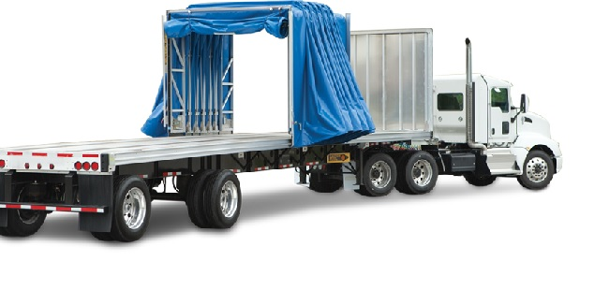
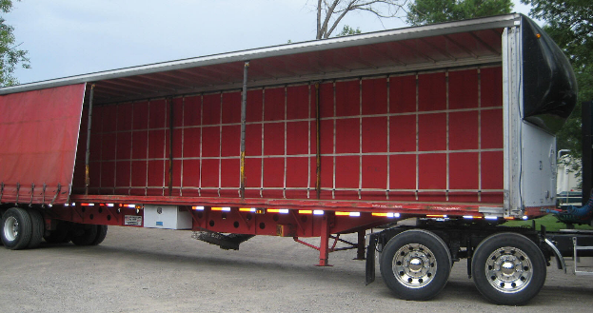
Specialized Flatbeds
All 3 give the loading flexibility of a flatbed, with fully enclosed protection!
Side kit
  Flatbed with 4x4 wooden or fiberglass panels along both sides
  Metal ribbing forms a frame over top of the trailer
  Tarp rolls over the frame
  Loads fork side, fork rear, or OHC
Conestoga
  Flatbed with a FULLY RETRACTABLE top and sides
  Entire enclosure slides to the front like an accordion at the push of a button
  Loads fork side, fork rear, or OHC
Curtainside
  Flatbed with a fixed top and front
  Rear has swing doors and one or both sides roll up
  Loads for side or fork rear

Slide 13
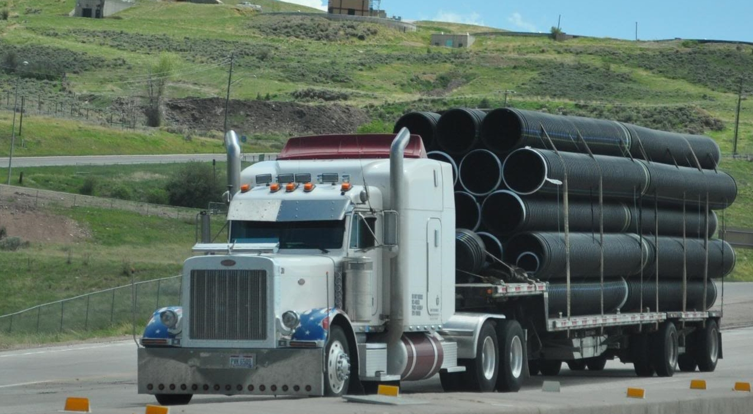
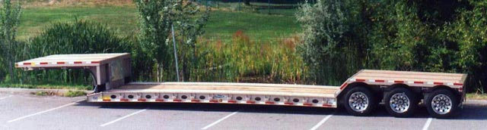
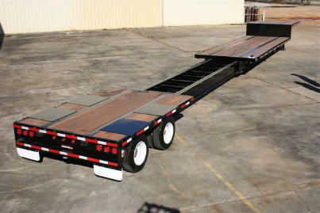
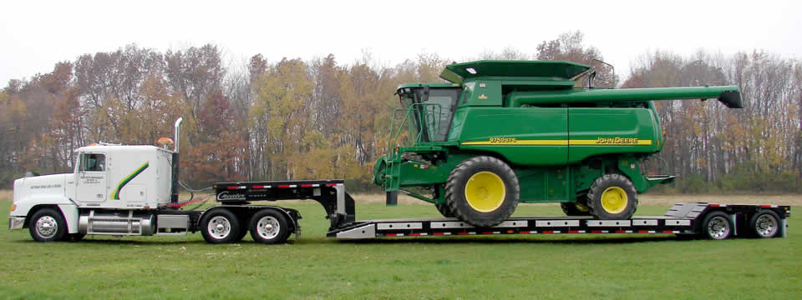
Specialized Flatbeds
Step deck
  Lower deck 2.5’ off the ground
  Watch the length- top deck will have 11’ and bottom will have 37’
  Can use load levelers to even out height
  Loads for side or OHC, not fork rear
Double Drop/Lowboy
  Lower deck (called the well) is 1.5’ off the ground
  Watch the length- the well normally allows for 29’ of material
  Loads fork side or OHC, not fork rear
Removeable Gooseneck (RGN)
  Step decks or Double Drops can also be RGN’s
  Front portion detaches to lay down ramps for equipment to be driven on from ground level
  Loads fork side, OHC or drive-up
Stretch Trailers
  Deck extends to allow for longer material to be loaded
These flatbeds allow for higher material to be loaded with a lower center of gravity

Slide 14
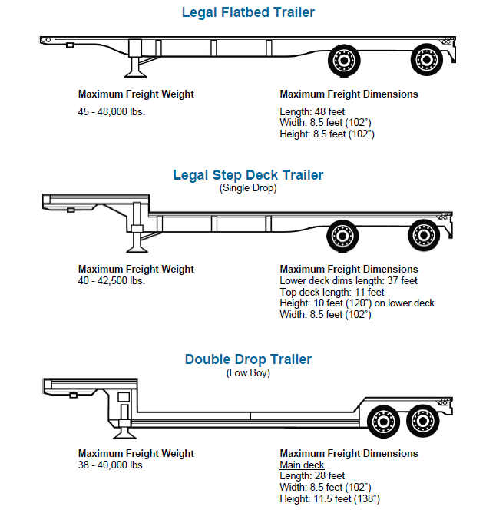

Slide 15
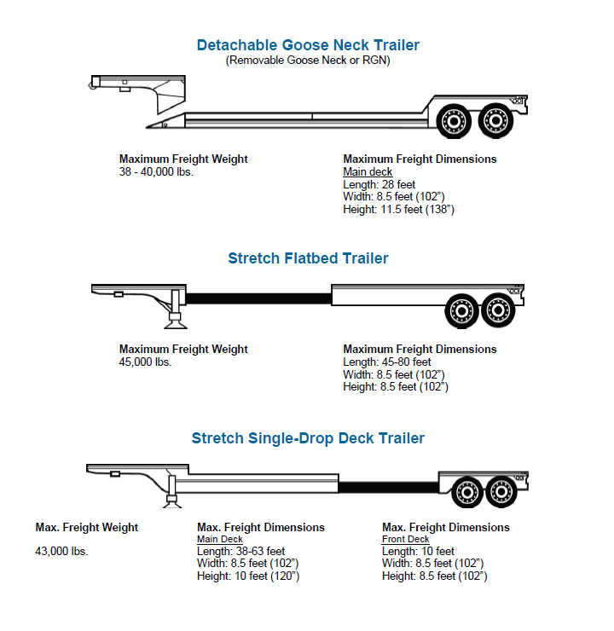

Slide 16
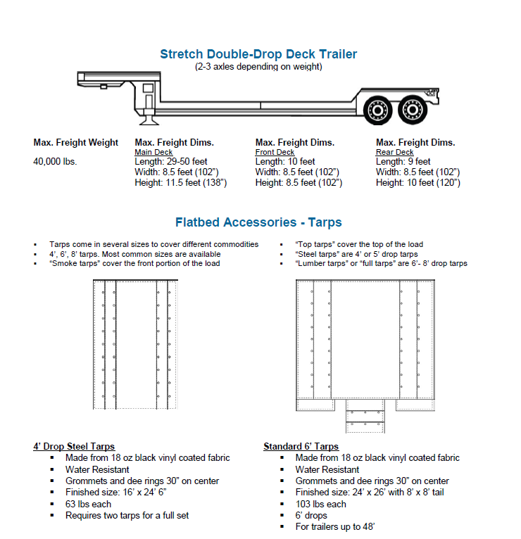

Slide 17
CLOSED DECK EQUIPMENT
-DRY VAN-REFRIGERATED VAN-

Slide 18
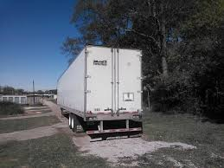
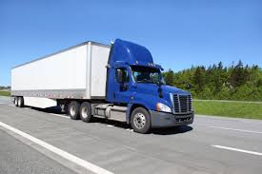
Dry Van
Fully enclosed trailer that opens in the rear
  Wooden floors allows drivers to nail boards down for blocking and bracing
Loading:
  Fork Rear
Dimensions & Capability:
  Weight: Typically scales 43-45,000
  Length: 53’, 48’
  Width: 96” or 102” *Keep in mind, the inside width will be less*
  Height: 8’
  Swing doors or roll-up

Slide 19
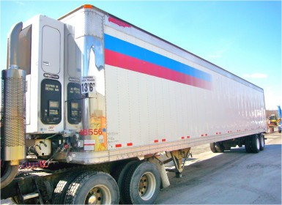
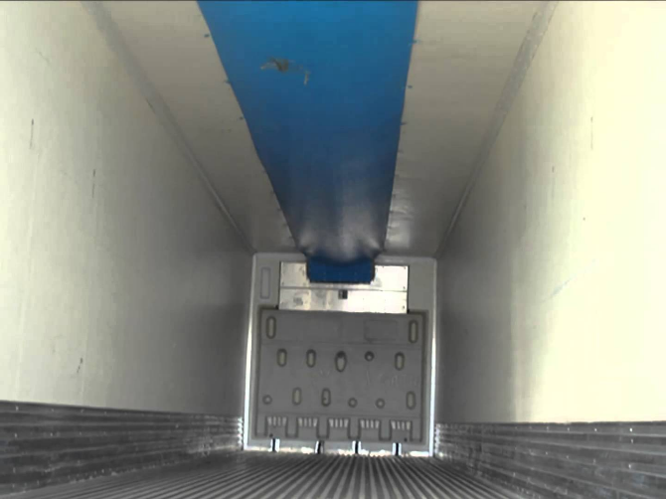
Refrigerated Van
Fully enclosed trailer that is temperature controlled
  Metal corrugated floors with insulated walls to control the temperature
  Can be set to a specific degree, set to a range, or “kept below” a number
  Can also be run with the refrigeration unit OFF
Loading:
  Fork Rear
Dimensions & Capability:
  Weight: Typically scales 40-43,000
  Length: 53’, 48’
  Width: 96” or 102” *Keep in mind, the inside width will be less*
  Height: 8’
  Swing doors

Slide 20
Van- Equipment
Logistics Bars
Liftgate
Pallet Jack

Slide 21
Van- Equipment
Dunnage
Lumper Fee
Pallet Exchange

Slide 22
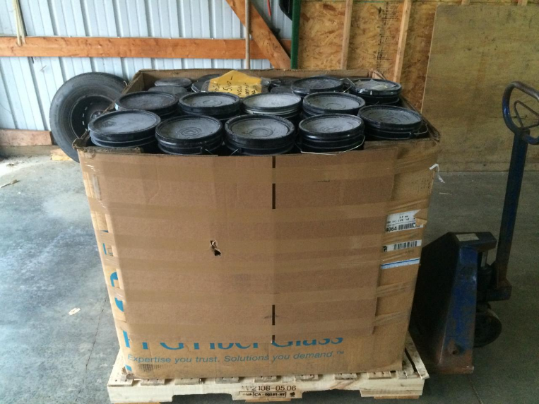
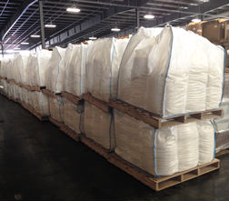
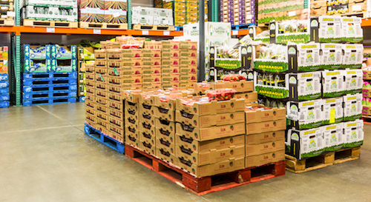
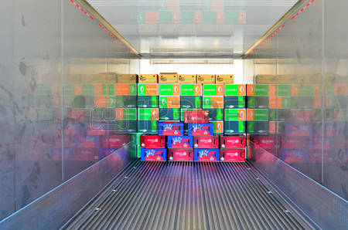
Van & Reefer - Packaging & Commodities
Packaging Types:
  Gaylords/Corrugated Boxes
  Supersacks
  Pallets
  Pieces
Van Commodities
  Plastics
  Retail
  Empty Pallets
  Skidded coils & other metals
  Paper
Refrigerated Commodities
  Produce
  Poultry
  Beverages

Slide 23
IMPORTANT THINGS TO CHECK
Every facility has their own scheduled load times. It is vital to call each facility and find out what their shipping and receiving hours are. For example, a facility may ship from 8:00am – 3:00pm Monday through Friday on a first come, first served basis, or may receive from 8:00am to 2:00pm by appointment. It is important to know this information so you can schedule the arrival times of your trucks better.
Some facilities only require certain types of trailers to get loaded or unloaded. For example if a facility needs a trailer to be dock height, do not send in a Step Deck, Lowboy or Double Drop trailer, unless you have confirmed with the loader that they will use a forklift.
Always confirm the Holiday Schedule with facilities you regularly load out of to avoid paying a TONU. For example a facility may regularly load from 8:00am – 11:00pm Monday through Friday. If your intended shipment date falls on a public holiday, their adjusted hours may be 8:00am – 4pm that day, or they may be closed the previous day.
As a rule of thumb, if you do not have certain information, this is acceptable to say to a carrier. For example you can say to a carrier, “I am waiting to confirm all the customer information but in the mean time I wanted to confirm that you driver has tarps in case he needs them,” Or “If they load by appointment what time can I schedule it for your driver?” OR “ At most the load could be 48,000lbs (flatbed) or 44,000lbs (Van).” It is better to have something and not need it, that to need it and not have it.

Slide 24
ADDITIONAL SERVICES
-LTL-POWER ONLY-OVER DIMENSIONAL-DROP TRAILER-
-DRAYAGE-RAIL-BARGE-AIR-INTERMODAL-

Slide 25
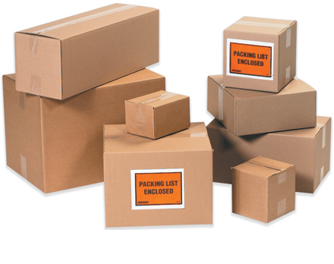
Less than Truckload (LTL)
When your customer has freight to move that won’t take up an entire truck’s worth of space, LTL can be an option
  Moved on van trailers (typically curtainsides)
  Not to be confused with flatbed partials
The process
  Your customers’ freight will be consolidated with that of other companies to maximize efficiency
  Carriers will load your freight and take it back to a distribution center, where it will change hands several times between pick-up and delivery
We utilize a third-party system for quotes
  We have contracts in place with LTL carriers who price our quotes based on the density of the material and the amount of deck space they occupy
  Immediate pricing and guaranteed capacity
It is important to understand that carriers have different requirements that can affect your rate, as well as accessorials
  Linear foot rules
  Classing and density
  Liftgate, appointments, sort & seg, ect.
This is a slower mode of transportation, but will save your customer a great deal of money in the long run

Slide 26
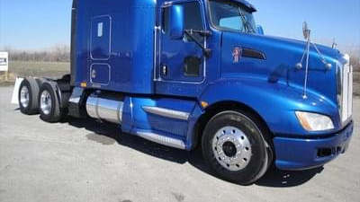
Power-Only
Power-only loads consist of the driver using their company tractor to haul the customer’s trailer. There are two types of power-only loads:
Tow-away
  Tractor picks up trailer and delivers to consignee
  May be pre-loaded, or it could be a live load
Load-out
  Tractor picks up an empty trailer and has a set number of days to deliver to the consignee
  During this time, the trailer is theirs to haul whatever freight they choose

Slide 27
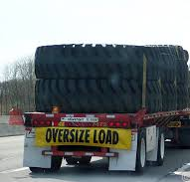
Over-Dimensional Loads
When your customer has a load that is over-weight, over-width, over-height, over-length… or a combination of all of them; we can still offer them solutions
In an instance where you need to exceed maximum legal requirements, any or all of the following may apply:
  Permits
  Flags & placards
  Specified hours of operation
  Specialized route
  Road closures
The carrier is responsible for any and all permits and other requirements associated with these loads
Things to keep in mind:
  Make sure you are using a RELIABLE carrier
  Rates to your customer and the carrier are going to be increased
  Permits are only valid in their state of issue
    Example: If your load goes through 4 states, you’ll need a permit for each state
  If they make it, WE CAN SHIP IT!!!
  Don’t ever turn down an opportunity because you aren’t sure how to move it, or think it will be too difficult. Someone is moving it for your customer currently… so why not you???

Slide 28
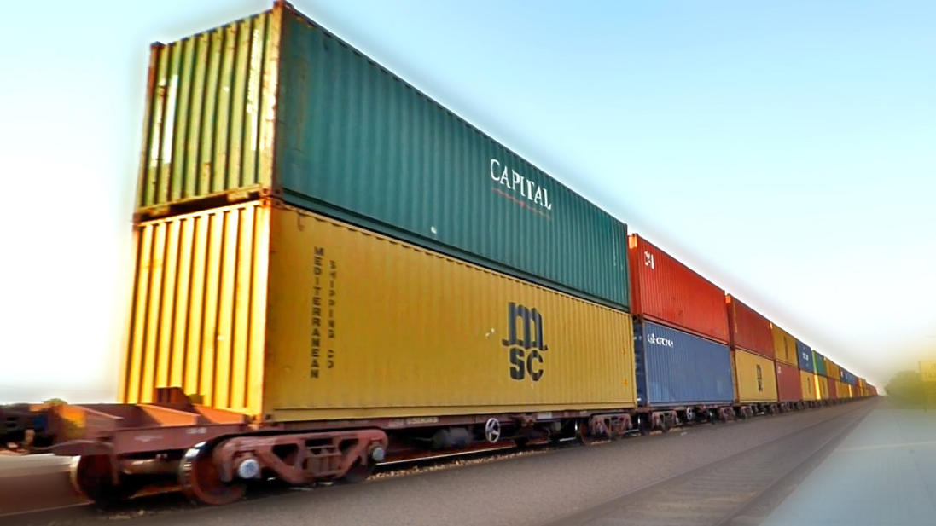
Special Services
Drop Trailer
  Driver leaves his trailer for a pre-determined amount of time for loading and/or unloading
Drayage
  Freight (usually containers) are picked up from the port or rail yard on a chassis and taken to their destination
  Sometimes will be warehoused or trans-loaded in the process
Rail
  Uses a number of train cars to transport large quantities of material at one time
  Different types of cars for different uses
  Generally less expensive than truckload
Barge
  Used for water transportation
  Different types of ships for different uses
  Least expensive mode of transportation
Air
  Can be used for extremely expedited situations
  Most expensive mode of transportation
Intermodal
  Using more than one mode of transportation for a shipment
  Typically moving freight in a container or in/on a trailer

Slide 29
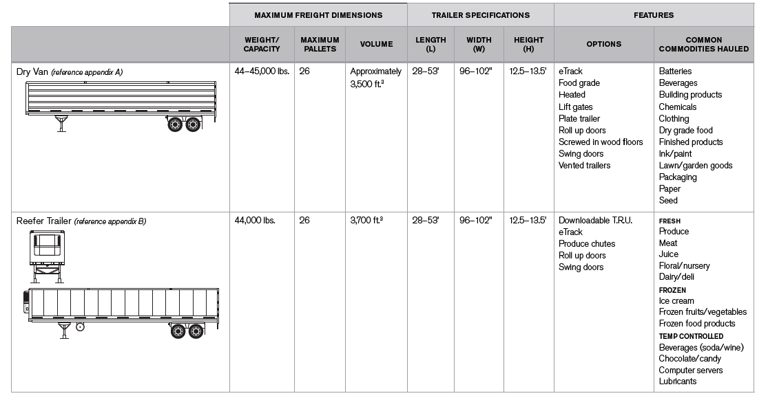

Slide 30
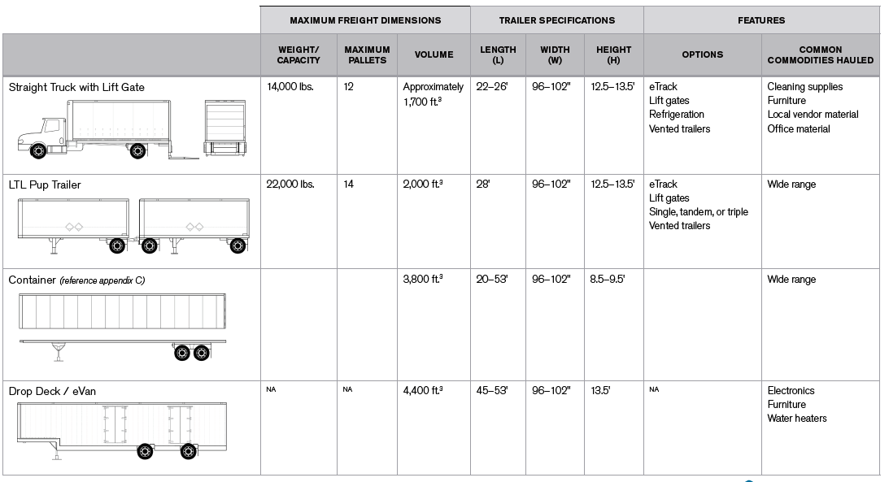

Slide 31
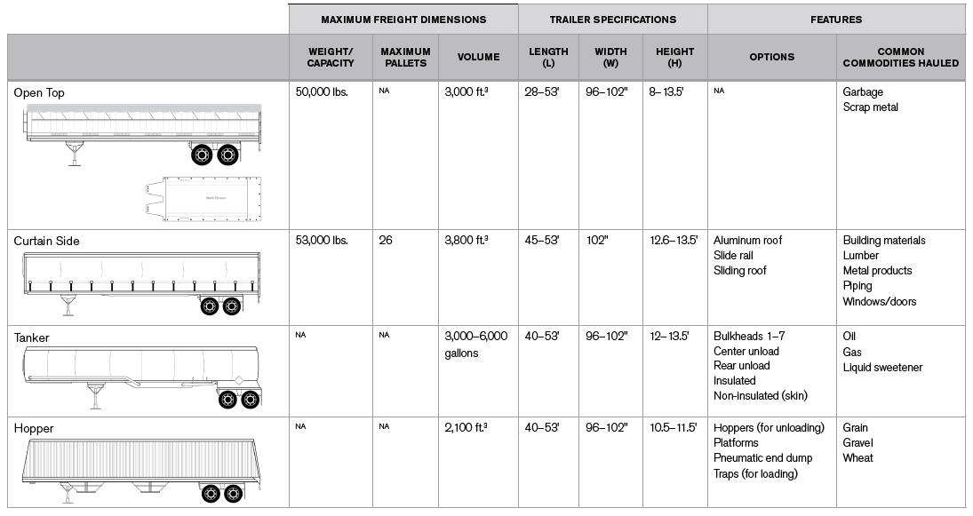

Slide 32
