Slide 1
BILLING RATE SHEETS UNBILLED PAPERWORK

Slide 2
RATE SHEETS
“IF IT’S NOT IN WRITING, IT DOES NOT EXIST”
All customer rate sheets should be sent to: ratesheets@beemac.com with the order number (pro number) in the subject line. This should be done at time of entering the order.
Rate sheets include any customer rates that are agreed upon between you and your customer. These include but are not limited to:
Spot Quotes.
Approved Quotes to customers via email.
Accessorial approvals from the customer.
Acceptable rates sheets are:
Actual tender sheet with rate on it.
Screenshot from customer or terms with rate on it.
Approval response from customer.

Slide 3
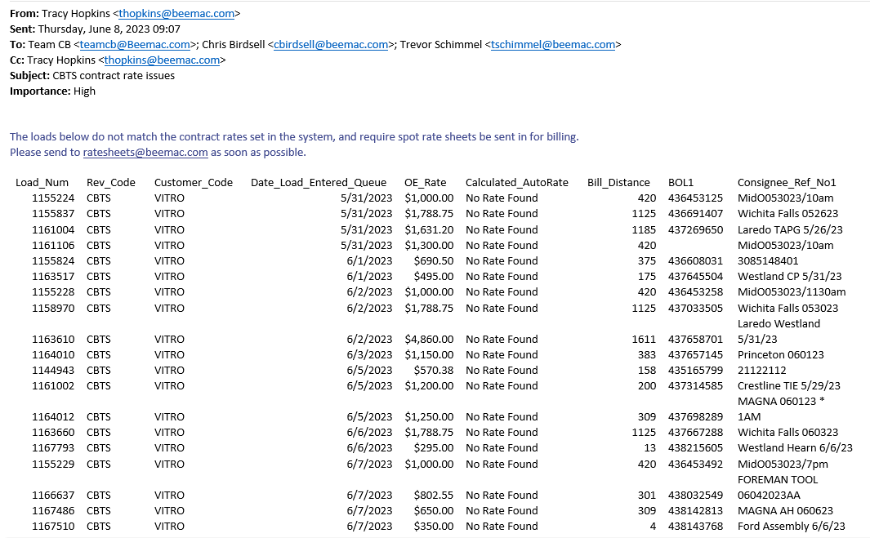
EXAMPLES OF RATE SHEETS
Negative effects on not submitting rate sheets:
Delayed process in billing.
Incorrectly invoicing the customer.

Slide 4
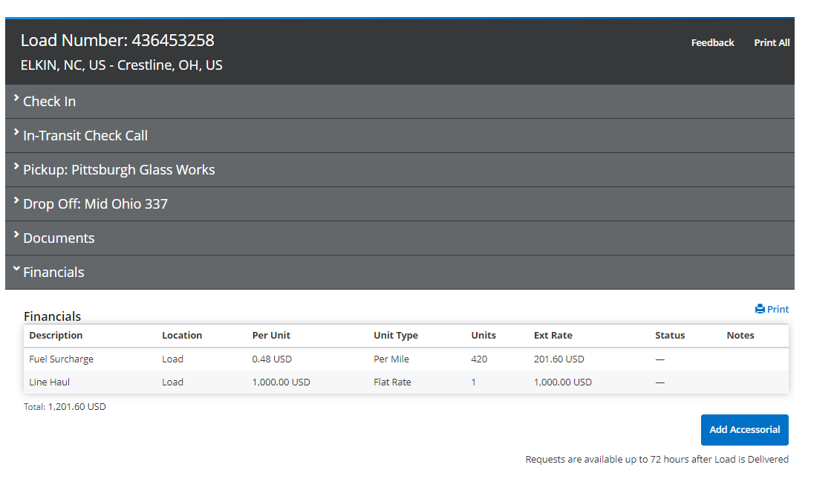
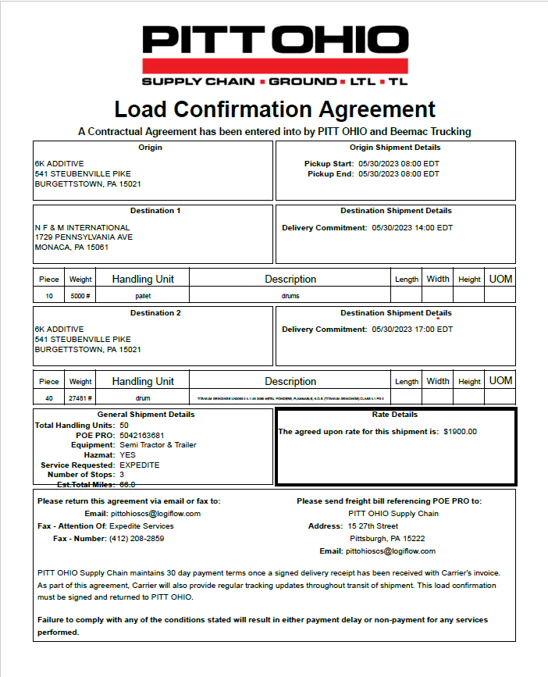
EXAMPLES OF RATE SHEETS

Slide 5
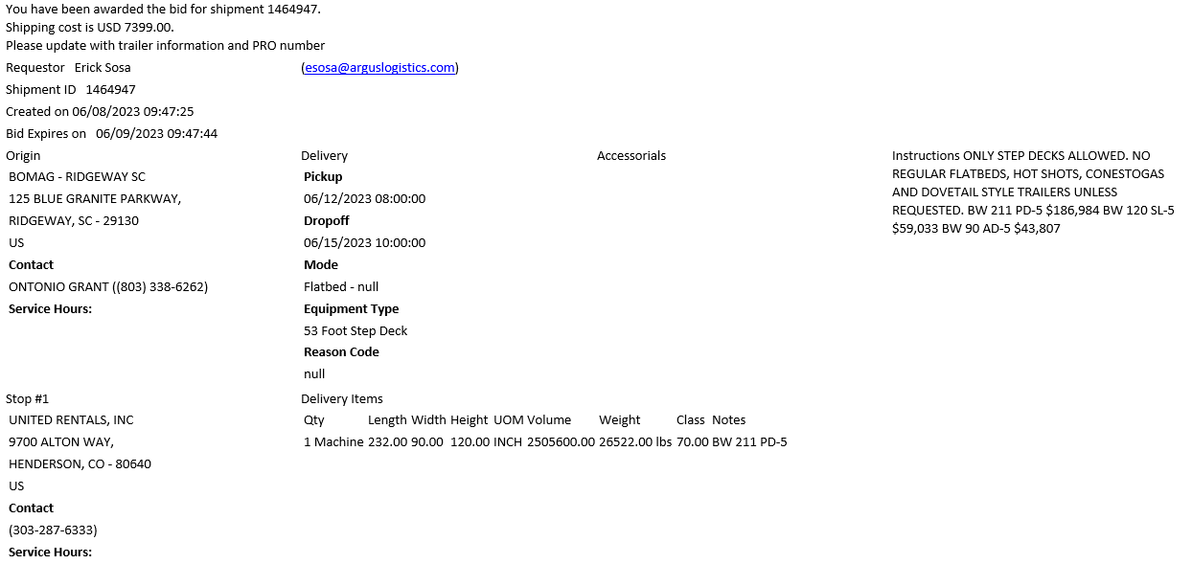
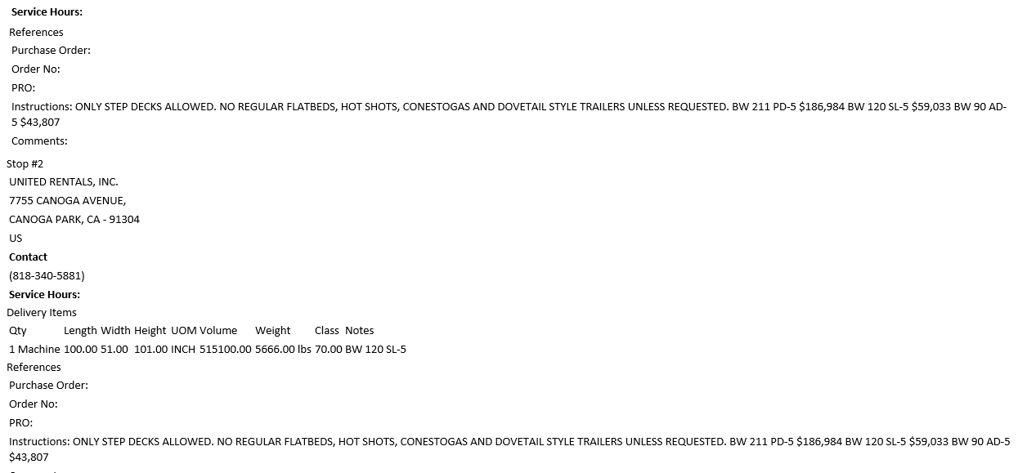
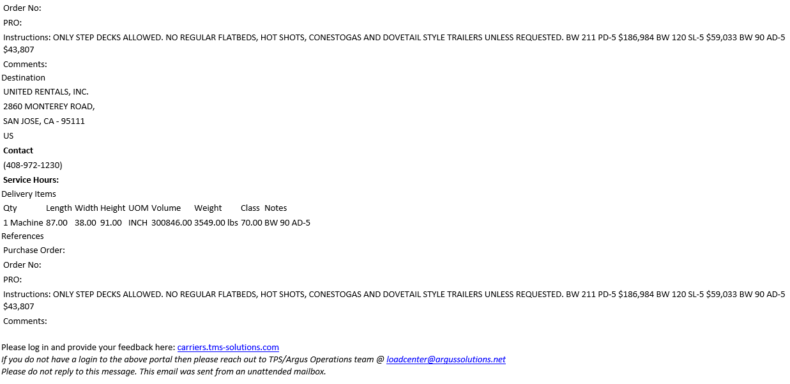
EXAMPLES OF RATE SHEETS

Slide 6
CONTRACT RATES/ FSC CHARTS/ CONTRACTS
Contract rates/ FSC CHARTS, Contracts should be sent to contractrates@beemac.com
Contract rates are:
Awards from RFPs.
One rate for multiple load projects.
Any agreed upon rate for a duration longer than one time use.
FSC charts are typically specified by the customer and change weekly in most cases.
Contracts typically will show contract rates, FSC charts and accessorial tables.
By submitting these to contractrates@beemac.com the typical rate sheet process can be ignored as rates will pull automatically in the system.

Slide 7
PAPERWORK SUBMISSION
paperwork@beemac.com = only to be used if you need to send a POD, the Order number (Pro number) must be in Subject Line of the email. This is an unmanned email. You typically won’t get answers back from questions to this email.
Carrier.invoice@beemac.com = all carrier paperwork goes here, that includes carrier rate confirmation sheet, invoices, mtr sheets and PODs. If you have questions regarding clarity of paperwork or need responses from paperwork submitted, confirmation of receipt, etc., use this email address instead.

Slide 8
PAPERWORK FOLLOW UP
When submitting paperwork verify that it was received.
If you are still being emailed for paperwork that was submitted, advise that it was sent and where it was sent to and verify they received it.
If carrier states they sent in paperwork, verify when they sent it and which email address they sent it to.

Slide 9
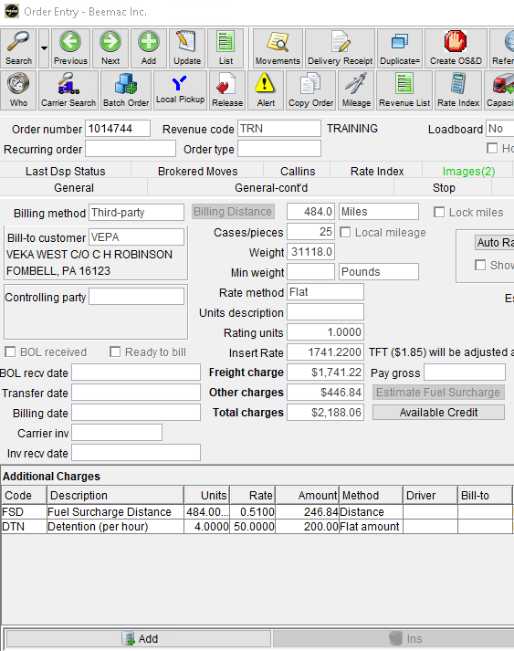
WHEN BUILDING LOADS
Take your time when building loads in McLeod to build them correctly.
Verify that your rates to your customer are correct.
Verify the fuel surcharge rate is correct or updated.

Slide 10
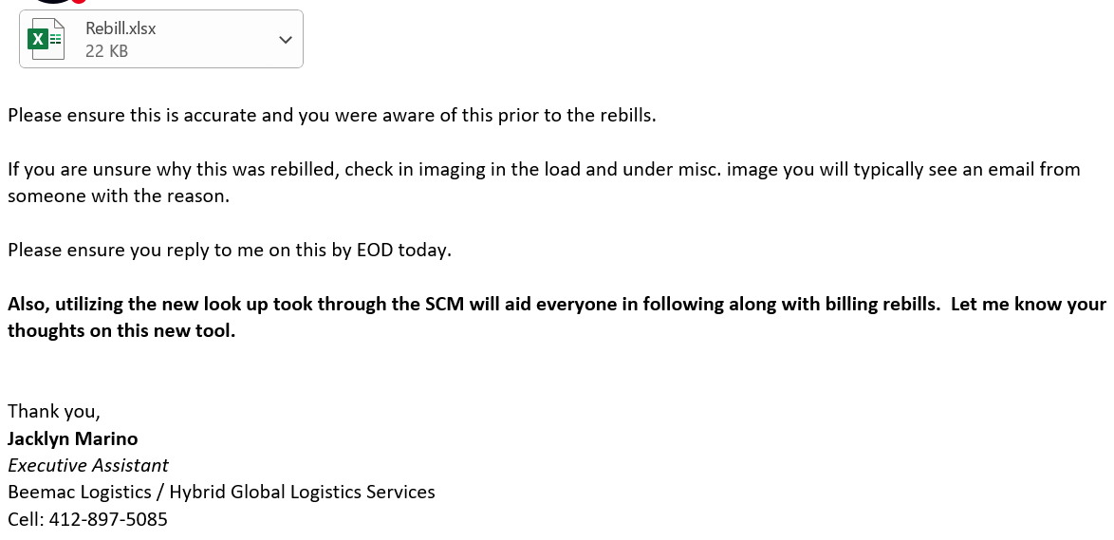
REBILLS
Make sure to doublecheck that the rebill is accurate.
Check your SCM to verify accuracy.
Send approval or denial within the same day.

Slide 11
REBILLS
UNDERSTANDING THE SPREADSHEET
Look for your Revenue code, pro number, initial bill date, rebill date and change in linehaul or margin.
Payout is not what you will be deducted, it will be your percentage of that number.
Always check the SCM for the load number to show initial and finalized payouts.

Slide 12
PROPER RESPONSE TIME TO INTERNAL EMAILS
The expectation for internal emails with requests is to have a response within 2 hours.

