Slide 1
GREENSCREENS
Experience the future of predictive freight pricing.

Slide 2
Sign into greenscreen to begin:
https://www.greenscreens.ai
Win more business, more profitably.

Slide 3
LANE DATA
Zip code is always more accurate in larger metros.
You have the option to toggle between Flat rate or per mile rate.
Enter the equipment type, the lane and click “Get rate”
All-in Rate to the carrier based on Beemac data.
This is the static network rate with a confidence level.
•Start rate for negotiations.
•Fuel amount has already been included in the Rate.
•Miles based off google miles.
Defaults to 15% unless you have markup data in place or historic data on that lane. Let’s you know the average margin.

Slide 4
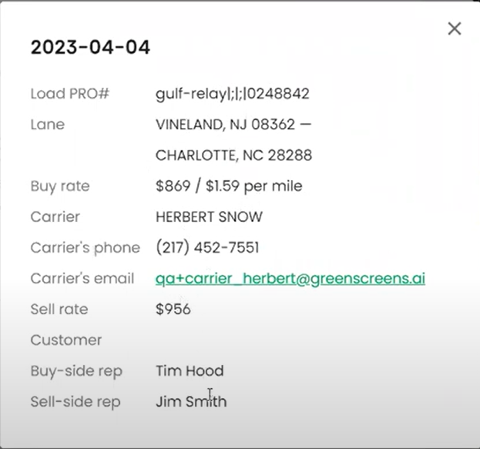
If you have moved this load in the last 30 days, you will be able to view averages and reports in the “Short term history” tab.
Hover over any of the dots to view details of the lane. Click on the dot to expand the box for more details.

Slide 5
The negotiation Coach is a summary of your short term history over the last 30 days.
The “Lane analytics” box lets you know how many days it takes on average to cover this lane.

Slide 6
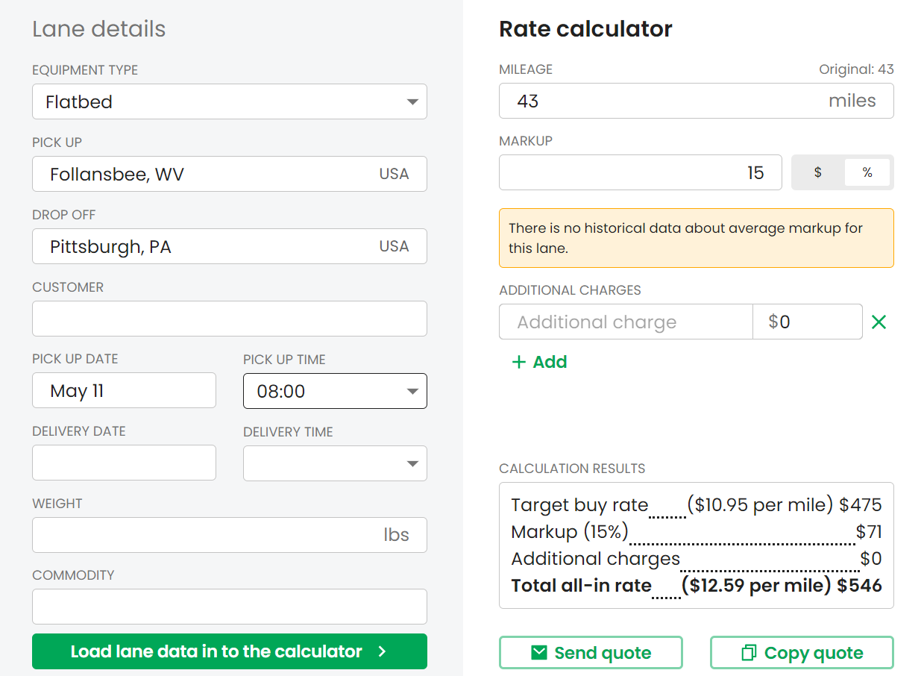
SENDING RATES TO THE CUSTOMER
Click on the calculator to add more information and additional (e.g., Lumper) charges if necessary.
You can copy the quote to your clipboard and open outlook and paste your notes to the body of your email.

Slide 7
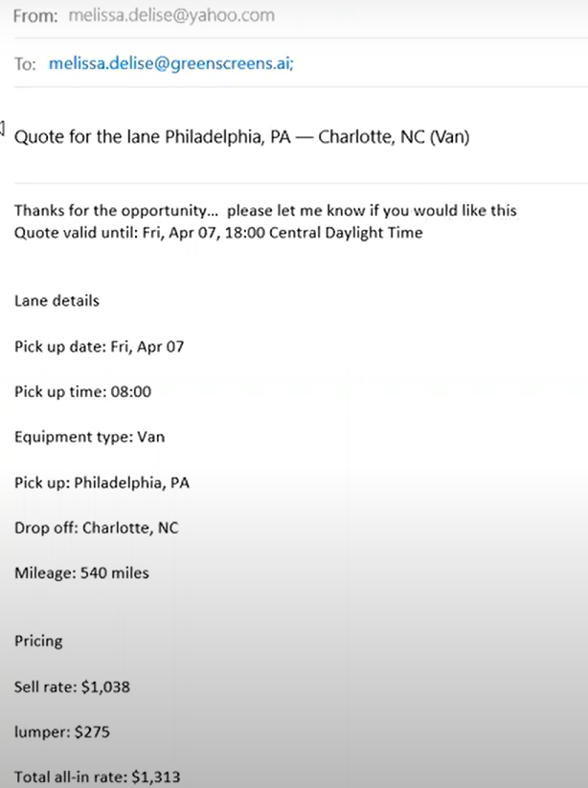
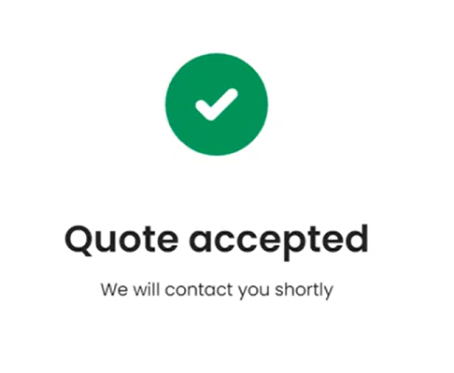
WHAT YOUR CUSTOMER WILL SEE
You can send a quote to your customers; they will see the all-in rate plus any additional charges. Or you can copy it to your clipboard and open outlook and paste your notes to the body of your email. Your customer will have the opportunity to accept or reject the load.
You will get an email notification when your customer has responded. Your customer will get a message saying you will contact them.

Slide 8
RECENT RATE QUOTES TO CUSTOMERS
When your customers have accepted the quote, it will show up like this in the “Recent quotes” box.
Anytime anyone searches for that exact lane and equipment type, it pops up here, plus any other quotes to different customers.

Slide 9
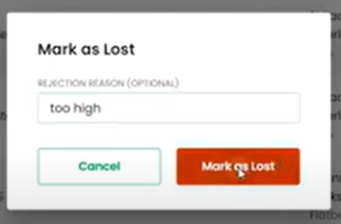
Under the quotes tab you can view any quotes by customer, pickup or drop off location, username (email address). You will also see a Month over month view, it will show the last 30 days of quotes, along with the win/ loss record.
You can change the status of a quote if you did not win it and add a reason.
All the quotes can be exported to an excel file.
You can also search a timeframe.

Slide 10
If a quote has expired, click on the three little dots and you can change the status.
On a side note, when building loads in the Order Entry screen, don’t forget to change the Mode to partial if you are not moving a full truckload so that we can obtain the most accurate rate calculations.

Slide 11
Under the Batch tab, you can search for up to 2500 lanes to quote.
Click on “Download template to begin adding your lanes to quote.

Slide 12
Copy and paste your data into the excel file. The required fields are Transport type, you can enter Origin City or state or Zip, Destination city or zip, weight, and commodity. **If you don’t have all the zip codes then don’t enter them altogether.

Slide 13
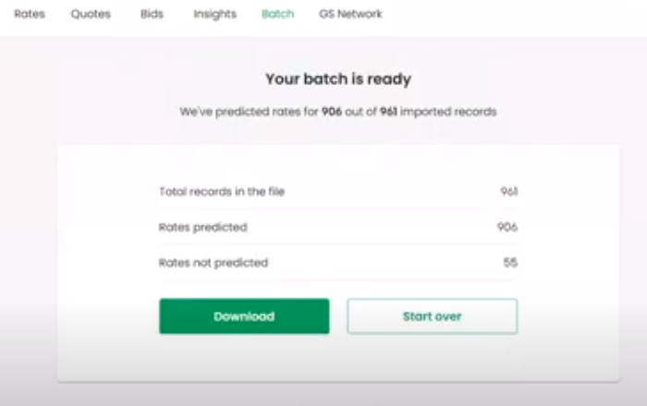
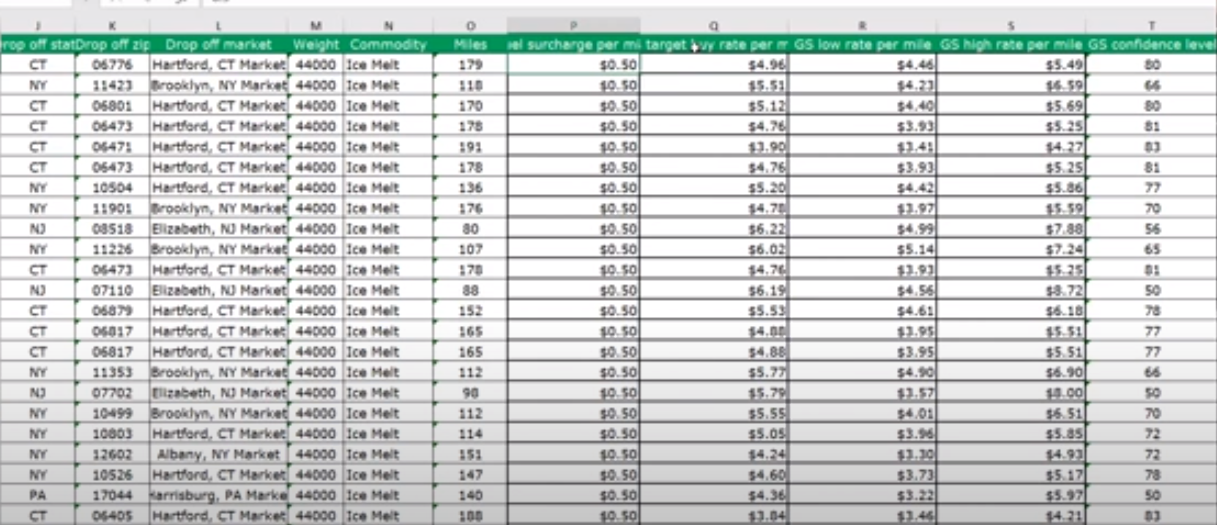
Save and upload your batch and you will be notified when it is complete.
Please note your Target rate is an all-in rate, with fuel added.

Slide 14
CARRIER BIDS
You can request a bid from all the carriers, and they will receive a blind copy of the email.
The offer to the carrier will appear in the “Recent bids” box and you can manually add bids also.

Slide 15
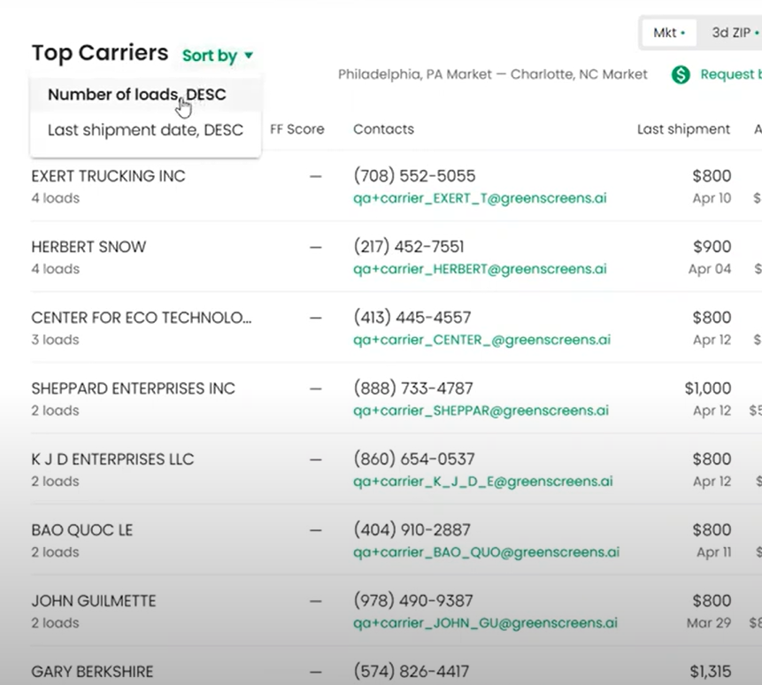
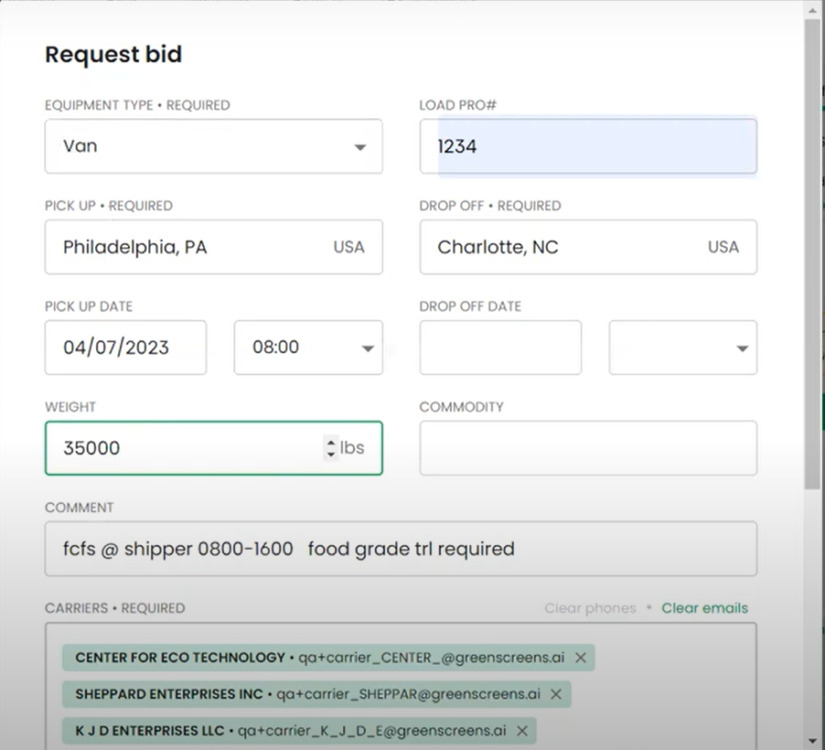
SENDING BLAST BIDS TO CARRIERS
You can view a list of carriers who have moved loads for you by number of loads or most recent date.
You can remove their phone numbers, manually add up to 150 carriers, and add as much information that you think the carriers would need to know and click “Request Bid.”

Slide 16
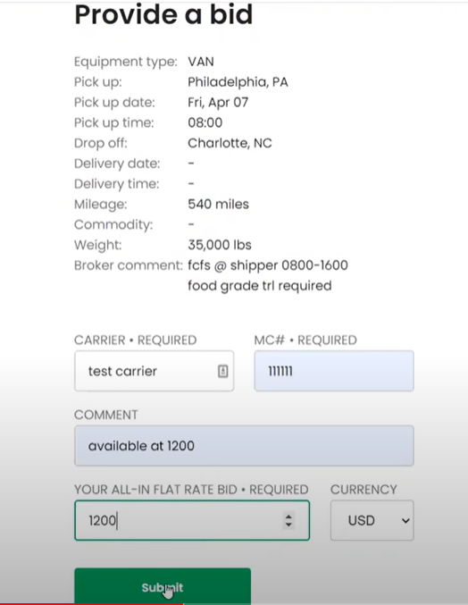
WHAT THE CARRIER WILL RECEIVE
Your carrier will receive an email with all the details and the carrier can provide a bid and submit their information. Your carrier will get a message saying you will contact them. You will get an email notification when your carrier has responded.

Slide 17
Under the Bids tab you can view any bids by customer, pickup or drop off location, and pro number (order number). You will also see a Month over month view, it will show the last 30 days of bids.
You can also search a timeframe and add a Bid.

