Slide 1
2023 csm training update

Slide 2
The New Beemac Sales Process

Slide 3
The New Beemac Sales Process
Identify – Sourcing Leads
Discover– Determining Prospects
Pain & Solutions – Understanding The Need
Activation – Earning The Business
Dynamic Relationships – Growing The Account, Reducing Churn

Slide 4
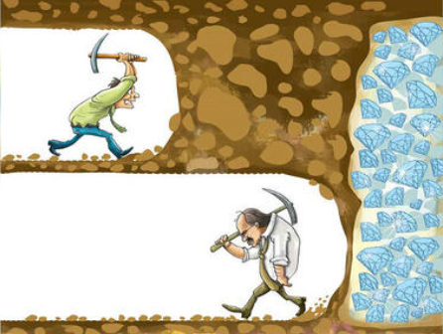
Time to Take Your Identified Leads and Discover which will be your prospects!
Now it is time to start dialing!
Your goal is not to sell anything to anyone. It is to understand individuals needs, and to align a mutually beneficial solution.
Rejection; is it an obstacle, an obstruction, or an opportunity?

Slide 5
Pre-Call Planning
DEFINE YOUR DESIRED OUTCOME BEFORE DIALING
Salespeople who take the time to identify their objectives for the call are much more likely to achieve them. Answer these questions before each call:
WHY AM I CALLING THIS PROSPECT?
What specific information do I need to get out of this call?
What specific information do I want the prospect to have after this call?
What is my desired outcome for the call?
SINGLE / DOUBLE / HOMERUN
What should be the next step after this call?
How will this call move the prospect closer to the buying decision?
Five Key Reasons to conduct pre-call Planning:
No Plan=No results
Make the most of limited talk time on the phone
Add value to each sales call
Prevent or mitigate surprises that may arise on the call
Accelerate the sales cycle by being fully prepared to sell any and all services

Slide 6
The Initial Cold Call
What is a Gatekeepers job?
What is your intent? What are you asking for?
“Can I tell you why I’m calling, and could you do me a favor and point me in the right direction”
What’s the right amount of small talk?
Is winning freight on the first call usually a good thing?
REMEMBER: The Truck Can’t Move Until the Entire Load is Secured – Remember, for the sales process to work, you must work the sales process. Slow down, stay calm, and don’t jump to the finish line.

Slide 7
Getting Permission to Continue
The goal of a successful introduction is to get the decision makers permission to continue your conversation, not close the deal right off the bat!
Be prepared to qualify and overcome objections right away
Sometimes they’re immediately interested and engage in your conversation with you
If they’re silent, or simply say “…ok?” what can you do?
Don’t panic! This is a tactic to get you to stumble. Ask directly if now is a good time to talk, and try to immediately add value to your call
“If I caught you at a bad time then I can try back this afternoon.”
“Is it okay If I let you know why it is that I’m calling, and you let me know if that sounds like something that would be of benefit to you?”

Slide 8
Using a “Pattern Interrupt”
This is a highly saturated industry, and your decision makers are used to an easily recognizable pattern in sales approaches.
A pattern interrupt is all about changing the momentum of the conversation by defying those expectations.
Pattern interrupts are all about saying or doing something that stands out as very different from what people expect.
The intent is to disarm the decision makers knee-jerk reaction to a pattern, and to engage in your conversation.
“I don’t blame you for not using brokers. I want to load our company assets first too.”
“We might not be a good fit for you. Why don’t we take 5 minutes to confirm, and then decide to close this out if not.”
The best time to think of a pattern interrupt is in advance! What could work for your conversations?

Slide 9
Decision Maker Introduction
You got past the gatekeeper, now it is time to make it happen!
You’re speaking to the decision-maker, the person you need to get in front of, what do you do?
Give them your quick introduction or “elevator speech”
DON’T make it too long- less is more. You’ll have plenty of time to ask and answer questions later.
Are you asking for conversation, or a commitment?
Don’t Spill Your Candy In The Lobby!
EXAMPLES:
“This is Jon with Beemac. We’re an asset based trucking company with a separate brokerage division. We’ve been around since 1984 and service customers from all different industries all over the world. I was calling to see how you go about selecting carriers for your shipments, and how we could possibly begin doing business with you.”
“Hi, this is Mason with Beemac, I’m hoping to have a conversation about potentially doing some business together. I regularly move freight in your market, and I have capacity to offer your company, would you be opposed to a few minute conversation to see if it makes sense for us to work together?”

Slide 10
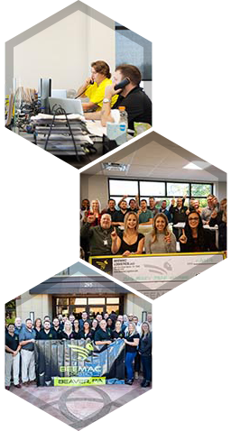
Initial Prospecting Call
When we confirm we are speaking with the correct point of contact we want to maintain a structure to our conversation:
Establish rapport: We shouldn’t shy away from personal conversations, like asking how a prospect’s weekend was or what team they’re rooting for in the game tonight. These intimate touches help us develop a more meaningful relationship with prospects and enhance our likeability which, hopefully, means a prospect will be more likely to buy from us.
Uncover pain points: Dive into their pain points during the call. By the end of the conversation, we should know all of their primary business challenges and the underlying causes associated with them. Once we have an understanding of these key issues, we can better position our product or services to solve them.
Create curiosity: Ask questions about their business. Ask more than tell. This conversation is about them and understanding their needs and problems. The less we talk about our business and product, the more our prospect will be interested to hear the final pitch.
Wrap it up: Don’t expect business on your first call. Find a calendar time between 24-48 hours after discovery call to book a follow-up call. Every call should end with a mutually agreed upon, in the calendar, next steps follow-up. Your contact should know when you’re calling next, and what you will discuss on that call, Every sales activity requires a follow up!

Slide 11
Discover: Build an Operations Profile
What are the main commodities that you ship?
Do you have any lanes that you run regularly?
Do any of your current lanes give you trouble?
How many loads do you move a day/week?
Do you handle both your inbound and outbound?
Is your business primarily full truckload or do you also have partials?
What about LTL?
How do you go about selecting carriers for your shipments?
How do you award freight to carriers?
Do you have any issues with your current carrier base?
My personal favorite:
“Tell me about how you currently select carriers for your shipments.”

Slide 12
Notes:
QUESTIONS:

